Slide 1
GARDENING TECHNOLOGIES

Slide 2
Benefits
Tool for adaptation to climate crisis
Improves diet quality
Enhances self sufficiency
Source of income
Enhances inclusion
Reduces pressure on land
Can address farm labor crisis

Slide 3
Backyard Gardens and Soil Health
Easier for a small household to manage soil fertility
Utilizes organic matter from the kitchen
Utilizes livestock manure better
It makes soil microbial action to thrive

Slide 4
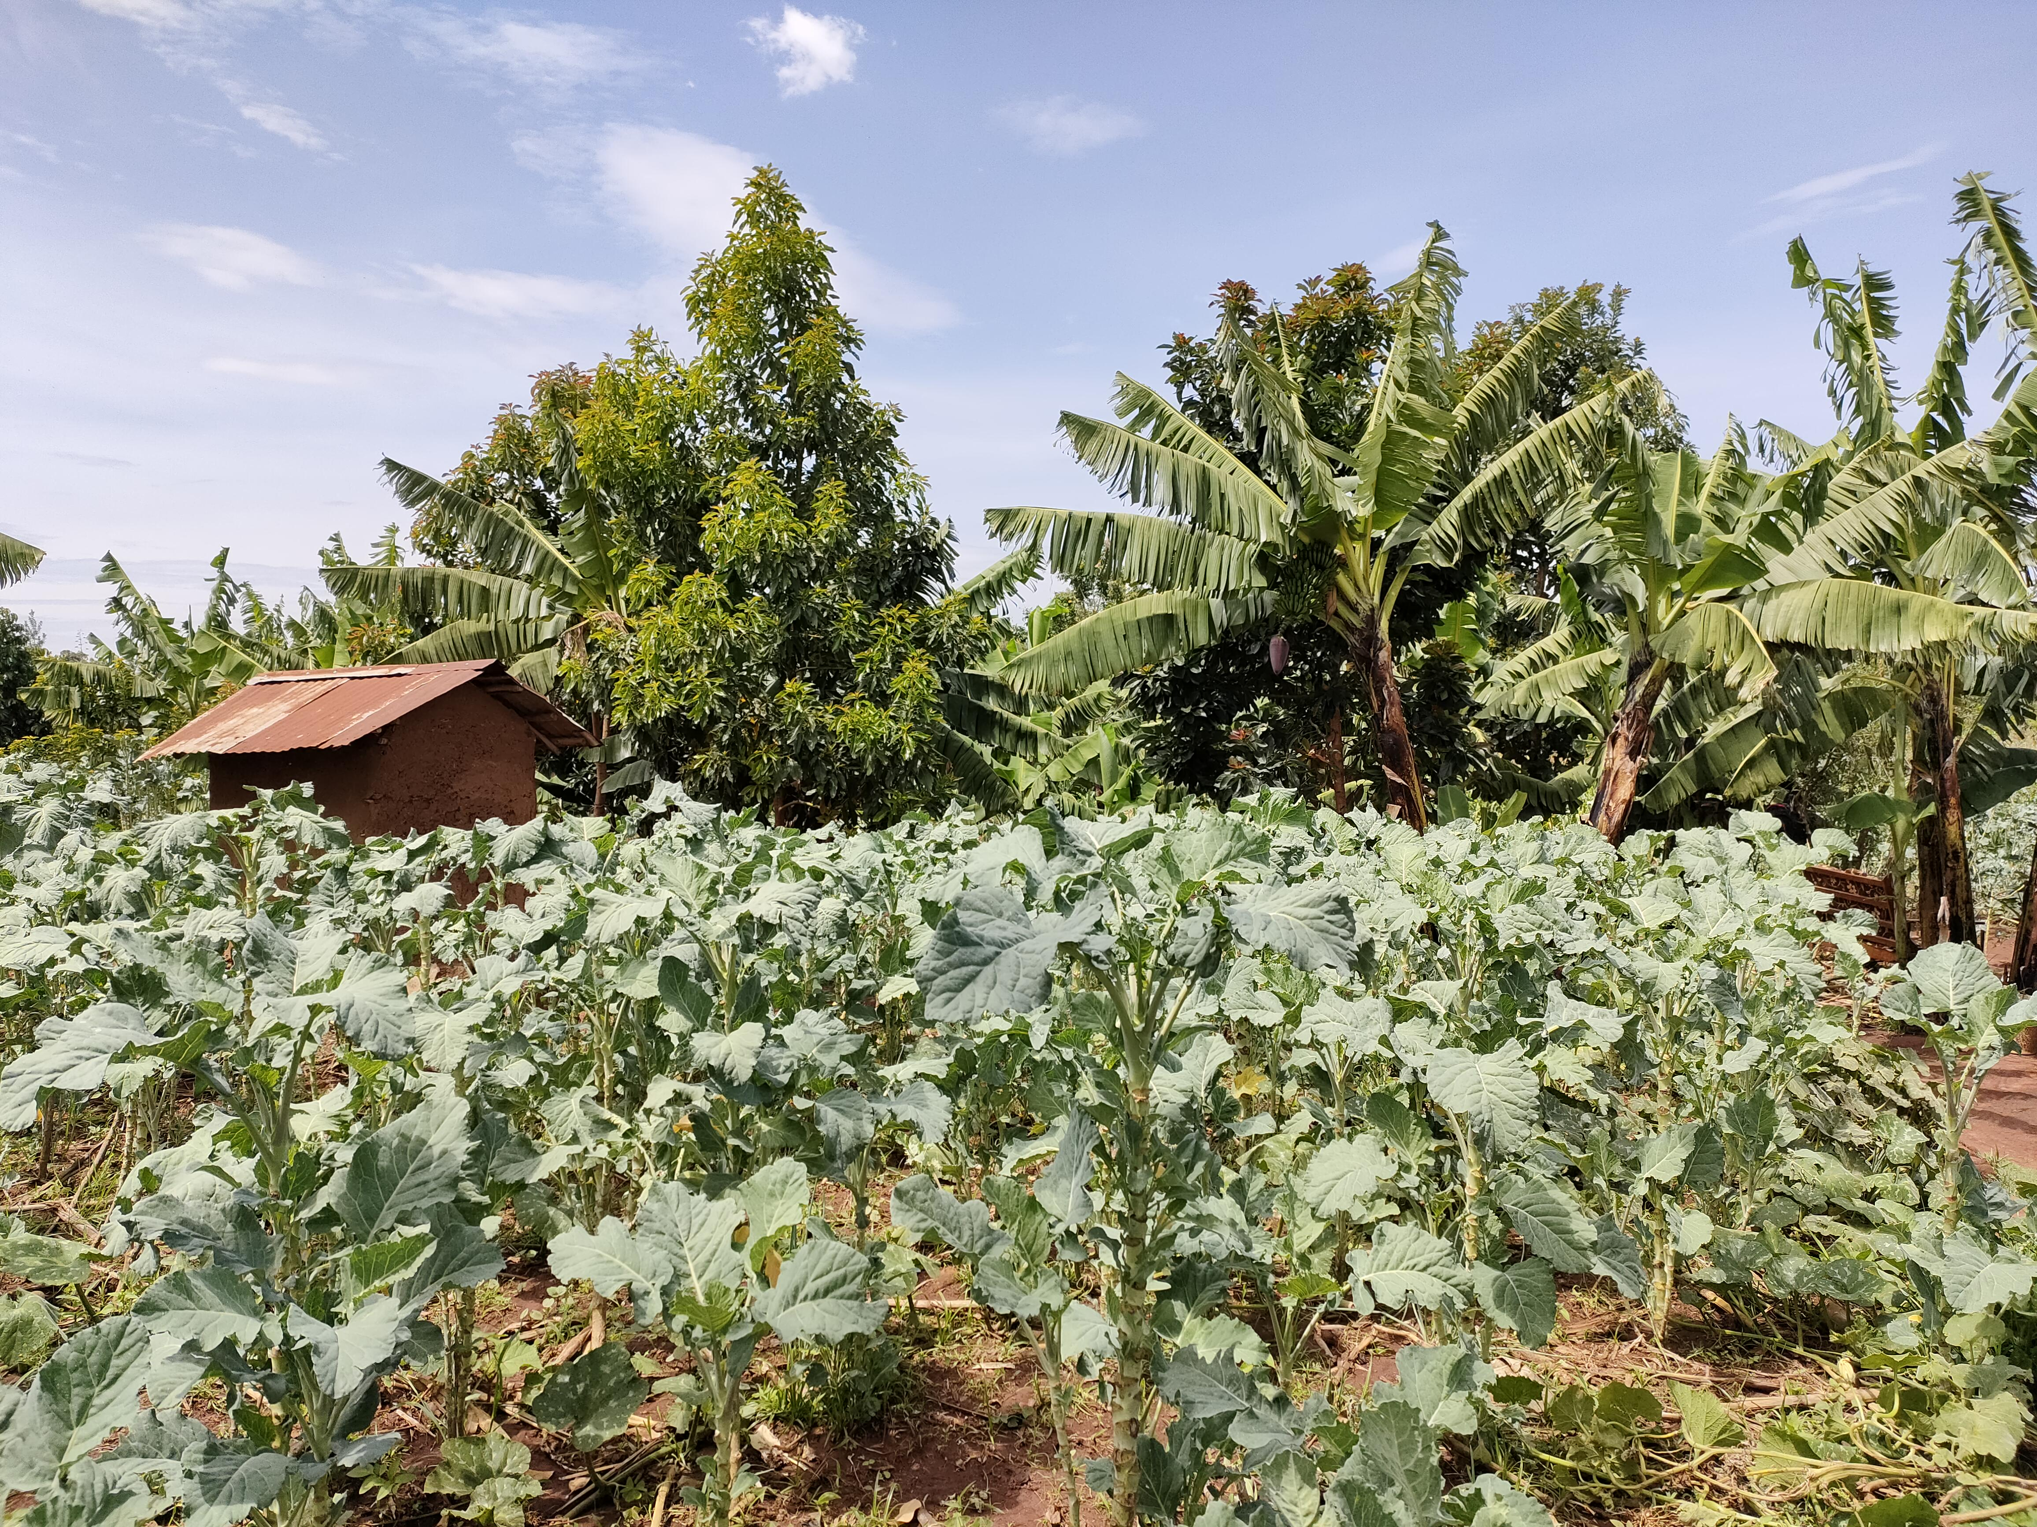
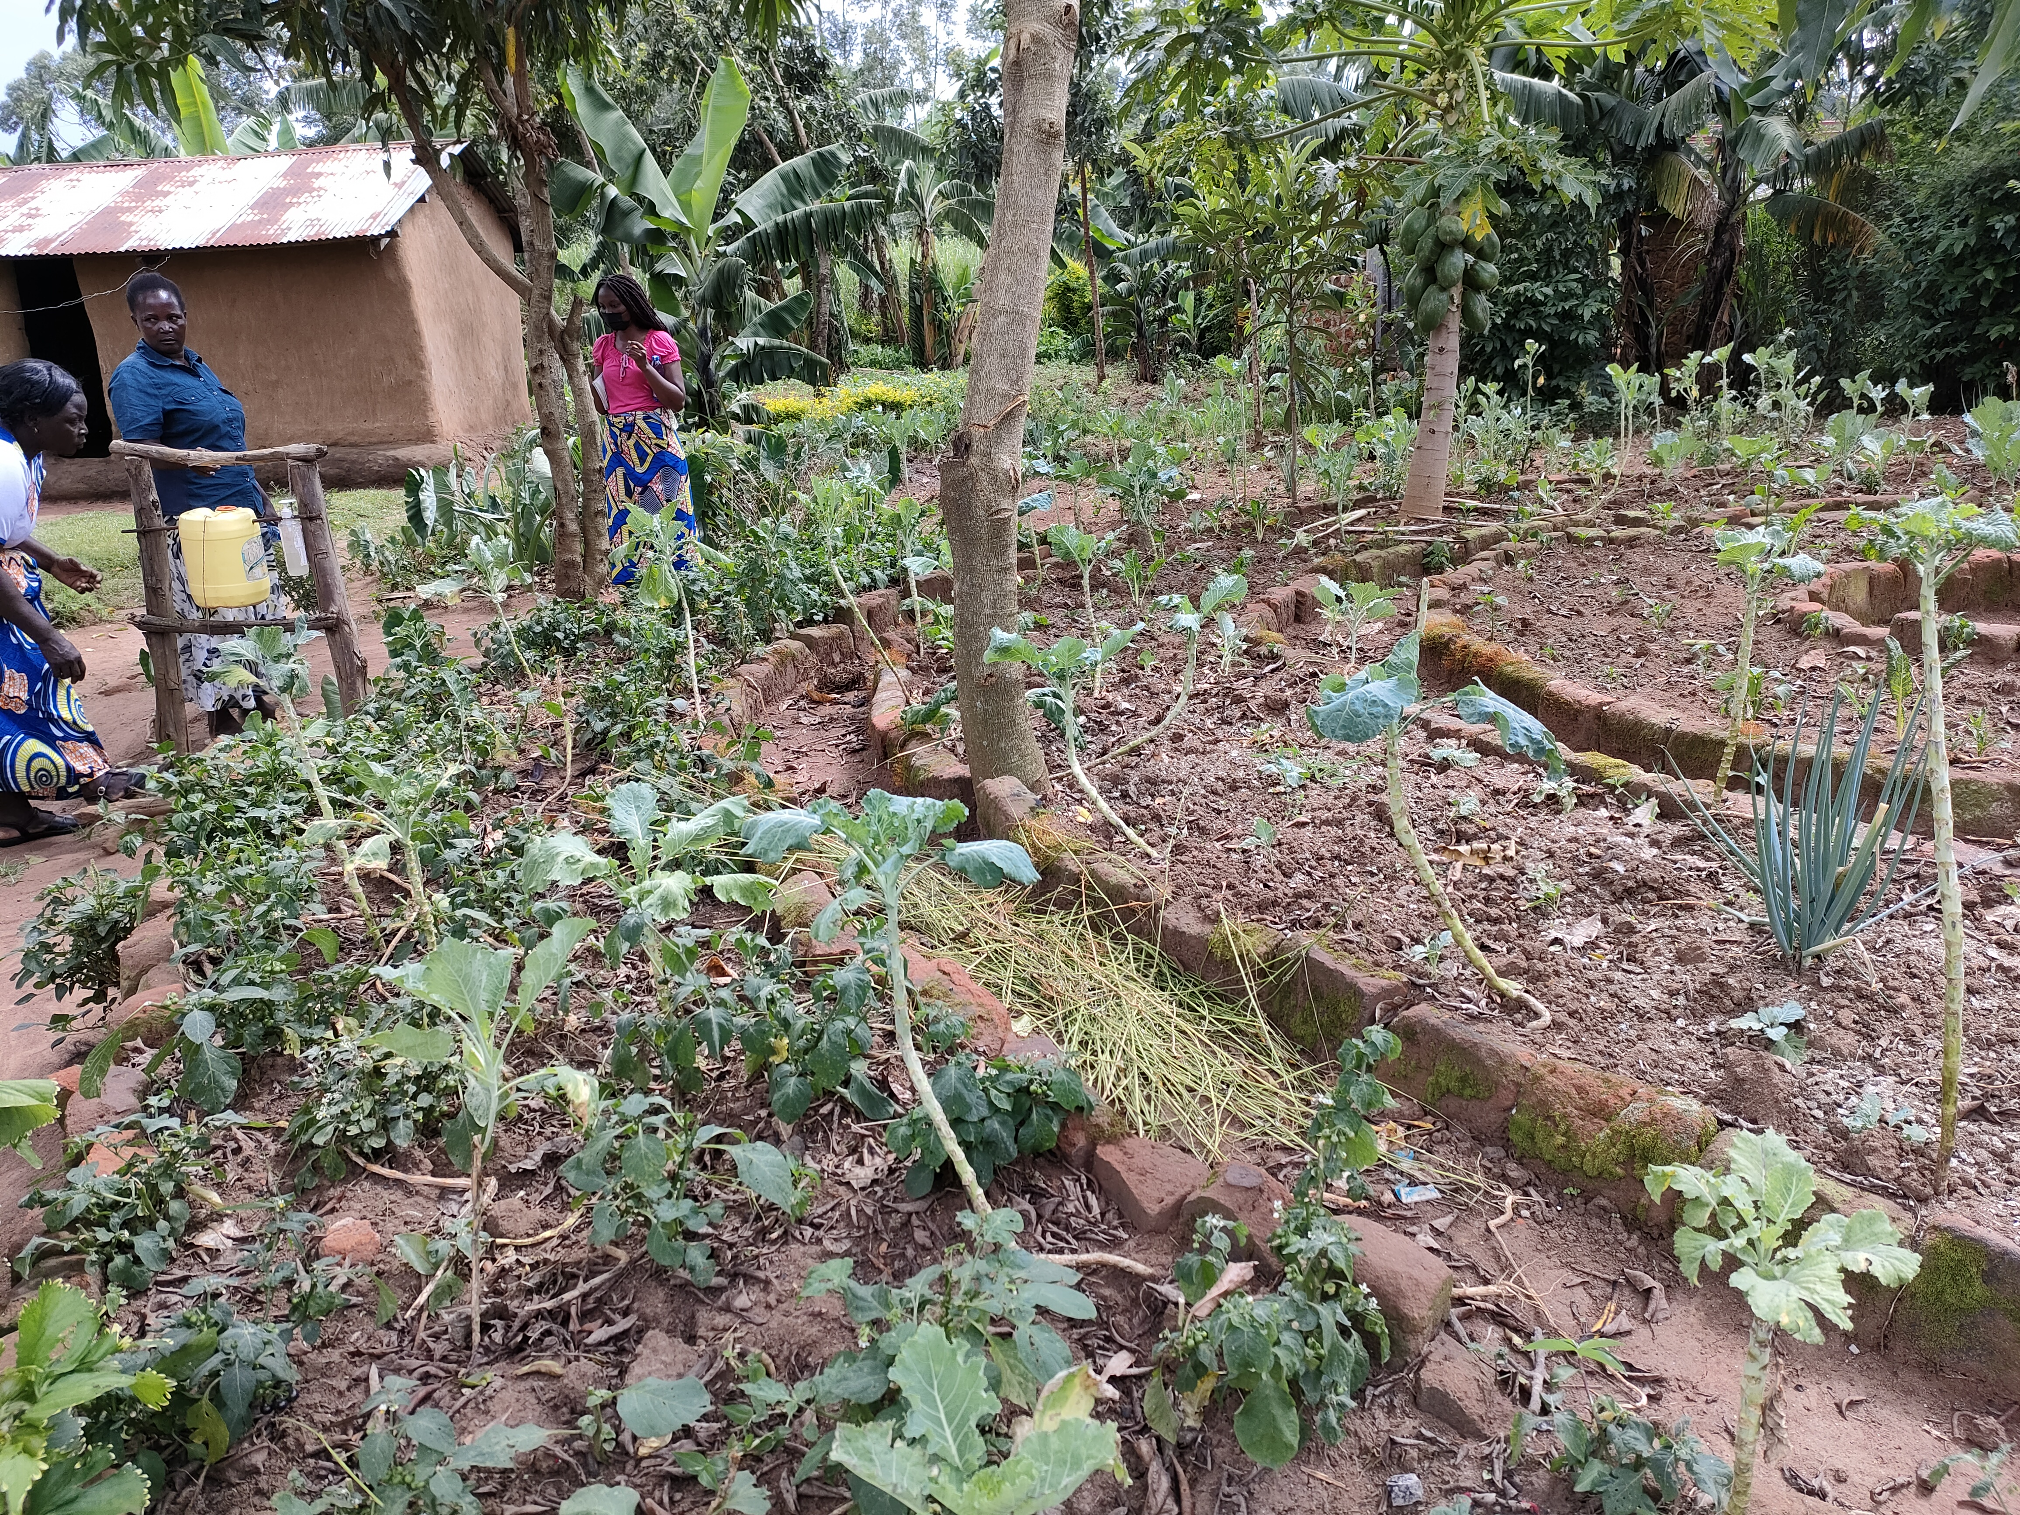
Typical Village gardens in Africa

Slide 5
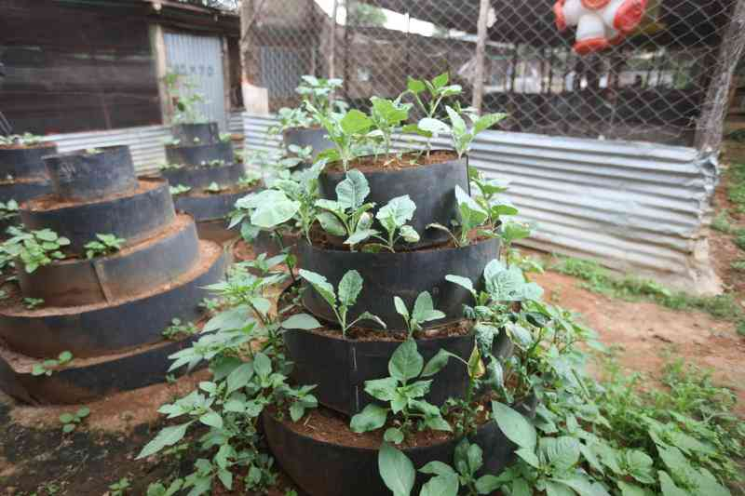
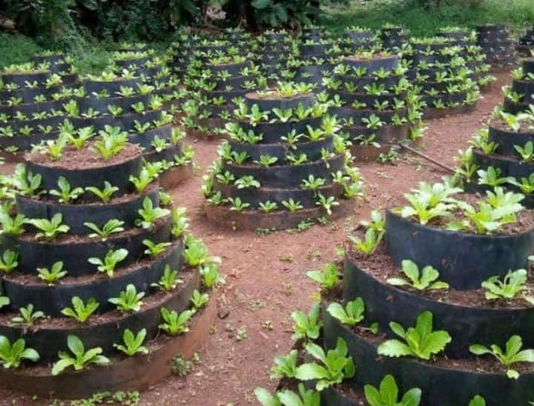
Cone Gardens

Slide 6
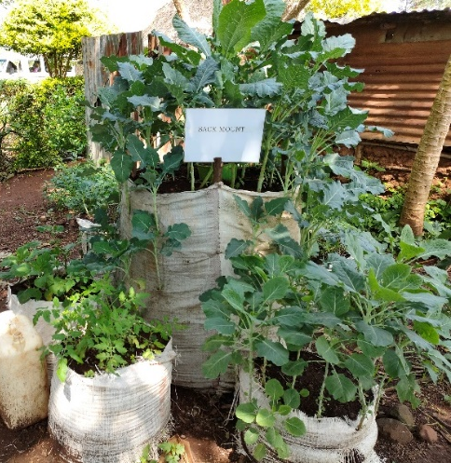
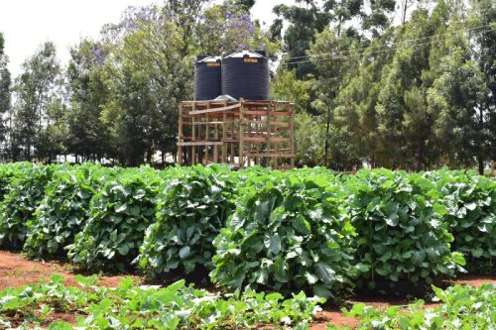
Multistorey Gardens

Slide 7
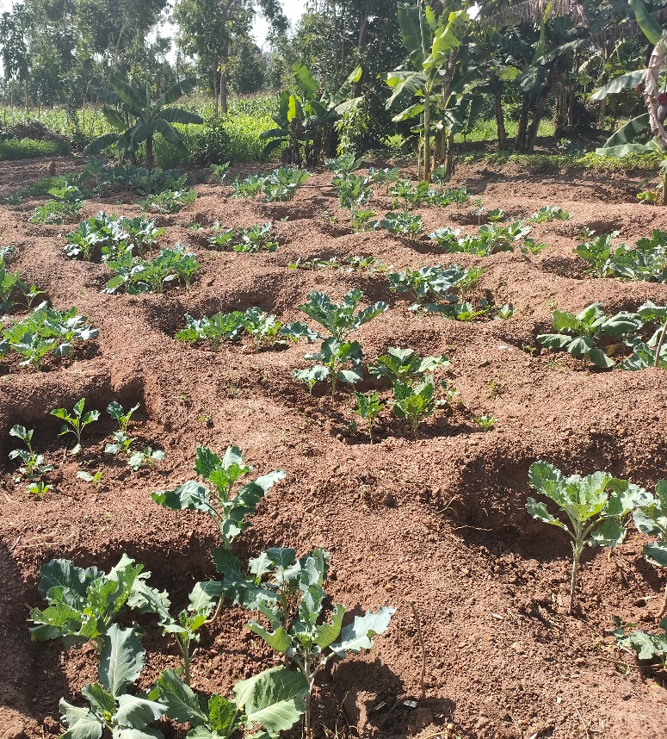
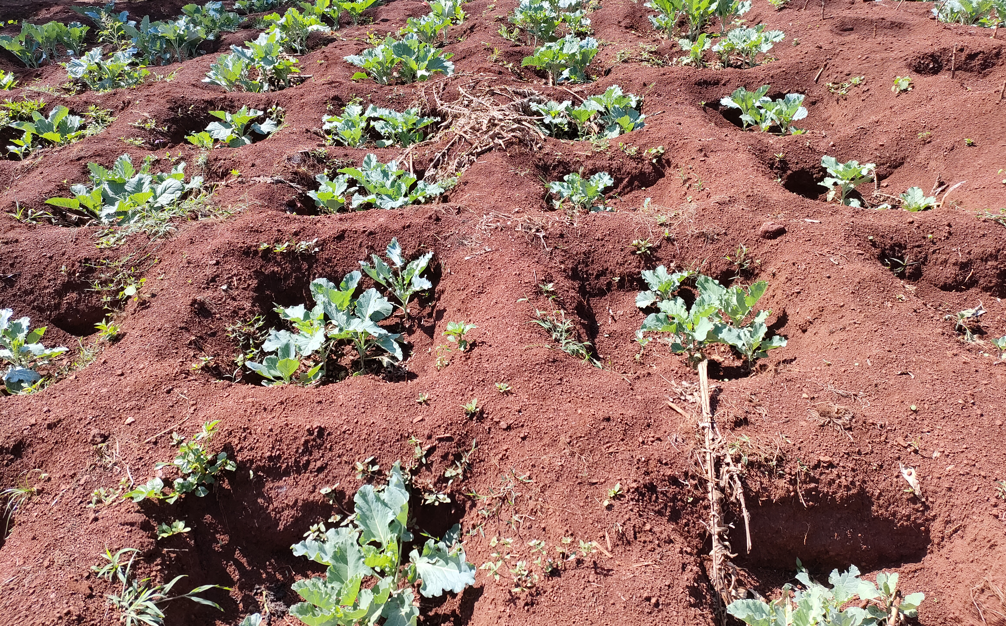
Zaypit/Tumbukiza Garden

Slide 8
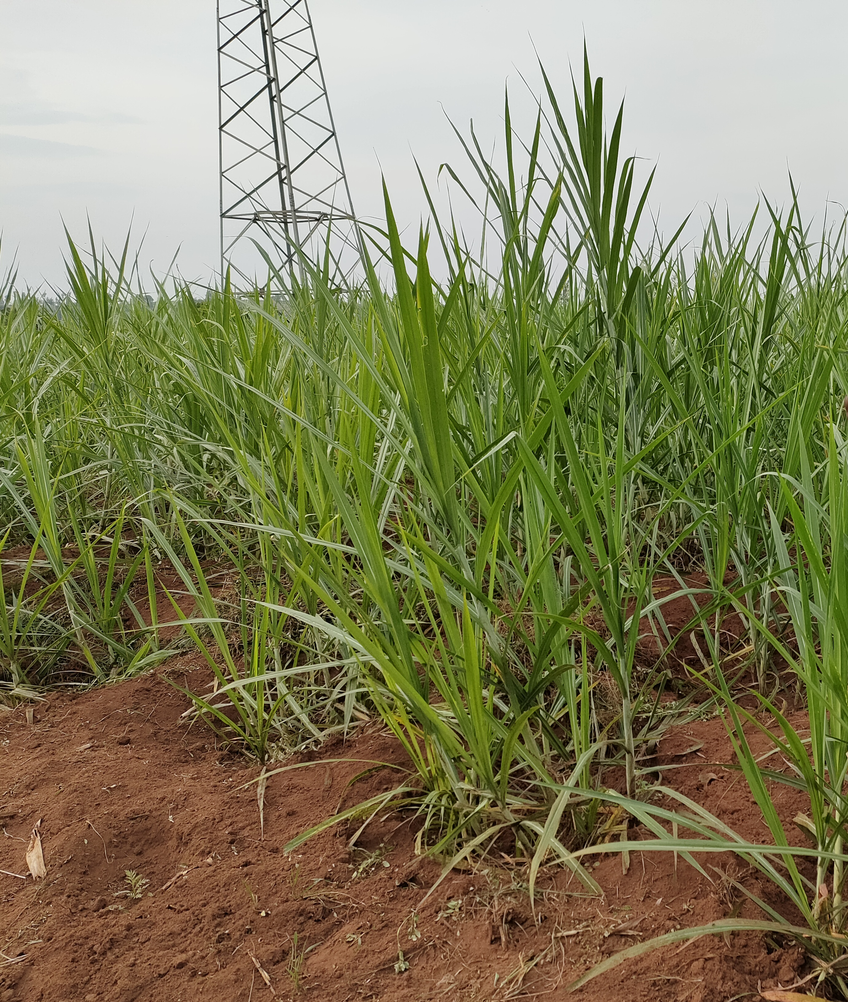

Slide 9
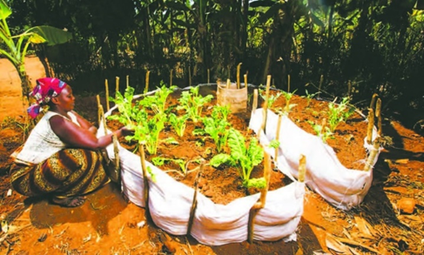
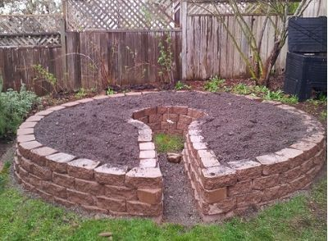
Keyhole Garden

Slide 10
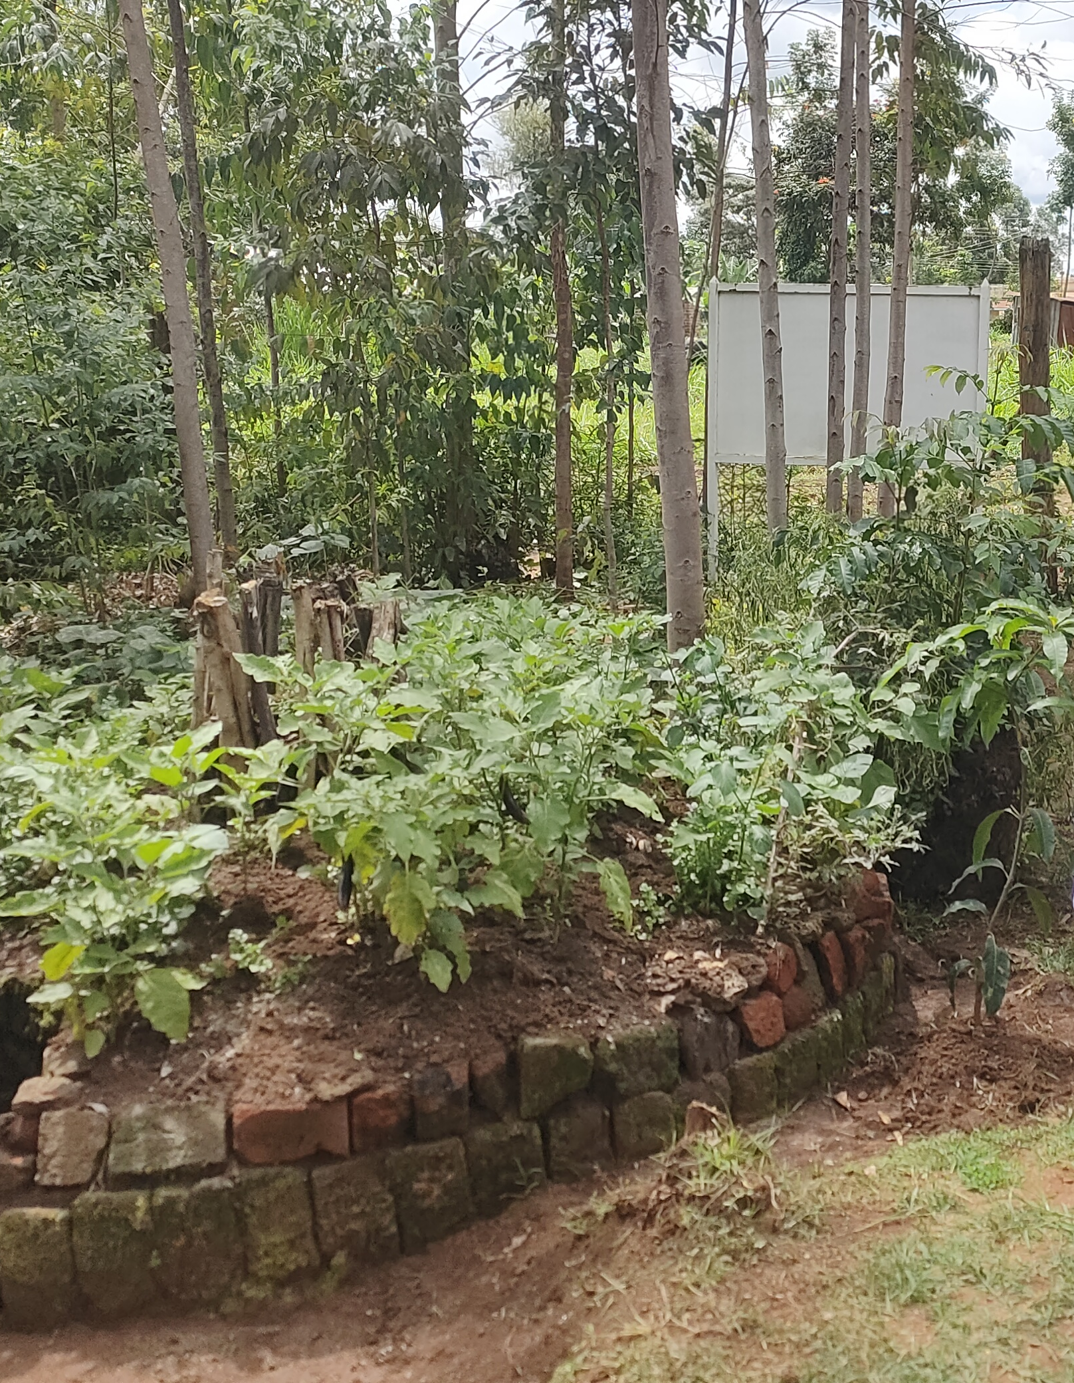
This keyhole garden is 10 years old!

Slide 11
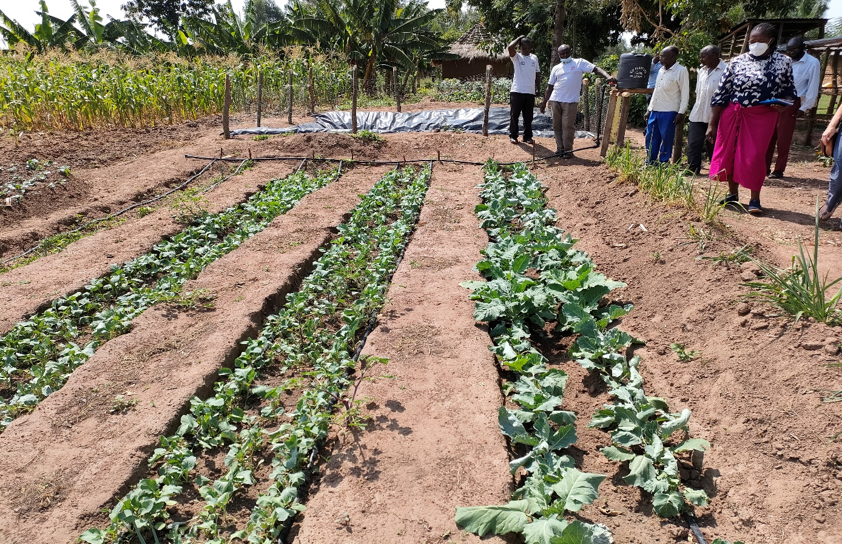
Sunken Bed

Slide 12
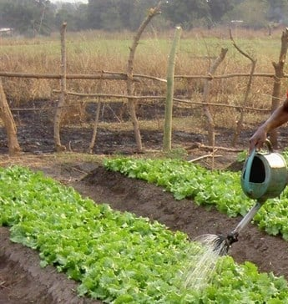
Riased Bed

Slide 13
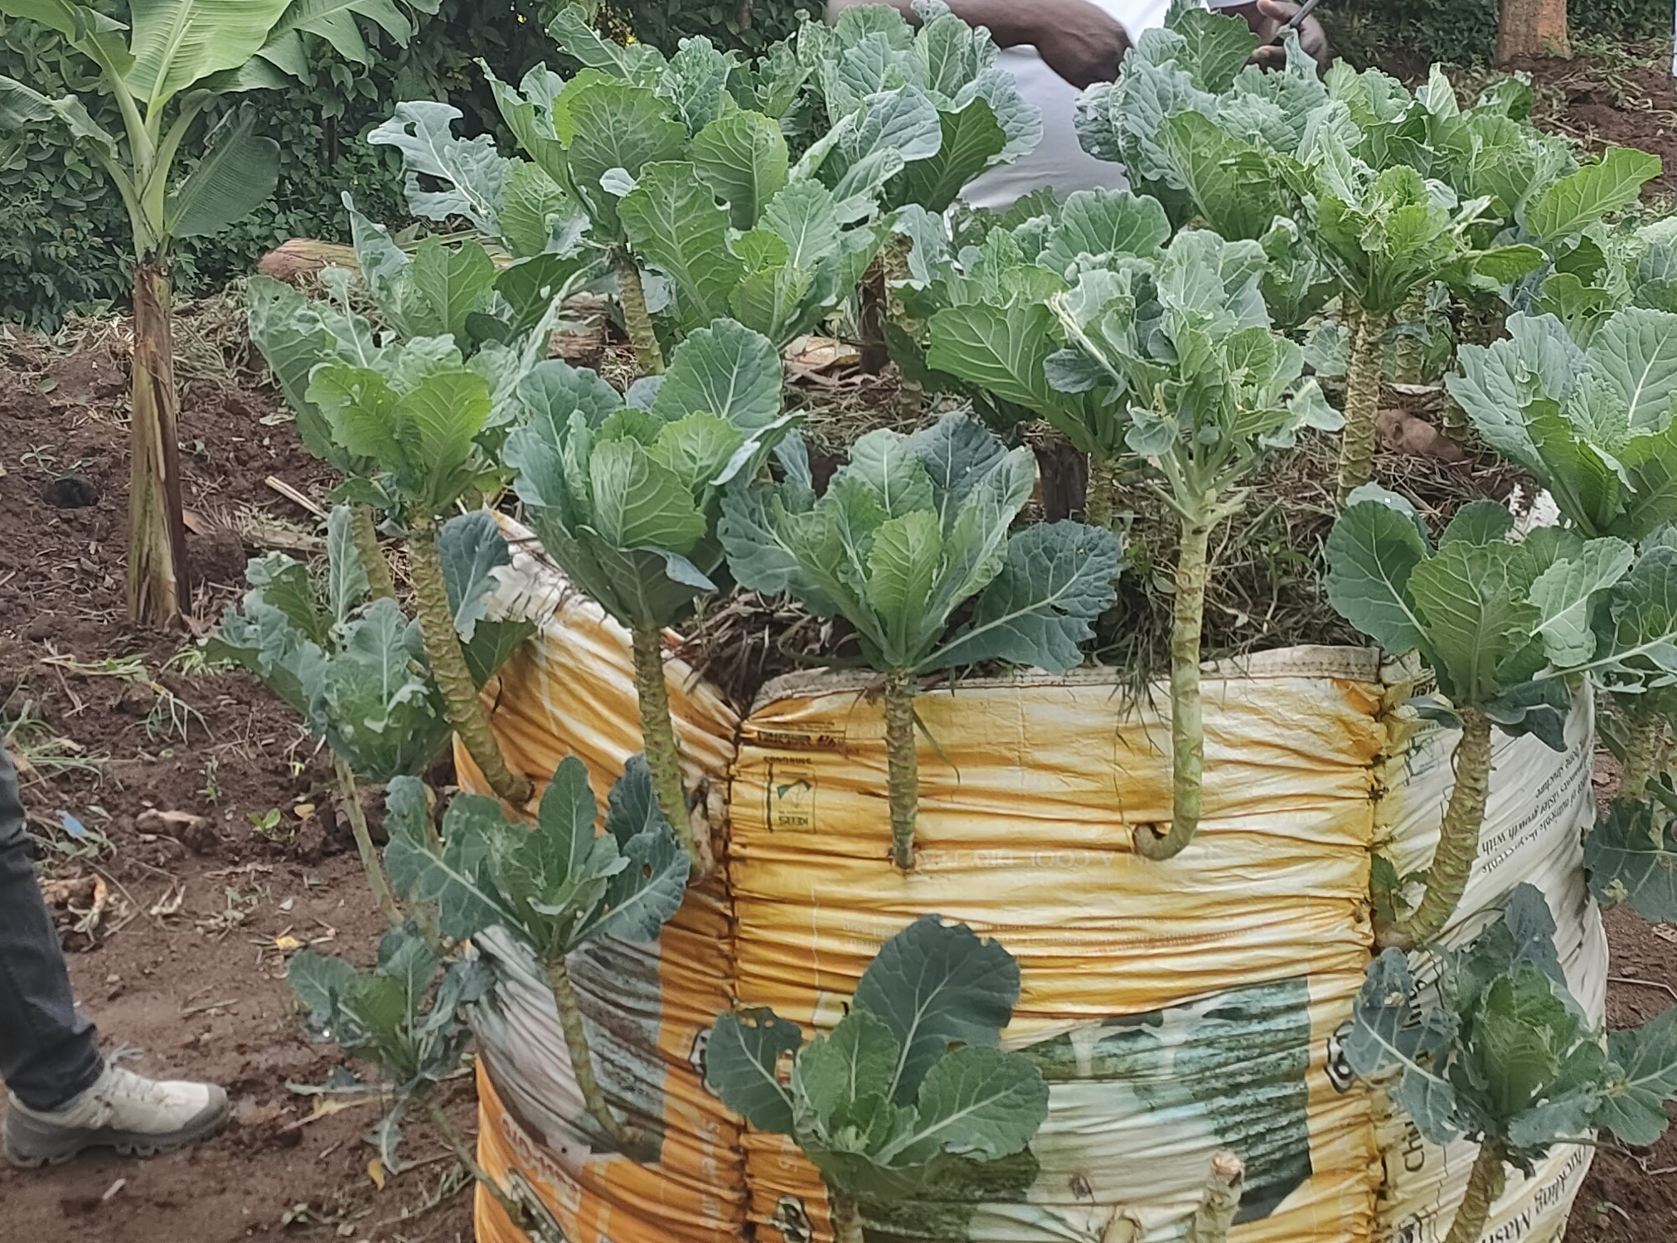
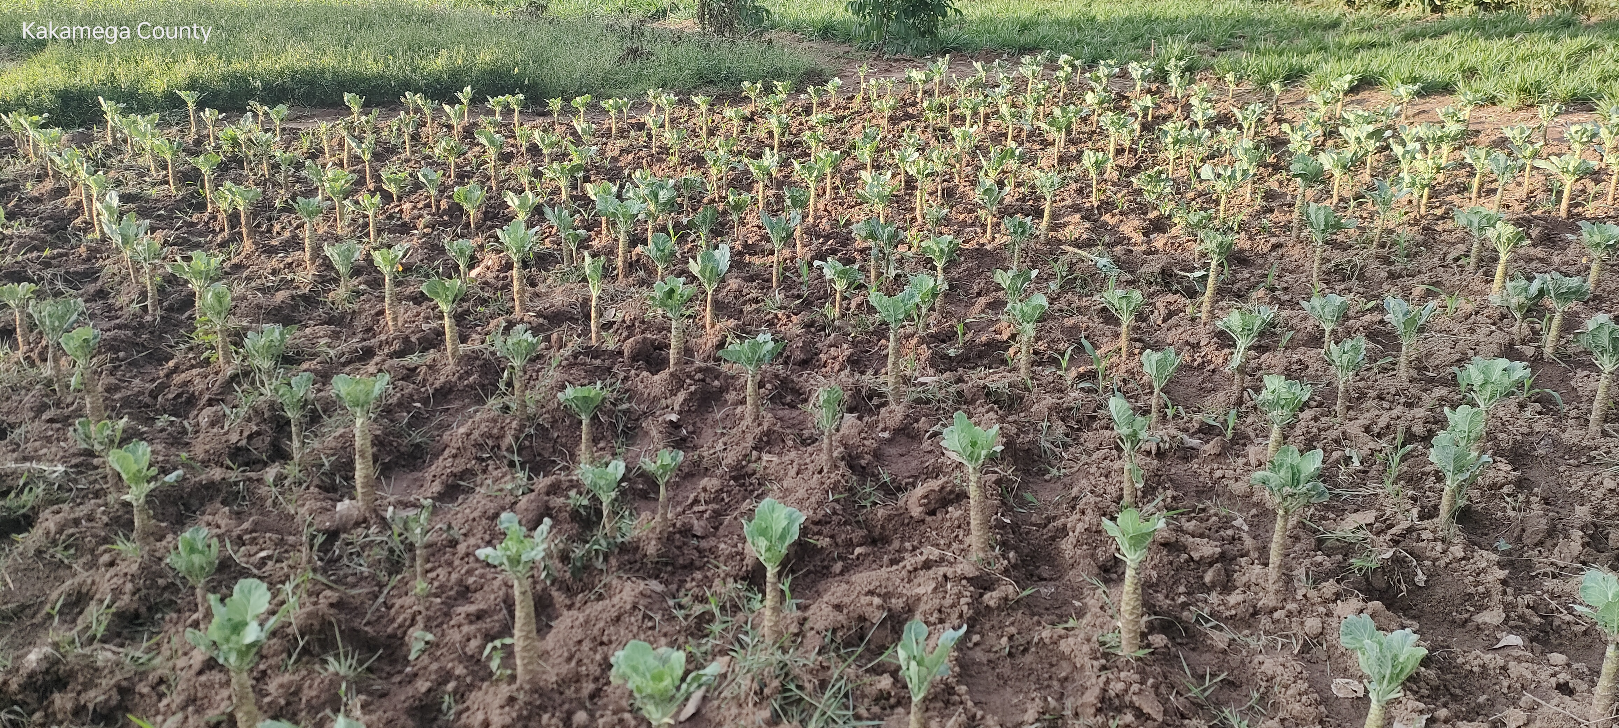

Slide 14
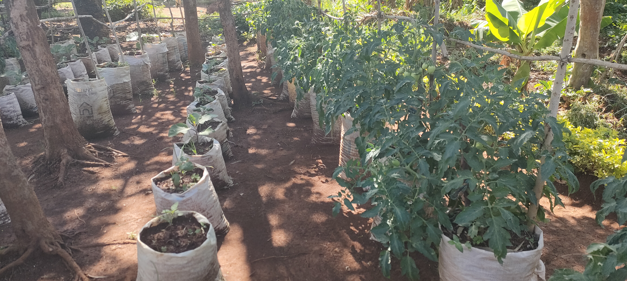
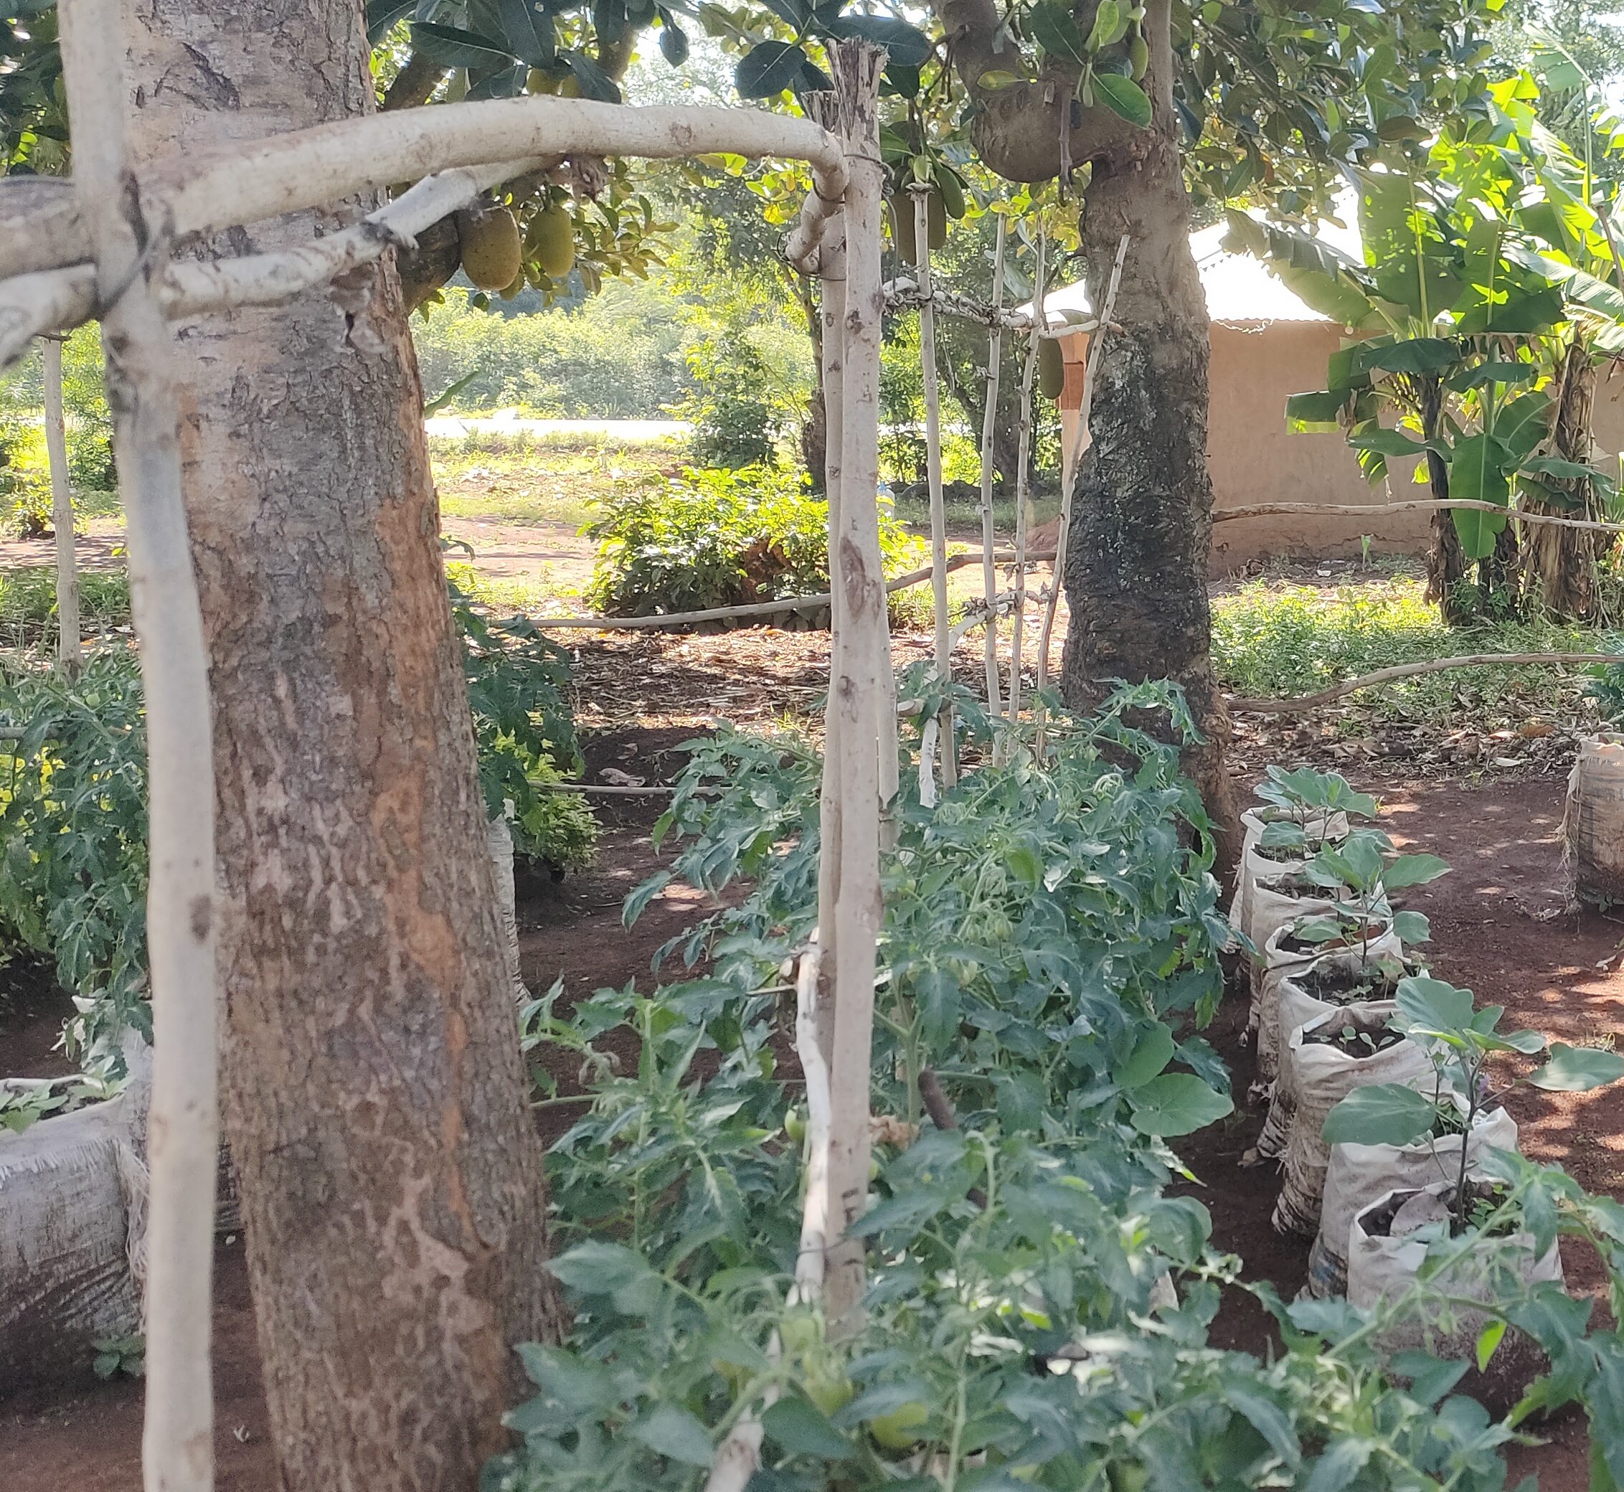
Sack Gardens

Slide 15
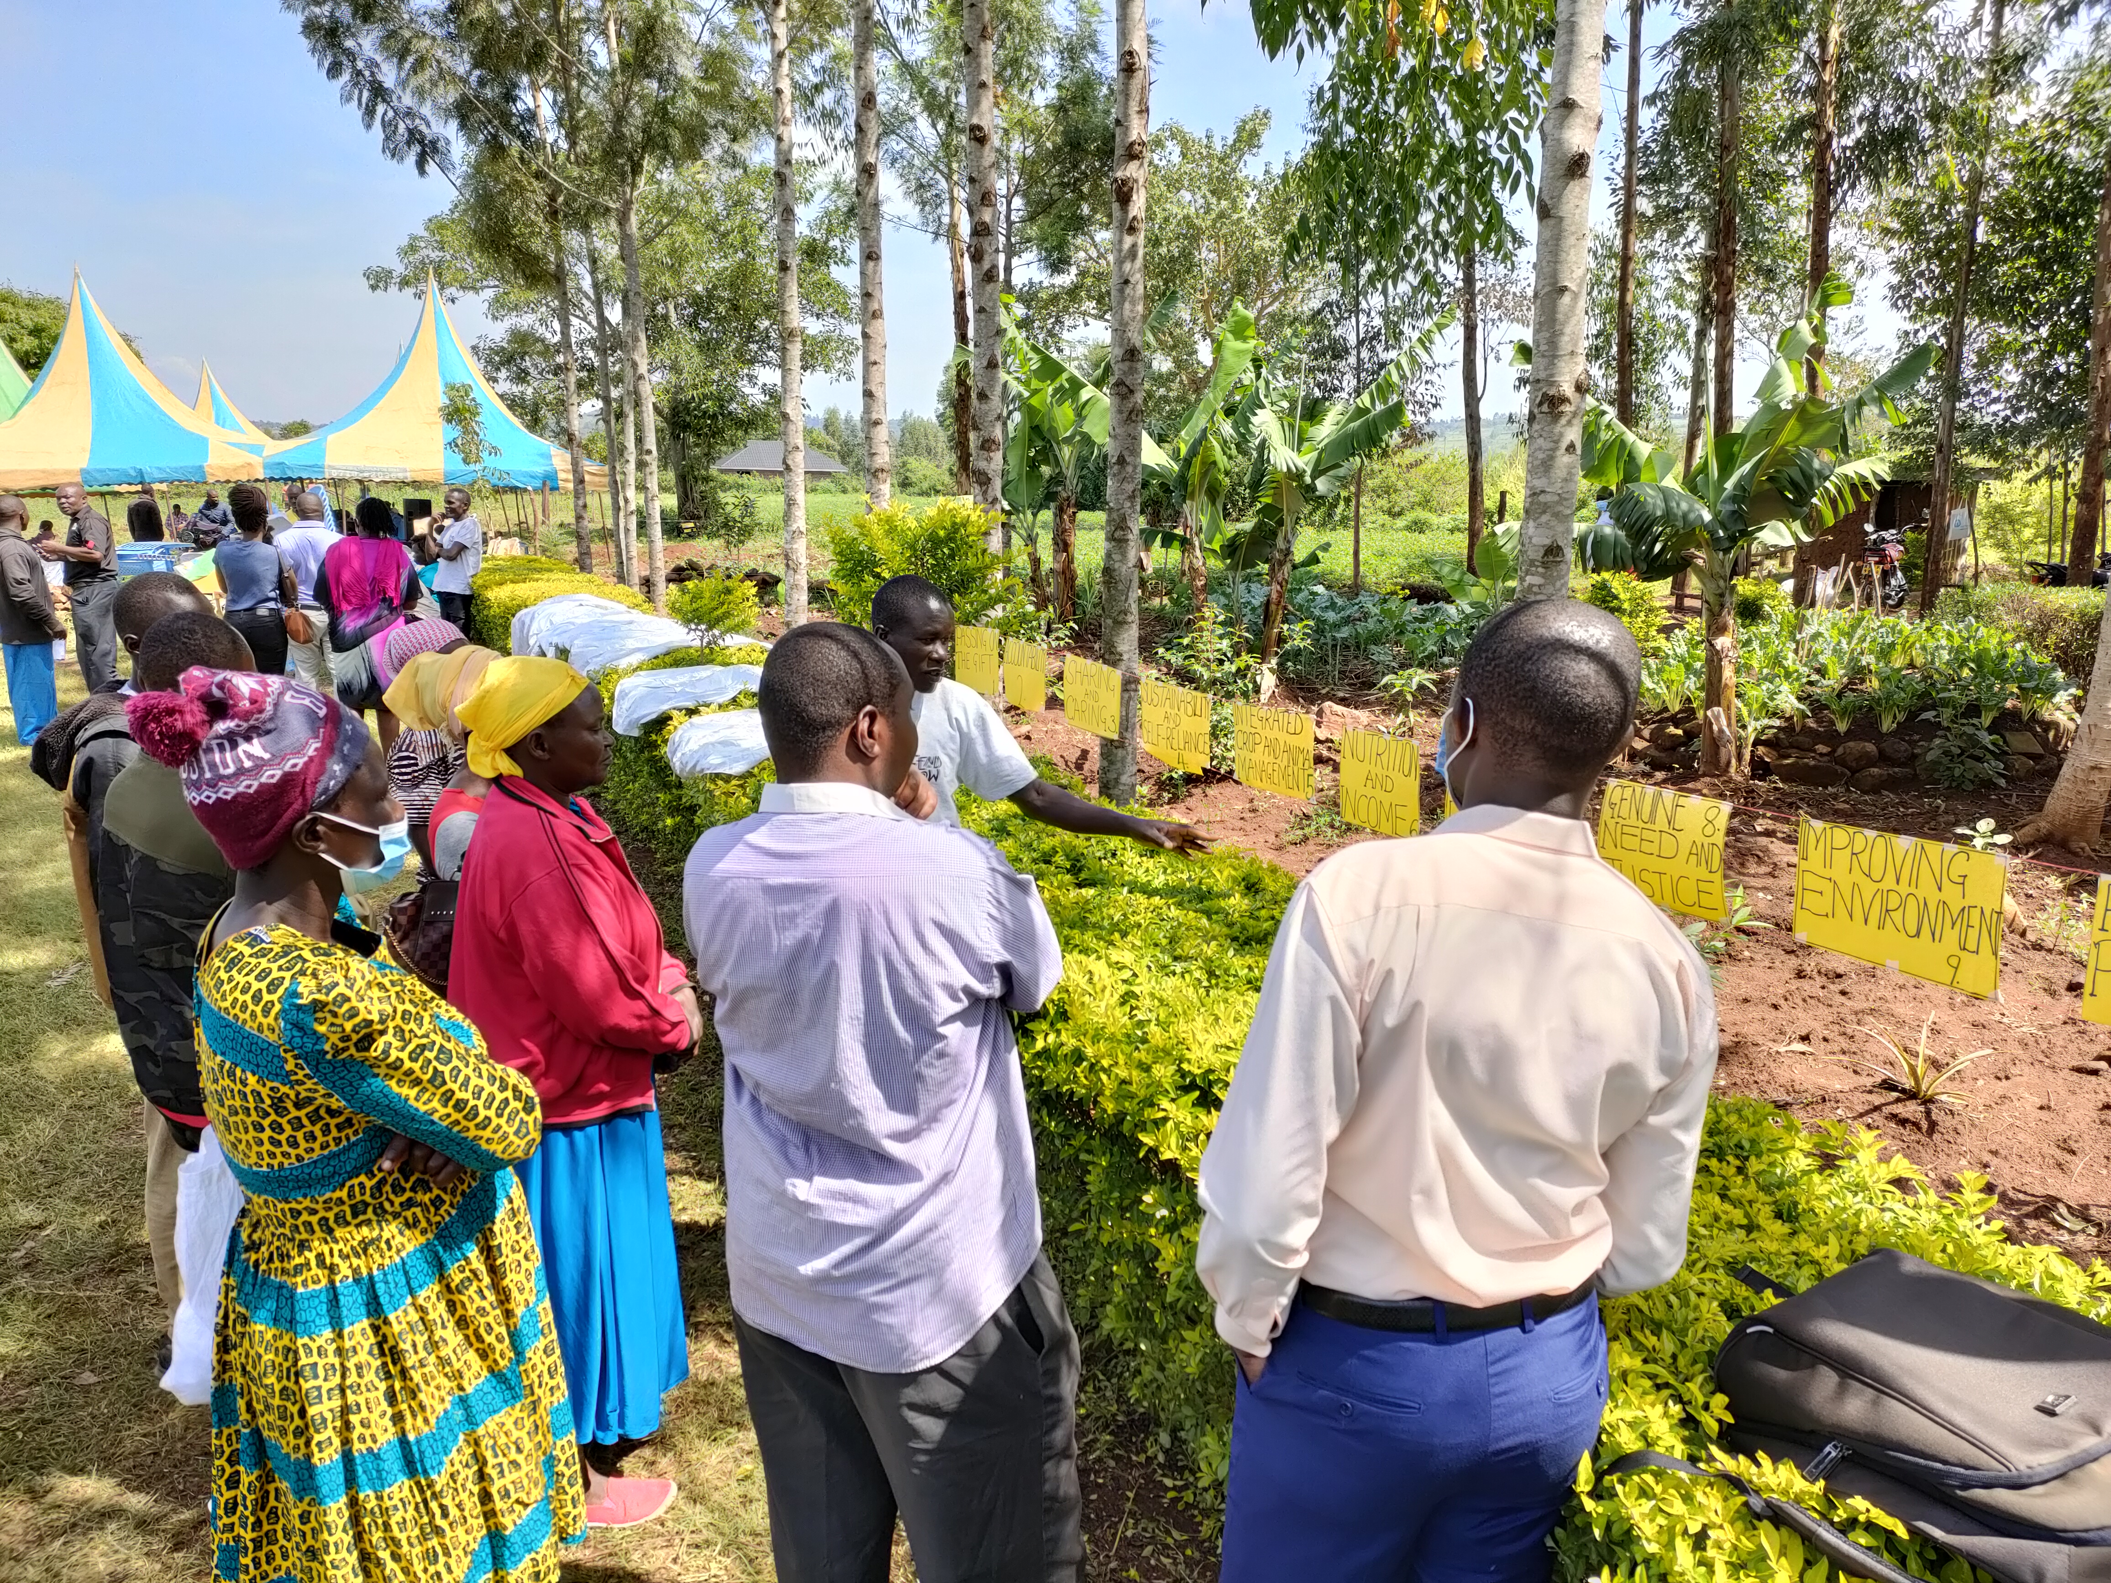
Public Learning Events

Slide 16
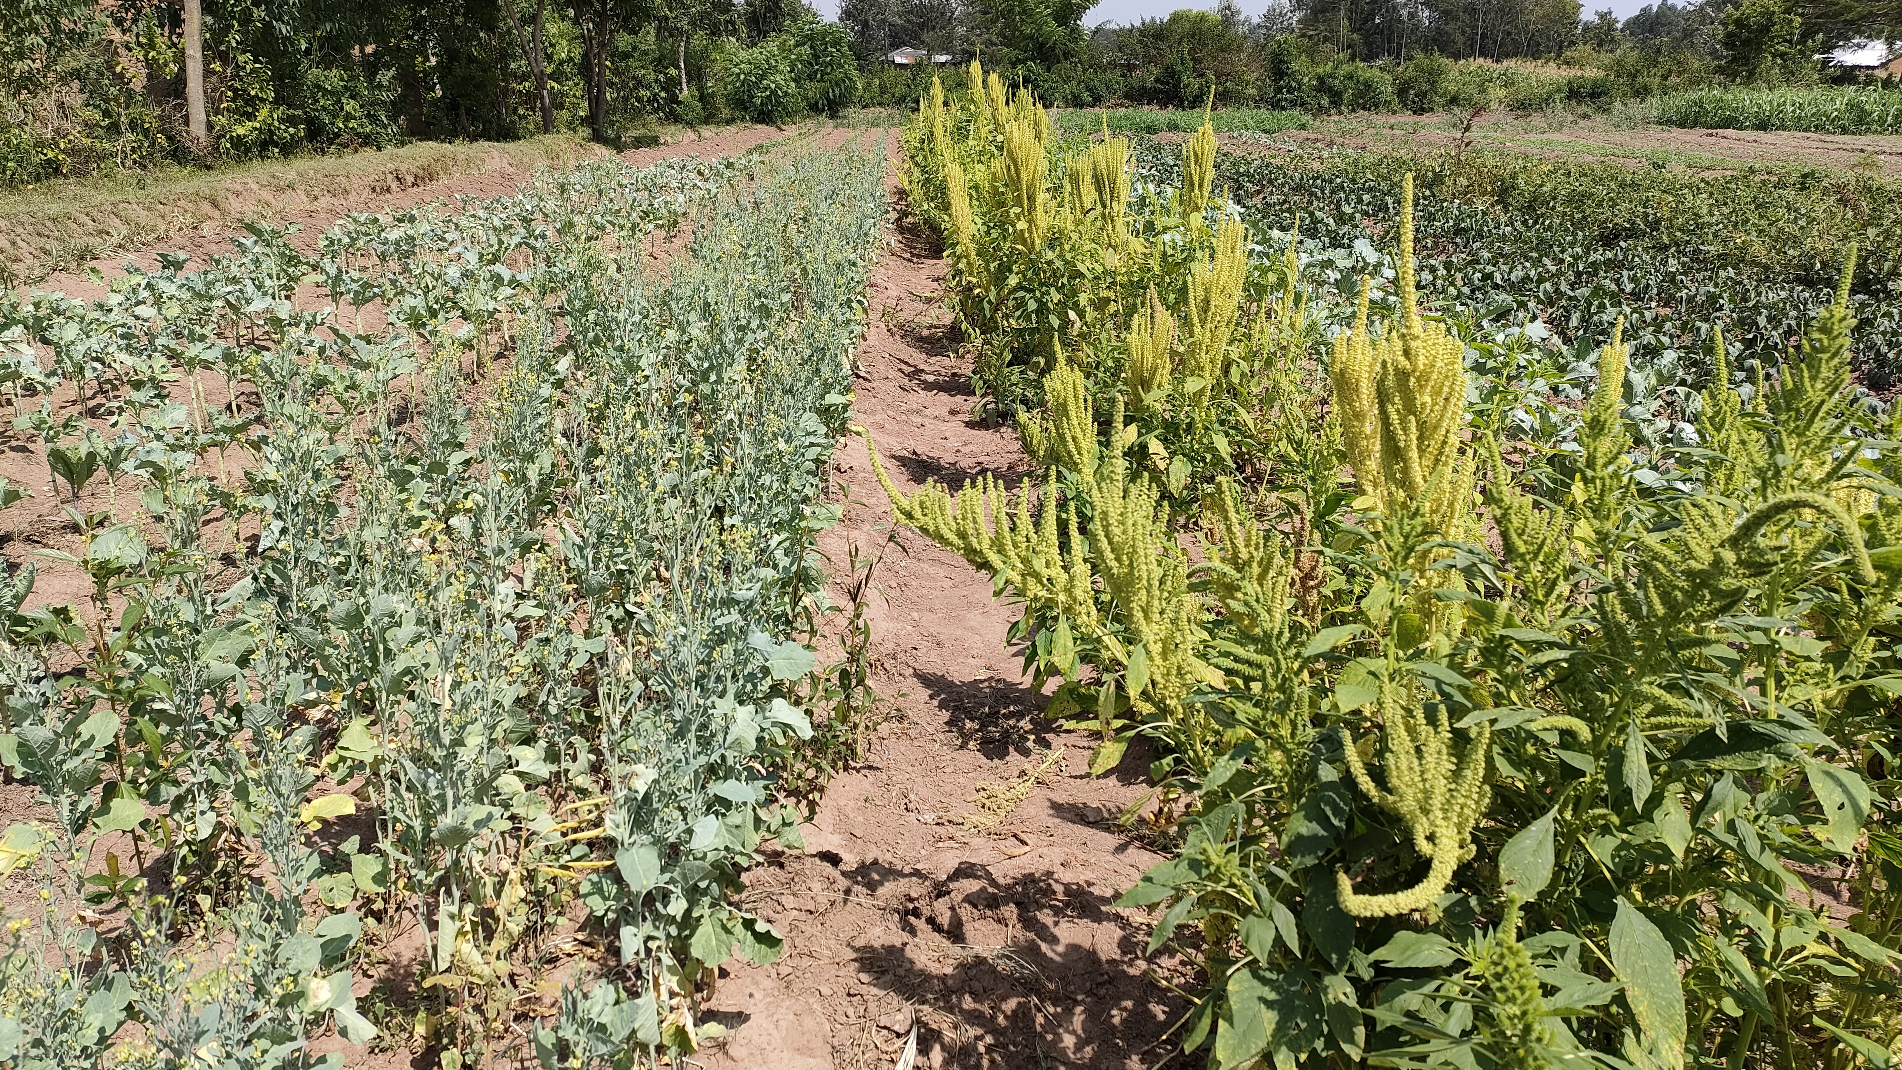

Slide 17
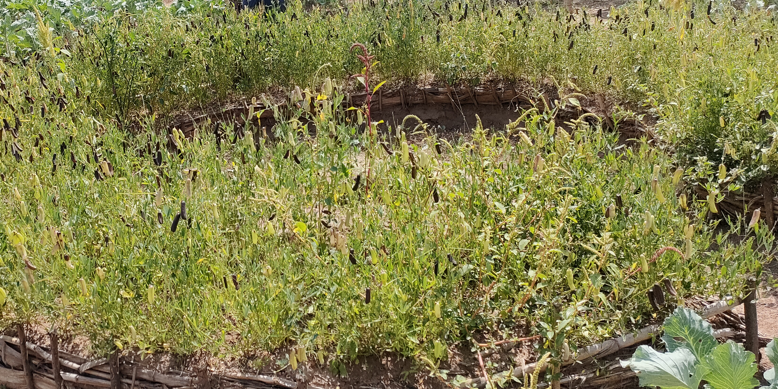
Indigenous crops

