Slide 1
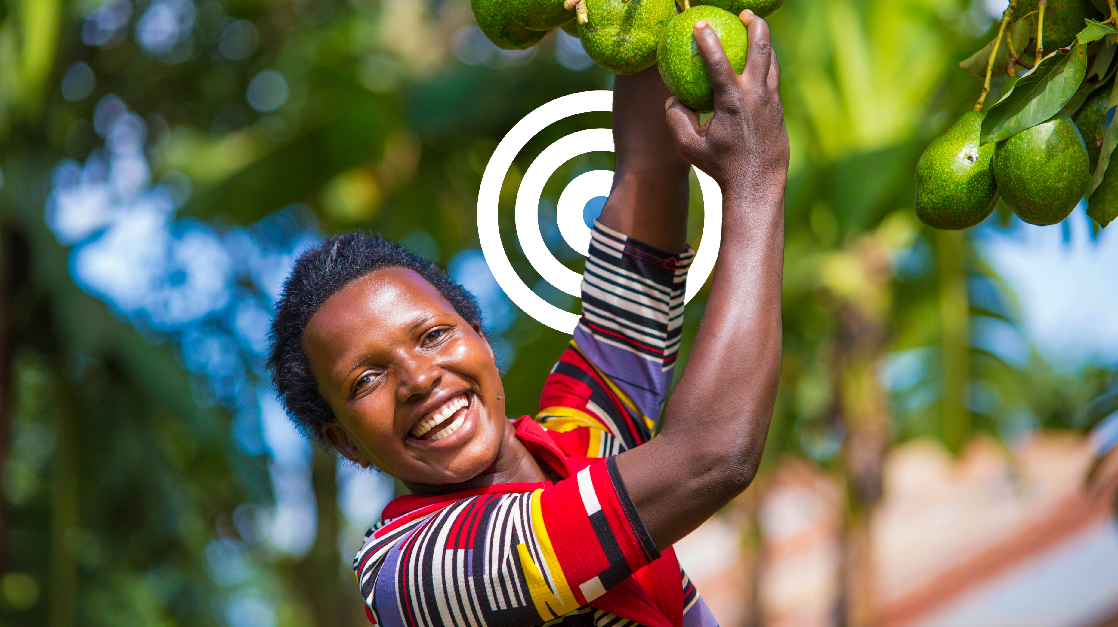
To see Confident and Thriving Africa

Slide 2
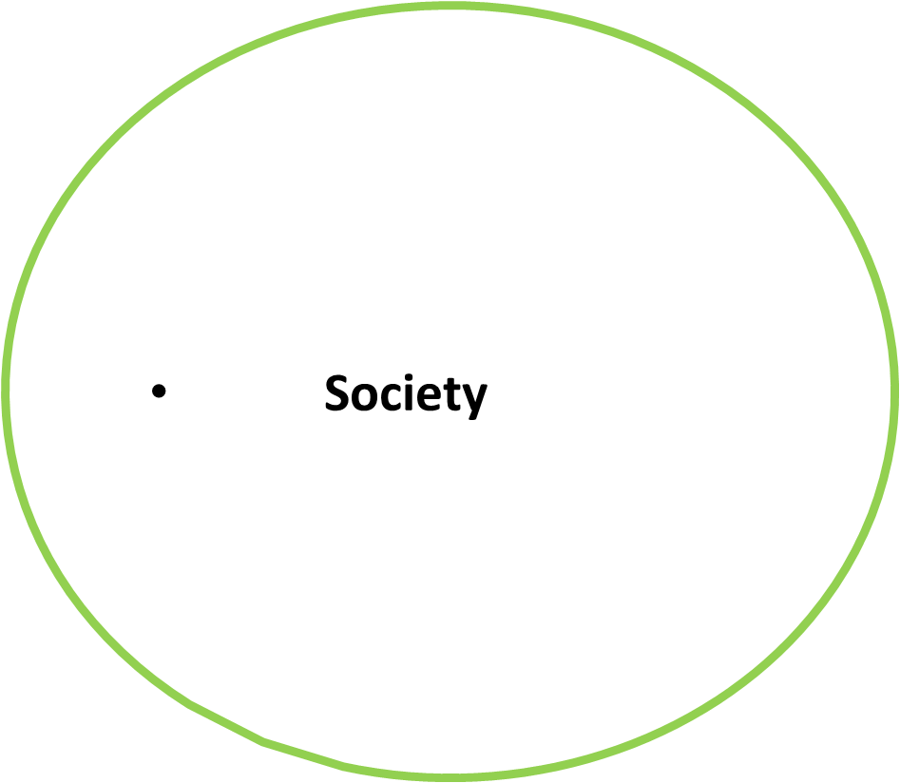

Inclusive Approach
Marginalized groups
transforming all societies by understanding the social context of the whole community
45 % of the EAC population lives below the US $2.15/day international poverty line according to East Africa community analysis 2023.
Women
Youth

Slide 3
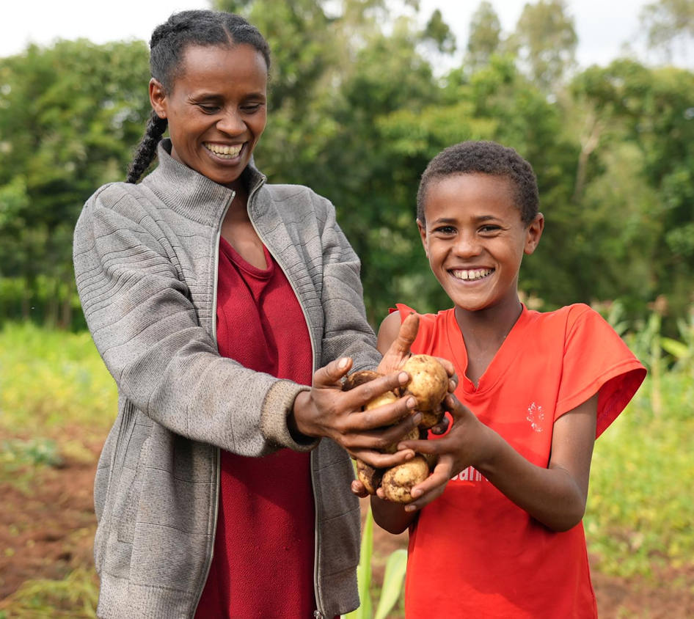
Integrated Approach
Sustainable Agriculture
Gender and Social Inclusion
Enterprise Development and Innovation

Slide 4
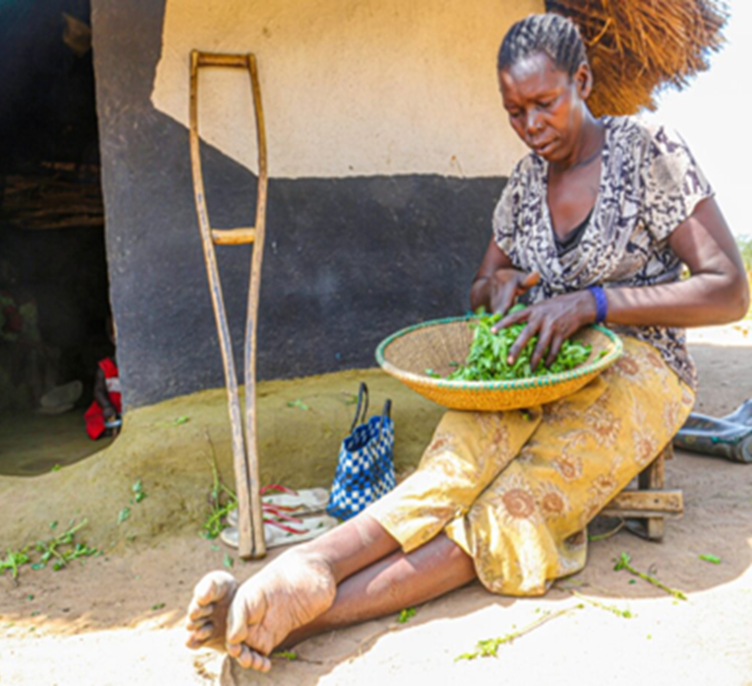
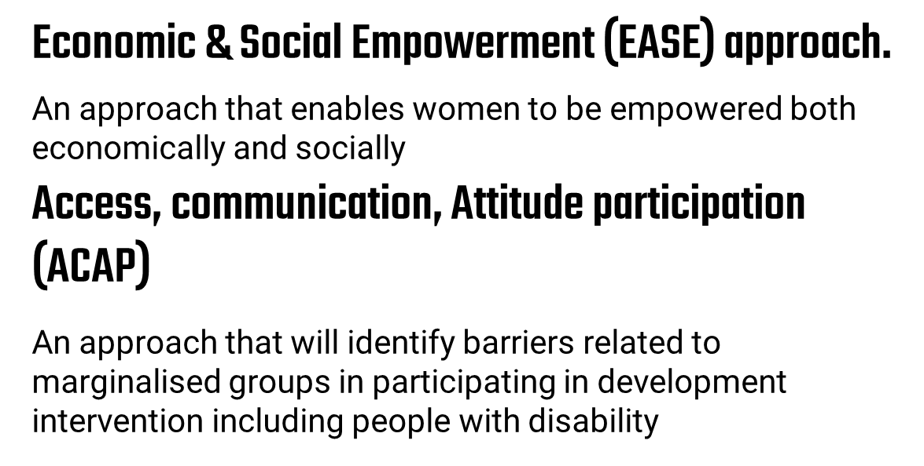
Innovative ,Transformative and Participatory Approaches

Slide 5
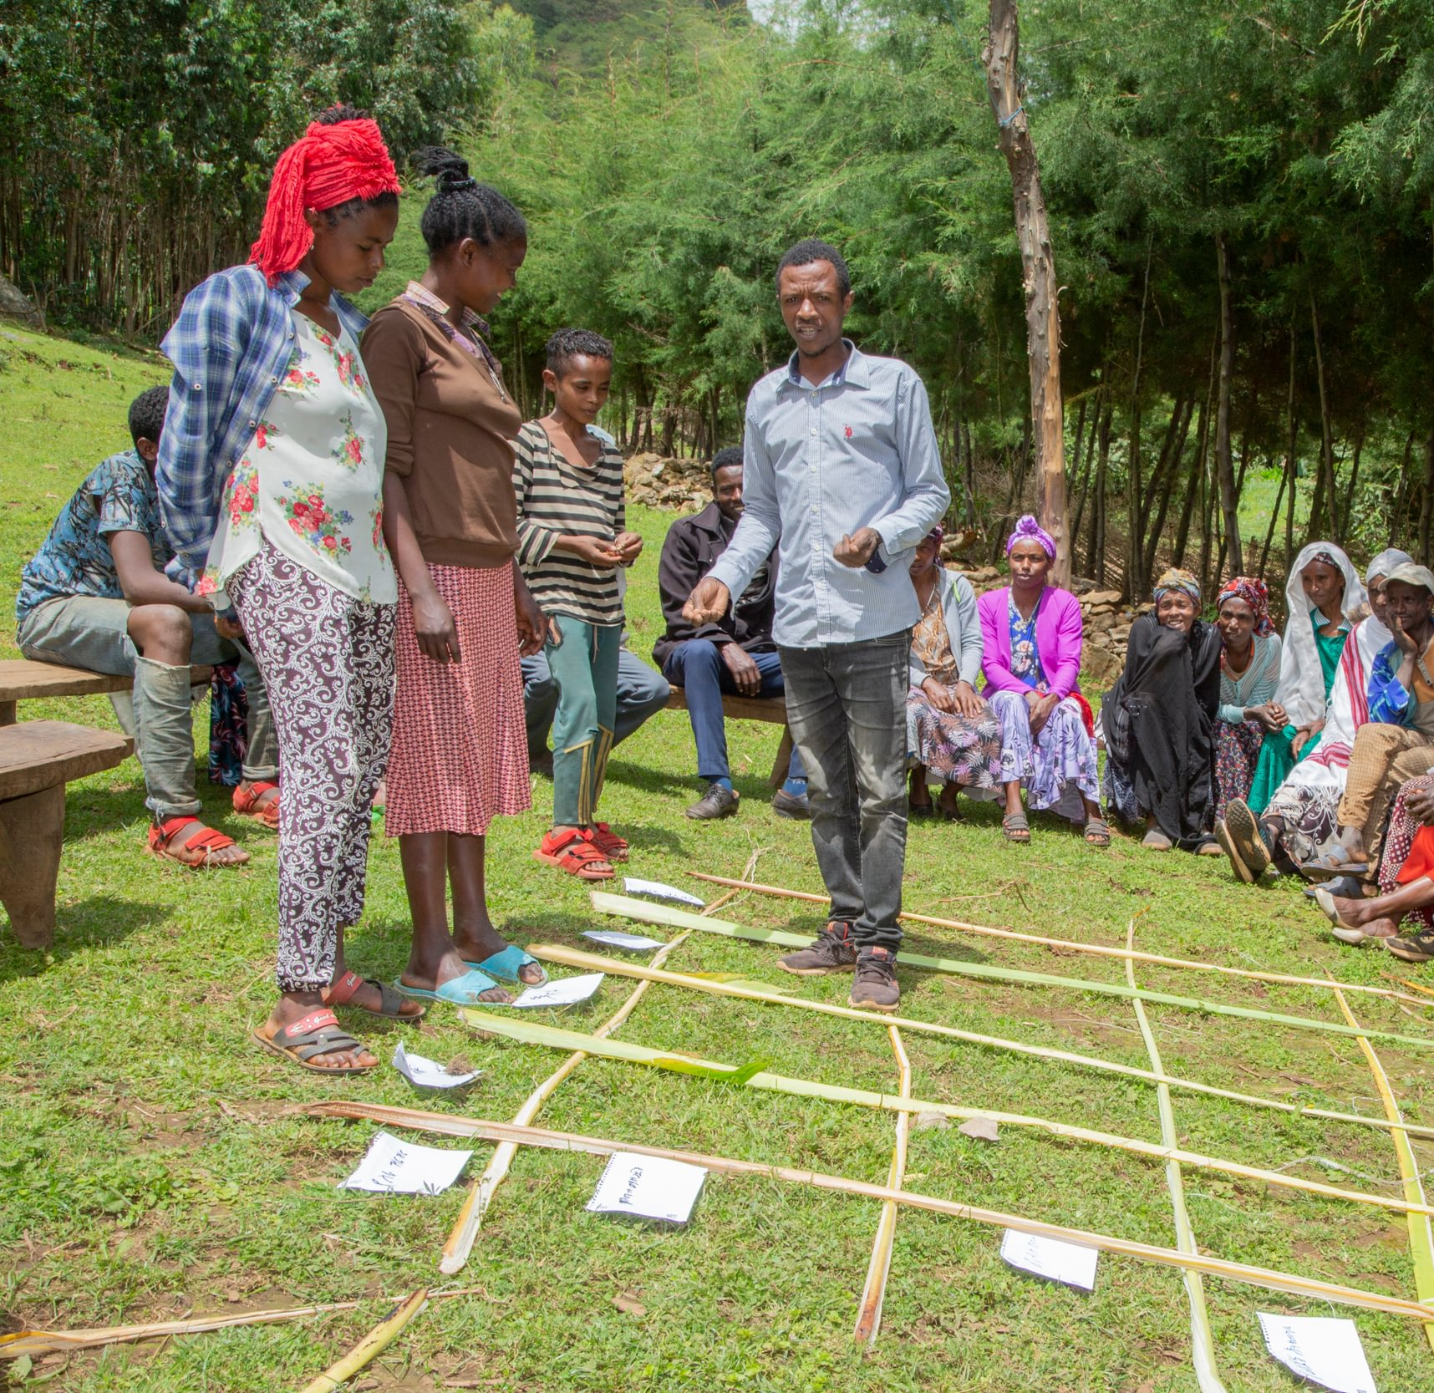
Transformative Household methodology (THM)
Community led safeguarding ​

Slide 6
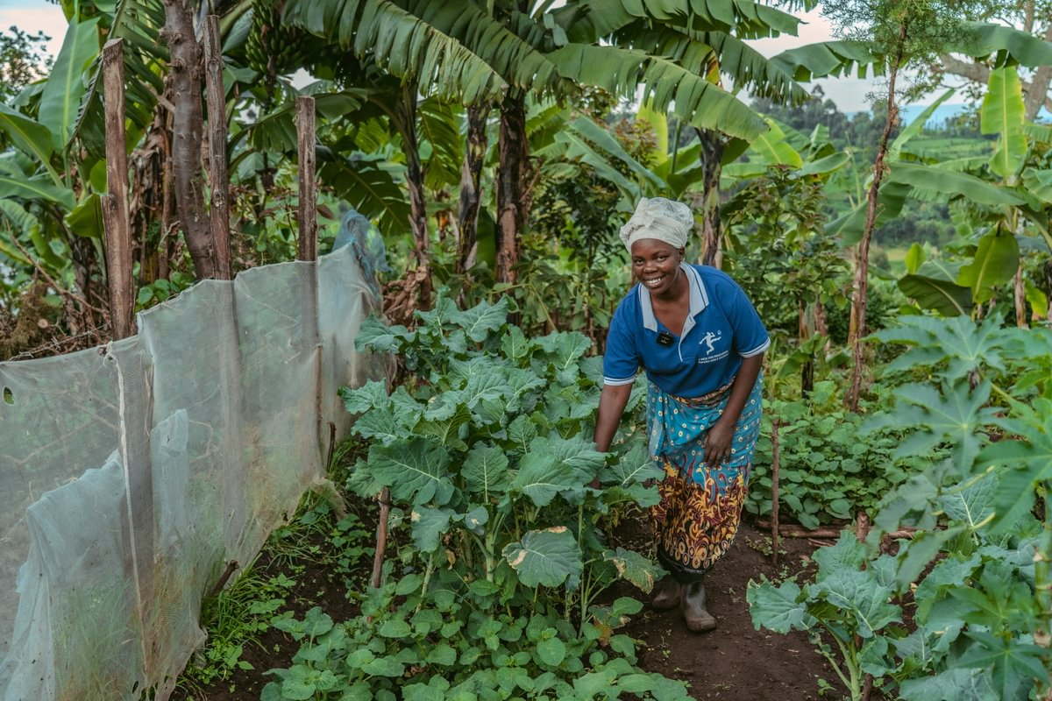
Agroecological Climate Positive Approach (ACPA)
Agroecological Climate Positive Approach is an alternative approach to agriculture production that not only leads to improved yields, but also contribute to improvement and regeneration of farming ecosystem, enhances biodiversity, and promotes climate change mitigation through lowering and sequestrating greenhouse gasses(beyond net zero)​

Slide 7
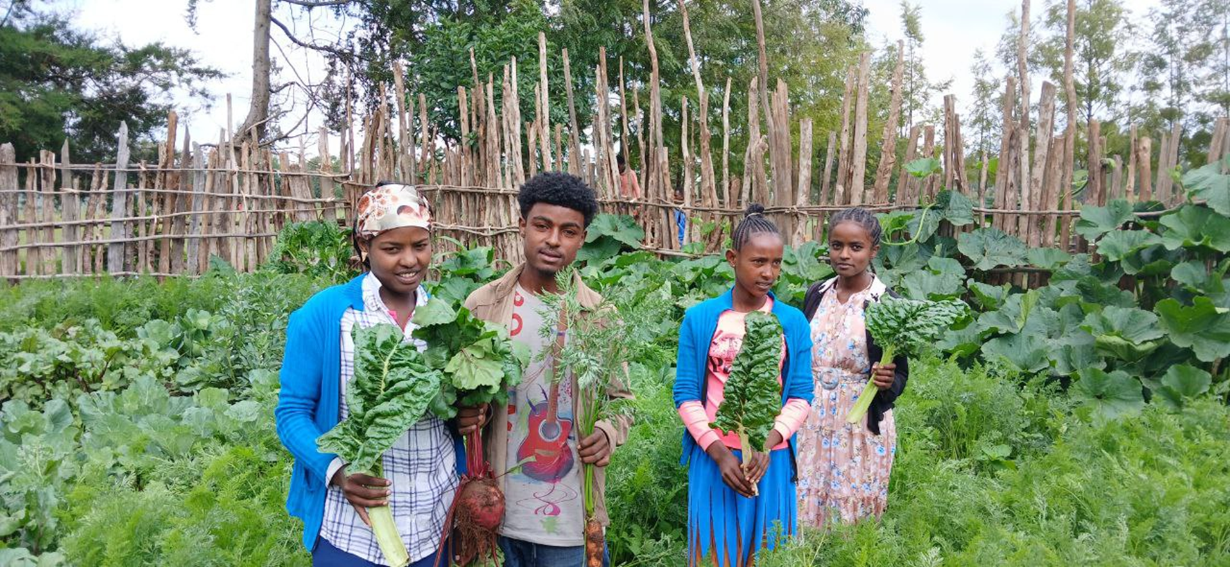
School gardening Equipping next generation to see the confident and thriving Africa

Slide 8
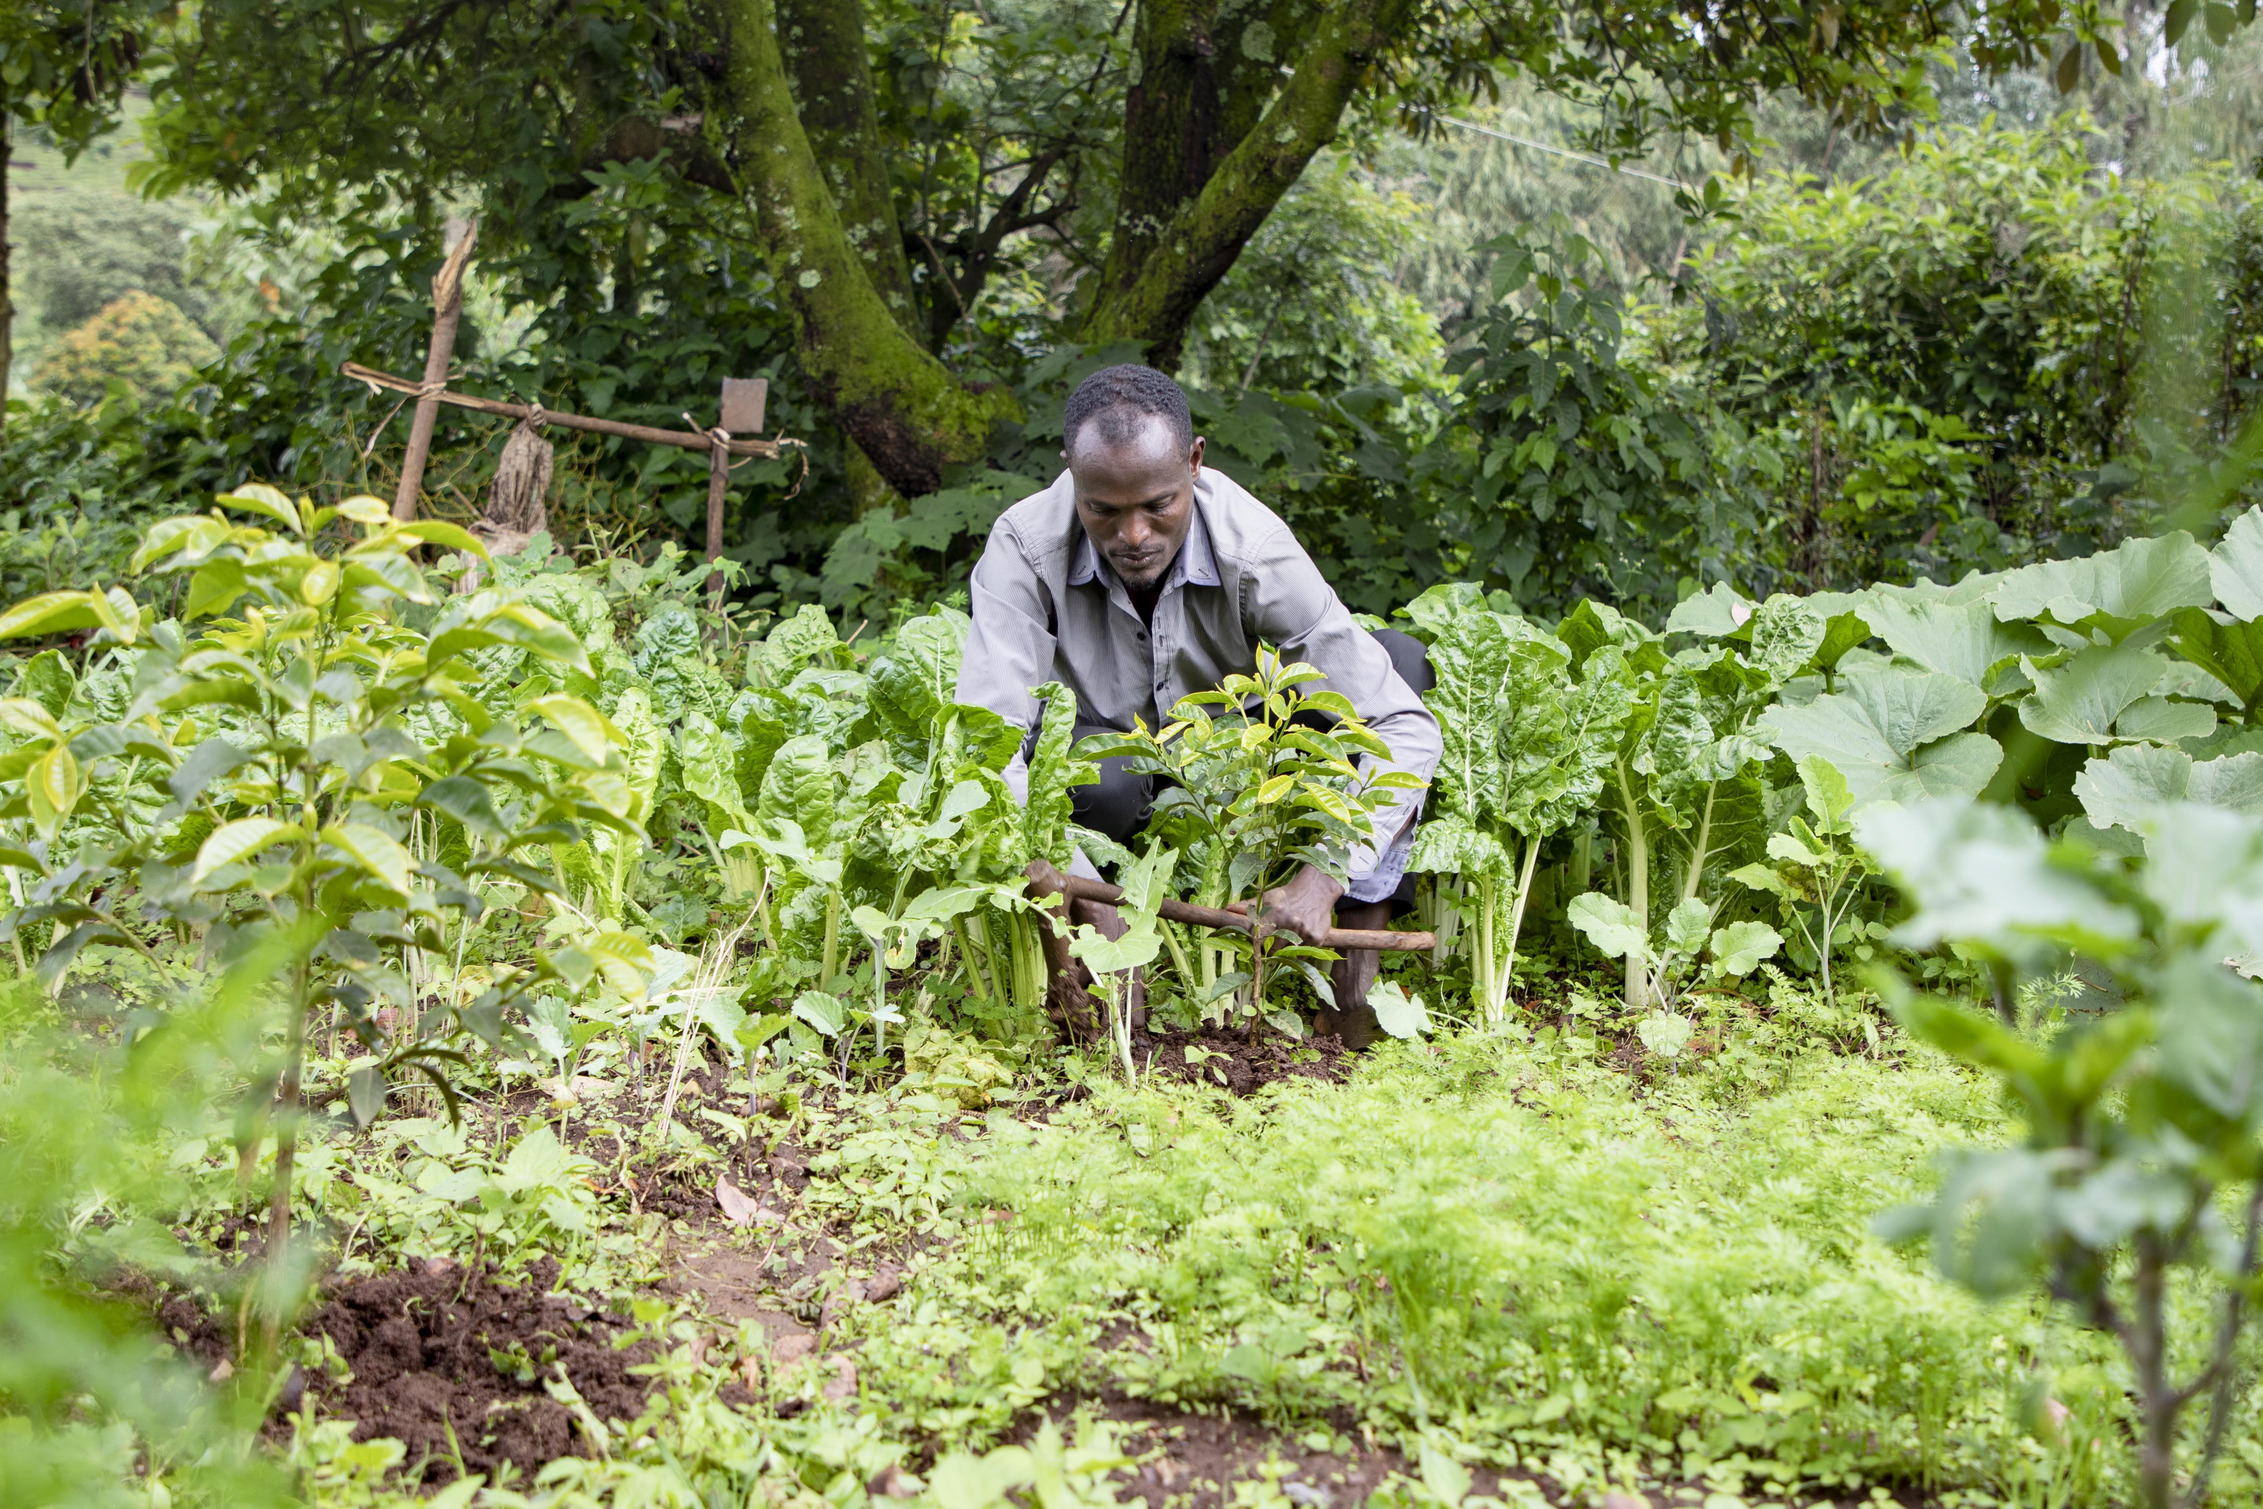
School gardening Equipping next generation to see the confident and thriving Africa

Slide 9
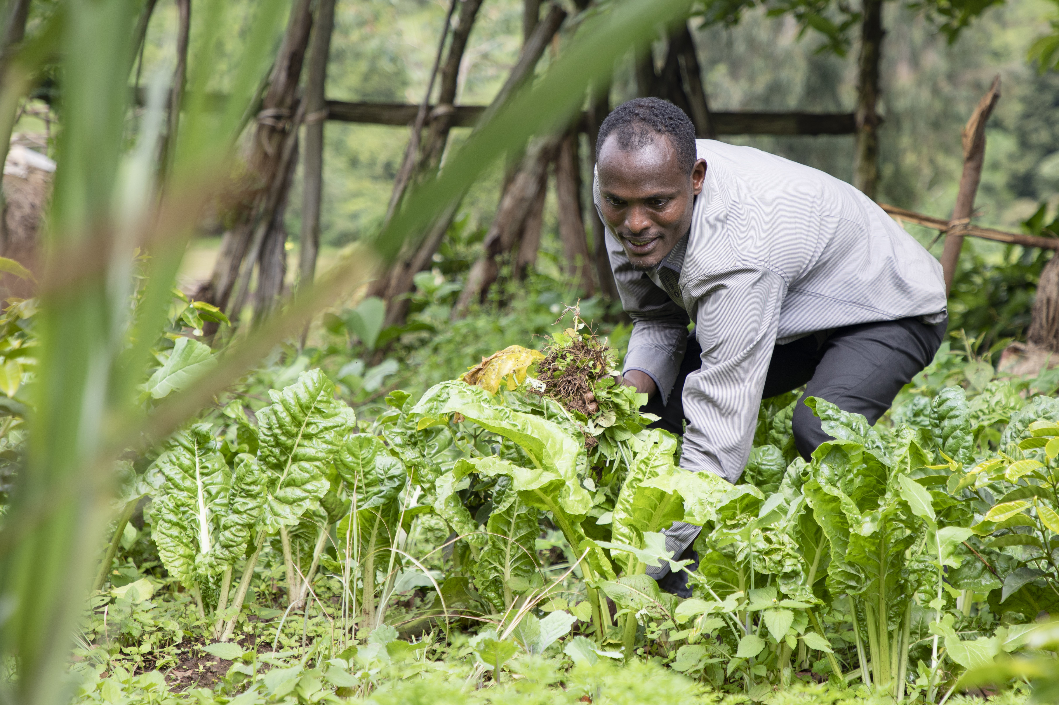
The ripple effect of our work: Hyilu, the teacher (see separate notes for story)

Slide 10
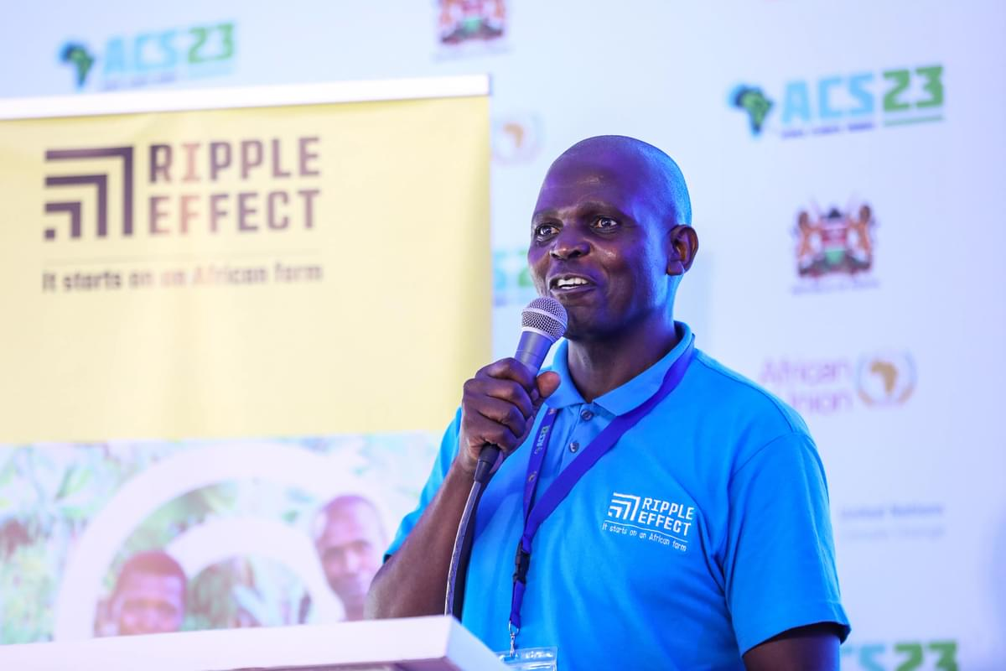
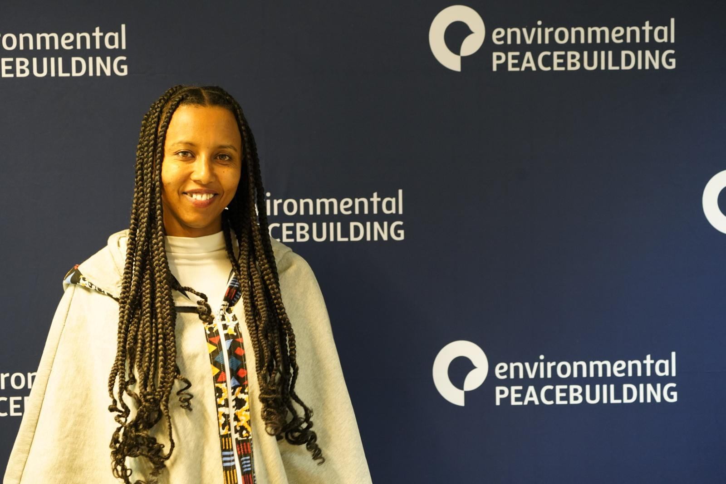
Participating and sharing in Regional and international platforms

Slide 11
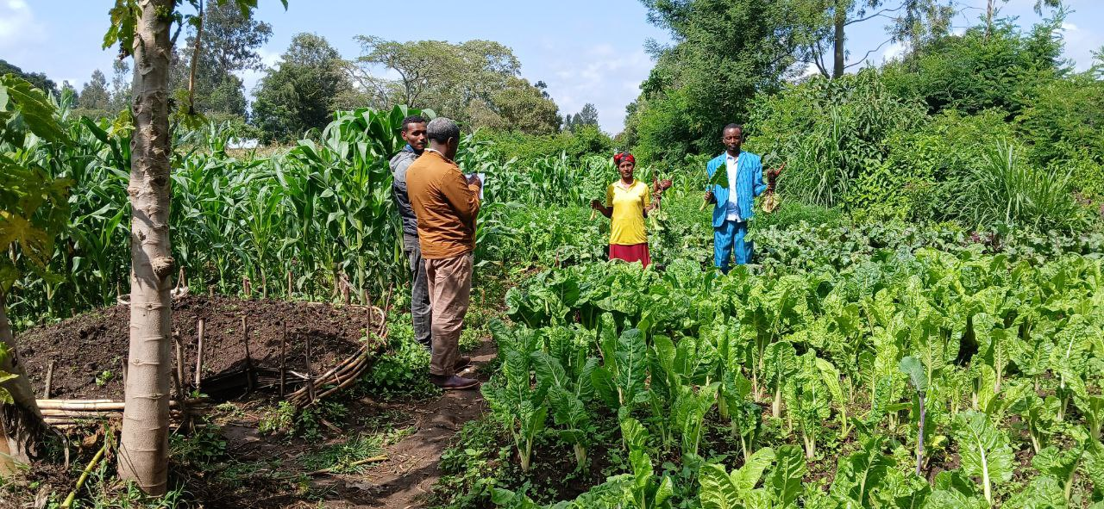
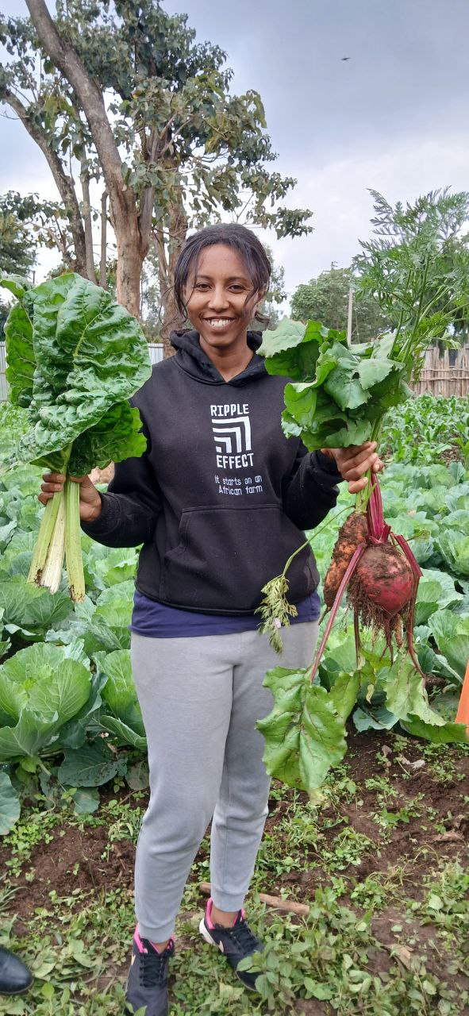
Farmers story

Slide 12
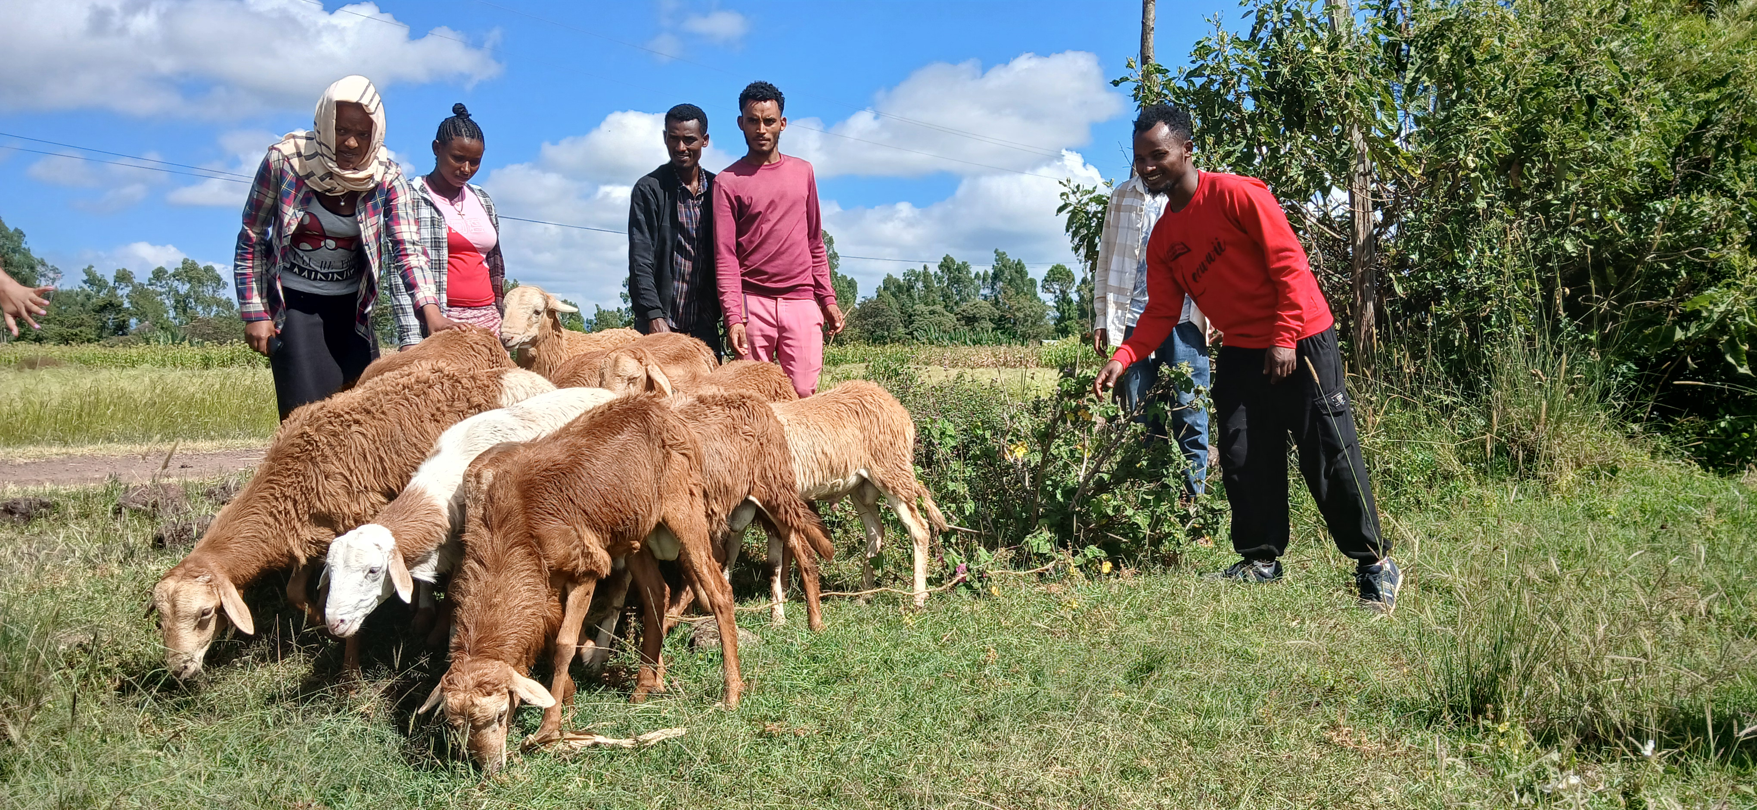
THANK YOU

