Slide 1
Ambassador general presentation 2026/27
Thank you for taking time to do this presentation.
Please adapt it to fit your audience and delete any slides you don’t need
There are 3 videos, delete what you don’t need
If possible, add in one of your own Ripple Effect stories to make it personal.
If you add anything in, please try to make sure all the fonts are the same.
Keep it simple, keep to one call to action only (Garden Twinning, Harvest, gift catalogue…).
Notes:
Thank you for taking time to do this presentation.
Please adapt it to fit your audience.
There are 3 videos, delete what you don’t need
If possible, add in one of your own Ripple Effect stories to make it personal.
If you add anything in, please try to make sure all the fonts are the same.
Keep it simple, keep to one call to action only (Garden Twinning, Harvest, gift catalogue…).

Slide 2


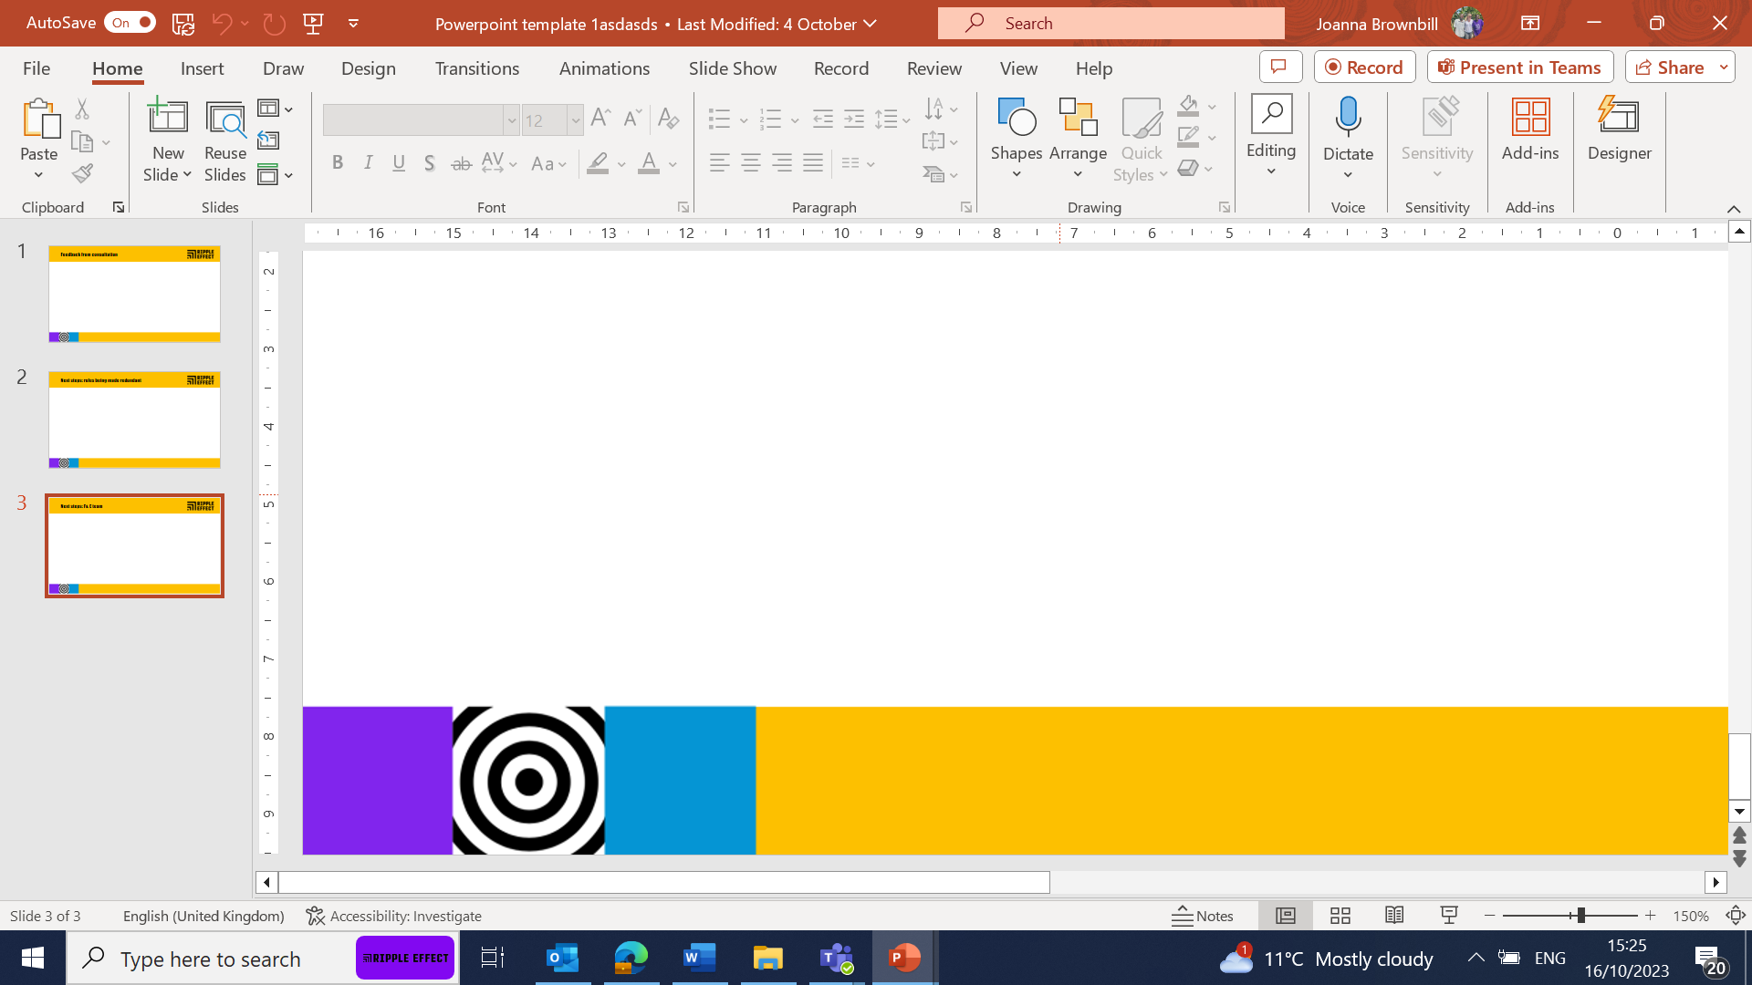
Timings for your presentation
Make sure you know the length of talk you are required to give, and don’t overrun!
Suggestions:
10-15 minutes - churches and schools usually only need a short talk (still very important). The Harvest/Christmas or Lent PPT will be a good length for this.
30 minutes – add a bit of the history of Ripple Effect (see slide 2) and a personal story
45 – 60 minutes – also add a video, time for discussion. Ask them questions too.

Slide 3
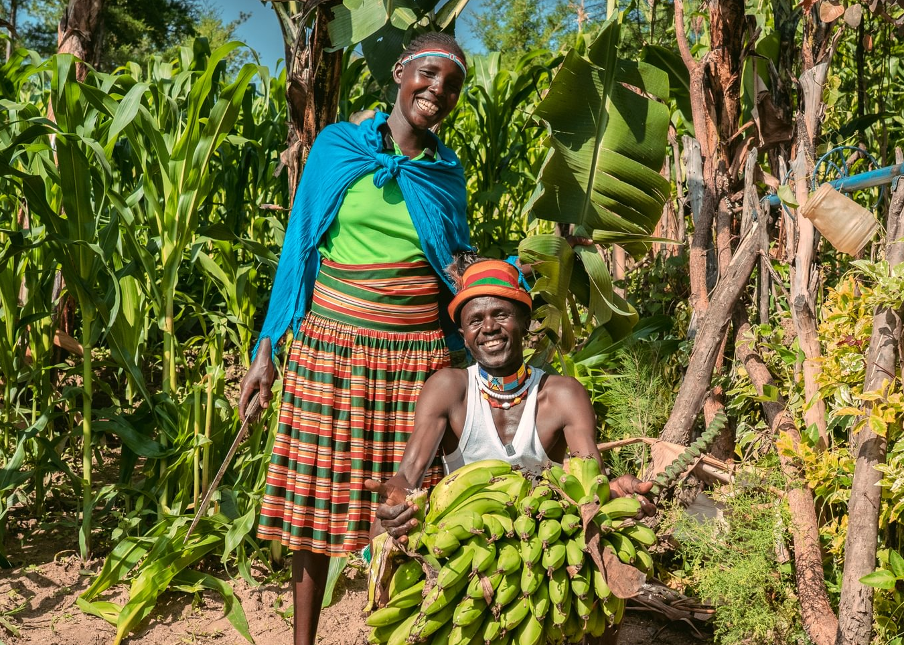
Thomas and Selena,
Ripple Effect farmers, Kenya
Notes:
Thank you for choosing to support Ripple Effect.
In this presentation, you’ll learn about the work of Ripple Effect and find out about twinning your garden, or your church’s garden to help support farming families in rural Africa .

Slide 4
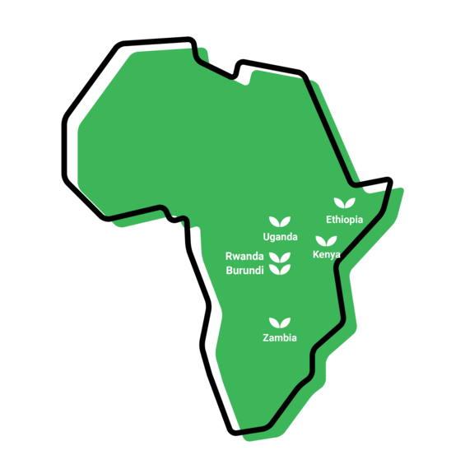
Where we work
Notes:
WHERE
Ripple Effect has established country programmes in Ethiopia, Kenya, Uganda, Rwanda, Burundi and Zambia.
80% of Ripple Effect staff are from these countries – working with and for the communities they live alongside.

Slide 5
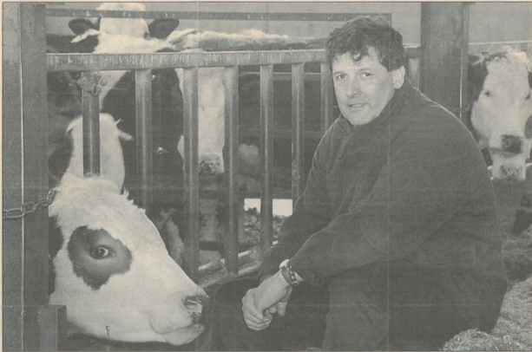
History of Ripple Effect (longer talk only)
Notes:
This slide will help bulk up your talk should you need a bit extra! But there won’t be time for this in a shorter talk
Photo: Founding Farmer - David Bragg preparing the cows to take onto the first plane to Uganda.
Ripple Effect was set up by a group of Christian dairy farmers from the UK in 1988.
Outraged at EU milk quotas, which were forcing them to slaughter healthy dairy cows, and in response to an appeal from Uganda for milk, they embarked on a project, which was set to become an innovative and practical charity.
Uganda was just emerging from a long civil war, communities and their farmland had been destroyed and much of the country's livestock wiped out. Several of the UK farmers flew to Africa to investigate how they could help.
Meeting with Ugandan farmers, the Bishop of Mukono, and a livestock expert, they saw how smallholder dairy farming in Africa could work. People there were unable to feed themselves and milk would provide an instant source of nutrition. They returned to the UK determined to help, and sent cows from their own herds to Uganda. Ripple Effect was born.
We've changed a lot since then.
We no longer send cows from the UK, we source them locally. In fact, livestock is just a tiny part of what we do today.
Over time, our work has expanded to include much wider training on nutrition, gender equality and business skills. We are proud to have worked with over 2 million people as they have learned to grow and sell more, and share their new-found knowledge with their neighbours, who then do the same.
Watch our video below to see how far we’ve come, with the help of our global family.

Slide 6
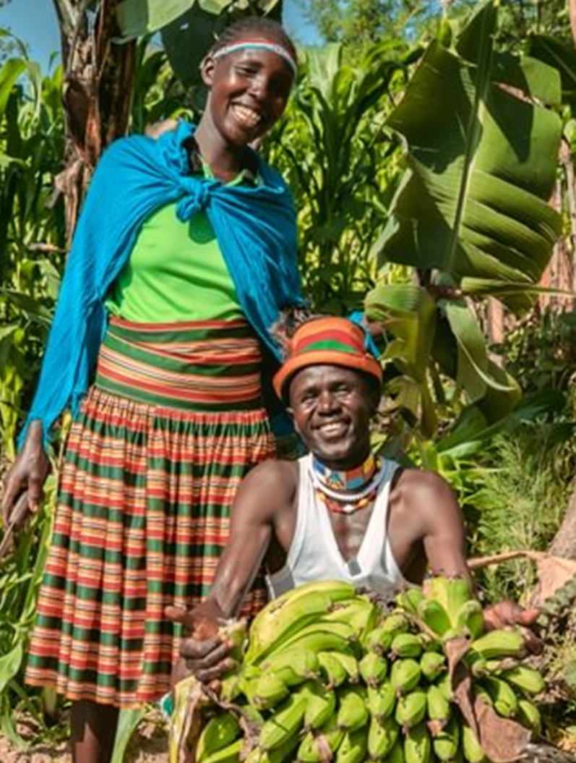
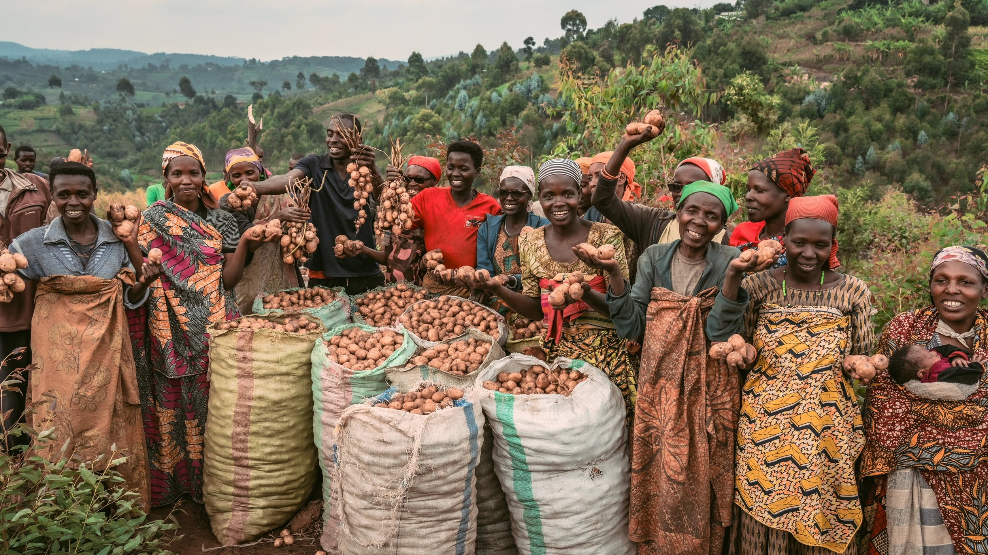
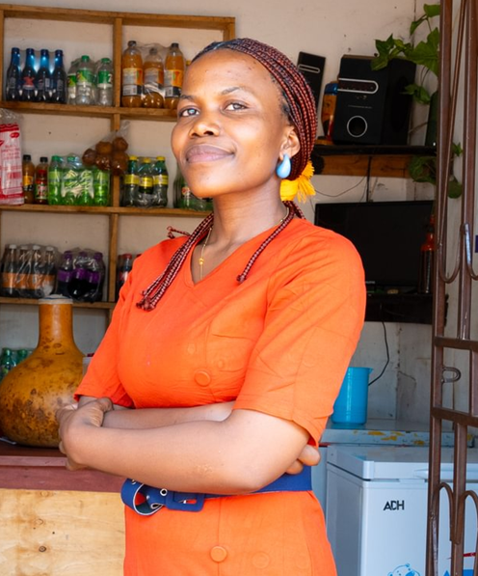
The three strands of our work
Notes:
We have 38 years' experience supporting families in rural Africa to learn more, grow more and sell more. Our projects are typically three years long. Once families have completed their Ripple Effect training, they then share what they know and have with their communities, creating a ripple effect across rural Africa.
There are three core strands to our work (detailed in the following slides)
Farming sustainably
Gender and social inclusion
Business skills

Slide 7

Farming sustainably
Farming sustainably
Meselech, Ripple Effect farmer, Ethiopia
Selena and Thomas, Ripple Effect farmers, Kenya
Notes:
Farming sustainably
Ripple Effect trains families in using up to date and traditional approaches to farming. Families learn to build productive farms and to adapt to the effects of the climate crisis. And ultimately their farms will have a climate-positive impact!
Community trainers and peer farmers share their knowledge with more farmers and communities, so there is a ripple effect of learning.
Ripple Effect helps farmers think about the resources available to them within their community. We then teach the organic agricultural principles and skills they need to integrate these into a sustainable, biodiverse farm – without expensive artificial fertilisers or GM seeds.
Techniques (many that you’ll be familiar with) such as water harvesting, composting, use of manure, vegetable growing, tree planting and animal husbandry are easily adaptable to each farmer’s own land and needs.

Slide 8
Gender & social inclusion
Gender and social inclusion
Ripple Effect farmers, Kenya
Ripple Effect farmers, Burundi, with their potato crop
Notes:
Gender and social inclusion:
Ripple Effect’s local staff in Africa help families develop a shared vision for their home. Through facilitated activities we help the family work out how best to share the workload and decision-making to achieve their vision.
Through this approach, family life becomes more harmonious and prosperous, and children grow up happier, better educated and with wider horizons.
Women in particular are supported to raise their aspirations beyond subsistence farming.
65% of the people we work with are women – research indicates women are more likely to invest income into their family’s future
50% of those women are widows – some of the most vulnerable people

Slide 9

Business skills
Patience, Ripple Effect farmer, Kenya
Notes:
Business skills
More farmers learn to manage their farm as a business, moving away from subsistence farming to control their own futures: developing profitable businesses and co-operatives which can access new markets.
As part of their training farmers learn money management and enterprise skills. They also investigate how best to add value to their produce – for example processing it into another product or storing it so that it can be sold out of season.
Ripple Effect farmers become resilient entrepreneurs, capable of making choices and in charge of their own futures.
In this photo Patience is part of a Ripple Effect project in Kenya. She is a single mother who has started a shop as part of the project, and has huge energy and big plans to match.

Slide 10
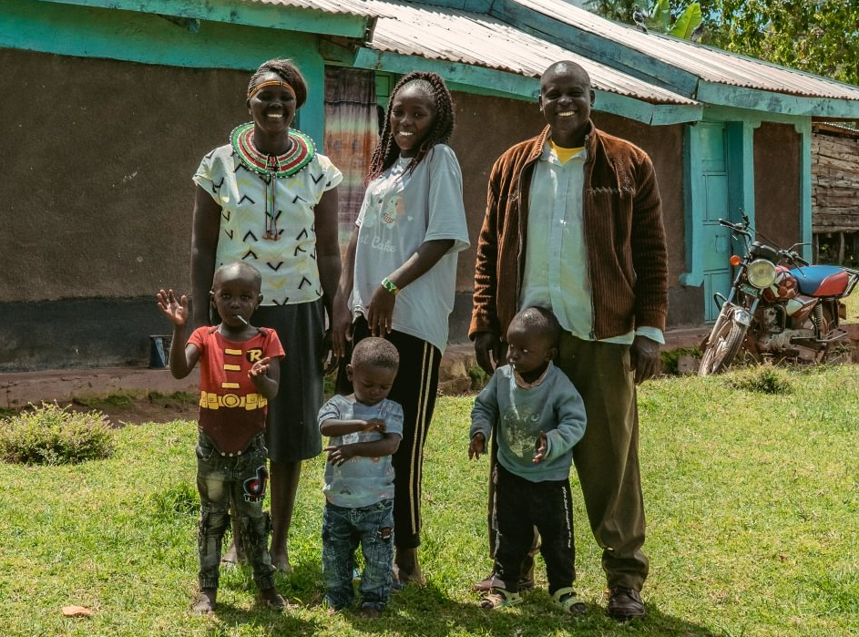
Priscillah’s’s story
Notes:
Priscillah, her husband and their family
Meet Priscillah…
My Name’s Priscillah, and I live in West Pokot, Kenya with my husband Dixon, five children and two grandchildren.
Not long ago, life was very difficult for us. The challenges we faced were the unreliable climate, and we didn’t know how to cope with it. We didn’t have the knowledge or access to a good variety of seeds. We also didn’t know how to plan our land or where to put what. We didn’t understand that there was potential to get so much income from what we had.
Through Ripple Effect’s training, I learned how to plan my land better, improve my soil, and manage water more effectively. Today, everything has changed.
Now I grow a wide variety of crops, including sweet potatoes, peas, legumes, and avocados. My land is carefully organised so that I can have continuous harvests throughout the year. I like growing nuts as it helps me meet the six food categories.
Growing a variety of crops has improved my soil and strengthened my family’s nutrition. Sweet potatoes are now a daily staple in our home, and I make sure that everything from the harvest is used so nothing goes to waste.
With irrigation from a nearby river and improved composting techniques, I am able to grow vegetables even during the dry season, when food used to be scarce.
This improved harvest has changed our family life. We now eat a wider variety of nutritious foods, and my children are healthier and better nourished.
Our income has also increased through the sale of surplus produce, helping us meet our essential needs. We don’t have any financial constraints these days.
My husband Dixon has also seen the change. He recognises both the improved harvest and my growing confidence and leadership. Together, we are building a more secure future from our land.

Slide 11
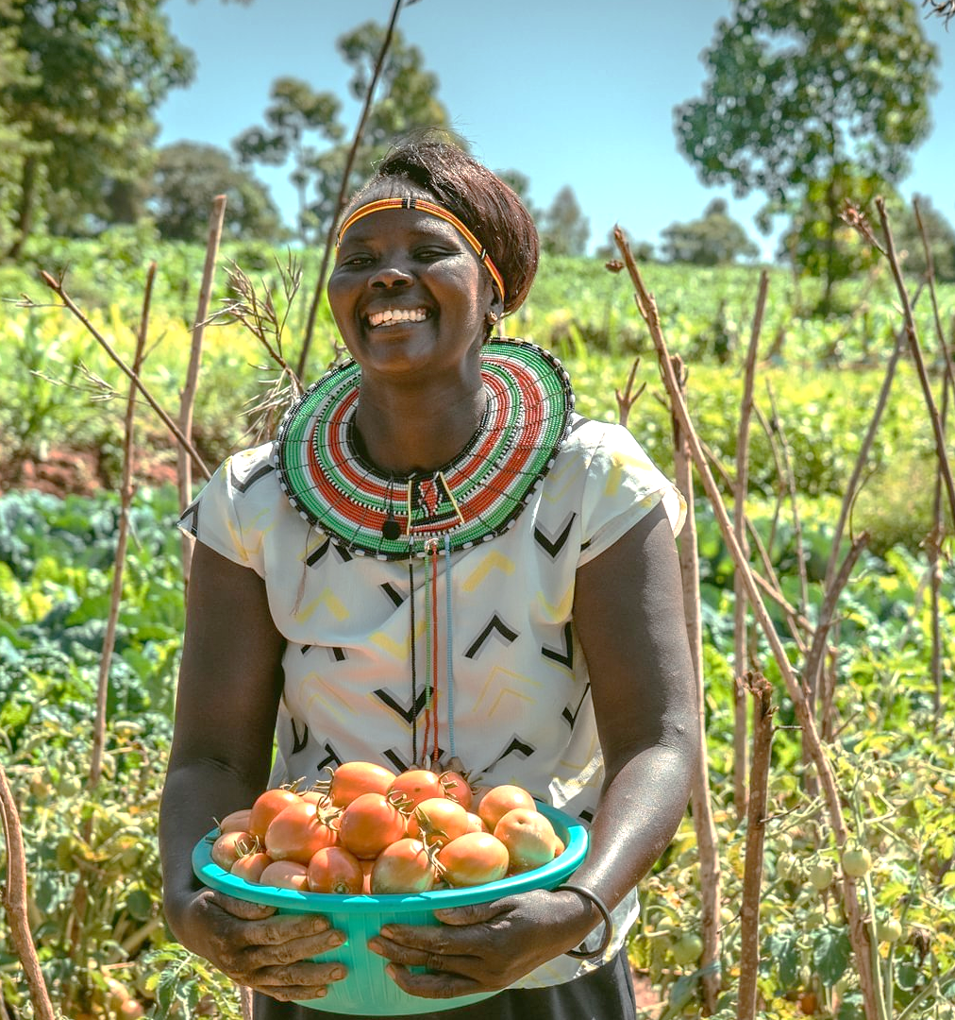
Therese’s story
“Now I can grow all the food my family needs… better nutrition is making my family stronger.”
Priscillah, Ripple Effect farmer, Kenya

Slide 12
Ambassador to add own Ripple Effect story here
Ambassador to add own Ripple Effect story here
Notes:
If you have a story from a field trip, please do add it in here.

Slide 13
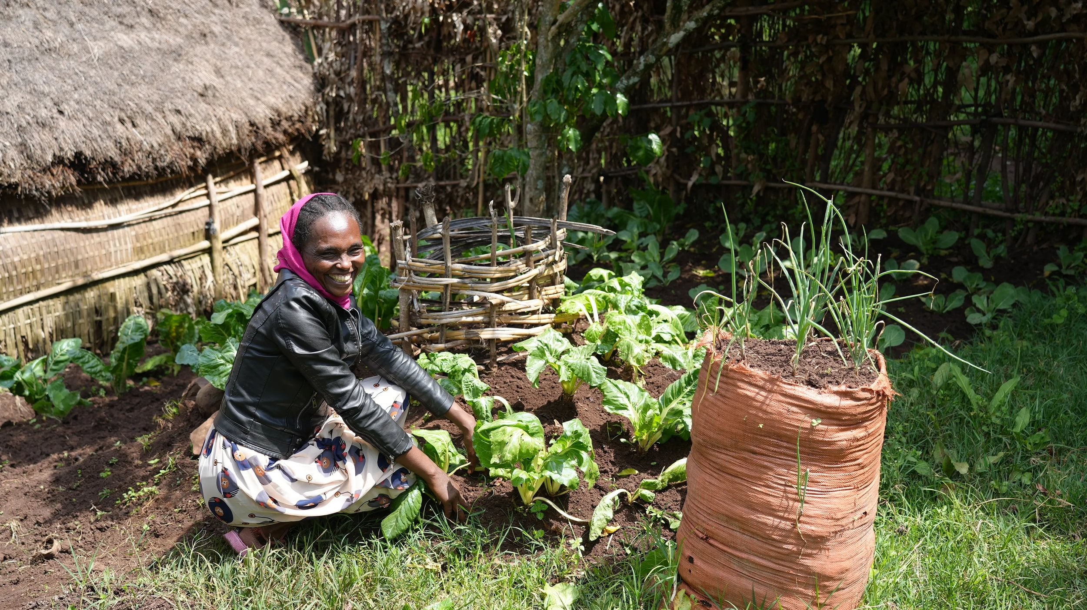
A keyhole garden
“To combat climate change, I’ve learned to plant trees. Also in the dry season when we can’t plant much, I plant kitchen gardens such as keyhole gardens and bag gardens close to my home where I can use wastewater to water the plants easily. I also use compost to add to the central basket and can still easily grow crops even in the dry season.”
Meselech, Ethiopia.”
Notes:
Meselech, a Ripple Effect farmer in Ethiopia

Slide 14
Keyhole garden
Notes:
A keyhole garden is a raised bed that has a composting basket in the centre. This design allows for efficient use of space, easy access to plants, and incorporates composting directly into the garden bed, providing nutrients to the surrounding plants. Keyhole gardens are designed to retain moisture and allow for better drainage, preventing waterlogging during heavy rains while ensuring that plants have access to water during dry periods. These types of gardens will help families adapt to the challenges of the climate crisis while ensuring they have access to nutritious food.
A keyhole garden allows a family to grow enough food for three meals a day – even in the face of an extreme climate and poor soil. The garden, shaped like a keyhole from above, encompasses a circular raised bed with a central basket where compostable waste is placed along with used water from the kitchen. These gardens give fantastic results quickly and add nutritious vegetables to provide a balanced diet

Slide 15
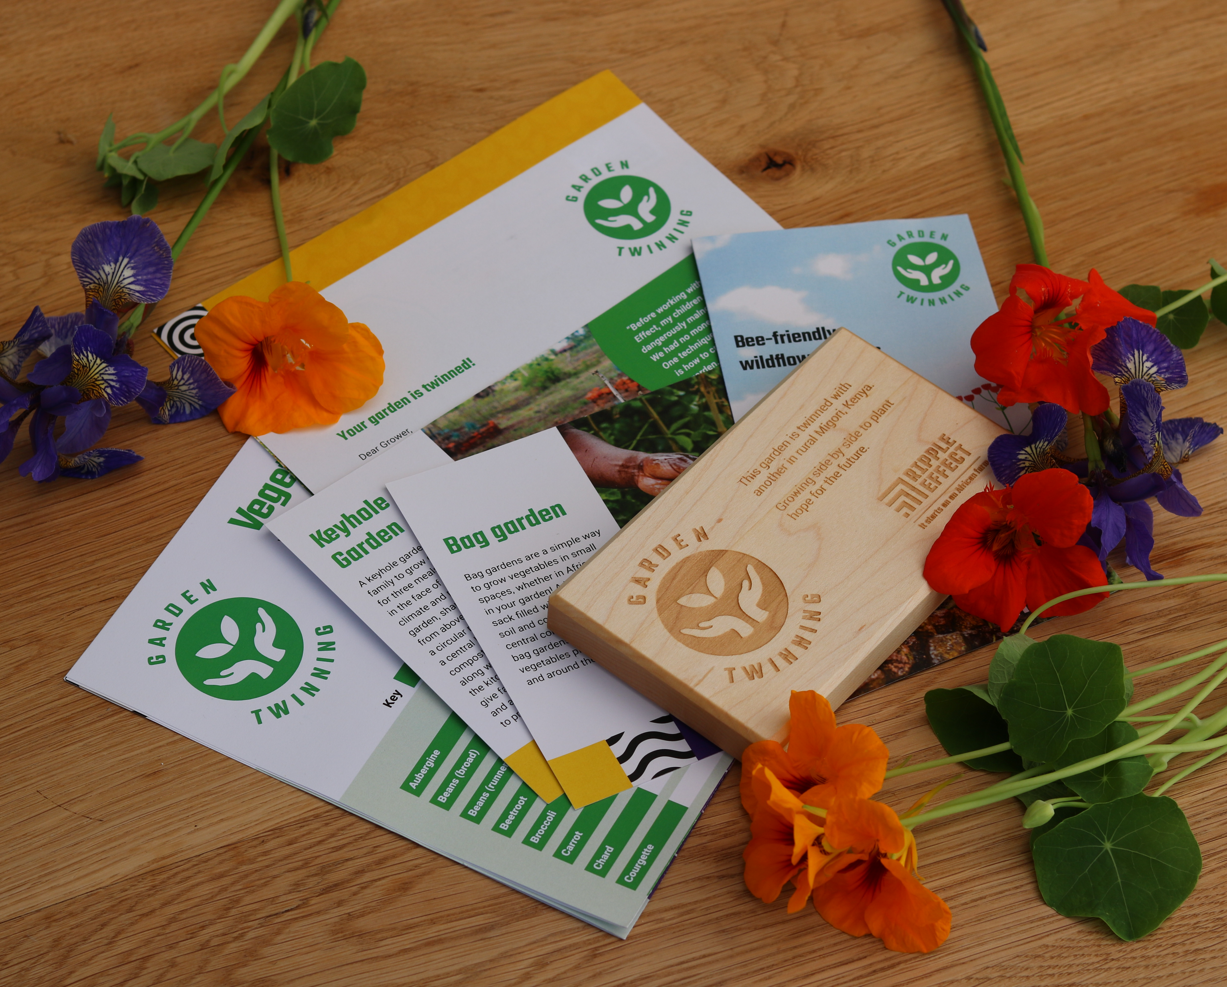
Twin your community garden!
In recognition of your donation of £120, your church will receive:
a sustainable wooden plaque to display in your garden
a vegetable growing guide from Charles Dowding, our no-dig expert
wildflower seeds to get you started on your Garden Twinning adventure
a garden twinning certificate to display inside your church or community space
an opportunity to have a speaker attend one of your meetings to help bring our work to life
Notes:
By twinning your church/community garden (£60 for an individual garden) you’ll be planting hope for our neighbours in rural Kenya. In return, you’ll receive:
a sustainable wooden plaque to display in your garden
a vegetable growing guide from Charles Dowding, our no-dig expert
wildflower seeds to get you started on your Garden Twinning adventure
a garden twinning certificate to display inside your church or community space, (church only)
and an opportunity to have a speaker attend one of your meetings to help bring our work to life (church only)
Plus, we can’t wait to share the practical techniques families in rural Africa are using in their own gardens to fight hunger and the climate crisis.
Please do get in touch with info@rippleeffect.org, if you need any further information and happy Twinning!

Slide 16
How your church/rotary can get involved
Churches: choose the most appropriate ASK
Sign up to Making Ripples (our church e-newsletter)
Christmas, Harvest, Lent
Mission Partnerships
Twin your church garden
Eco Tips
Rotary Clubs
Sign up to e-news to keep up to date with Ripple Effect’s work
Notes:
Churches: choose the most appropriate ASK
Sign up to Making Ripples (our church e-newsletter)
Christmas, Harvest, Lent
Mission Partnerships
Twin your church garden
Eco Tips
Rotary Clubs
Sign up to e-news to keep up to date with Ripple Effect’s work
There are price points on the next slide

Slide 17
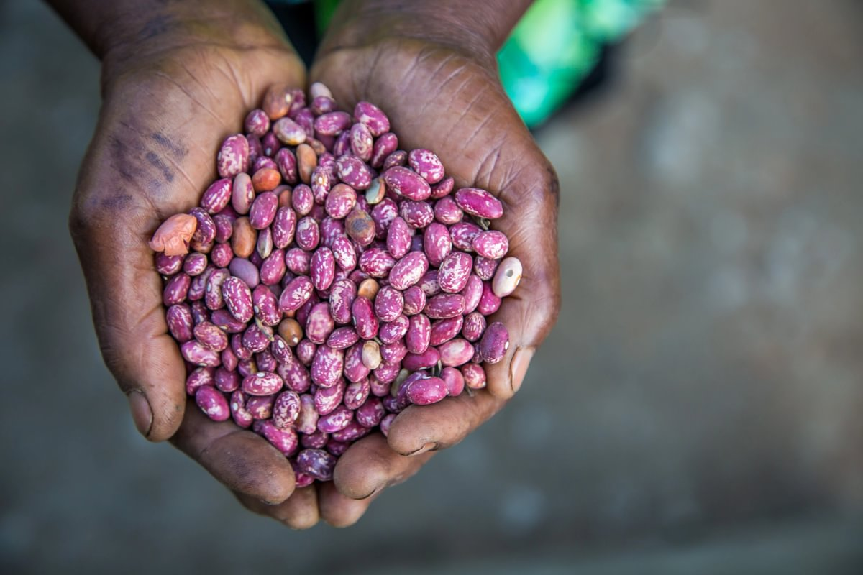
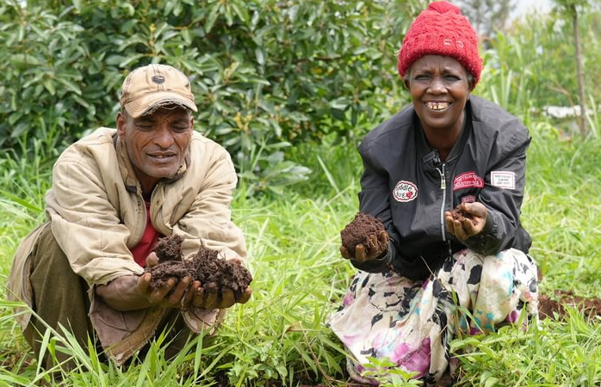
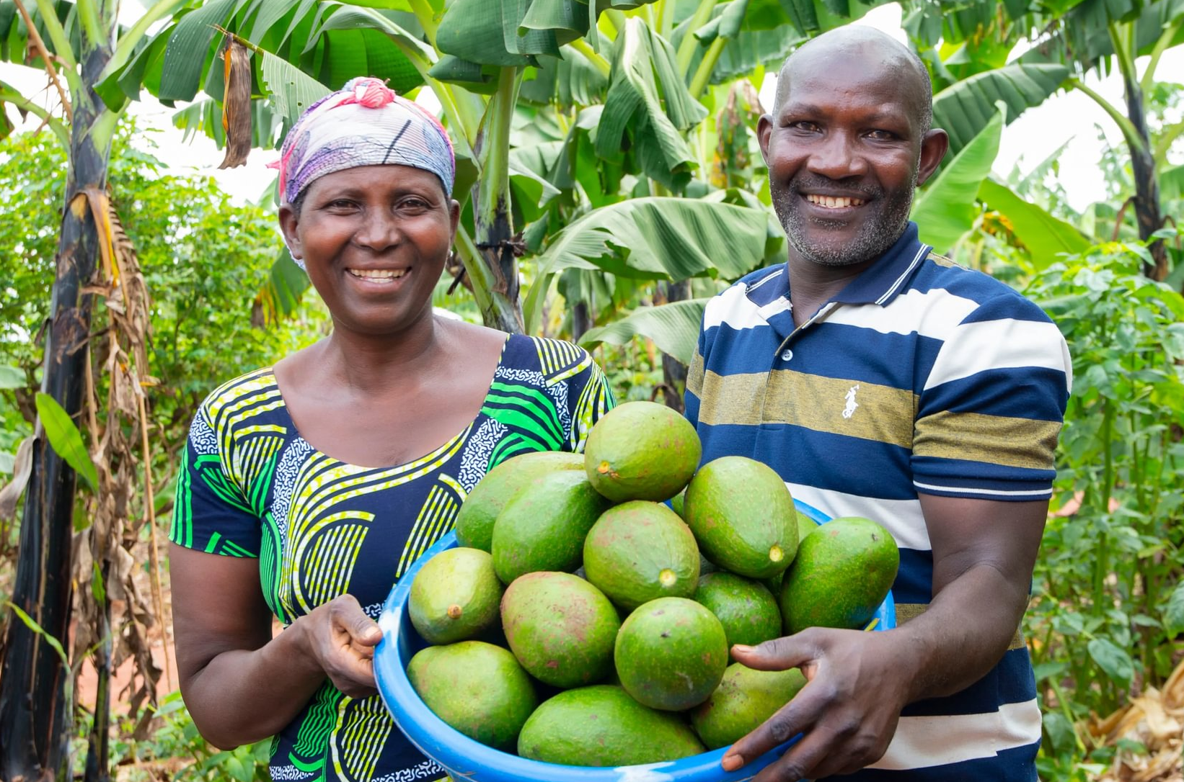
How your church/group can help
£100 could provide farmers with drought-resistant seeds, helping them grow food year-round.
£250 could train farmers in climate-smart methods to improve soil quality and protect their land from climate shocks such as droughts and floods.
£500 could support farmers to build resilient, eco-friendly income streams and learn money management.
Find out more at rippleeffect.org

Slide 18
Videos
There will be 3 video options for you to add into this presentation (see speaker talks on the resources page). Two of them are embedded so you won’t need Wi-Fi, but it will take up a lot of extra space.
What we do (1 minute - embedded)
Working Together with our Farming Communities (3 minutes - embedded)
Push Pull (4 minutes - YouTube link)
Notes:
There will be 4 video options for you to add into this presentation (see speaker talks on the resources page). Two of them are embedded so you won’t need Wi-Fi, but it will take up a lot of extra space.
What we do (1 minute - embedded)
Working Together with our Farming Communities (3 minutes - embedded)
Push Pull (4 minutes - YouTube link)

Slide 19
Question time
If you need to fill some time why not give a chance for them to ask you questions, or you can even ask them questions!
If you don’t know the answer, that’s OK, tell them you’ll find out and let them know.

Slide 20
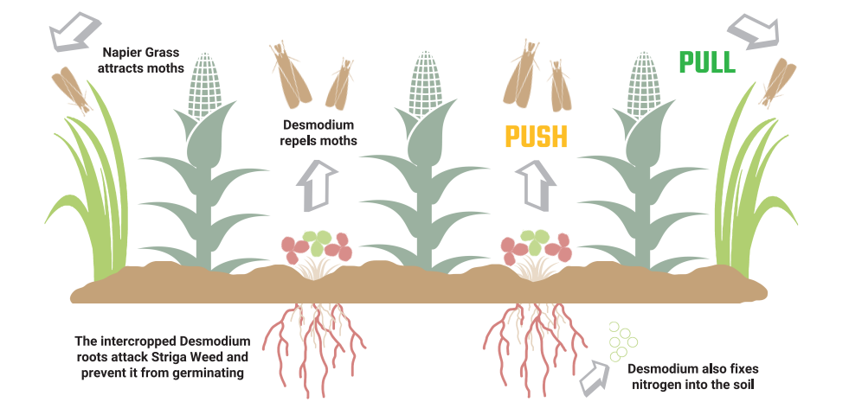
Useful extra information slides: Intercropping
Notes:
Further information can be found in the Sustainable techniques from rural Africa leaflet Also known as Push Pull. You can find further information here Ripple Effect | Push-pull biotechnology
How does push-pull work?
The technique is straightforward. Farmers intercrop their maize with the legume crop Desmodium (also known as tick clover) which continuously produces defence odours that repel (push) stemborer moths away from the maize. Desmodium also deters the growth of the Striga weed.
The pull element is provided by Bracharia or Napier grass planted as a border crop around a maize plot. It offers the multiple benefits of being attractive to stemborers while also fixing nitrogen into soil, and being a nutritious animal feed.

Slide 21
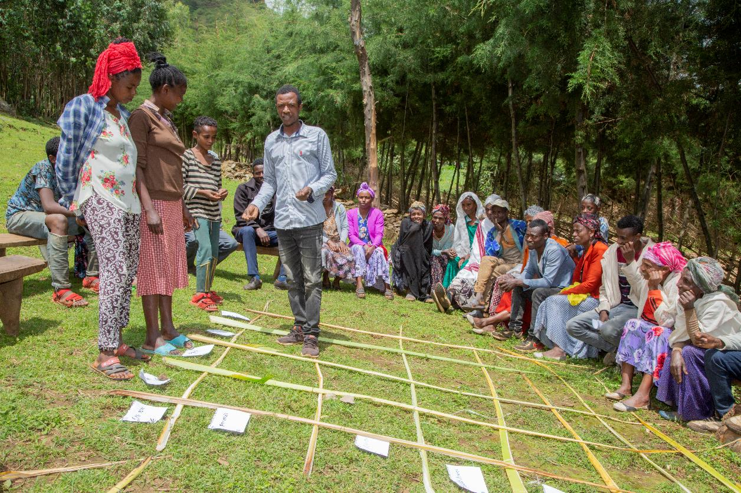
Useful extra information slides: THM
Notes:
Transformative household methodology (you can read the THM paper if you’d like more information THM-for-Gender-and-Nutrition-Training-Manual-May-2023-V2-FINAL-PDF-1_2023-07-26-122431_rbye.pdf)
The Transformative Household Methodology (THM) is a tool that aims at creating awareness of intra-household gender relations between women, men, girls, and boys. The THM identifies the different roles and responsibilities of household members, their access and control over resources and their related benefits.
The THM methodology has been implemented in all Ripple Effect country programmes in Burundi, Ethiopia, Kenya, Rwanda, Uganda and Zambia. This innovative relationships methodology contributes to women’s empowerment by reducing their unpaid workload in the household, giving them more time and energy to be involved in community work and higher-value activities. It has also increased the decision making at household level. We see women becoming more involved in household decision-making, including discussions about how substantial amounts of money should be spent. We also see men getting involved with decisions around cooking and food.
“Whenever I earned money, I never discussed with my wife how to spend it; it was mine and I spent it as I wished; sometimes on unnecessary things. I am glad now we jointly decide how we spend family income which has led to developments in our home.” Jean-Baptiste Ripple Effect project participant.
Our data shows that women's physical workload decreases as a result of THM sessions and that men became significantly more involved in nearly all household activities. Even when men reported that they were teased by others for performing what were perceived as “female” tasks they persevered, which indicates an authentic Transformative Household Methodology for Gender & Nutrition 10 change in attitude. Critically, when household workloads are more fairly shared, and women have a voice in what crops will be grown or what equipment or livestock will be bought, farm yields tend to increase. Families become more food secure, and this increased security improves family relationships further, cementing the changes in a positive feedback loop.

Slide 22
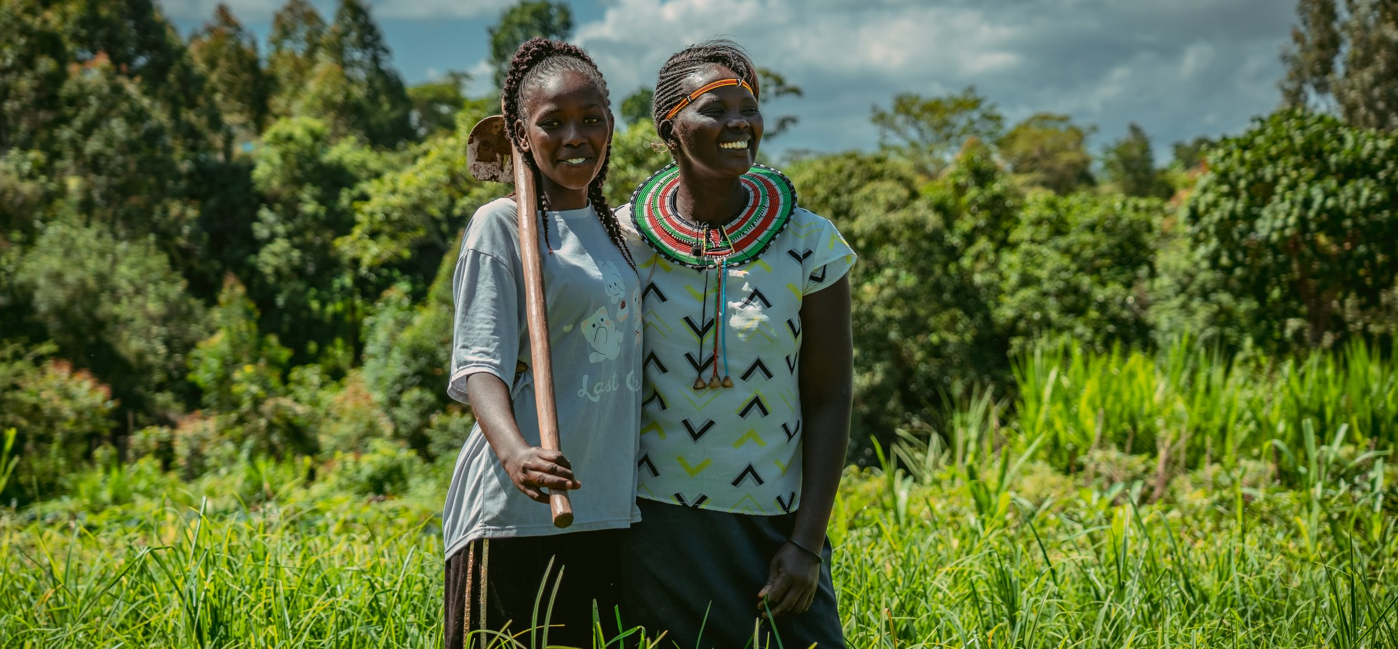
Thank you for choosing to support Ripple Effect
For more information about how your church can get involved with our work visit www.rippleeffect.org or email info@rippleeffect.org

