Slide 1
Ambassador general presentation 2026

Slide 2
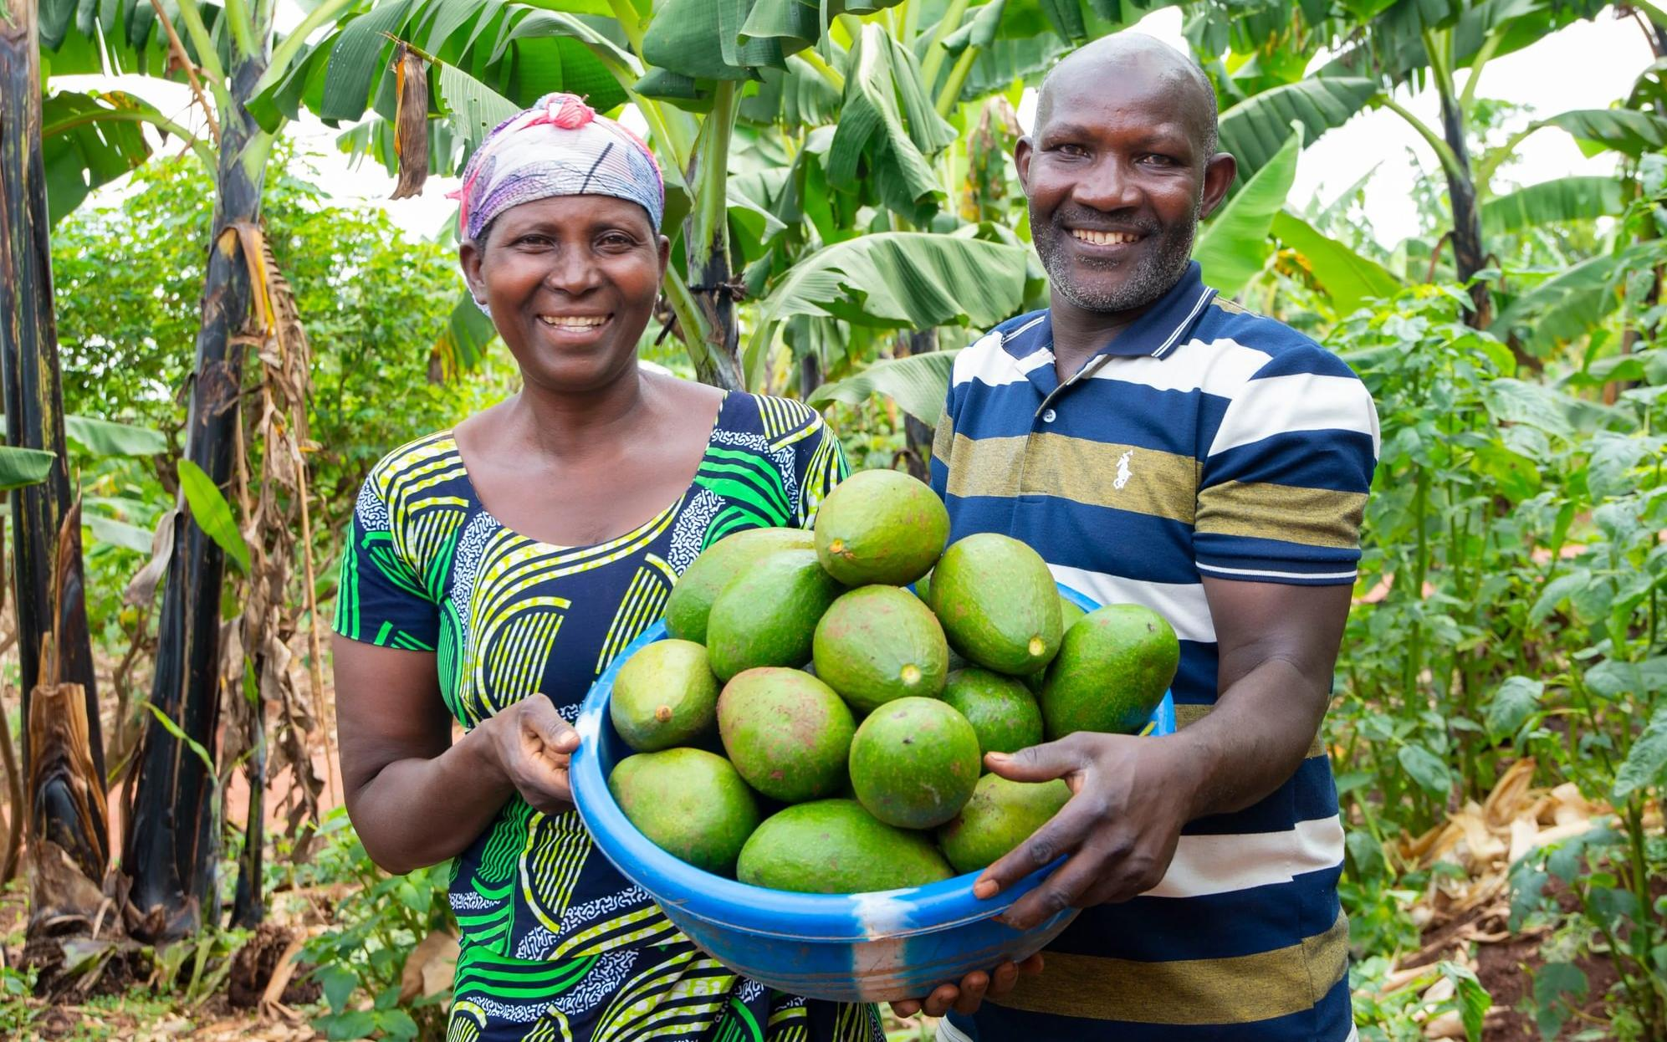

Therese and Deogratias,
Ripple Effect farmers, Rwanda
Notes:
Thank you for choosing to support Ripple Effect.
In this presentation, you’ll learn about the work of Ripple Effect and find out about twinning your garden, or your church’s garden to help support farming families in Kenya.

Slide 3
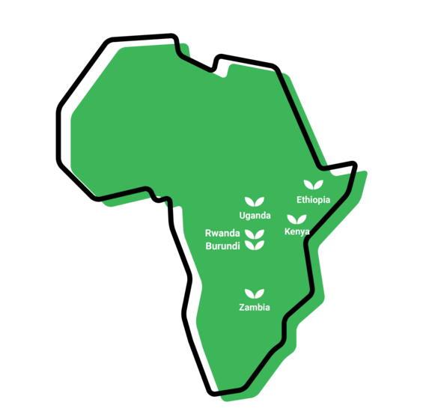
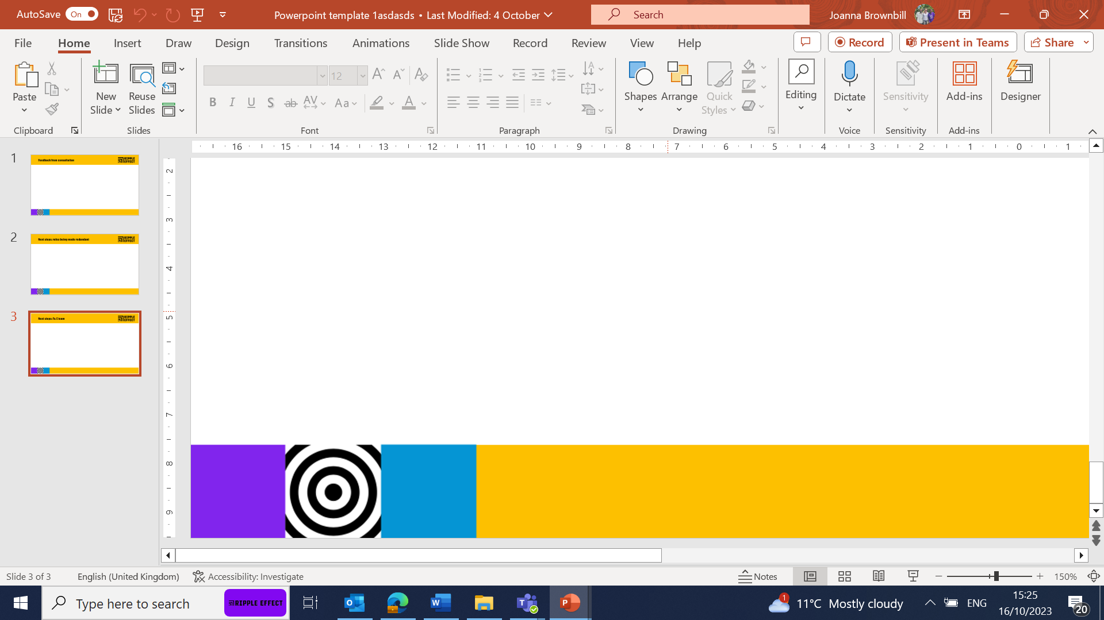
Where we work
Notes:
WHERE
Ripple Effect has established country programmes in Ethiopia, Kenya, Uganda, Rwanda, Burundi and Zambia.
80% of Ripple Effect staff are from these countries – working with and for the communities they live alongside.

Slide 4
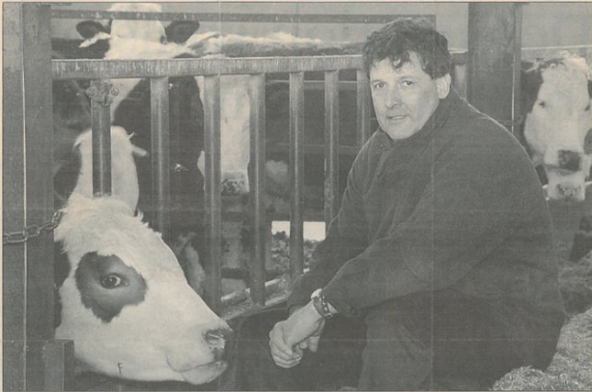
History of Ripple Effect (longer talk only)
Notes:
This slide will help bulk up your talk should you need a bit extra! But there won’t be time for this in a shorter talk
Photo: Founding Farmer - David Bragg preparing the cows to take onto the first plane to Uganda.
Ripple Effect was set up by a group of Christian dairy farmers from the UK in 1988.
Outraged at EU milk quotas, which were forcing them to slaughter healthy dairy cows, and in response to an appeal from Uganda for milk, they embarked on a project, which was set to become an innovative and practical charity.
Uganda was just emerging from a long civil war, communities and their farmland had been destroyed and much of the country's livestock wiped out. Several of the UK farmers flew to Africa to investigate how they could help.
Meeting with Ugandan farmers, the Bishop of Mukono, and a livestock expert, they saw how smallholder dairy farming in Africa could work. People there were unable to feed themselves and milk would provide an instant source of nutrition. They returned to the UK determined to help, and sent cows from their own herds to Uganda. Ripple Effect was born.
We've changed a lot since then.
We no longer send cows from the UK, we source them locally. In fact, livestock is just a tiny part of what we do today.
Over time, our work has expanded to include much wider training on nutrition, gender equality and business skills. We are proud to have worked with over 2 million people as they have learned to grow and sell more, and share their new-found knowledge with their neighbours, who then do the same.
Watch our video below to see how far we’ve come, with the help of our global family.

Slide 5
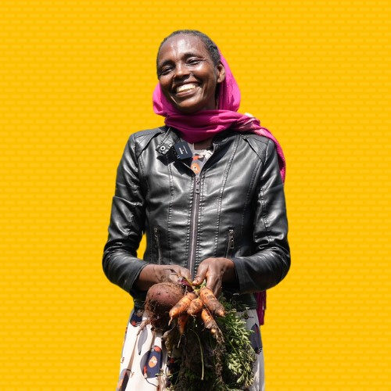
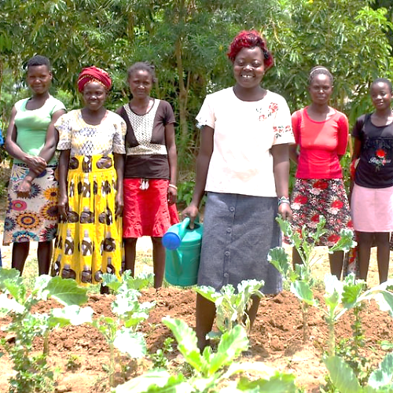
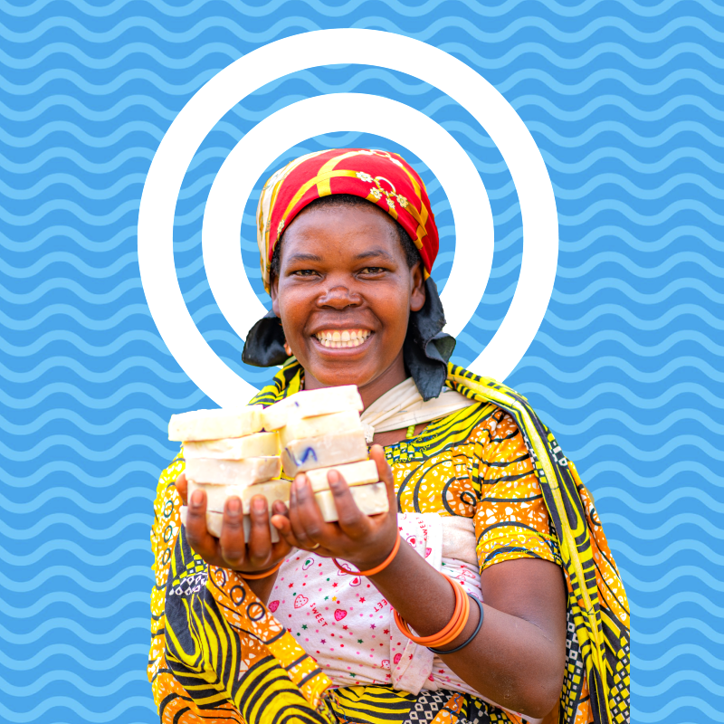
The three strands of our work
Notes:
We have 37 years' experience supporting families in rural Africa to learn more, grow more and sell more. Our projects are typically three years long. Once families have completed their Ripple Effect training, they then share what they know and have with their communities, creating a ripple effect across rural Africa.
There are three core strands to our work (detailed in the following slides)
Farming sustainably
Gender and social inclusion
Business skills

Slide 6
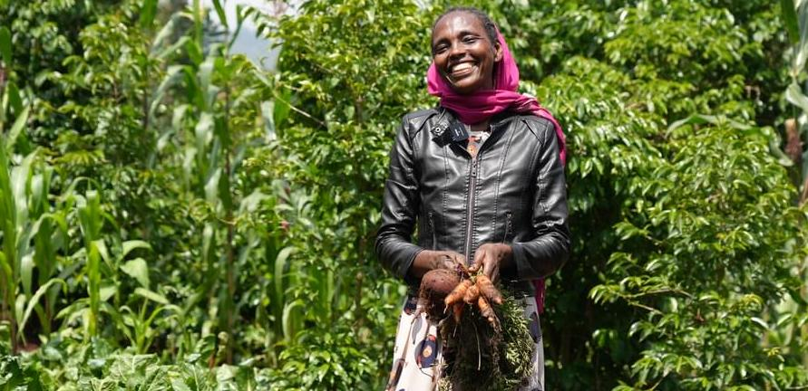
Farming sustainably
Meselech, Ripple Effect farmer, Ethiopia
Notes:
Farming sustainably
Ripple Effect trains families in using up to date and traditional approaches to farming. Families learn to build productive farms and to adapt to the effects of the climate crisis. And ultimately their farms will have a climate-positive impact!
Community trainers and peer farmers share their knowledge with more farmers and communities, so there is a ripple effect of learning.
Ripple Effect helps farmers think about the resources available to them within their community. We then teach the organic agricultural principles and skills they need to integrate these into a sustainable, biodiverse farm – without expensive artificial fertilisers or GM seeds.
Techniques such as water harvesting, composting, use of manure, vegetable growing, tree planting and animal husbandry are easily adaptable to each farmer’s own land and needs. Being able to grow more, better, means a more diverse diet and improved nutrition.

Slide 7
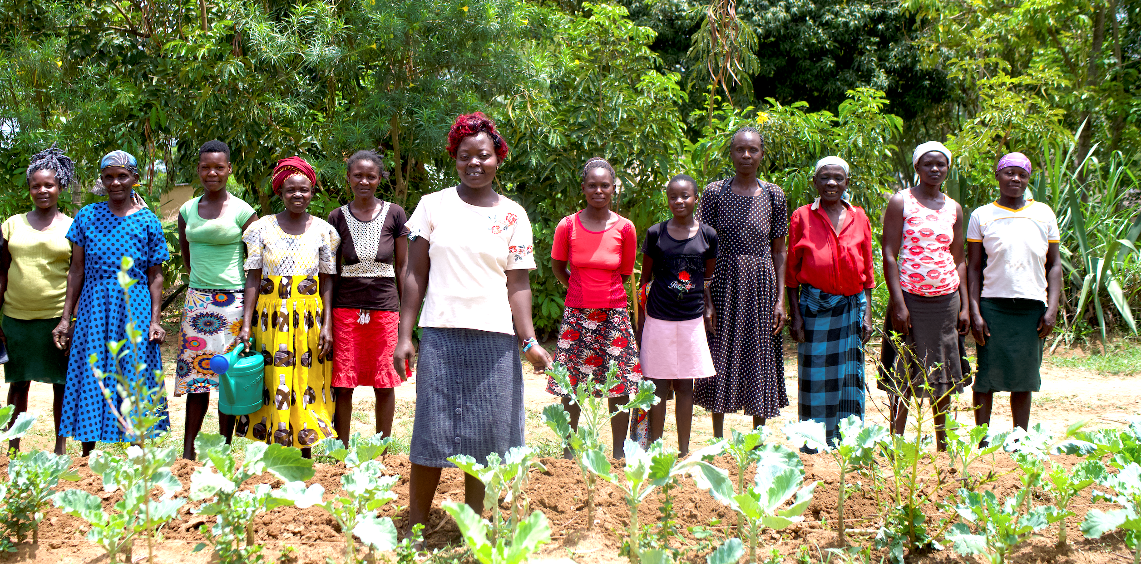
Gender and social inclusion
Ripple Effect farmers, Kenya
Notes:
Gender and social inclusion:
Ripple Effect’s local staff in Africa help families develop a shared vision for their home. Through facilitated activities we help the family work out how best to share the workload and decision-making to achieve their vision.
Through this approach, family life becomes more harmonious and prosperous, and children grow up happier, better educated and with wider horizons.
Women in particular are supported to raise their aspirations beyond subsistence farming.
65% of the people we work with are women – research indicates women are more likely to invest income into their family’s future
50% of those women are widows – some of the most vulnerable people

Slide 8
Business skills
Agripine, Ripple Effect farmer, Burundi
Notes:
Business skills
More farmers learn to manage their farm as a business, moving away from subsistence farming to control their own futures: developing profitable micro-businesses, co-operatives and agri-businesses which can access new markets.
Once families are eating well and earning enough to send their children to school, we encourage them to think bigger, beyond just food security.
As part of their training they learn money management and enterprise skills so they can access savings and credit services.
They also investigate how best to add value to their produce – for example processing it into another product; and how to store it – enabling it to be sold out of season.
Farmers sometimes group together into cooperatives, allowing access to more training, better infrastructure and more reliable markets.
They become resilient entrepreneurs, capable of making choices and in charge of their own futures.
In this photo Agripine is holding the soap that she has been making and selling for profit.

Slide 9
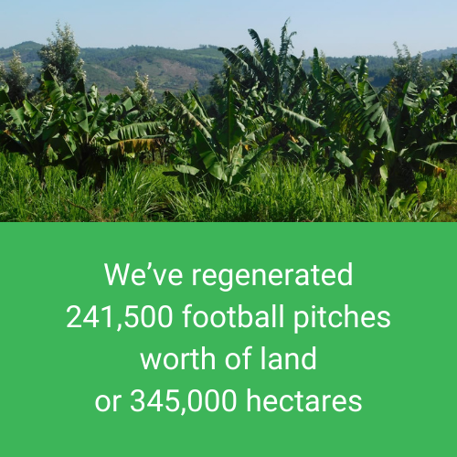
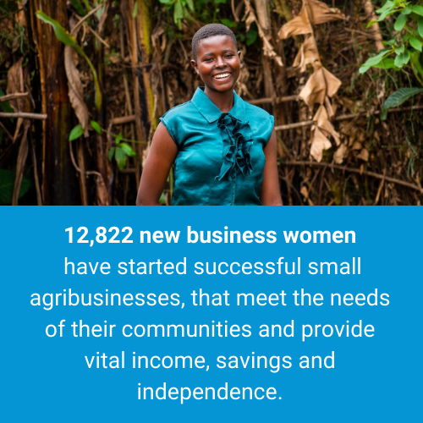
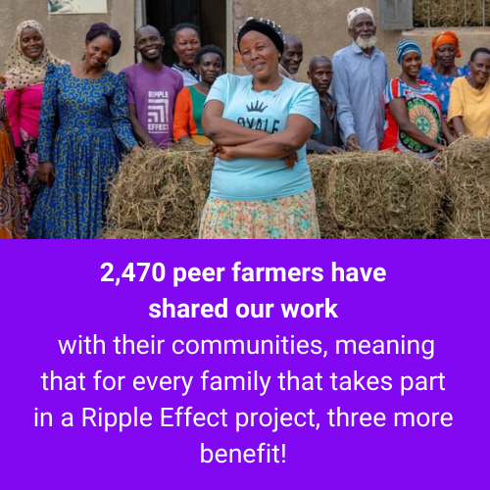
Our impact
Notes:
This last year, we’ve worked with 1.38 million people – our biggest year to date:
We’ve regenerated 241,500 football pitches worth of land, or 345,000 hectares
12,822 new businesswomen have started successful small agribusinesses, that meet the needs of their communities and provide vital income, savings and independence.
2,470 peer farmers have shared our work with their communities, meaning that for every family that takes part in a Ripple Effect project, three more benefit!

Slide 10
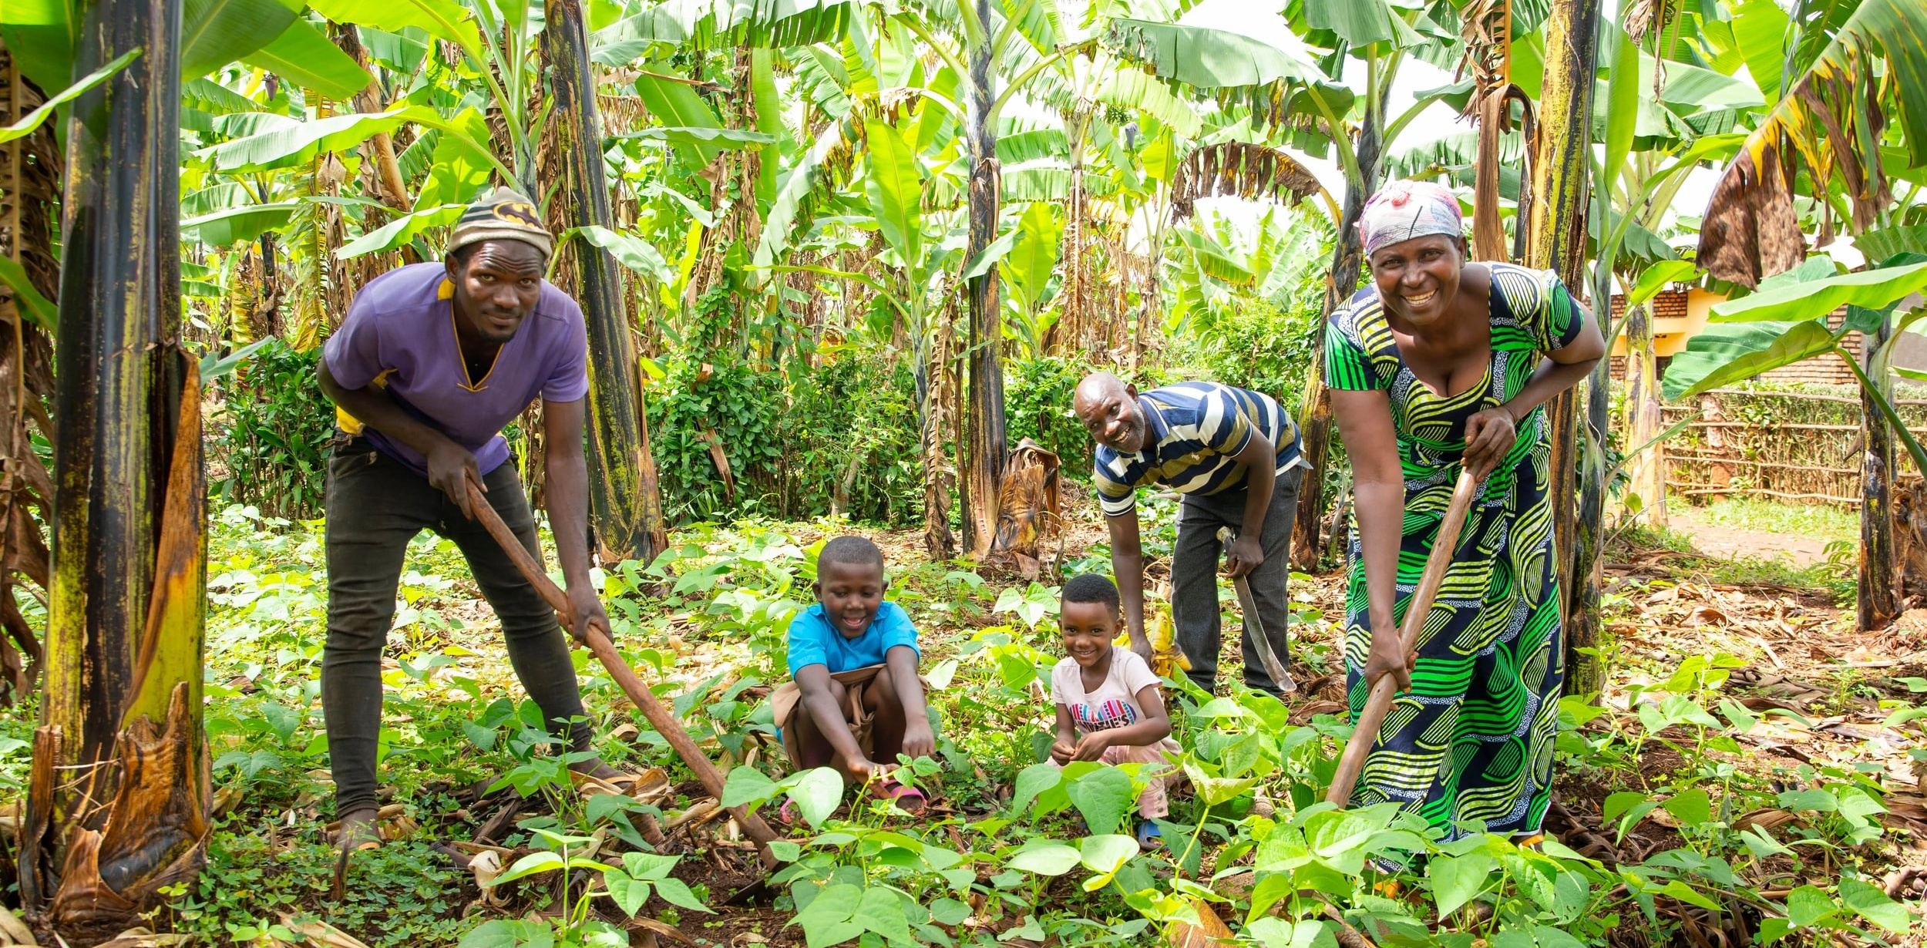
The Restore project
Therese and Deogratias, and family
Ripple Effect farmers, Rwanda
Notes:
Project Summary: Restore
Focus: Restoring land and protecting natural resources around Lake Cyohoha for future generations. Increasing crop yields and improving ways for families to earn a living.
Location: Burundi (Kirundo Province) and Rwanda (Bugesera District) – working alongside communities living around Lake CyohohaTarget Impact: 13,000 people
The challenge facing women and youth
Soil erosion and over-exploitation has left the land around Lake Cyohoha depleted, stripping away smallholder farmers’ ability to grow food, and leaving them vulnerable to climate shocks like drought and flooding. Local communities are suffering from hunger and poverty – they can’t grow enough food to feed their families, let alone to generate what would be their only source of income.
The Solution
Farmers taking part in the Restore project will receive training in how to protect and regenerate their natural resources, including soil and water, through activities such as reducing pollution, controlling erosion and tree planting.
Farmers will learn how to grow more crops and raise healthier livestock by using sustainable farming techniques like terracing, composting, and planting food and fodder crops together.
Households will be empowered to increase their income by learning to add value to their produce and by building connections with local markets.
Natural resource management
We will work alongside local communities to increase their understanding of why soil and water conservation is important. Training will focus on how farmers can prevent soil erosion by helping the soil retain water and nutrients. This will include setting up terraces and planting trees to bind soil and slow down water run-off. By attending volunteer peer farmer training, farmers will learn how to share their new skills within their communities.
Improved crop yields
Climate-smart techniques will include composting, mulching and intercropping, in order to boost soil fertility, increase water retention and reduce the need for chemical fertilisers. To kick start productivity in restored soils, farmers will be provided with drought-resistant vegetable and fruit seed varieties, which will enable them to grow sufficient food all year round to eat and sell. To help farmers reduce losses caused by pests and diseases that thrive in extreme climatic conditions, they will also learn about natural pest control methods, removing the need for expensive and environmentally harmful chemical pesticides which have already damaged the lake.
Alternative livelihoods
Project staff will mentor farmers to explore green business opportunities and new income streams. Training in post-harvest techniques will reduce losses and add value to crops. Small livestock placements (e.g. poultry, goats) will help build stable, long-term income. Healthier animals will also improve nutrition and offer products for sale.

Slide 11
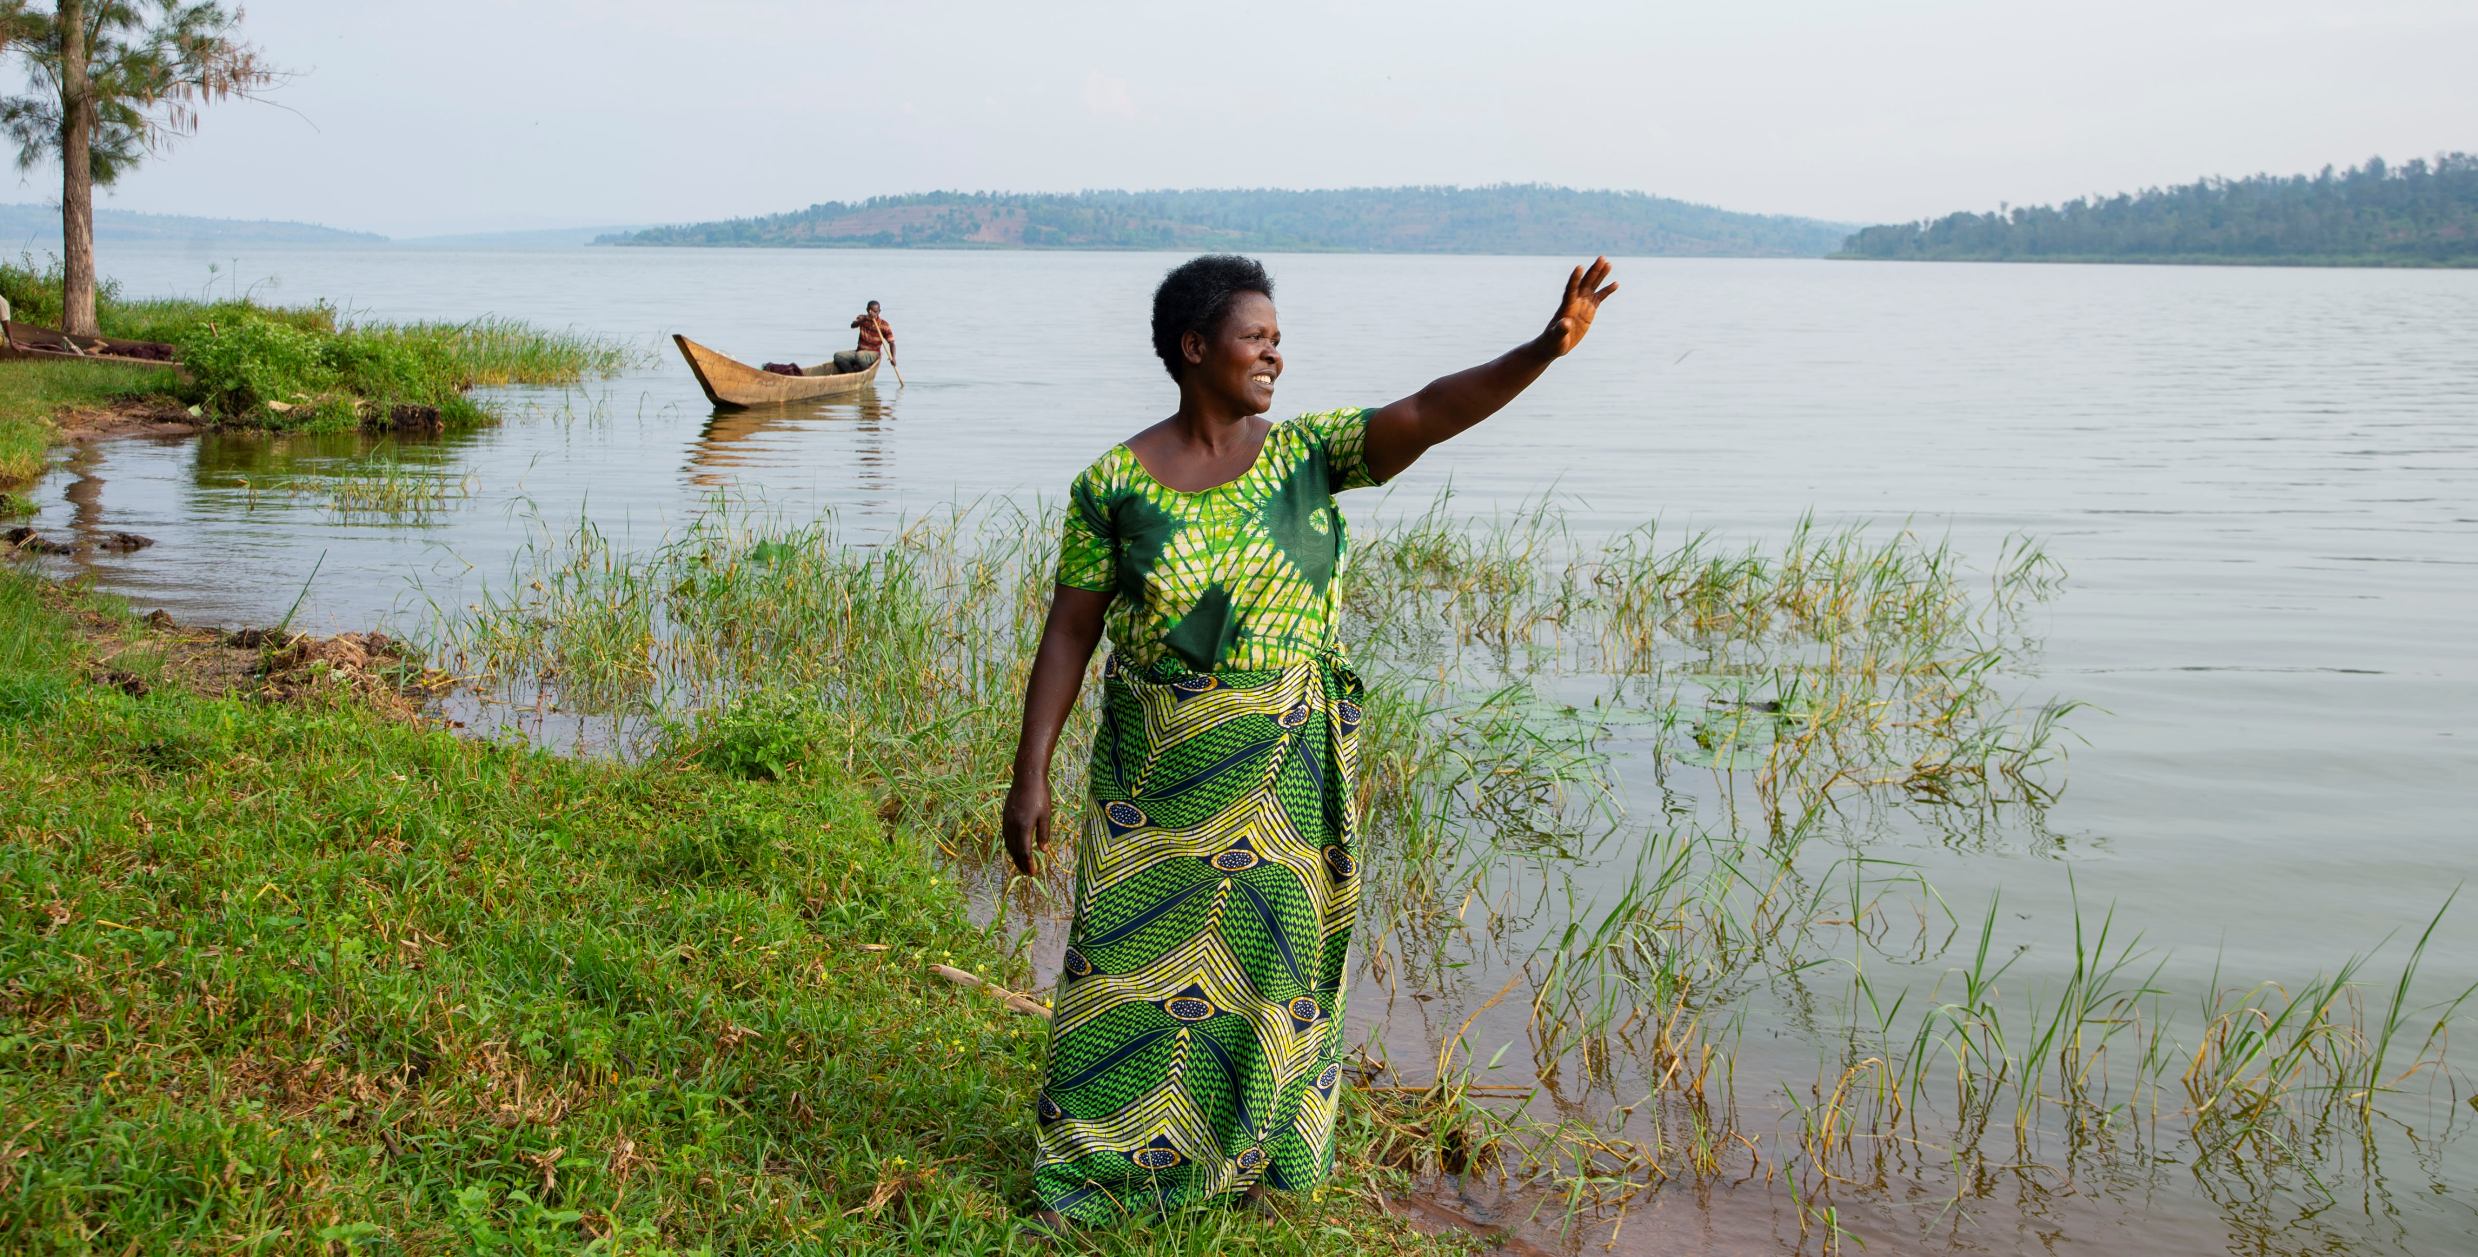
Jeanne’s story
Notes:
Jeanne’s story
Jeanne wakes up each morning unsure if she’ll have enough food to feed her five children. In Rwanda, the long dry seasons - worsened by the climate crisis - make farming increasingly difficult. Some days, her children survive on just one meal.
Jeanne is a single mother living in the region around Lake Cyohoha, a vital wetlands area on the Rwanda–Burundi border. The lake is a crucial source of water for surrounding communities, but the land is suffering. Extreme weather, including drought and floods, has led to failed harvests and deepening poverty. Soil erosion from the surrounding hills only makes things worse.
Jeanne doesn’t own land - she farms plots belonging to others and must share whatever she grows with them. Jeanne told us:
“Most of the time we eat once per day… there is starvation...Not taking care of the soil and the environment may cause us losses… our soil may be wiped away.”
But there is hope. Ripple Effect’s Restore project is helping families like Jeanne’s by teaching sustainable farming techniques, including intercropping and terracing. These practices protect the soil, boost harvests, and improve long-term resilience. Find out how, by reading Therese’s story on the next slide.

Slide 12
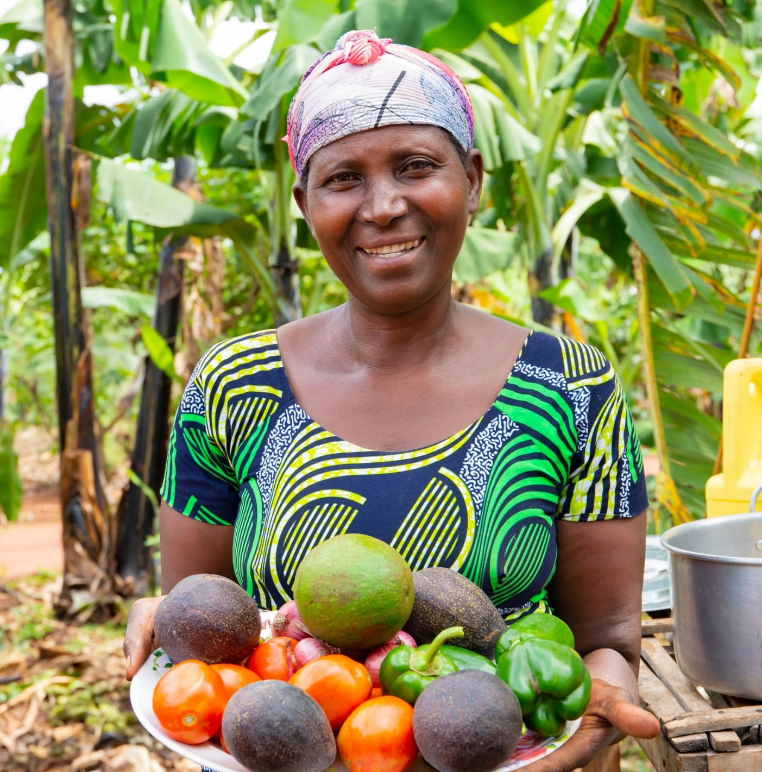
Therese’s story
“When you practice soil conservation, you have increased yields, and you are able to progress… As you can see, I have a project of growing vegetables.”
Therese, Ripple Effect farmer, Rwanda
Notes:
Meet Therese
Therese, is a married mother of six who lives in Rwanda. Just like Jeanne, Therese used to struggle with unproductive land. But after she started working with Ripple Effect, things began to change for the better.
She received seeds, tools and training, and now her land is healthy. Therese grows an abundance of crops including coffee, peanuts, beetroot and fruits. She keeps livestock, and her family eat three times a day. Therese generously shares the knowledge she has with her neighbours, creating a ripple effect in her community.
Therese told us: “My neighbours and I visit each other to exchange ideas about farming...I share the knowledge with them so they too can recover from malnutrition.​
Therese works hard on her farm and has dreams for the future. She wants all her children to study and do well. Isn’t that what we all want for our families?

Slide 13
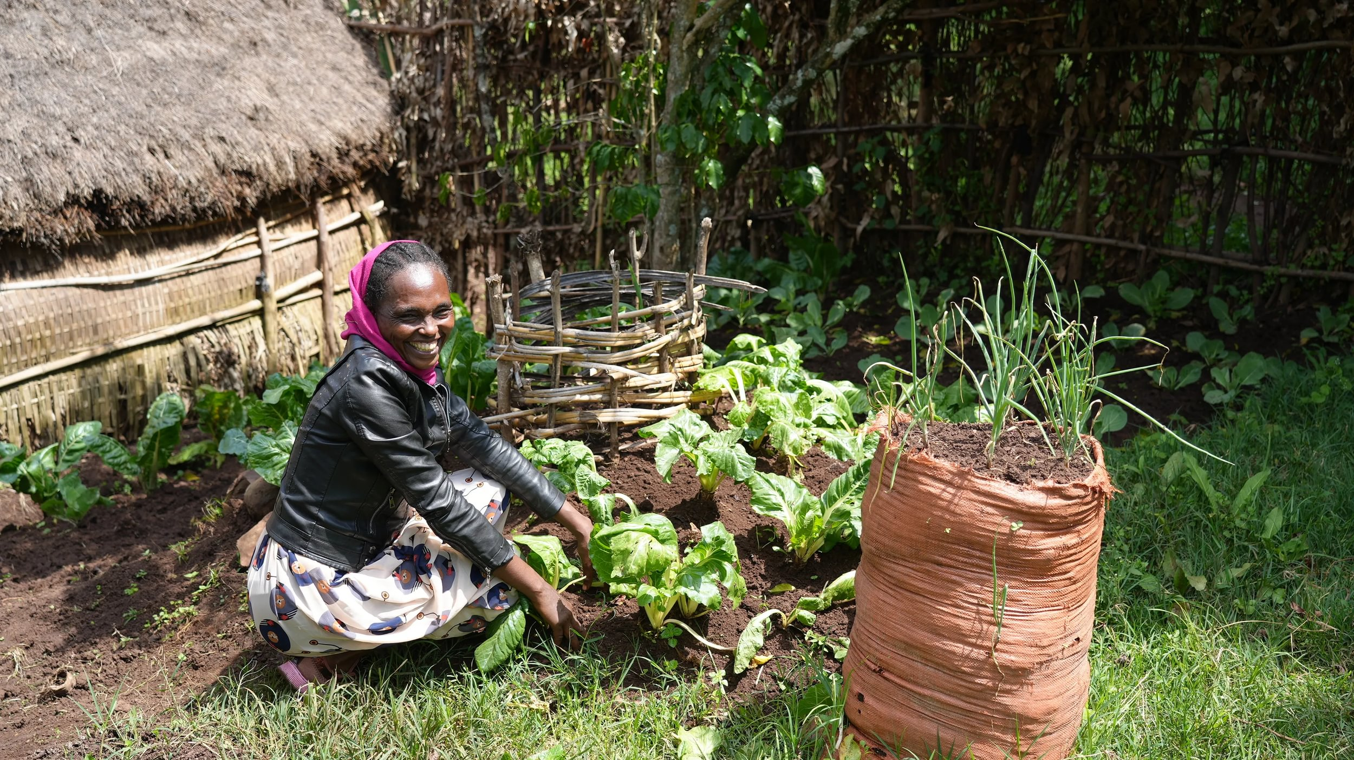
A keyhole garden
“To combat climate change, I’ve learned to plant trees. Also in the dry season when we can’t plant much, I plant kitchen gardens such as keyhole gardens and bag gardens close to my home where I can use wastewater to water the plants easily. I also use compost to add to the central basket and can still easily grow crops even in the dry season.”
Meselech, Ethiopia.”
Notes:
Meselech, a Ripple Effect farmer in Ethiopia

Slide 14
Keyhole garden
Notes:
A keyhole garden is a raised bed that has a composting basket in the centre. This design allows for efficient use of space, easy access to plants, and incorporates composting directly into the garden bed, providing nutrients to the surrounding plants. Keyhole gardens are designed to retain moisture and allow for better drainage, preventing waterlogging during heavy rains while ensuring that plants have access to water during dry periods. These types of gardens will help families adapt to the challenges of the climate crisis while ensuring they have access to nutritious food.
A keyhole garden allows a family to grow enough food for three meals a day – even in the face of an extreme climate and poor soil. The garden, shaped like a keyhole from above, encompasses a circular raised bed with a central basket where compostable waste is placed along with used water from the kitchen. These gardens give fantastic results quickly and add nutritious vegetables to provide a balanced diet

Slide 15
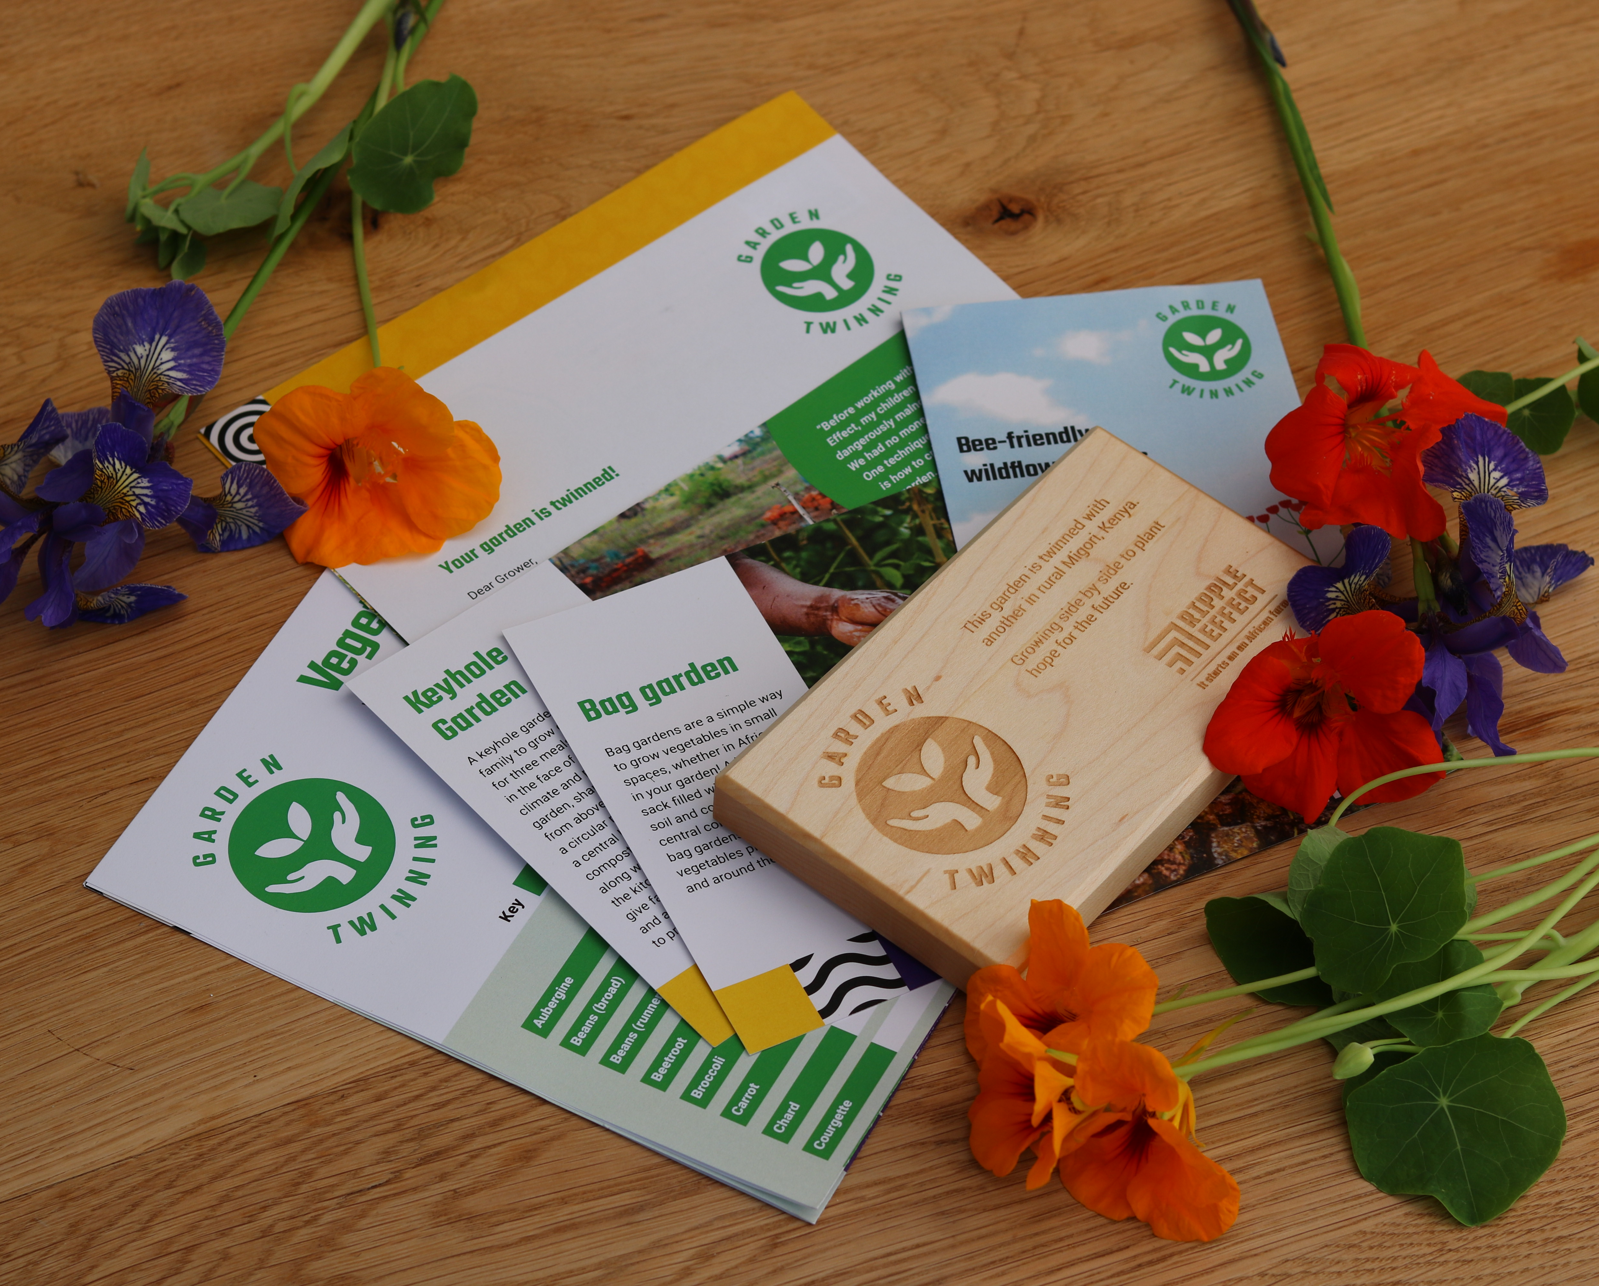
Twin your community garden!
In recognition of your donation of £120, your church will receive:
a sustainable wooden plaque to display in your garden
a vegetable growing guide from Charles Dowding, our no-dig expert
wildflower seeds to get you started on your Garden Twinning adventure
a garden twinning certificate to display inside your church or community space
an opportunity to have a speaker attend one of your meetings to help bring our work to life
Notes:
By twinning your church/community garden (£60 for an individual garden) you’ll be planting hope for our neighbours in rural Kenya. In return, you’ll receive:
a sustainable wooden plaque to display in your garden
a vegetable growing guide from Charles Dowding, our no-dig expert
wildflower seeds to get you started on your Garden Twinning adventure
a garden twinning certificate to display inside your church or community space, (church only)
and an opportunity to have a speaker attend one of your meetings to help bring our work to life (church only)
Plus, we can’t wait to share the practical techniques families in rural Africa are using in their own gardens to fight hunger and the climate crisis.
Please do get in touch with info@rippleeffect.org, if you need any further information and happy Twinning!

Slide 16
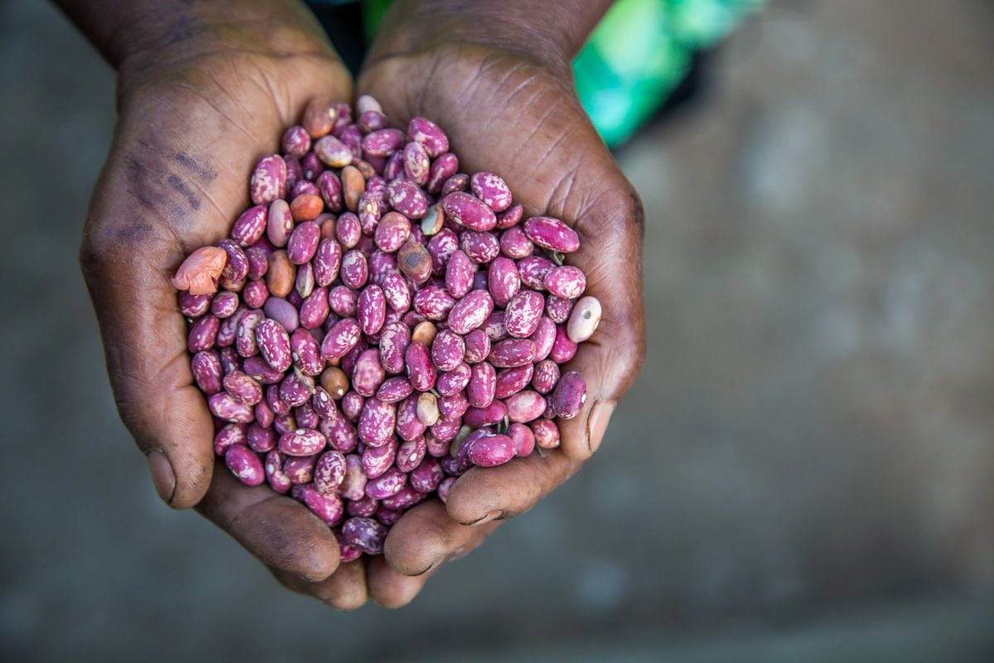
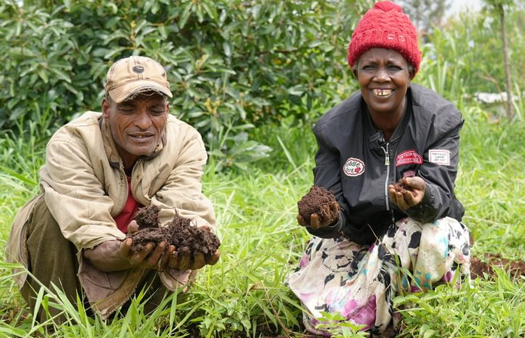
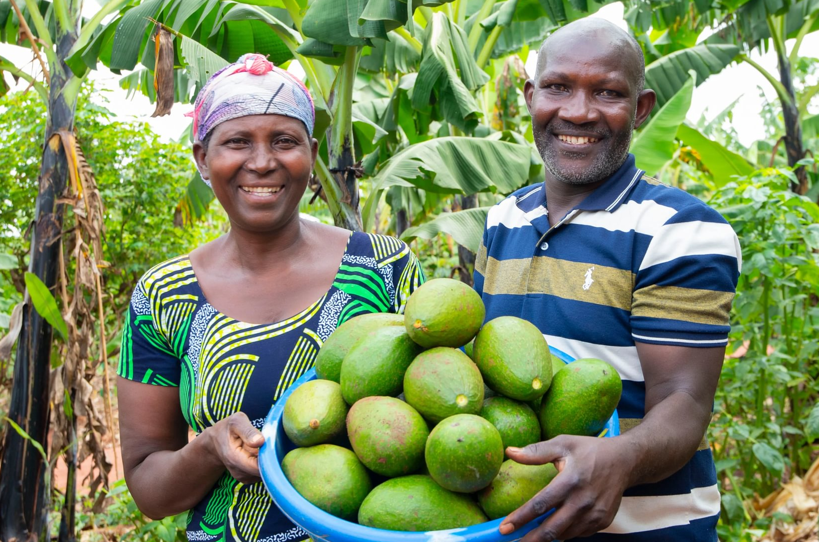
How you can help
£100 could provide farmers with drought-resistant seeds, helping them grow food year-round.
£250 could train farmers in climate-smart methods to improve soil quality and protect their land from climate shocks such as droughts and floods.
£500 could support farmers to build resilient, eco-friendly income streams and learn money management.
Find out more at rippleeffect.org

Slide 17
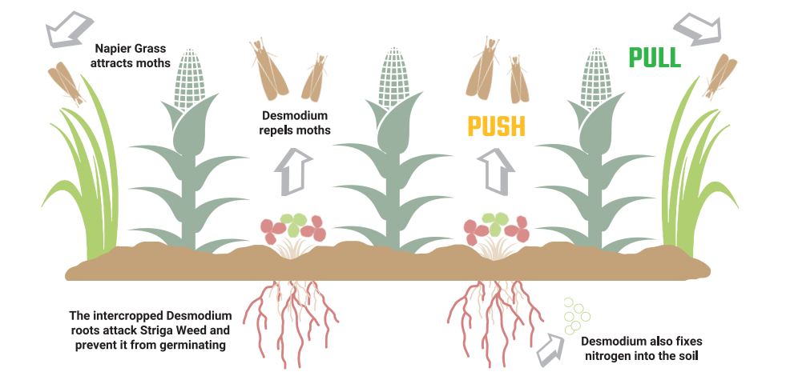
Useful extra information slides: Intercropping
Notes:
Further information can be found in the Sustainable techniques from rural Africa leaflet Also known as Push Pull. You can find further information here Ripple Effect | Push-pull biotechnology
How does push-pull work?
The technique is straightforward. Farmers intercrop their maize with the legume crop Desmodium (also known as tick clover) which continuously produces defence odours that repel (push) stemborer moths away from the maize. Desmodium also deters the growth of the Striga weed.
The pull element is provided by Bracharia or Napier grass planted as a border crop around a maize plot. It offers the multiple benefits of being attractive to stemborers while also fixing nitrogen into soil, and being a nutritious animal feed.

Slide 18
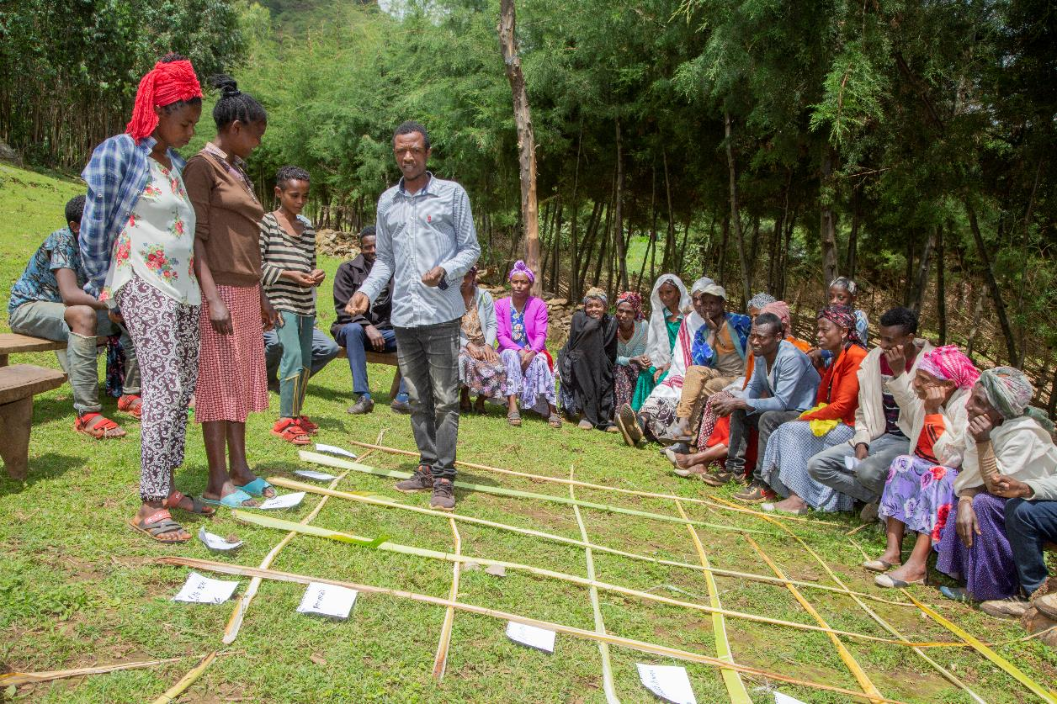
Useful extra information slides: THM
Notes:
Transformative household methodology
The Transformative Household Methodology (THM) is a tool that aims at creating awareness of intra-household gender relations between women, men, girls, and boys. The THM identifies the different roles and responsibilities of household members, their access and control over resources and their related benefits.
The THM methodology has been implemented in all Ripple Effect country programmes in Burundi, Ethiopia, Kenya, Rwanda, Uganda and Zambia. This innovative relationships methodology contributes to women’s empowerment by reducing their unpaid workload in the household, giving them more time and energy to be involved in community work and higher-value activities. It has also increased the decision making at household level. We see women becoming more involved in household decision-making, including discussions about how substantial amounts of money should be spent. We also see men getting involved with decisions around cooking and food.
“Whenever I earned money, I never discussed with my wife how to spend it; it was mine and I spent it as I wished; sometimes on unnecessary things. I am glad now we jointly decide how we spend family income which has led to developments in our home.” Jean-Baptiste Ripple Effect project participant.
Our data shows that women's physical workload decreases as a result of THM sessions and that men became significantly more involved in nearly all household activities. Even when men reported that they were teased by others for performing what were perceived as “female” tasks they persevered, which indicates an authentic Transformative Household Methodology for Gender & Nutrition 10 change in attitude. Critically, when household workloads are more fairly shared, and women have a voice in what crops will be grown or what equipment or livestock will be bought, farm yields tend to increase. Families become more food secure, and this increased security improves family relationships further, cementing the changes in a positive feedback loop.

Slide 19
Question time
If you need to fill some time why not give a chance for them to ask you questions, or you can even ask them questions!
If you don’t know the answer, that’s OK, tell them you’ll find out and let them know.

Slide 20
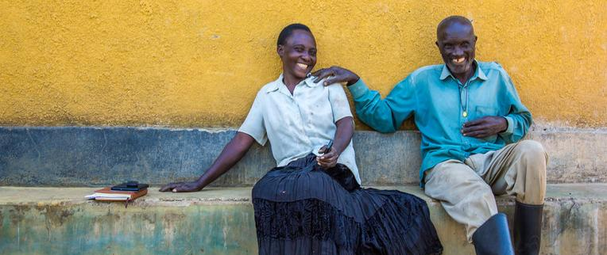
Thank you!
For more information about how your church can get involved with our work visit www.rippleeffect.org or email info@rippleeffect.org
Notes:
Thank you for listening!

