Slide 1



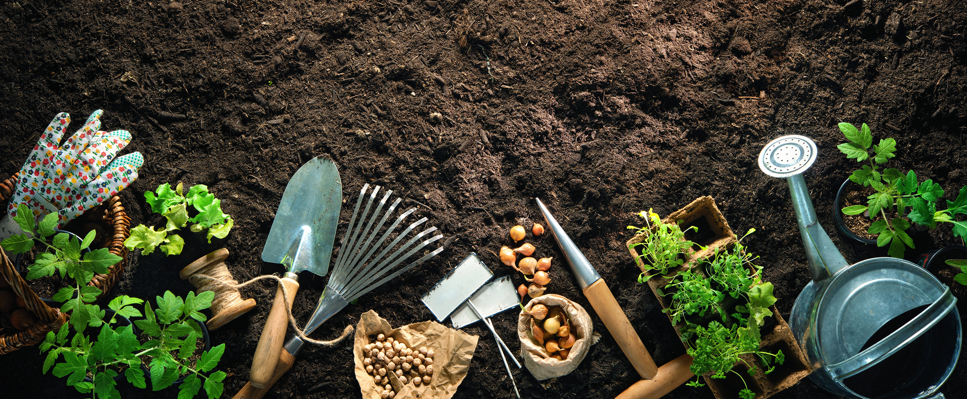
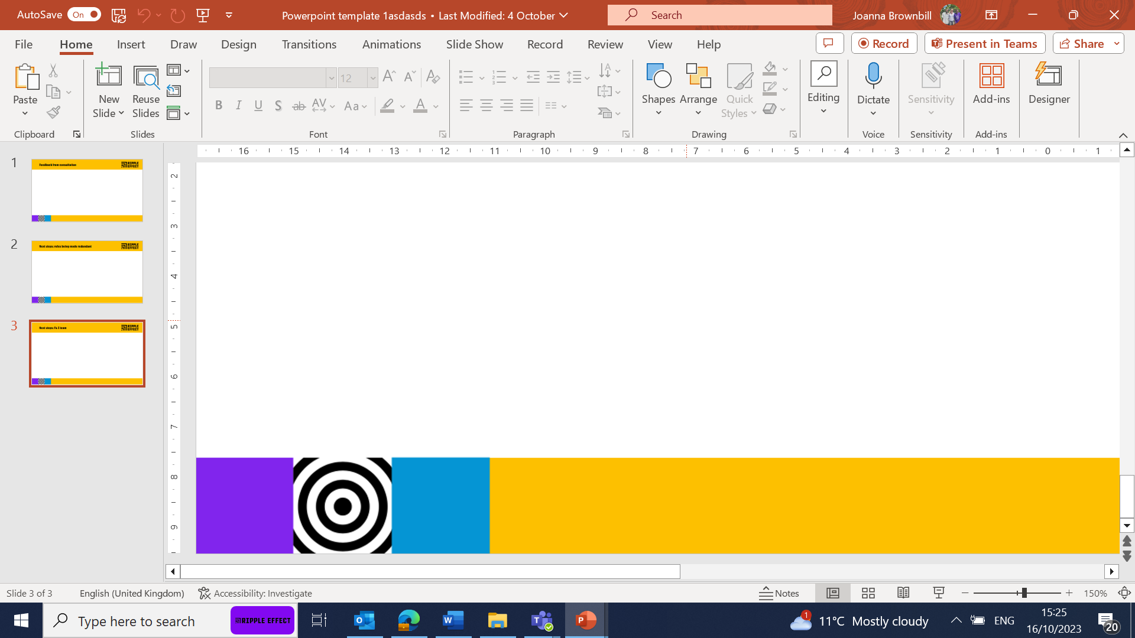
Test your knowledge with our…
Garden Quiz!
Sandy soil which is poor at holding water and nutrients for plants to grow.

Slide 2
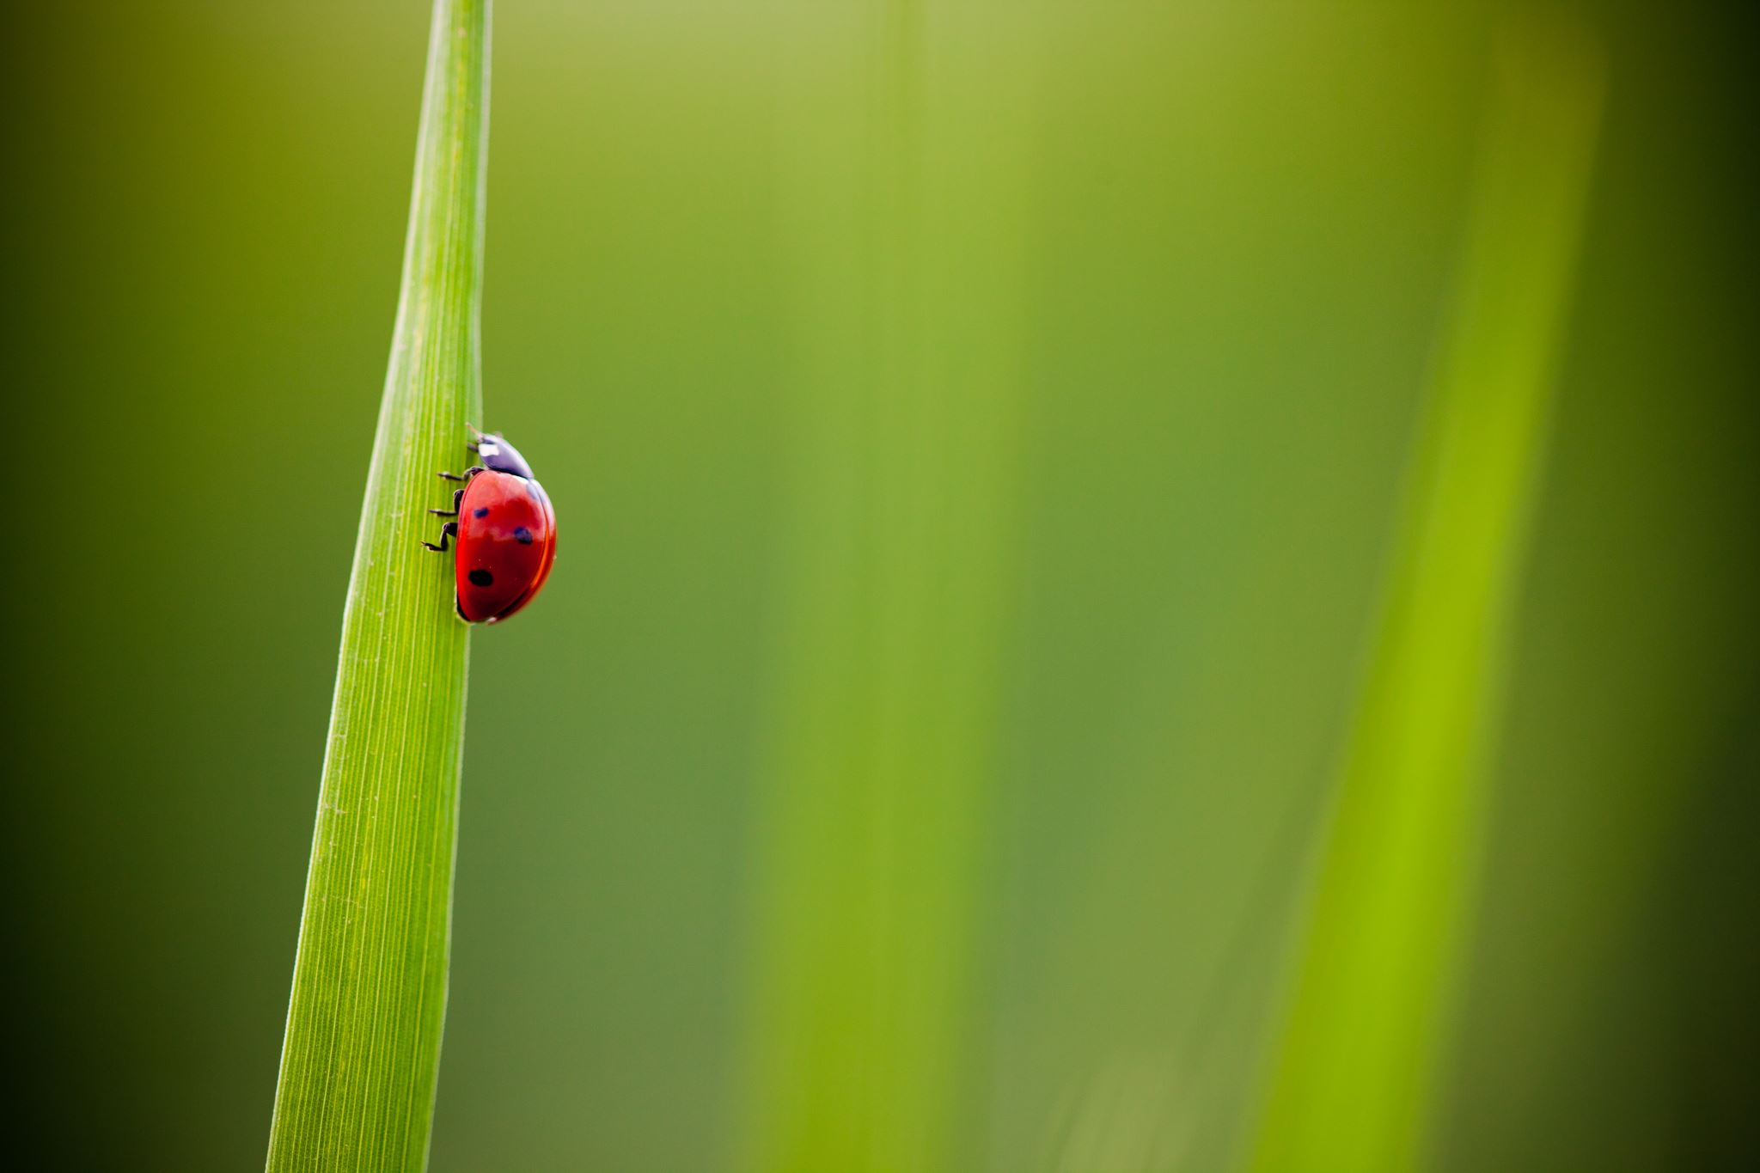
EYFS & KS1- Round 1 ‘Garden Knowledge’
Which creature is a gardener’s friend?
A) worm
B) dragon
C) shark
What do bees do in the garden?
A) play football
B) pollinate flowers
C) eat the plants
In which season do most flowers start to bloom?
A)Winter
B) Summer
C) Spring

Slide 3
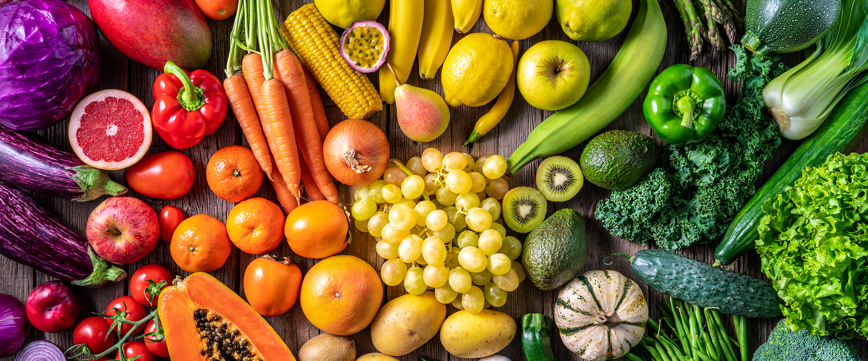
EYFS & KS1- Round 2 ‘What am I?- Mystery Fruit and Veg!’
1. I'm orange and crunchy. Rabbits love me. What am I?
2. I'm long and yellow, and monkeys love me. What am I?
3.I'm green on the outside, pink inside, and full of juicy black seeds. I grow in hot countries.
4.I am a root vegetable. You might eat me mashed, fried or boiled.
5. I'm leafy and green. I'm in salads, sandwiches, and burgers.
Sandy soil which is poor at holding water and nutrients for plants to grow.

Slide 4
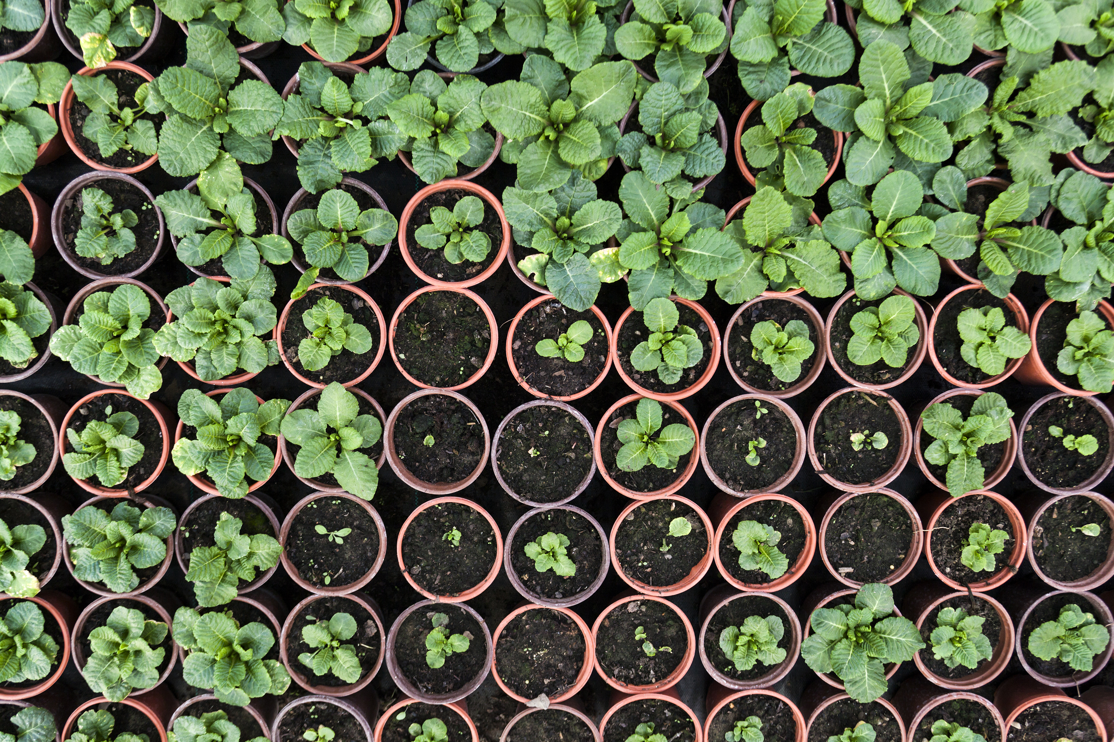
KS1- Round 3- Can we grow it?
Which of these items can you grow outside in a UK garden? say ‘Grow it!’ for yes or ‘No Way!’ for ‘no’.
Pineapple
Peas
Mobile phone
Strawberries
Chocolate bar
Round 3- Can we grow it?
Which of these items can you grow outside in a UK garden? say ‘Grow it!’ for yes or ‘No Way’ for ‘no’
Pineapple
Peas
Mobile phone
Strawberries
Chocolate bar
Sandy soil which is poor at holding water and nutrients for plants to grow.

Slide 5
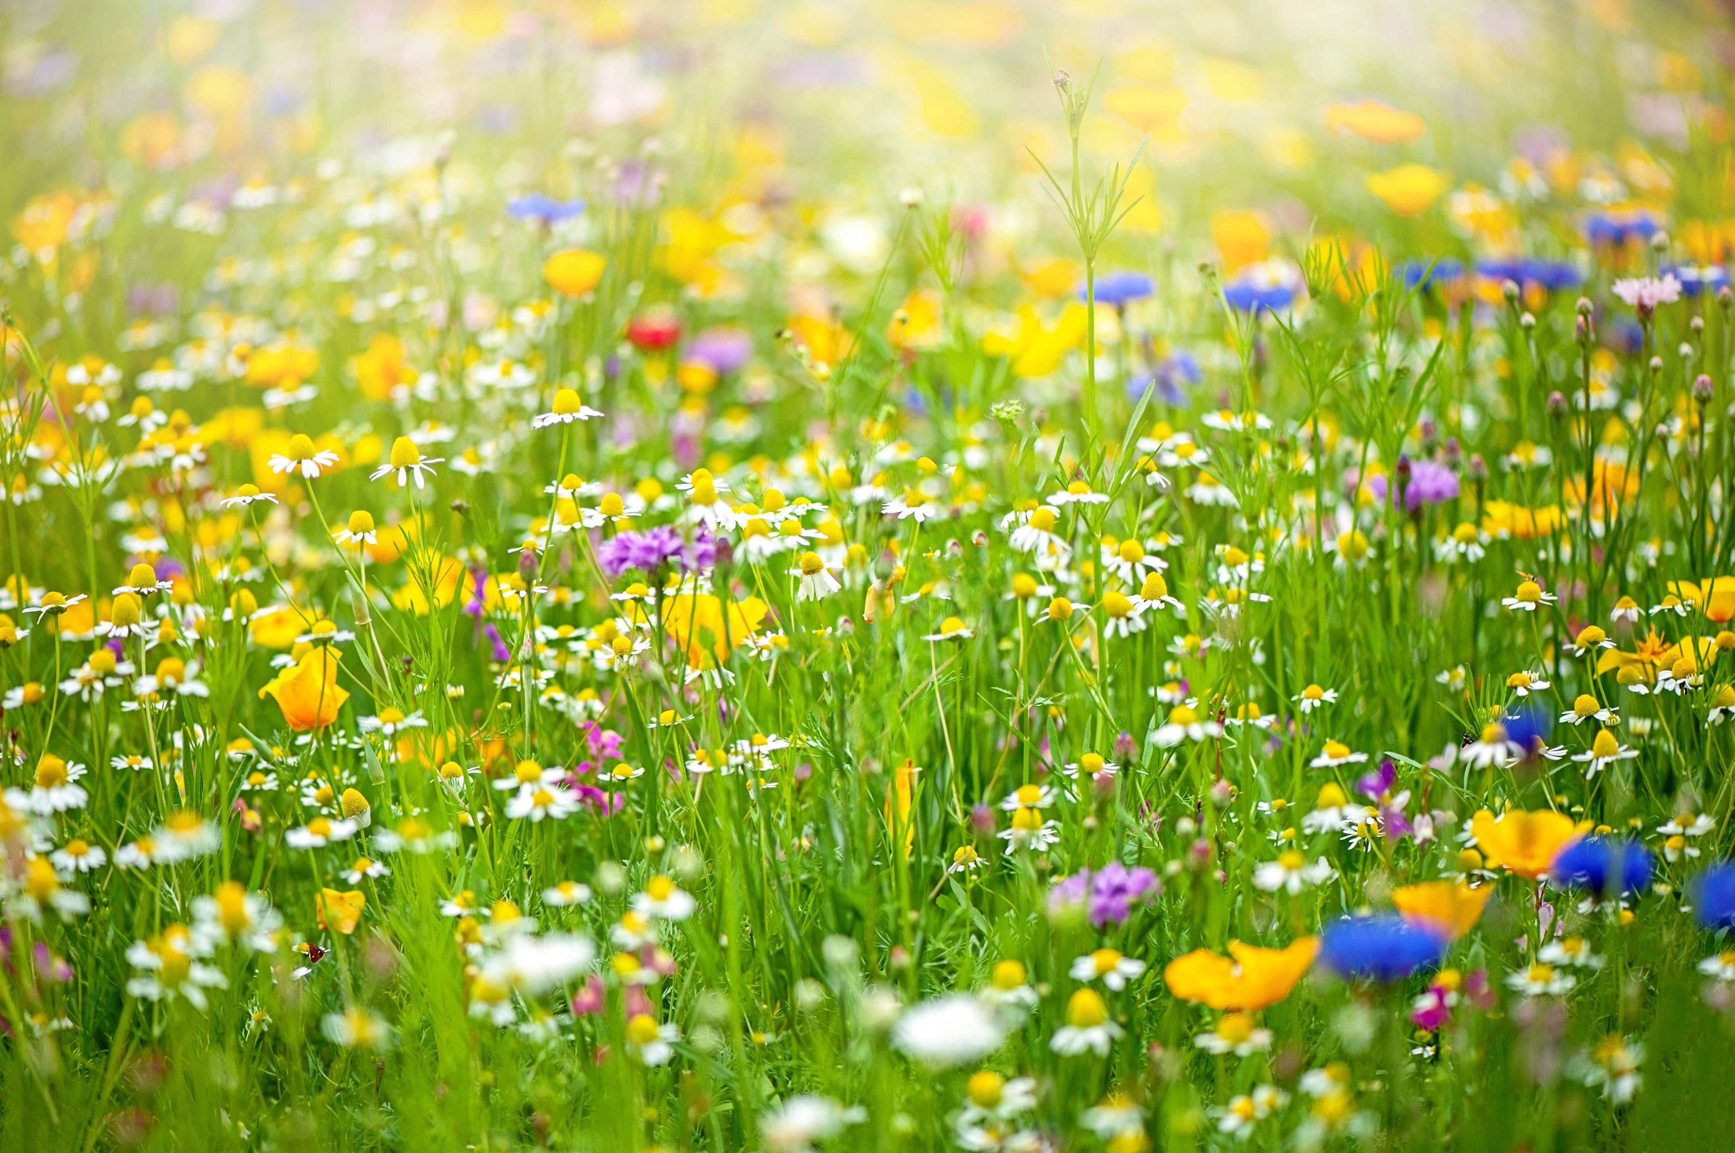
EYFS & KS1- ANSWERS
Round 1
A-Worm (they help to make the soil healthy)
B-Bees pollinate flowers
C –Spring – plants need light, water, air, the right temperature and time to grow. The weather usually starts to warm up in spring and the days are brighter than in winter.
Round 2
Carrot
Banana
Watermelon
Potato
Lettuce
Round 3
1.No Way! (Needs a warm climate, like in Africa, or Greenhouse)
2.Grow it!
3.No Way!
4.Grow it!
5.No Way! (made from cacao, grown in Africa but not UK gardens)

Slide 6
KS2- Round 1 ‘What am I?- Mystery Fruit and Veg!’
1. I am full of antioxidants and great in muffins. I am a small sweet berry that grows on bushes. I am purple, red or blue.
2. I'm a fruit but often get mistaken for a vegetable! I am round and, most commonly, red. I'm often used in cooking sauces or eaten raw in salads
3.I’m green and small and pop out of a pod. I share my name with one of the letters in the alphabet.
4.I'm a fruit that grows on trees. I have seeds inside and a red, green or yellow crunchy skin. You can make a pie with me.
5. I'm a vegetable that grows underground. I'm packed with beta-carotene which our bodies turn into vitamin A- this helps us to see better, especially in the dark!
Sandy soil which is poor at holding water and nutrients for plants to grow.

Slide 7
KS2- Round 2 ‘True or False’
1. Pollen is produced by a plant's leaves
2. A flower's job is to help a plant reproduce
3. Seeds are not living organisms
4. Pollen is only dispersed by the wind.
5. Some plants release their seeds using natural explosions!

Slide 8
KS2- Round 3- Fill in the Blank
1: ______ take in water from the soil?
A) Leaves
B) Stem
C) Roots
2. When a seed starts to grow into a new plant, the process is called ____
A) Germination
B) Pollination
C) Composting
3. __________ is the process of a plant making its own food using sunlight?
A) Transpiration
B) Photosynthesis
C) Pollination
Round 3- Can we grow it?
Which of these items can you grow outside in a UK garden? say ‘Grow it!’ for yes or ‘No Way’ for ‘no’
Pineapple
Peas
Mobile phone
Strawberries
Chocolate bar
Sandy soil which is poor at holding water and nutrients for plants to grow.

Slide 9
KS2- ANSWERS
Round 1
Blueberry
Tomato
Pea
Apple
Carrot
(You could make this a multiple choice round if you feel your children would benefit from more support)
Round 2
False- pollen is produced by the anther which is part of a plant's stamen.
True
False – seeds are living organisms, they need the right conditions to survive
False- pollen is dispersed by the wind and insects
True- some plants like Himalayan Balsam are 'ballistic' meaning they release their seeds in this way
Round 3
C- Roots
A- Germination
B- Photosynthesis

Slide 10
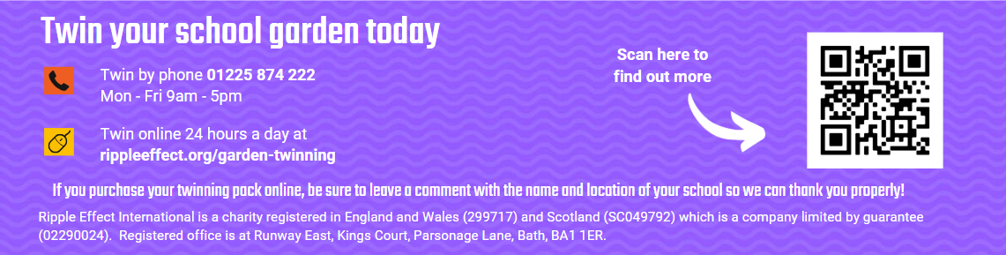
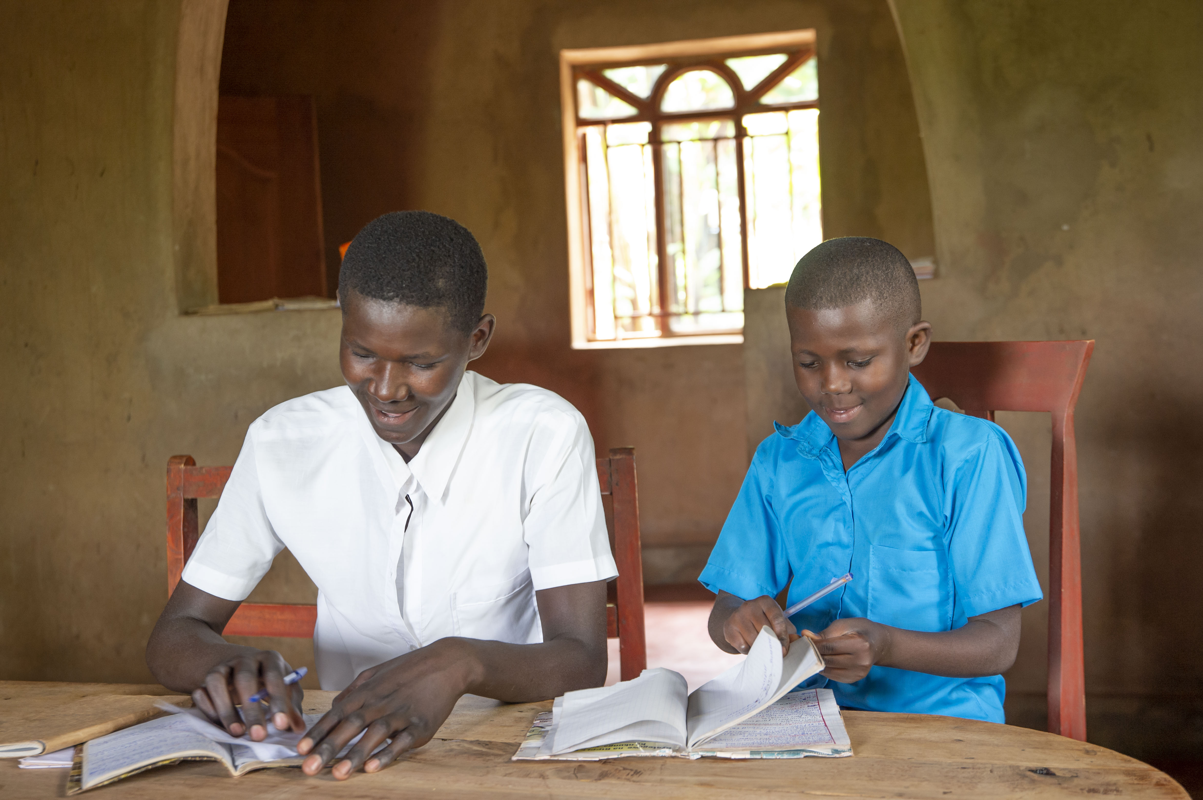
Garden Twinning
Twin your school garden today for £120 and help farming families like Eric and Aline’s to grow a brighter future!
garden today

