Slide 1
Ripple Effect
Harvest Quiz 2025

Slide 2

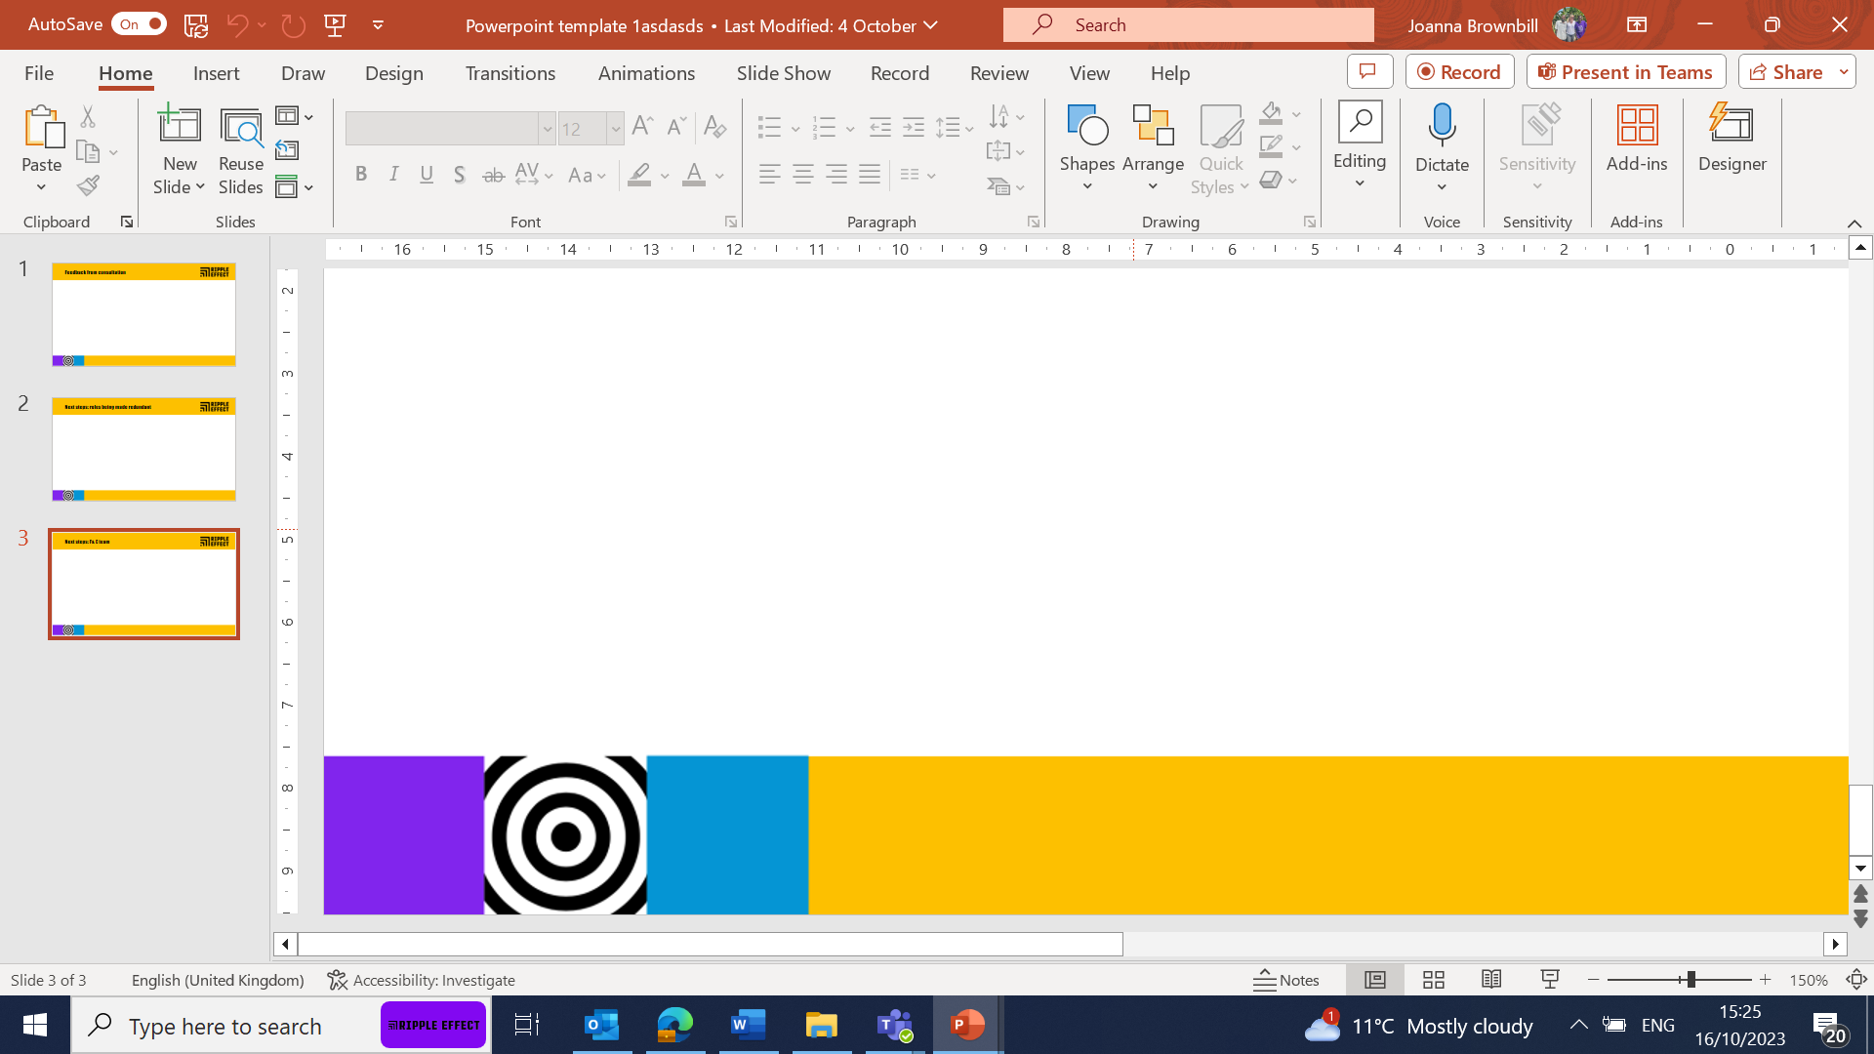
Harvest Quiz 2025
Take this quiz to find out how much you know about fruit.

Slide 3
Harvest Quiz 2025
1. Which small, sweet yellow fruit grows on a spiky plant and symbolises hope in communities where Ripple Effect works?
A) Mango
B) Banana
C) Pineapple

Slide 4
Harvest Quiz 2025
2. Passion fruits grow on a vine and are often used to make juice.
A) True
B) False

Slide 5
Harvest Quiz 2025
3. Which fruit is green on the outside, red on the inside, and can help keep you hydrated in hot climates?

Slide 6
Harvest Quiz 2025
4. A pineapple is a single fruit that grows from one flower.
A) True
B) False

Slide 7
Harvest Quiz 2025
5. Which citrus fruit, full of Vitamin C, helps keep immune systems strong?

Slide 8
Harvest Quiz 2025
6. Which fruit is known as the “butter fruit” because of its creamy texture and is also rich in healthy monounsaturated (healthy) fats?
Olive
Avocado
Coconut

Slide 9
Harvest Quiz 2025
7. Mango trees can take several years to bear fruit but live for decades.
A) True
B) False

Slide 10
Harvest Quiz 2025
8. Avocados contain a fatty acid that is particularly beneficial for heart health. What is the name of this fatty acid?
Linoleic acid
Oleic acid
Palmitic acid

Slide 11
Harvest Quiz 2025
9. Botanically speaking, a banana is actually a berry. What common fruit, surprisingly, isn’t a berry by botanical definition?
Strawberry C) Avocado
Banana D) Papaya

Slide 12
Harvest Quiz 2025
10. Which purple fruit has a spongy inside and is often cooked in savoury dishes in East Africa?

Slide 13
WARNING!!
ANSWERS ON THE NEXT SLIDE

Slide 14
ANSWERS
C) Pineapple
A) True
Watermelon
B) False
Orange
B) Avocado
True
B) Oleic
A) Strawberry
Aubergine

