Slide 1
RIPPLE EFFECT ORGANOGRAM JANUARY 2026

Slide 2
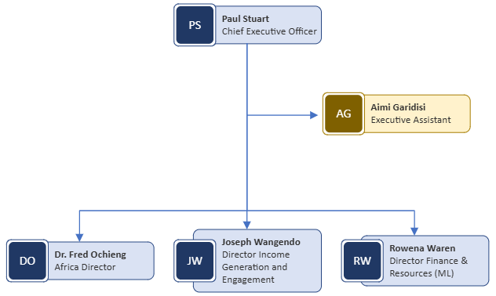
Global Senior Leadership team

Slide 3
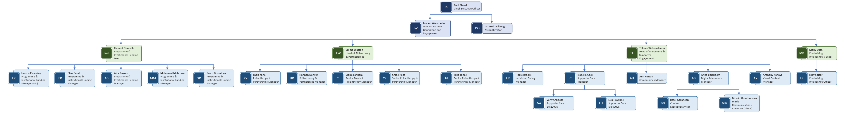
GLOBAL FUNDRAISING AND ENGAGEMENT

Slide 4
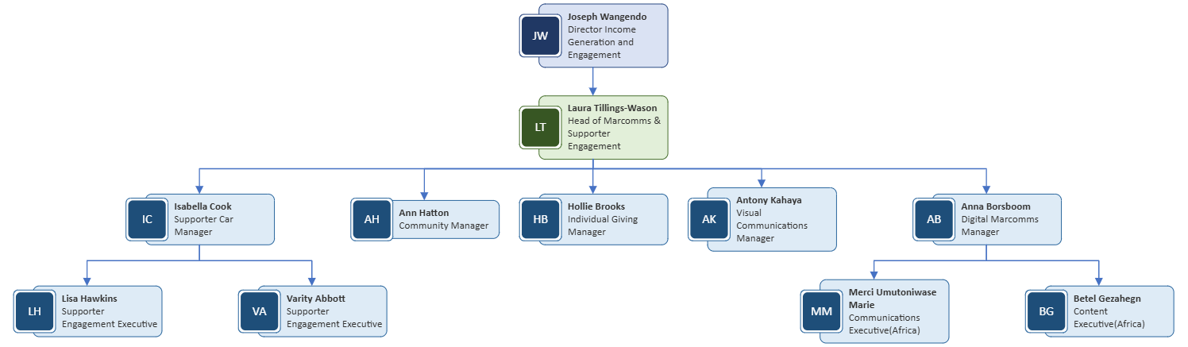
Marcomms & Supporter Engagement

Slide 5
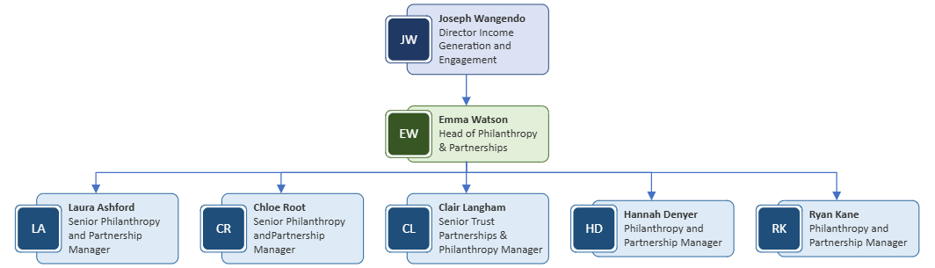
Philanthropy & Partnerships

Slide 6
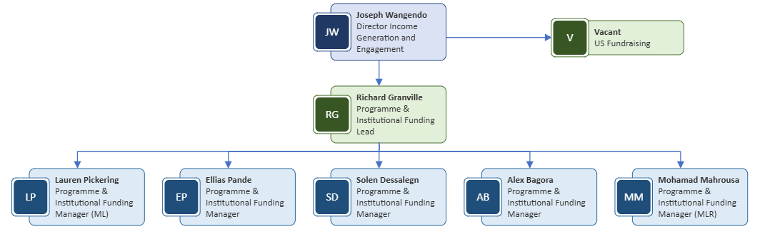
Programme & Institutional Funding

Slide 7
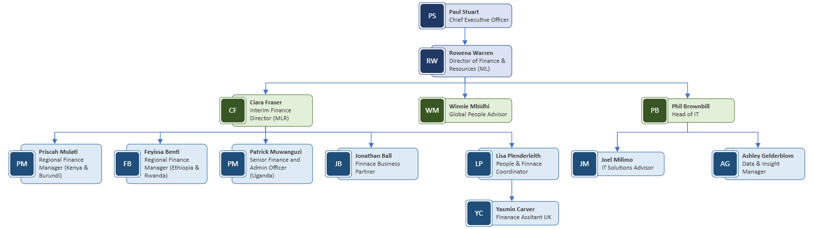
Finance and resources

Slide 8
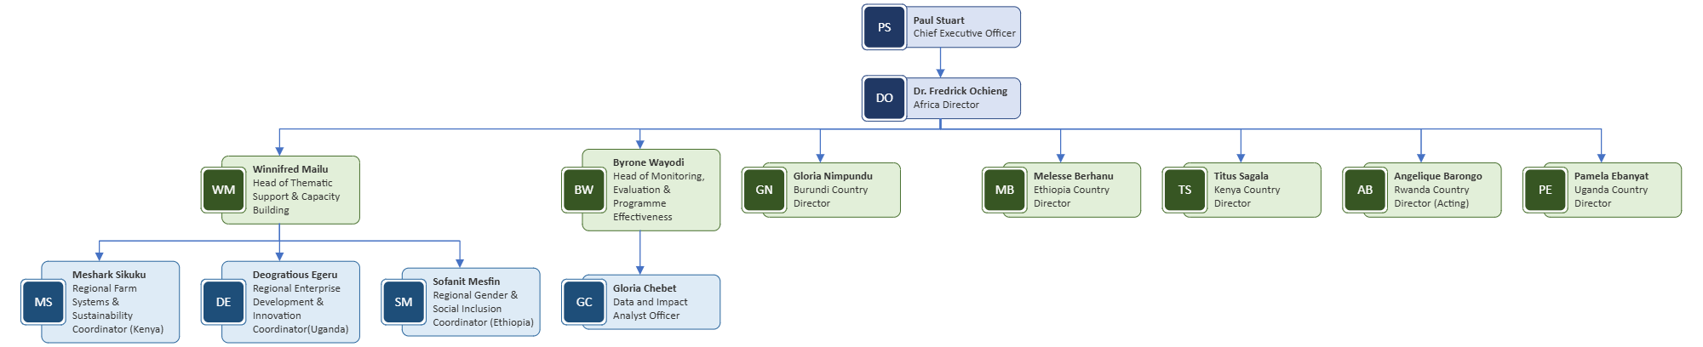
Regional Hub and International Programmes

