Slide 1
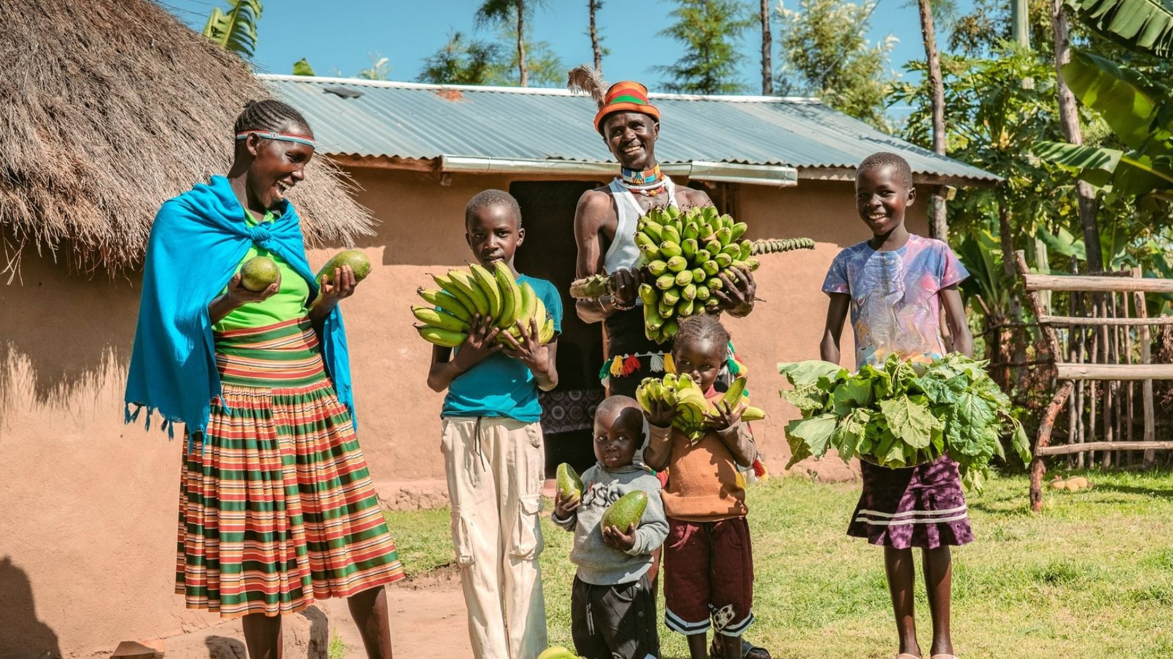

Selena and Thomas, Ripple Effect farmers, with their family, Kenya
Notes:
Thank you for choosing to support Ripple Effect this Lent.
During Lent, we are called to reflect on faith, perseverance, and care for creation. In this presentation, you’ll hear about Thomas and Selena in Kenya and how practical training, hard work, and trust in God have helped one family grow food, improve nutrition, and become more resilient in the face of drought and climate change. It is a reminder that even small actions, nurtured with patience and hope, can bring new life.
But first of all, let’s find out more about the work of Ripple Effect.
There are some slides at the end of this presentation with some interesting Kenya facts, should you wish to include them in your presentation.

Slide 2
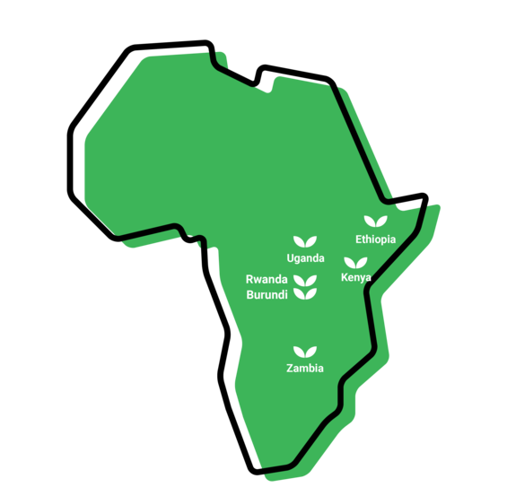

Where we work
Notes:
WHERE
Ripple Effect has established country programmes in Ethiopia, Kenya, Uganda, Rwanda, Burundi and Zambia.
80% of Ripple Effect staff are from these countries – working with and for the communities they live alongside.

Slide 3
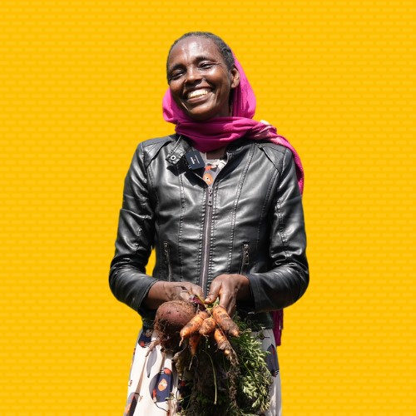
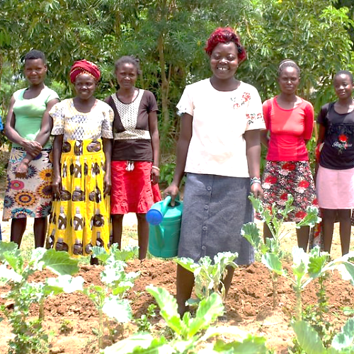
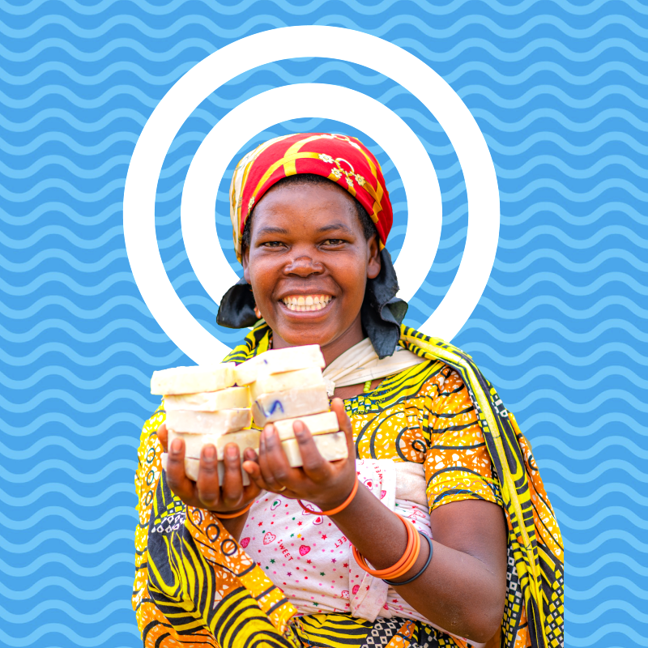
The three strands of our work
Notes:
We have over three decades of experience supporting families in rural Africa to learn more, grow more and sell more. Our projects are typically three years long. Once families have completed their Ripple Effect training, they then share what they know and have with their communities, creating a ripple effect across rural Africa.
There are three core strands to our work (detailed in the following slides)
Farming sustainably
Gender and social inclusion
Business skills

Slide 4
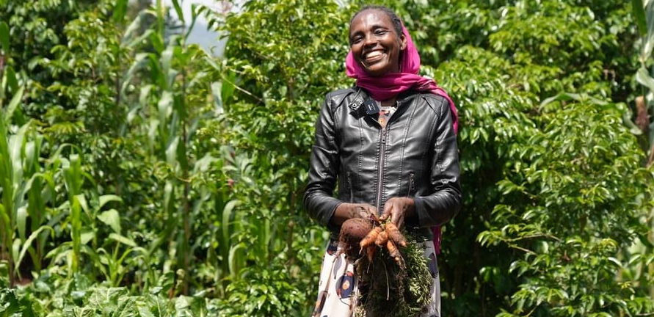
Farming sustainably
Meselech, Ripple Effect farmer, Ethiopia
Notes:
Farming sustainably
Ripple Effect trains families in using up to date and traditional approaches to farming. Families learn to build productive farms and to adapt to the effects of the climate crisis. And ultimately their farms will have a climate-positive impact!
Community trainers and peer farmers share their knowledge with more farmers and communities, so there is a ripple effect of learning.
Ripple Effect helps farmers think about the resources available to them within their community. We then teach the organic agricultural principles and skills they need to integrate these into a sustainable, biodiverse farm – without expensive artificial fertilisers or GM seeds.
Techniques that will be familiar to you, such as water harvesting, composting, use of manure, vegetable growing, tree planting and animal husbandry are easily adaptable to each farmer’s own land and needs. Being able to grow more, better, means a more diverse diet and improved nutrition.

Slide 5
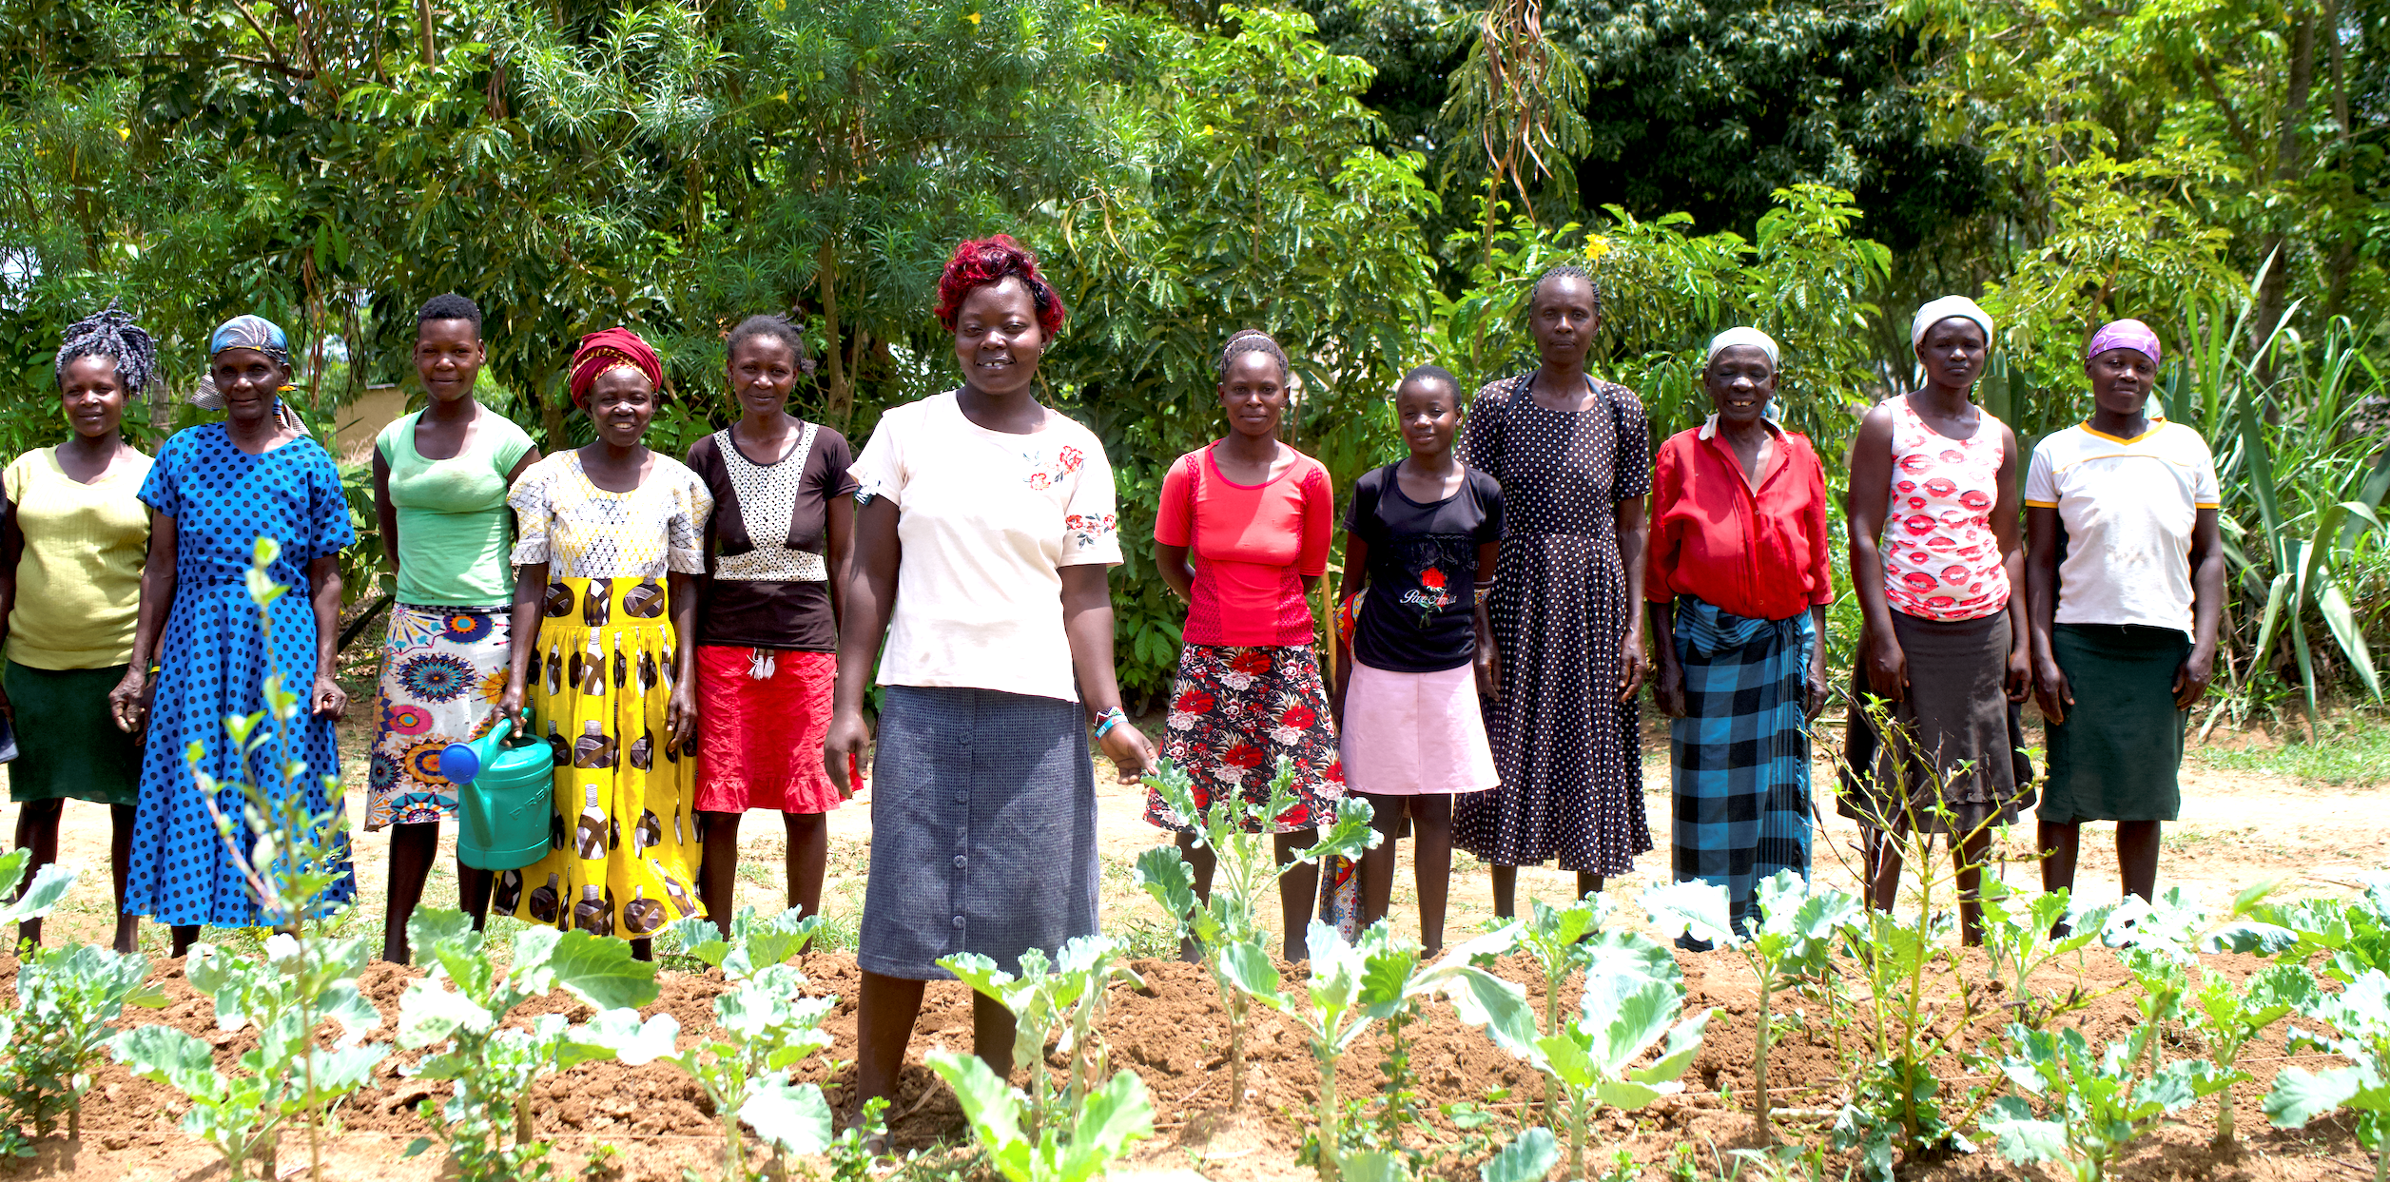
Gender and social inclusion
Ripple Effect farmers, Kenya
Notes:
Gender and social inclusion:
Ripple Effect works with the most marginalised of communities: widows, orphans, those with disabilities or living with HIV/AIDs. Across all the strands of our work we leave no one behind.
We facilitate women and men sharing decisions and responsibilities equally, extending the impact of our work across generations, and ensuring that people with different needs and abilities have the opportunity to learn more, grow more and sell more.
Through this approach, family life becomes more harmonious and prosperous, and children grow up happier, better educated and with wider horizons.

Slide 6
Business skills
Agripine, Ripple Effect farmer, Burundi
Notes:
Business skills
Once families are eating well and earning enough to send their children to school, we encourage them to think bigger, beyond just food security.
As part of their training, they learn money management and enterprise skills so they can access savings and credit services.
They also investigate how best to add value to their produce – for example processing it into another product; and how to store it – enabling it to be sold out of season.
Farmers become resilient entrepreneurs, capable of making choices and in charge of their own futures.
In this photo Agripine is holding the soap that she has been making and selling for profit.

Slide 7
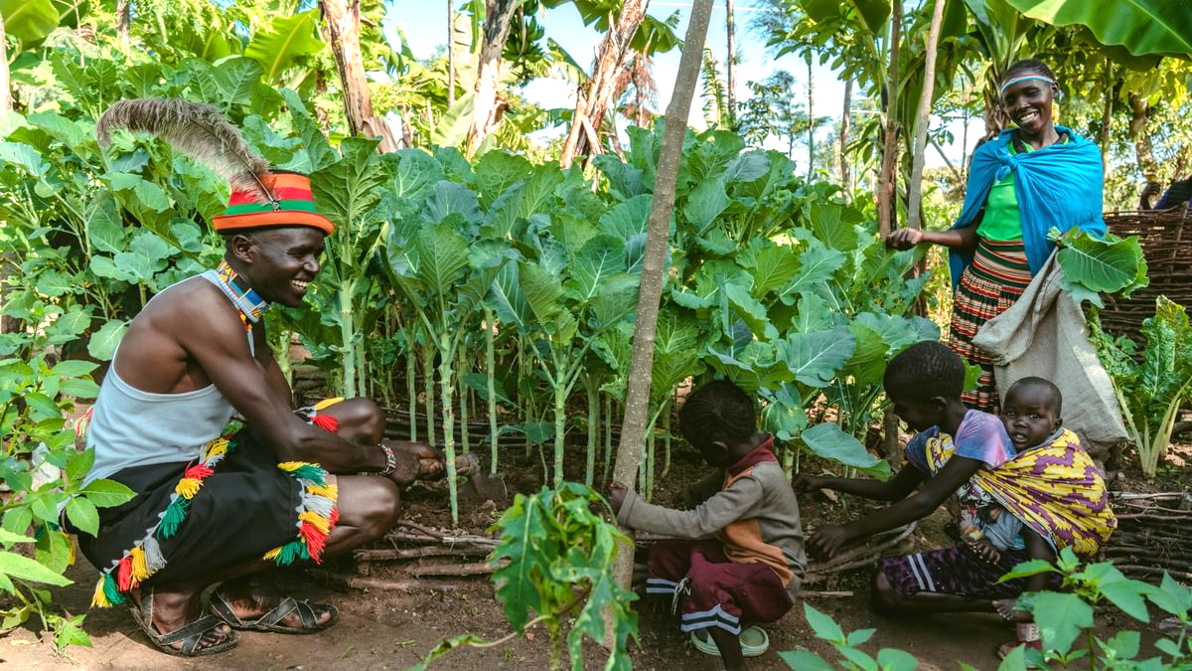
Nahimana’s story
Nahimana, Burundi
Notes:
Meet Thomas and Selena and their family (in the photo)
When we Thomas and Selena a few months ago, this is what they told us:
We have started a vegetable garden and now receive 400KS weekly from the profits. Through the training provided by Ripple Effect, we have learned new gardening techniques that not only improve our harvests but also make us more resilient to drought and climate challenges. Thanks to this, we are already enjoying a balanced and nutritious diet.
Overcoming Challenges
Even with the training, growing vegetables is not always easy. Dry weather and water scarcity have been major obstacles. But I [Thomas] continue to plant new vegetables after each harvest, and I mulch my raised beds. The mulch retains moisture and afterwards it rots and becomes compost! (which in turns improves the soil)
Reflecting on the Past
Life was harder when I was a child. We cut trees and burned charcoal, which affected the environment, and we often only ate one meal a day.
But today, with better knowledge, tools, and training, Thomas and his family able to grow more food and improve their lives.
I am most proud of my vegetable gardens, which have provided a good income in a short time.

Slide 8
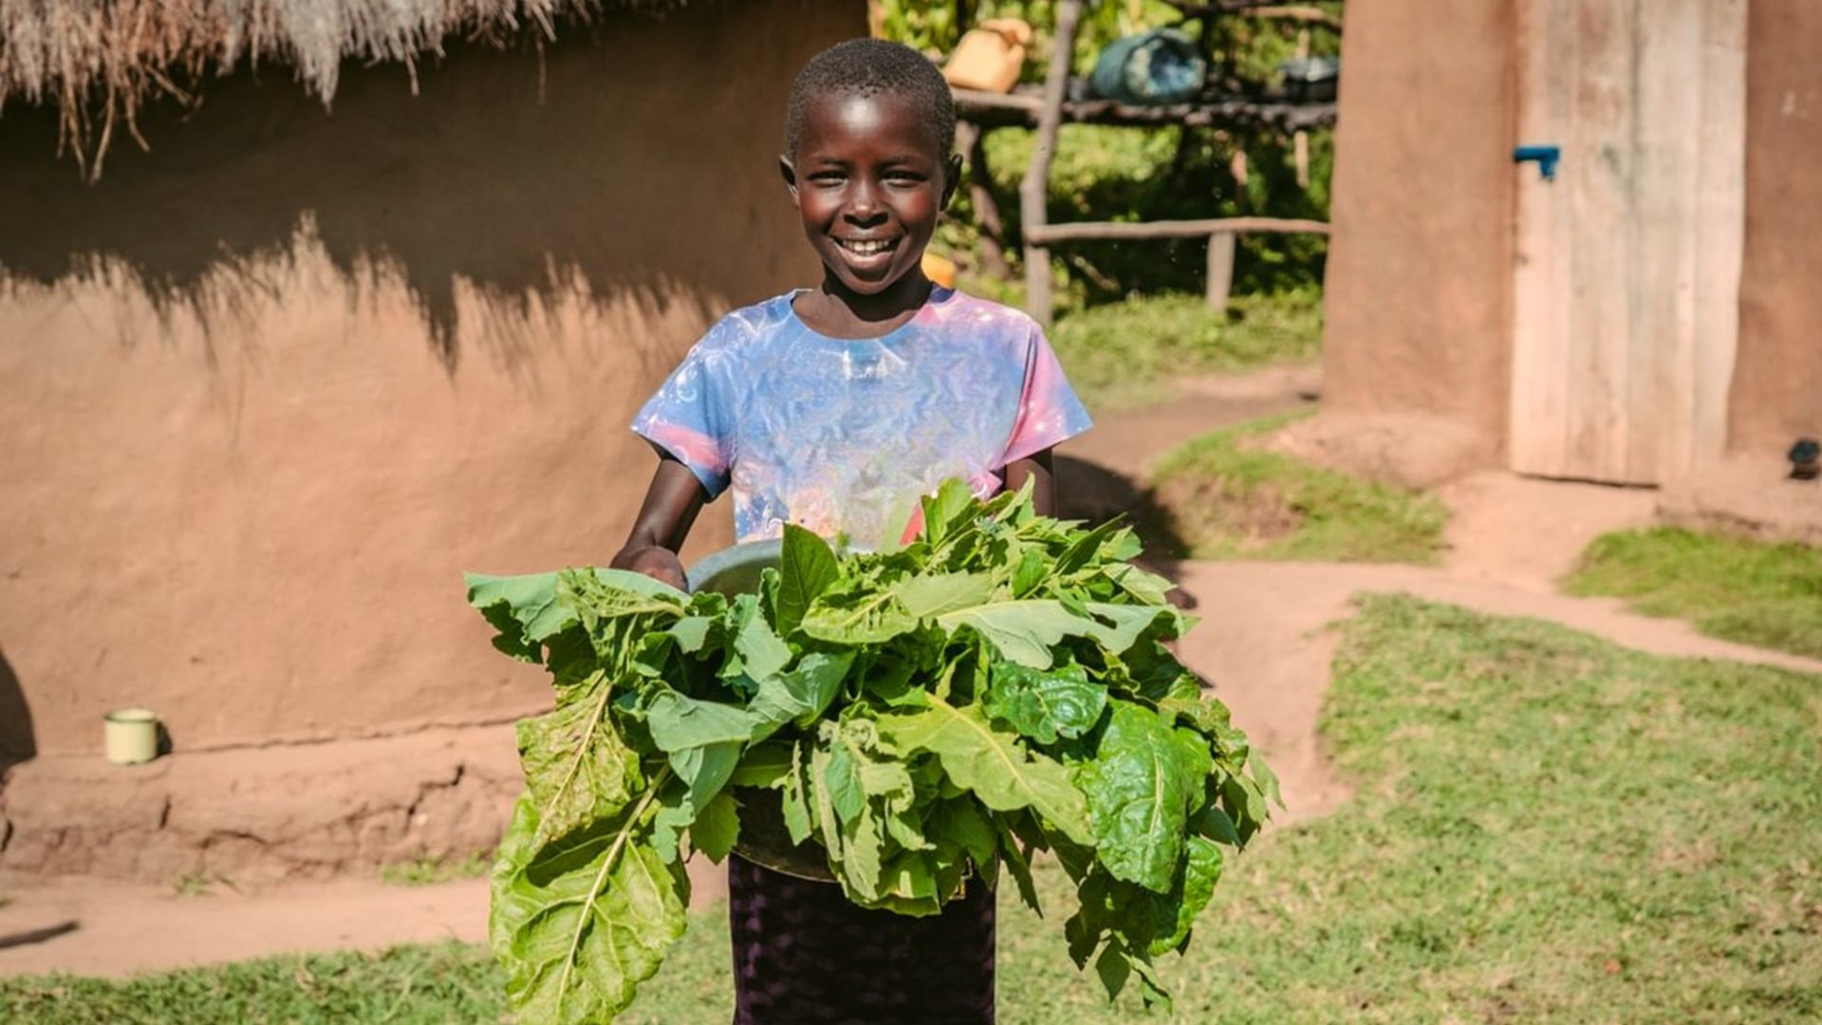
Notes:
Buretti (in the photo), Thomas and Selena’s daughter, also works hard on the land. They all work together!

Slide 9
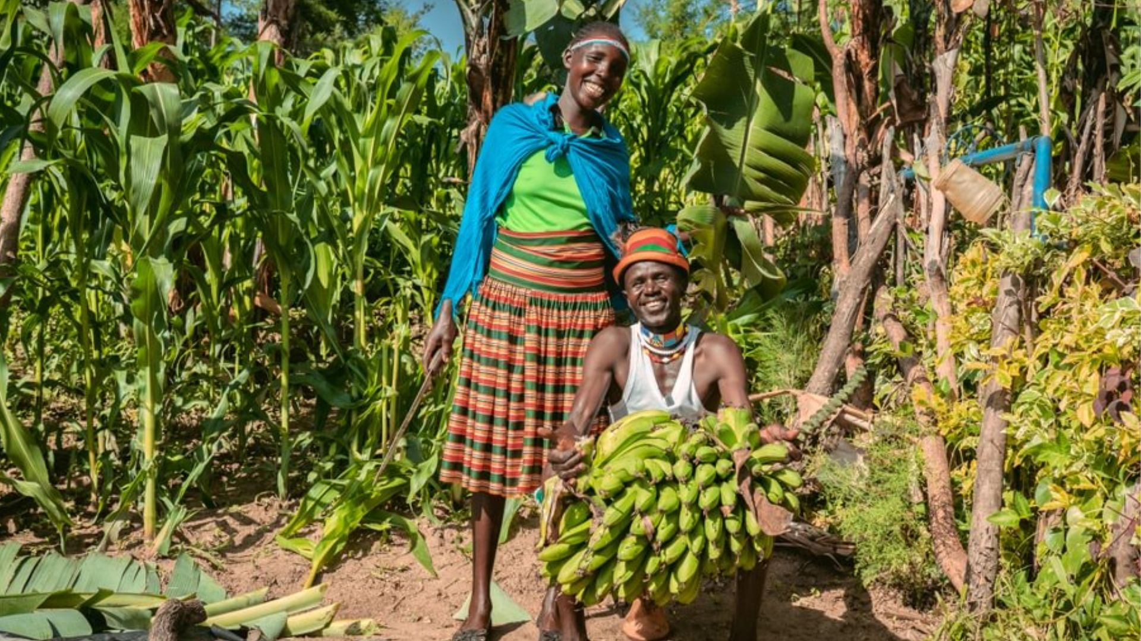
“My family nutrition has changed. There didn’t used to be enough food for us all. We’d make ugali in the evenings and eat the leftovers for breakfast. From the production of fruit, including bananas, and vegetables we’ve been able to earn enough to buy other food types.
We eat three meals a day now and they are very nutritious.”
Selena, Kenya.
Notes:
Take Action this Lent
This Lenten season reminds us that faith, perseverance, and resilience can bring life and hope, even in difficult circumstances. Let us care for creation, support our families, and trust in God’s guidance as we work together for a better future.
If you’ve been inspired by the work of Ripple Effect and Selena and Thomas’s story, please consider supporting our work today.
With your support, Ripple Effect can continue working alongside communities in rural Africa — helping families like theirs grow food, build resilience to the climate crisis, and secure their futures.
Thank you for acting this Lent.

Slide 10
How your church can act this Lent
£100 could provide vital training before the next planting season – improving soil quality and increasing crop yields.
£250 could help farmers to grow enough food all year round, even as the climate changes.
£400 could provide training in practical technologies, like keyhole gardens - starting now!
Support farmers this Lent: rippleeffect.org/lent

Slide 11
Thank you for choosing to support Ripple Effect this Lent!
Ripple Effect farmers, Uganda
Support farmers this Lent: rippleeffect.org/lent

Slide 12
Thank you for choosing to support Ripple Effect this Lent!
The following slides provide some additional information about Kenya
Ripple Effect farmers, Uganda
Support farmers this Lent: rippleeffect.org/lent

Slide 13
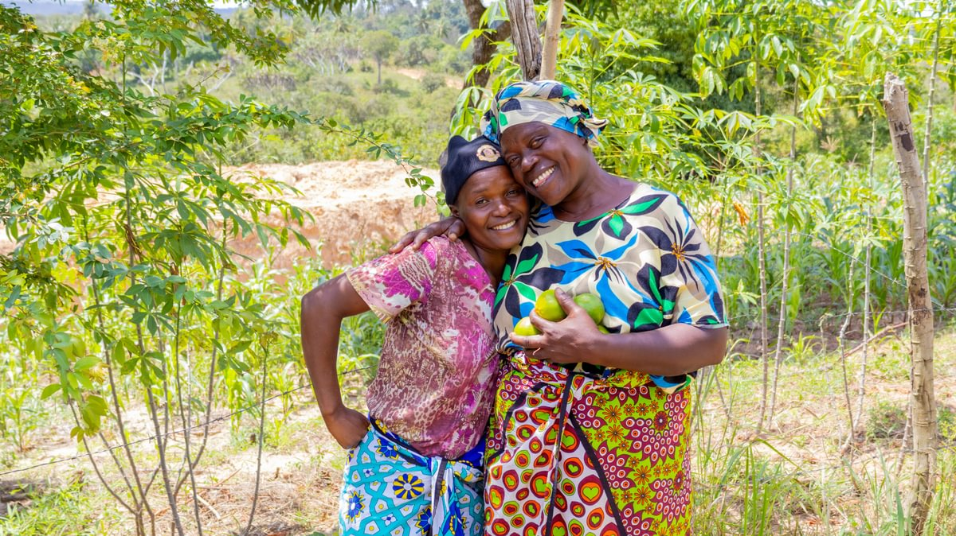
Additional information about Kenya
Ripple Effect farmers, Uganda
Fatuma, Ripple Effect farmer, Kenya, with her mother
Notes:
Building rural resilience in Kenya: farming communities leading change
Kenya is a country of immense potential, but many rural communities are facing increasing hardship due to climate change, economic instability, and food insecurity. Prolonged droughts, unpredictable rainfall, and rising living costs are making it harder for smallholder farmers to grow enough to eat or earn a stable income.
As an international development charity, Ripple Effect works alongside farming families in Kenya to build resilience through sustainable agriculture, regenerative land management, and rural enterprise development. By gaining practical skills and tools, farming families are leading the way in lifting themselves out of poverty and creating lasting, local change.

Slide 14
Some stats about Kenya
37% of people in rural Kenya live in poverty
Around 80% of Kenya’s population lives in rural areas and depends heavily on agriculture
67% of young Kenyans are unemployed
Ripple Effect farmers, Uganda
Support farmers this Lent: rippleeffect.org/lent
Notes:
37% of people in rural Kenya live in poverty
Approximately 37% of rural Kenyans live below the national poverty line, struggling to access essentials such as food, healthcare, education, and reliable income (Kenya Poverty and Equity Assessment, World Bank, 2023). Meanwhile, economic inequality remains stark nationally, with a small elite controlling the majority of wealth, deepening the divide between urban and rural populations.
Climate change threatens the livelihoods of rural communities
Around 80% of Kenya’s population lives in rural areas and depends heavily on agriculture, which accounts for about 33% of the country’s GDP (World Bank, 2023). However, climate shocks such as prolonged droughts, unpredictable rainfall, and flooding are increasingly damaging crops and livestock, putting farmers’ incomes and food security at serious risk.
67% of young Kenyans are unemployed
Although Kenya’s overall unemployment rate stands at 12.7%, young people aged 15 to 34, who make up 35% of the population, face a disproportionately high unemployment rate of 67%, according to the Federation of Kenya Employers (FKE). This severe lack of job opportunities, especially in rural areas, limits young people’s ability to build livelihoods and contribute economically.

Slide 15
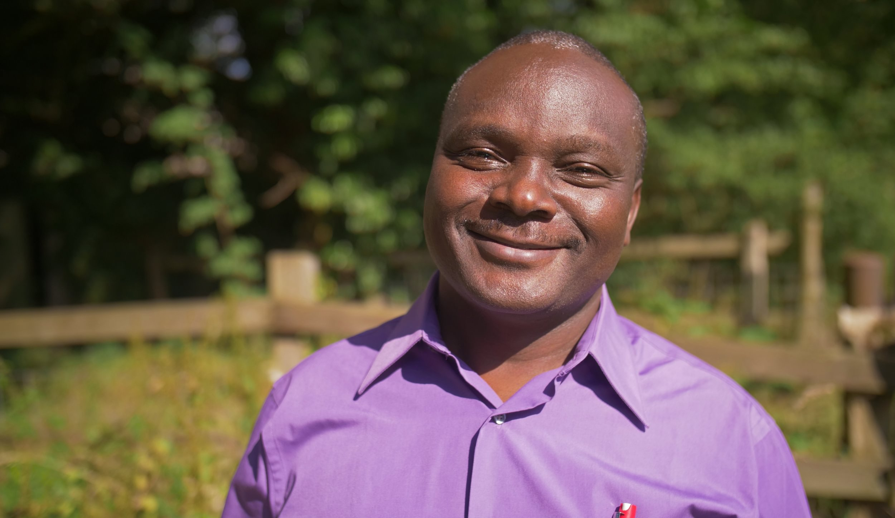
Ripple Effect is transforming rural Kenya
"Ripple Effect is transforming rural Kenya - empowering families to farm sustainably, earn with dignity, and build climate resilience. We’re not just ending poverty; we’re nurturing hope, equity, and opportunity for generations to come.“
Titus Sagala, Ripple Effect Kenya Country Director
Ripple Effect farmers, Uganda
Support farmers this Lent: rippleeffect.org/lent
Notes:
"Ripple Effect is transforming rural Kenya - empowering families to farm sustainably, earn with dignity, and build climate resilience. We’re not just ending poverty; we’re nurturing hope, equity, and opportunity for generations to come."
Titus Sagala, Ripple Effect Kenya Country Director
Creating lasting change for Kenyan communities through sustainable agriculture and inclusion
At Ripple Effect, we work closely with communities across Kenya to restore the land and promote climate-smart farming that strengthens food security and builds resilience to a changing climate. Our nutrition and food security programmes improve the health and wellbeing of children and families. We are committed to animal welfare, encouraging sustainable livestock care that supports both people and nature.
Gender equality and social inclusion guide all our work, ensuring women and marginalised groups access training, resources, and decision-making roles. Through youth upskilling and employment initiatives, young people gain practical skills and economic opportunities to shape their own futures. By sharing knowledge and sustainable tools, Ripple Effect nurtures lasting change and stronger communities across Kenya’s rural areas.
60%of young people earned more than $2.15 per day after just one year of the Low Hanging Fruit project, up from 16% at project start.

