Slide 1
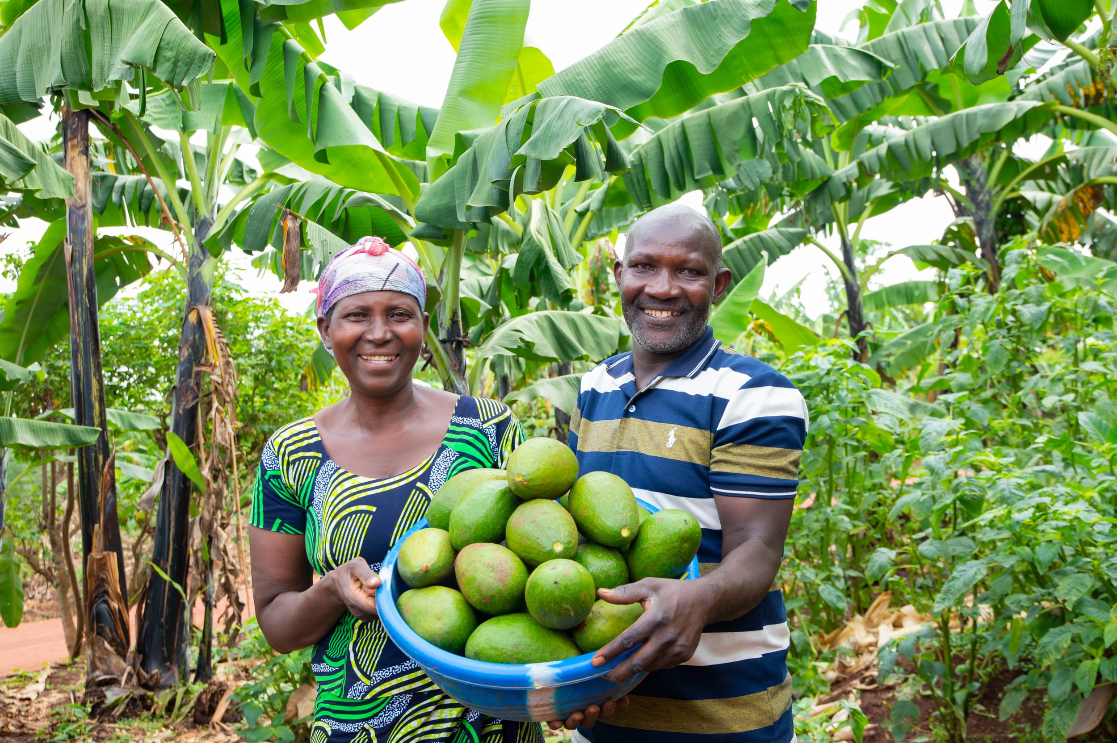


Therese and Deogratias,
Ripple Effect farmers, Rwanda
Notes:
Thank you for choosing to support Ripple Effect this Harvest.
In this presentation, you’ll learn about the work of Ripple Effect and find how your church can support farming families in rural Africa to restore their land for a future free from hunger.

Slide 2
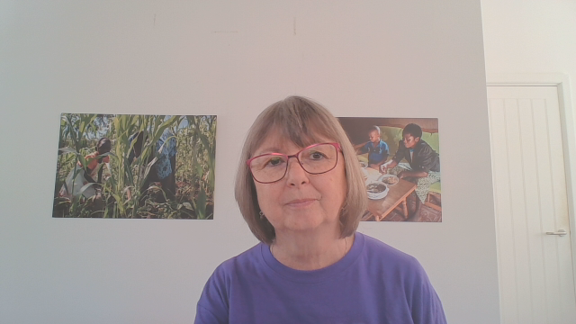
If you have any questions, email me:
ann.hatton@rippleeffect.org

Slide 3
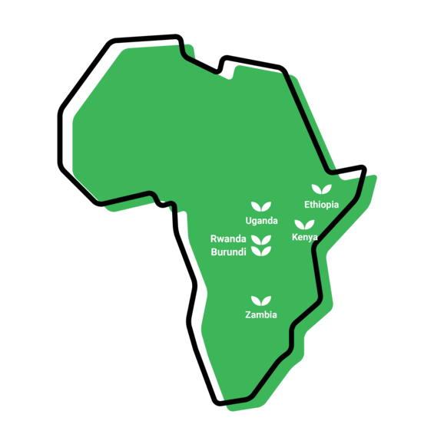
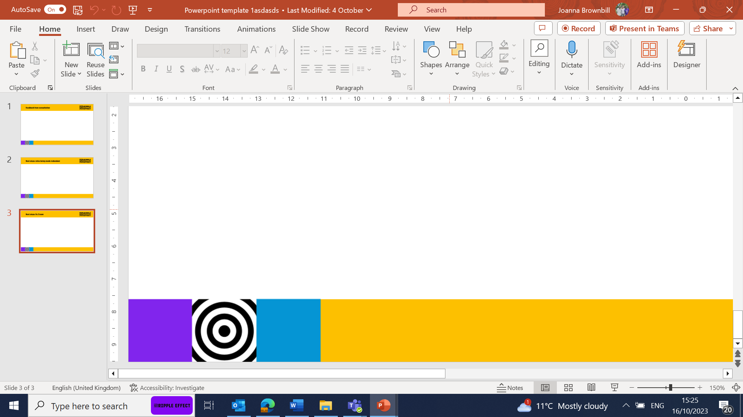
Where we work
Notes:
WHERE
Ripple Effect has established country programmes in Ethiopia, Kenya, Uganda, Rwanda, Burundi and Zambia.
80% of Ripple Effect staff are from these countries – working with and for the communities they live alongside.

Slide 4
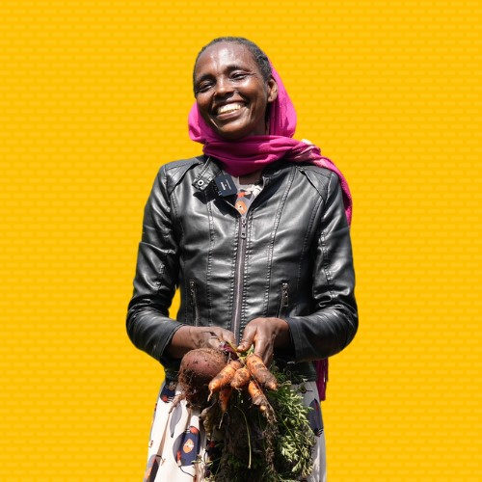
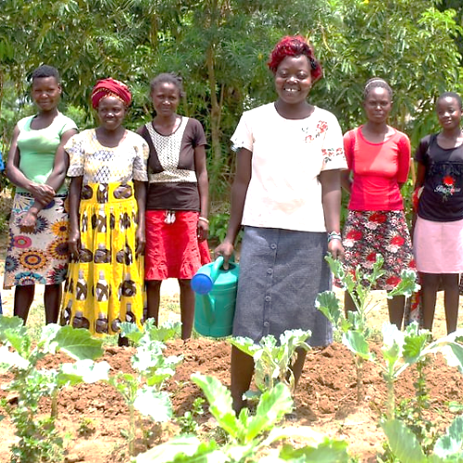
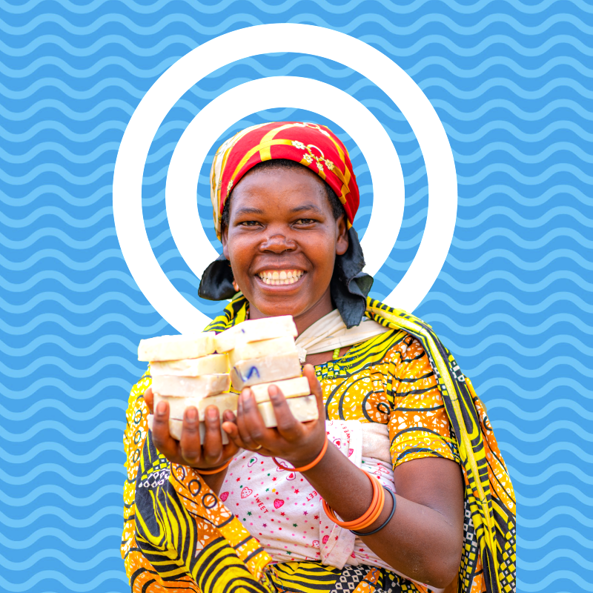
The three strands of our work
Notes:
We have 37 years' experience supporting families in rural Africa to learn more, grow more and sell more. Our projects are typically three years long. Once families have completed their Ripple Effect training, they then share what they know and have with their communities, creating a ripple effect across rural Africa.
There are three core strands to our work (detailed in the following slides)
Farming sustainably
Gender and social inclusion
Business skills

Slide 5
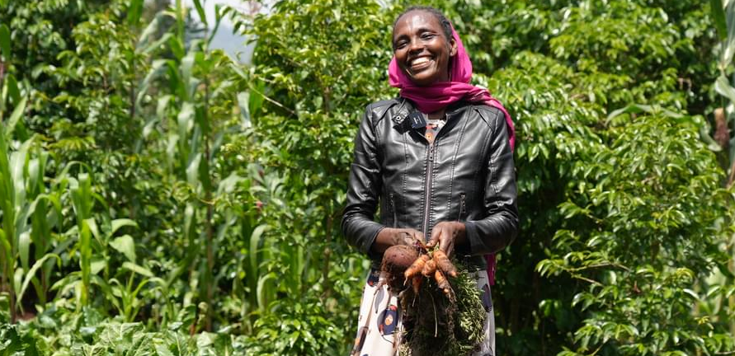
Farming sustainably
Meselech, Ripple Effect farmer, Ethiopia
Notes:
Farming sustainably
Ripple Effect trains families in using up to date and traditional approaches to farming. Families learn to build productive farms and to adapt to the effects of the climate crisis. And ultimately their farms will have a climate-positive impact!
Community trainers and peer farmers share their knowledge with more farmers and communities, so there is a ripple effect of learning.
Ripple Effect helps farmers think about the resources available to them within their community. We then teach the organic agricultural principles and skills they need to integrate these into a sustainable, biodiverse farm – without expensive artificial fertilisers or GM seeds.
Techniques (many that you’ll be familiar with) such as water harvesting, composting, use of manure, vegetable growing, tree planting and animal husbandry are easily adaptable to each farmer’s own land and needs.

Slide 6
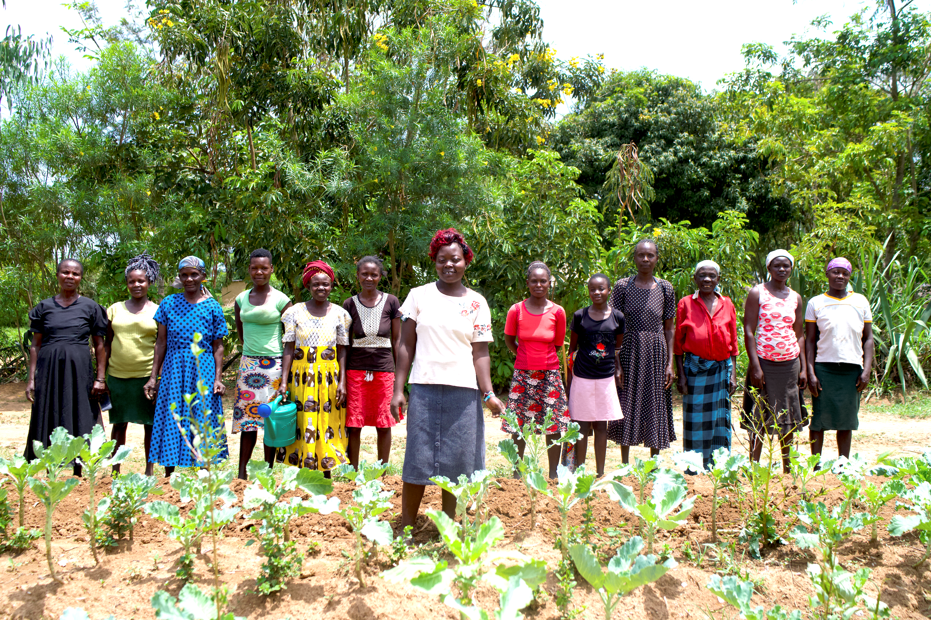
Gender and social inclusion
Ripple Effect farmers, Kenya
Notes:
Gender and social inclusion:
Ripple Effect’s local staff in Africa help families develop a shared vision for their home. Through facilitated activities we help the family work out how best to share the workload and decision-making to achieve their vision.
Through this approach, family life becomes more harmonious and prosperous, and children grow up happier, better educated and with wider horizons.
Women in particular are supported to raise their aspirations beyond subsistence farming.
65% of the people we work with are women – research indicates women are more likely to invest income into their family’s future
50% of those women are widows – some of the most vulnerable people

Slide 7
Business skills
Agripine, Ripple Effect farmer, Burundi
Notes:
Business skills
More farmers learn to manage their farm as a business, moving away from subsistence farming to control their own futures: developing profitable businesses and co-operatives which can access new markets.
As part of their training farmers learn money management and enterprise skills. They also investigate how best to add value to their produce – for example processing it into another product or storing it so that it can be sold out of season.
Ripple Effect farmers become resilient entrepreneurs, capable of making choices and in charge of their own futures.
In this photo Agripine is holding the soap that she has been making and selling for profit.

Slide 8
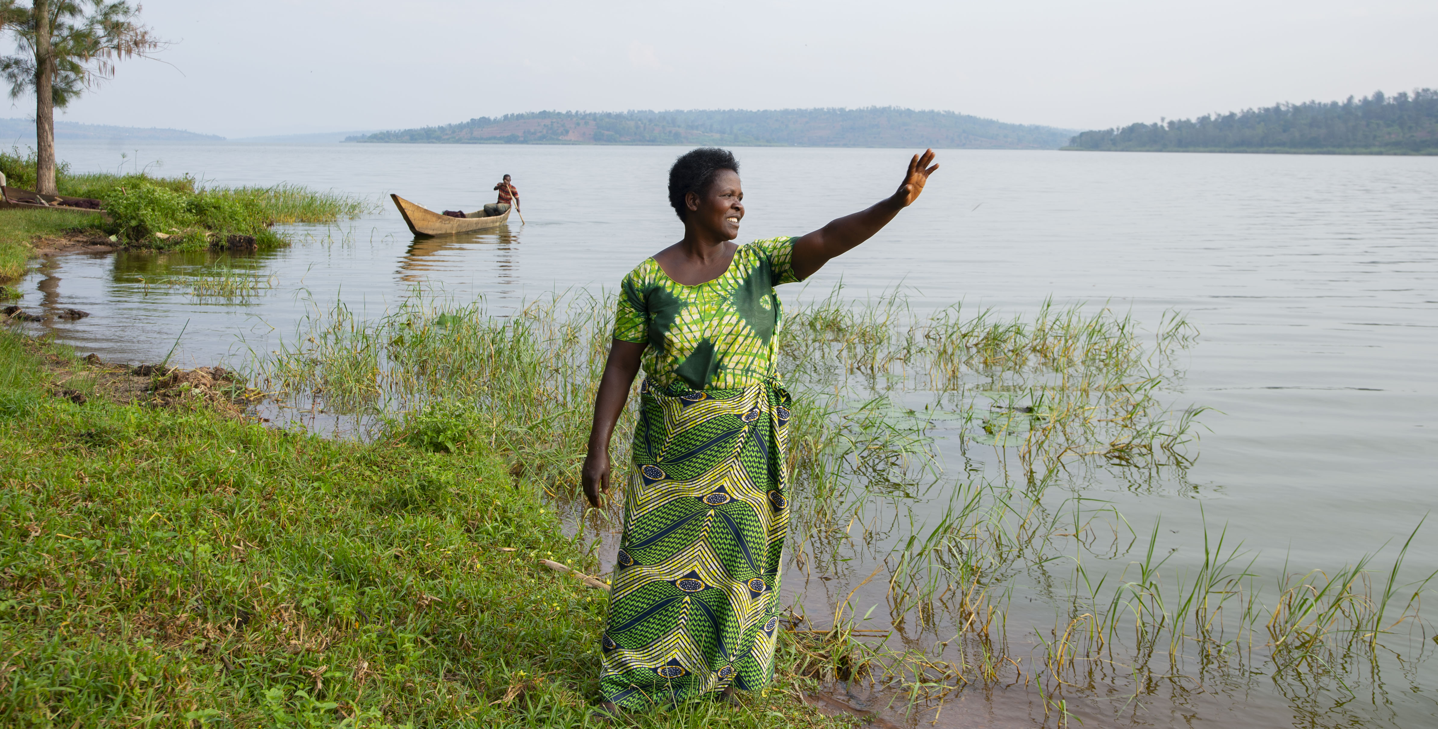
Jeanne’s story
Notes:
Jeanne’s story
Jeanne wakes up each morning unsure if she’ll have enough food to feed her five children. In Rwanda, the long dry seasons - worsened by the climate crisis - make farming increasingly difficult. Some days, her children survive on just one meal.
Jeanne is a single mother living in the region around Lake Cyohoha, a vital wetlands area on the Rwanda–Burundi border. The lake is a crucial source of water for surrounding communities, but the land is suffering. Extreme weather, including drought and floods, has led to failed harvests and deepening poverty. Soil erosion from the surrounding hills only makes things worse.
Jeanne doesn’t own land - she farms plots belonging to others and must share whatever she grows with them. Jeanne told us:
“Most of the time we eat once per day… there is starvation...Not taking care of the soil and the environment may cause us losses… our soil may be wiped away.”
But there is hope. Ripple Effect’s Restore project is helping families like Jeanne’s by teaching sustainable farming techniques, including intercropping and terracing. These practices protect the soil, boost harvests, and improve long-term resilience. Find out how, by reading Therese’s story on the next slide.

Slide 9
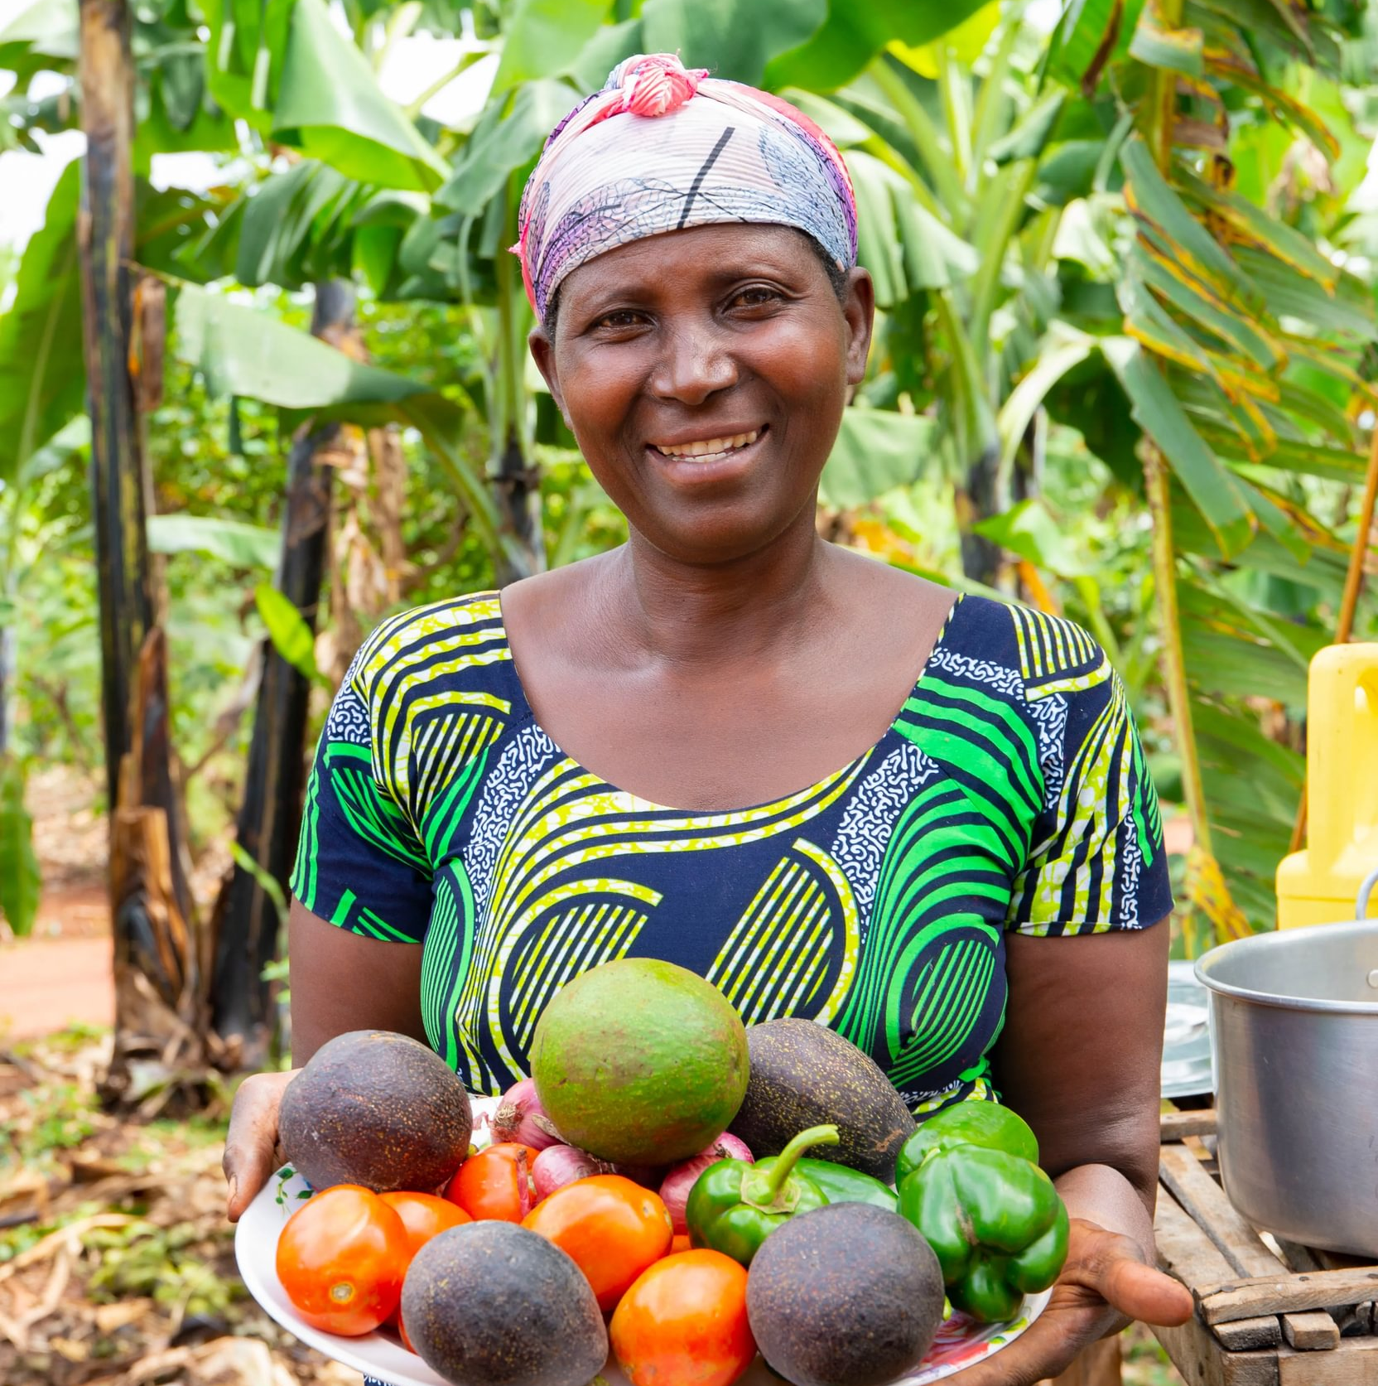
Therese’s story
“When you practice soil conservation, you have increased yields, and you are able to progress… As you can see, I have a project of growing vegetables.”
Therese, Ripple Effect farmer, Rwanda
Notes:
Meet Therese
Therese, is a married mother of six who lives in Rwanda. Just like Jeanne, Therese used to struggle with unproductive land. But after she started working with Ripple Effect, things began to change for the better.
She received seeds, tools and training, and now her land is healthy. Therese grows an abundance of crops including coffee, peanuts, beetroot and fruits. She keeps livestock, and her family eat three times a day. Therese generously shares the knowledge she has with her neighbours, creating a ripple effect in her community.
Therese told us: “My neighbours and I visit each other to exchange ideas about farming...I share the knowledge with them so they too can recover from malnutrition.​
Therese works hard on her farm and has dreams for the future. She wants all her children to study and do well. Isn’t that what we all want for our families?

Slide 10
How your church can help
You could:
Donate your Harvest collection
Host a cake sale with a pineapple theme
Host a Songs of Praise evening
Host a Harvest supper
Find out more at rippleeffect.org/harvest
Notes:
The Restore project is vital not just for families, but for the region’s wider environmental health. Lake Cyohoha is a crucial water source, and restoring soil prevents runoff that pollutes the lake and damages biodiversity. With healthy land, healthy crops, and resilient ecosystems, this region can have a fighting chance against the climate crisis.
£250 could train mothers, like Jeanne, in climate-smart technologies helping families regenerate their land, grow enough to eat and sell, and build a future filled with hope.
This Harvest, will your church donate your Harvest collection, host a Harvest supper, or organise a Songs of Praise event to support mothers like Jeanne?
With help from your church, mothers like Jeanne can transform their lives—feeding their children well, restoring their soil, and sending their children to school.
Whatever you are able to give, your donation is supporting families like Jeanne’s to restore their land for a future free from hunger. Thank you.

Slide 11
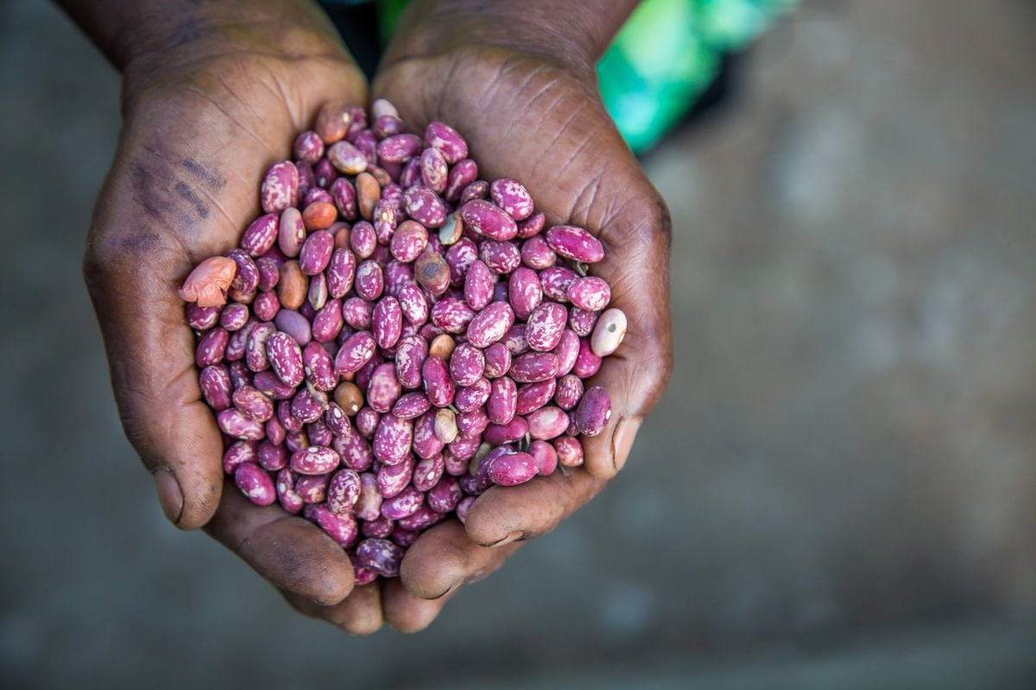
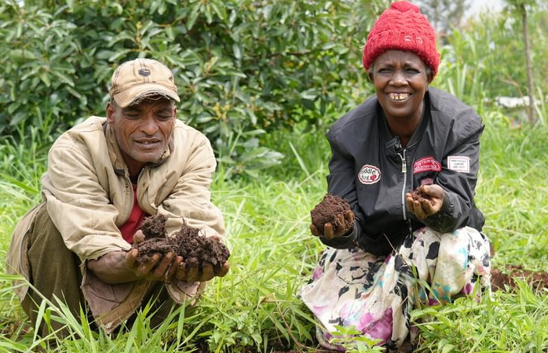
How your church can help
£100 could provide farmers with drought-resistant seeds, helping them grow food year-round.
£250 could train farmers in climate-smart methods to improve soil quality and protect their land from climate shocks such as droughts and floods.
£500 could support farmers to build resilient, eco-friendly income streams and learn money management.
Find out more at rippleeffect.org/harvest

Slide 12
Thank you for choosing to support Ripple Effect this Harvest!
Find out more at rippleeffect.org/harvest

