Slide 1
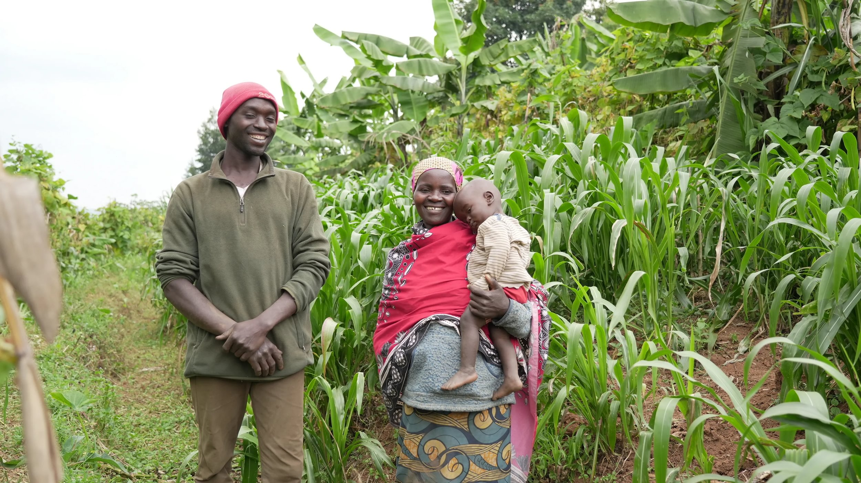

This Christmas, will your church help families in Burundi grow hope?
Clementine, Uganda
Nahimana, Jean-Paul and Arcade, Burundi
Notes:
Thank you for choosing to support Ripple Effect this Christmas.
In this presentation, you’ll learn about the work of Ripple Effect and find out how your church can support farming families, like Nahimana’s, in rural Africa to fight hunger and the climate crisis.

Slide 2
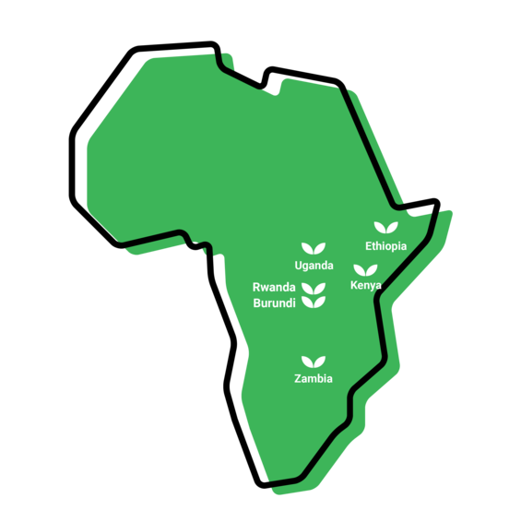

Where we work
Notes:
WHERE
Ripple Effect has established country programmes in Ethiopia, Kenya, Uganda, Rwanda, Burundi and Zambia.
80% of Ripple Effect staff are from these countries – working with and for the communities they live alongside.

Slide 3
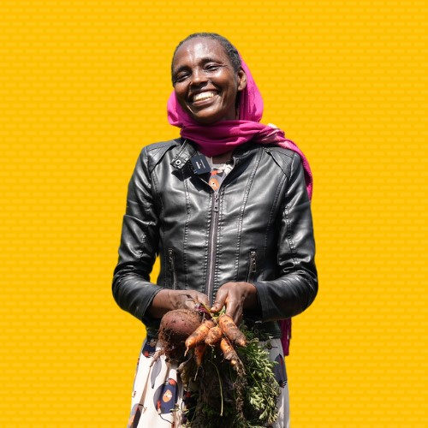
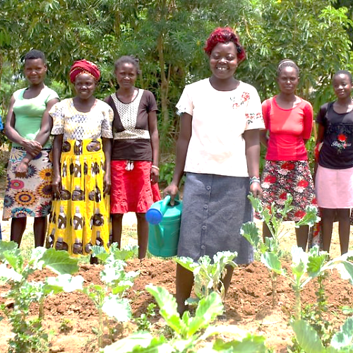
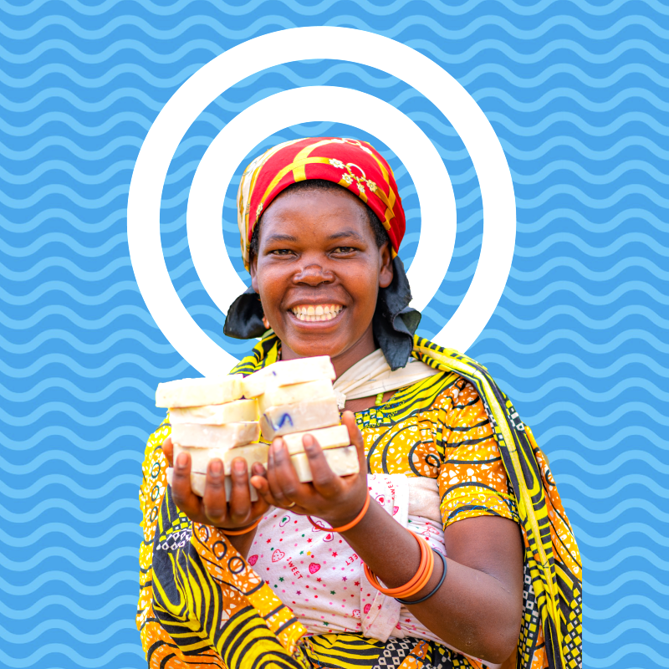
The three strands of our work
Notes:
We have 36 years' experience supporting families in rural Africa to learn more, grow more and sell more. Our projects are typically three years long. Once families have completed their Ripple Effect training, they then share what they know and have with their communities, creating a ripple effect across rural Africa.
There are three core strands to our work (detailed in the following slides)
Farming sustainably
Gender and social inclusion
Business skills

Slide 4
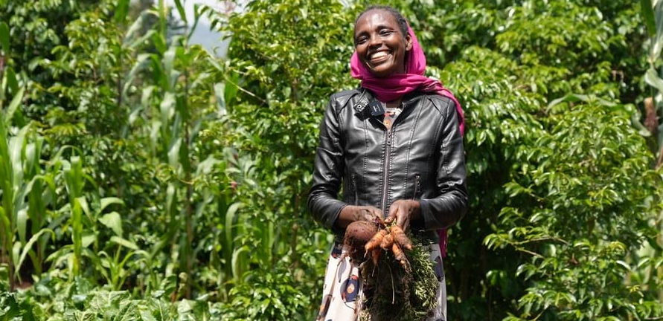
Farming sustainably
Meselech, Ripple Effect farmer, Ethiopia
Notes:
Farming sustainably
Ripple Effect trains families in using up to date and traditional approaches to farming. Families learn to build productive farms and to adapt to the effects of the climate crisis. And ultimately their farms will have a climate-positive impact!
Community trainers and peer farmers share their knowledge with more farmers and communities, so there is a ripple effect of learning.
Ripple Effect helps farmers think about the resources available to them within their community. We then teach the organic agricultural principles and skills they need to integrate these into a sustainable, biodiverse farm – without expensive artificial fertilisers or GM seeds.
Techniques that will be familiar to you, such as water harvesting, composting, use of manure, vegetable growing, tree planting and animal husbandry are easily adaptable to each farmer’s own land and needs. Being able to grow more, better, means a more diverse diet and improved nutrition.

Slide 5
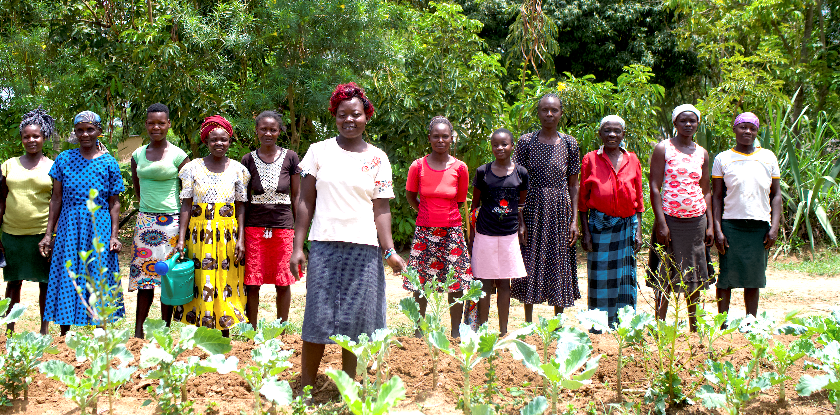
Gender and social inclusion
Ripple Effect farmers, Kenya
Notes:
Gender and social inclusion:
Ripple Effect works with the most marginalised of communities: widows, orphans, those with disabilities or living with HIV/AIDs. Across all the strands of our work we leave no one behind.
We facilitate women and men sharing decisions and responsibilities equally, extending the impact of our work across generations, and ensuring that people with different needs and abilities have the opportunity to learn more, grow more and sell more.
Through this approach, family life becomes more harmonious and prosperous, and children grow up happier, better educated and with wider horizons.

Slide 6
Business skills
Agripine, Ripple Effect farmer, Burundi
Notes:
Business skills
Once families are eating well and earning enough to send their children to school, we encourage them to think bigger, beyond just food security.
As part of their training they learn money management and enterprise skills so they can access savings and credit services.
They also investigate how best to add value to their produce – for example processing it into another product; and how to store it – enabling it to be sold out of season.
Farmers become resilient entrepreneurs, capable of making choices and in charge of their own futures.
In this photo Agripine is holding the soap that she has been making and selling for profit.

Slide 7
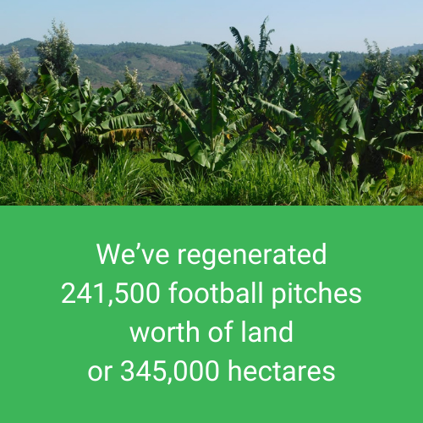
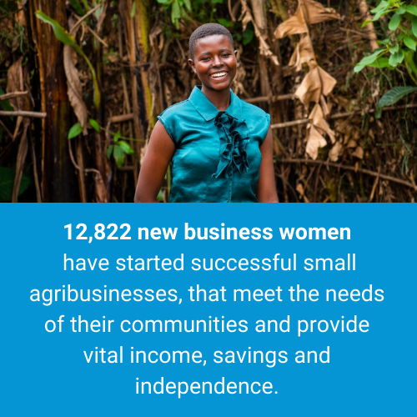
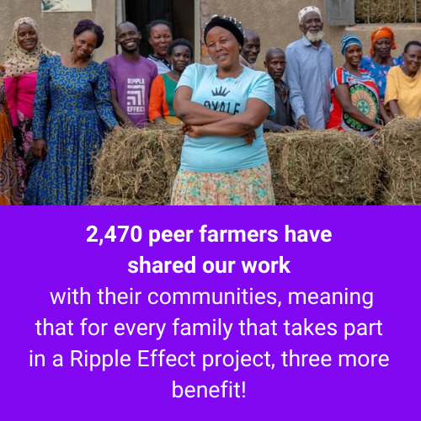
Our impact
Notes:
This last year, we’ve worked with 1.38 million people – our biggest year to date:
We’ve regenerated 241,500 football pitches worth of land, or 345,000 hectares
12,822 new businesswomen have started successful small agribusinesses, that meet the needs of their communities and provide vital income, savings and independence.
2,470 peer farmers have shared our work with their communities, meaning that for every family that takes part in a Ripple Effect project, three more benefit!

Slide 8
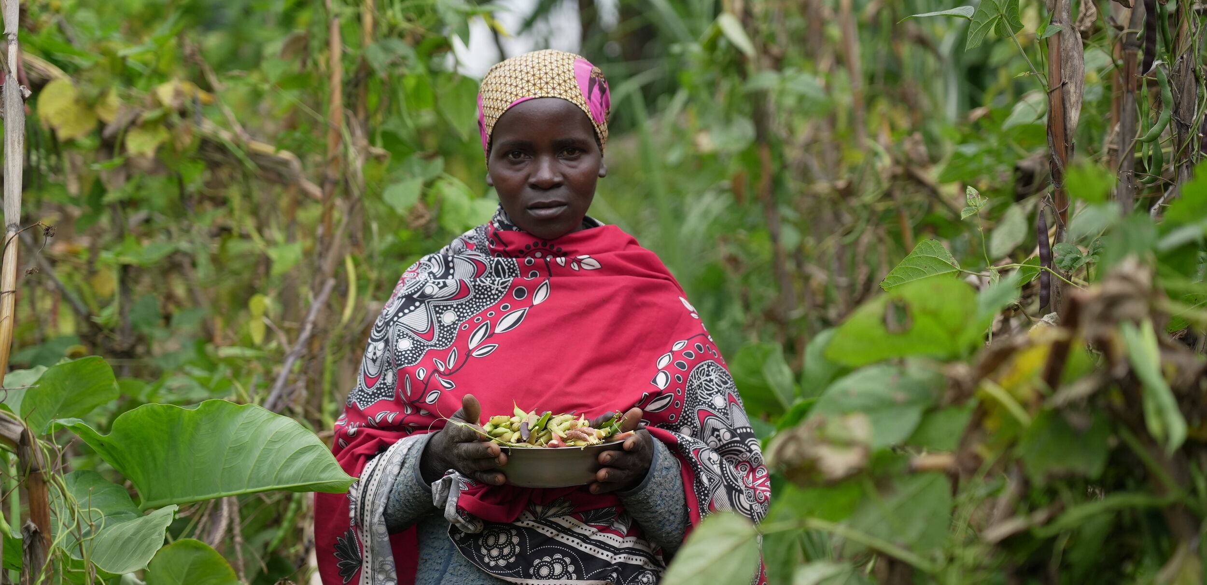
Nahimana’s story
Nahimana, Burundi
Notes:
In Burundi, one in two children under five are stunted, putting their growth and future at risk.
For parents like Nahimana and Jean-Paul in Burundi, this is the heartbreak they used to live with every day. They struggled to feed their four children. Before joining Ripple Effect’s project, Nahimana and Jean-Paul were feeling the catastrophic impact of climate change on their land - long periods of drought coupled with crop destroying heavy rain and hail meant crop yields were low.
Nahimana shared their story: “We’d only eat sweet potatoes without any other vegetables as we couldn’t afford them. We only ate in the evenings. My children always complained that they didn’t get enough food.”
Can you imagine hearing that from your own child – knowing there was nothing more you could give?
Nahimana and her family are working hard to give their children a brighter future. With the support of Ripple Effect, families like Nahimana’s are learning to grow nutritious food, plant drought-resistant crops, and share ‘pass-on’ gifts of livestock with their neighbours - creating ripples of hope through their communities.

Slide 9
Nahimana’s story
Edith in her shop, Uganda
Nahimana, Jean-Paul and Arcade, Burundi
Notes:
Nahimana told us: “A peer farmer trainer is helping us maintain our small plot and improve soil quality. I’ve received fruit seedlings and learned farming techniques which are supporting us. Now when there is drought, we will plant drought-resistant crops like amaranth.”
Pass-on gifts are central to our work. With your support, each family we work with passes on produce or livestock to another. This generosity ripples through the whole community. Nahimana and Jean-Paul, received four pigs from fellow farmers in the project, and in time they will pass on gifts too, creating further ripples of change in the community.
This Christmas, churches and congregations can stand with families like Nahimana’s and help make their wishes a reality.

Slide 10
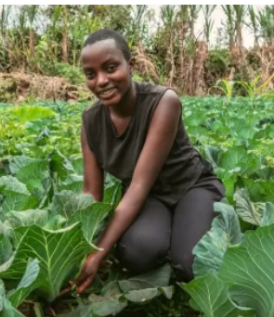
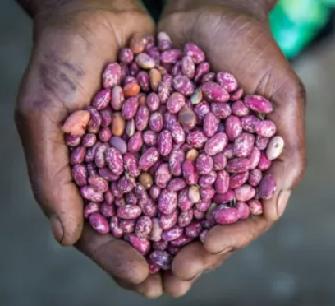
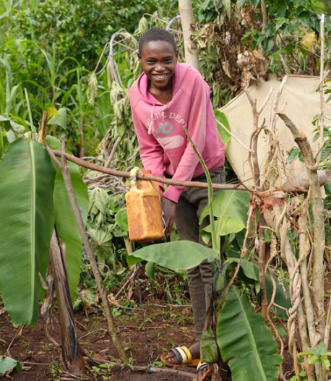
How your church can help
£100 could provide training to improve the quality of soil and increase crop yields.
£250 could enable farmers to grow enough food all year round in the face of the changing climate.
£400 could provide training in all kinds of technologies such as the keyhole garden.
Find out how you can give the gift of education this Christmas
rippleeffect.org/church-xmas

Slide 11
How your church can help
You could:
Donate your Christmas collection
Host a Christmas carol service evening
Donate to a whole church Christmas card for everyone to sign
Find out how you can give the gift of education this Christmas
rippleeffect.org/church-xmas

Slide 12
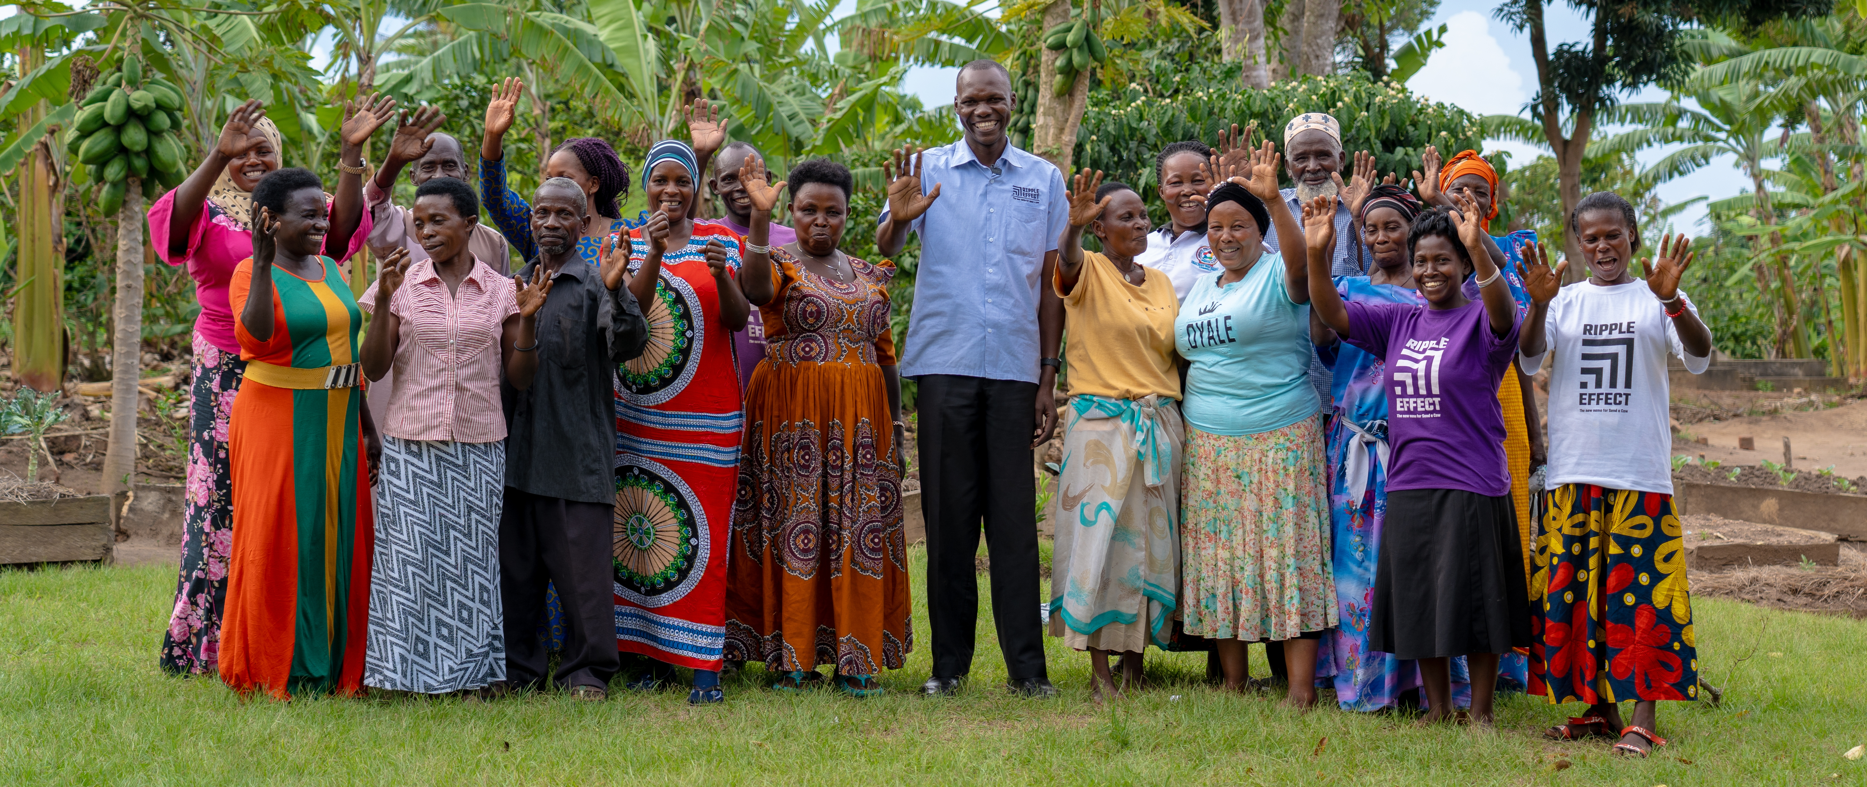
Thank you for choosing to support Ripple Effect this Christmas!
Ripple Effect farmers, Uganda
Find out how you can give the gift of education this Christmas rippleeffect.org/church-xmas

