Slide 1



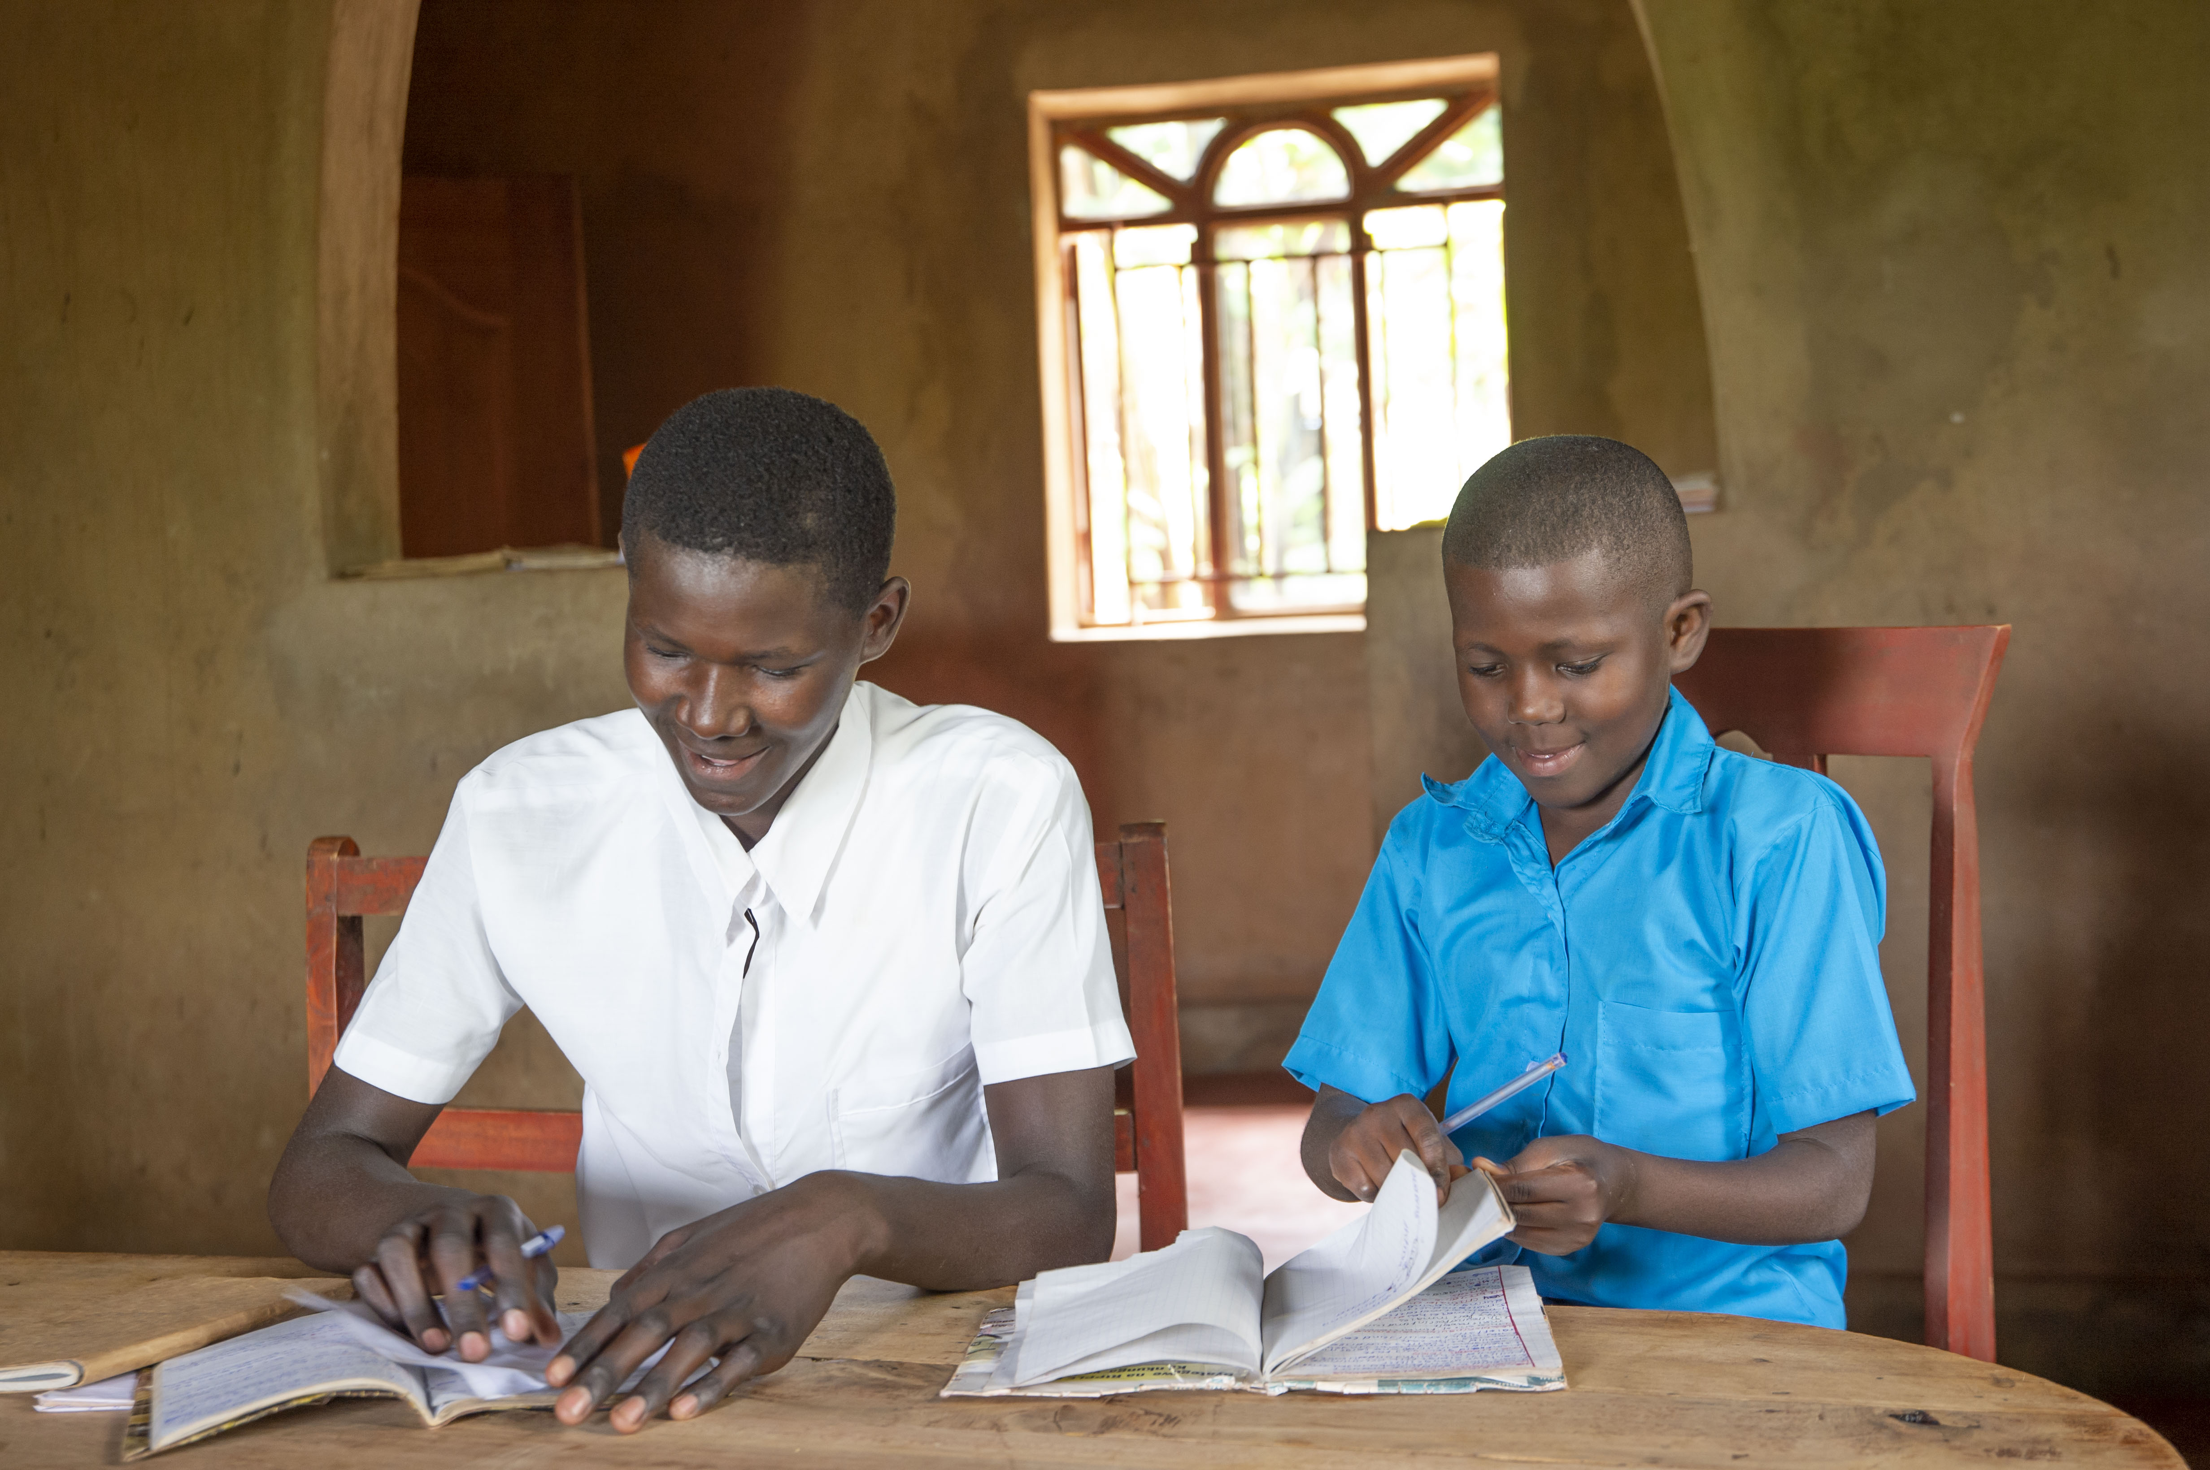
How can our school start a ripple effect?

Slide 2
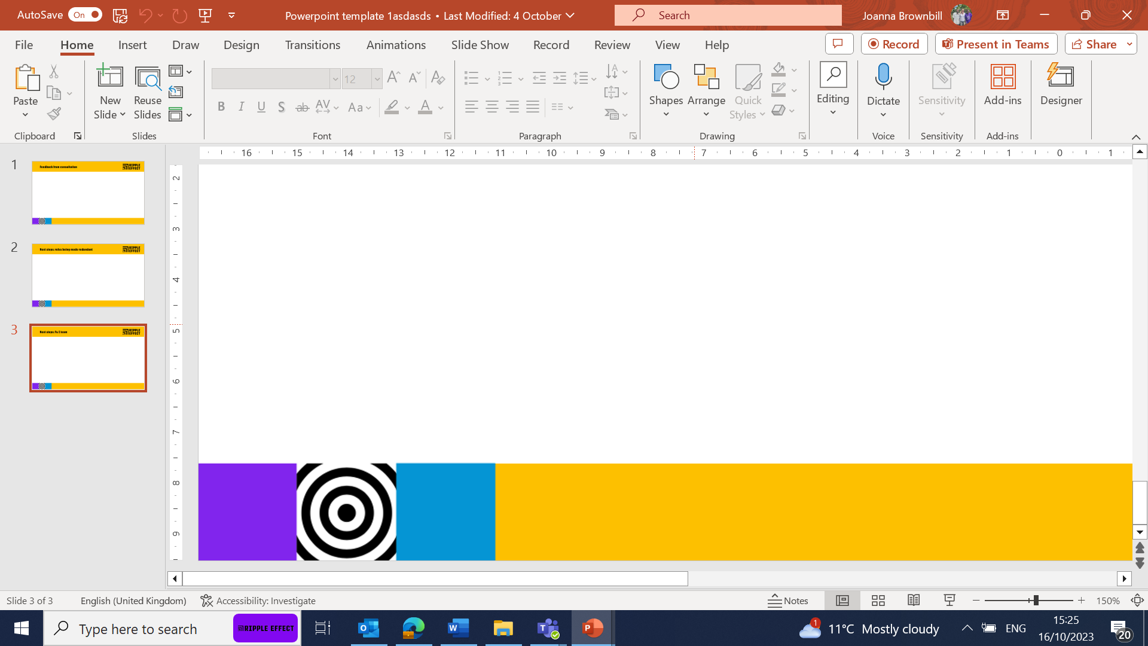
Team work

Slide 3
What is 'team work'?
Working together to achieve a common goal

Slide 4
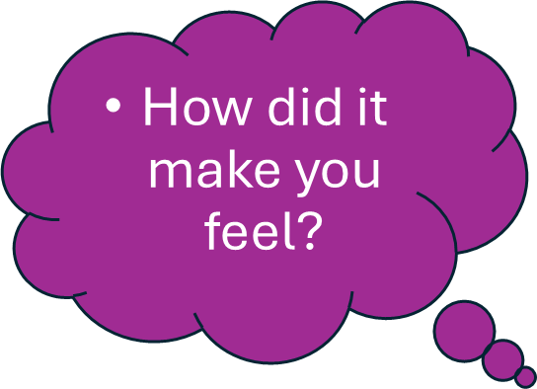
Can you think of a time that you worked in a team?
What did you do?

Slide 5
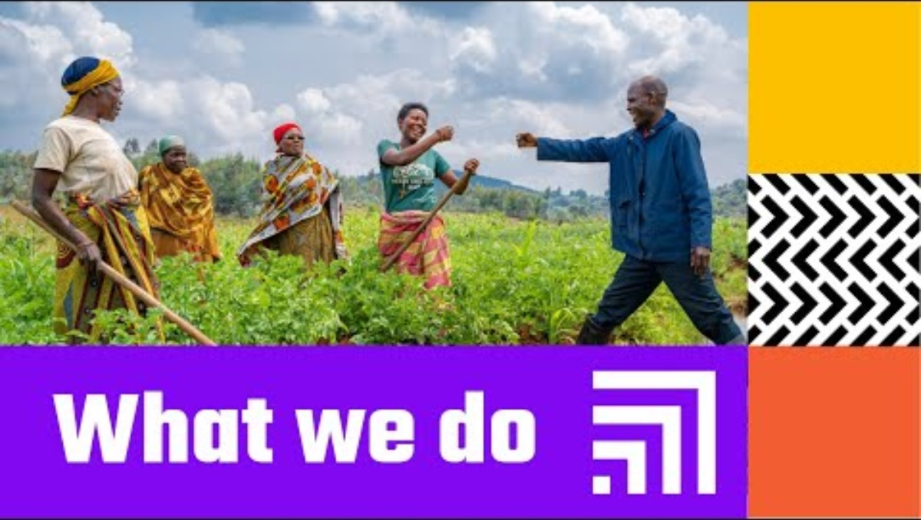
Who are Ripple Effect?
Who are Ripple Effect?
Ripple Effect: what we do (youtube.com)

Slide 6
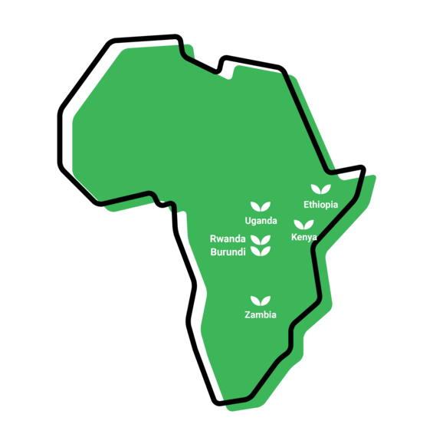
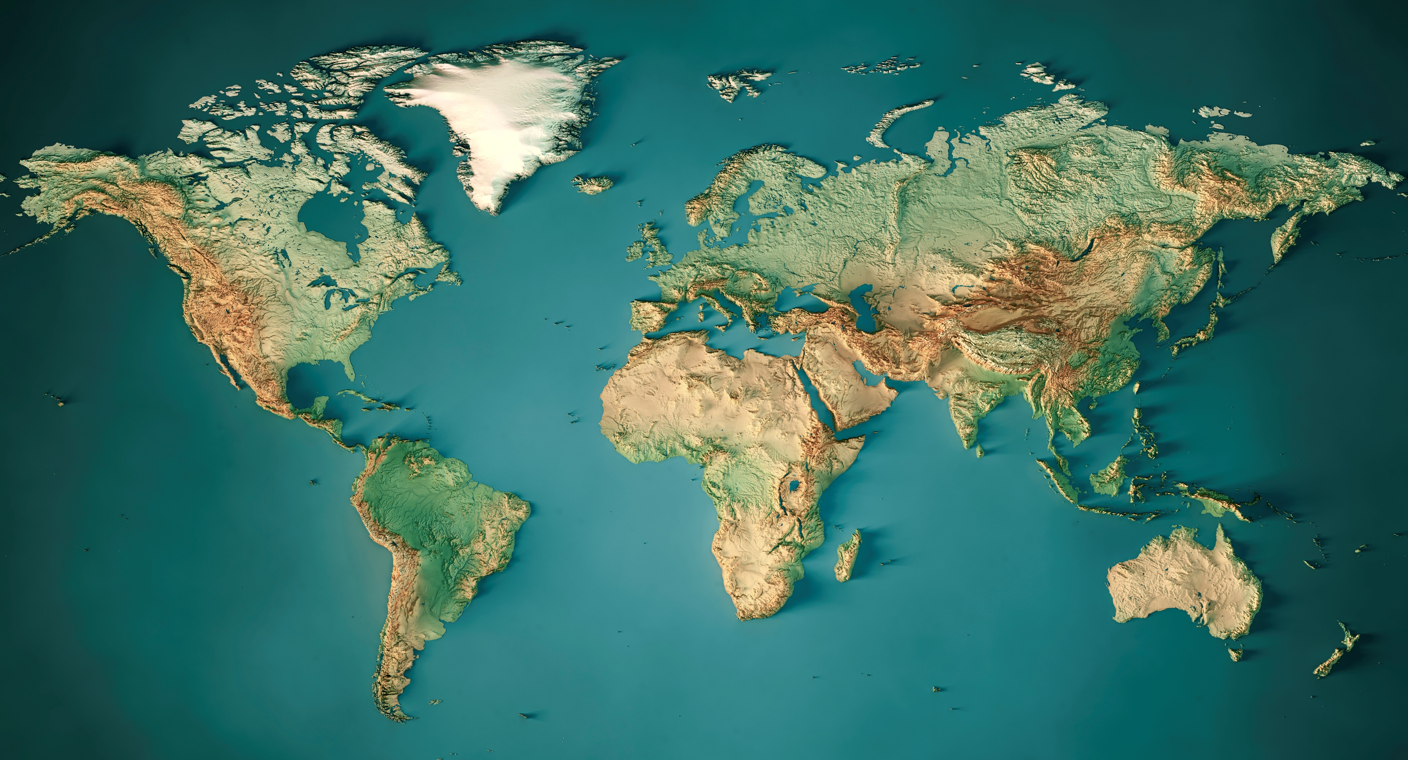
Africa
These are the countries where Ripple Effect works

Slide 7
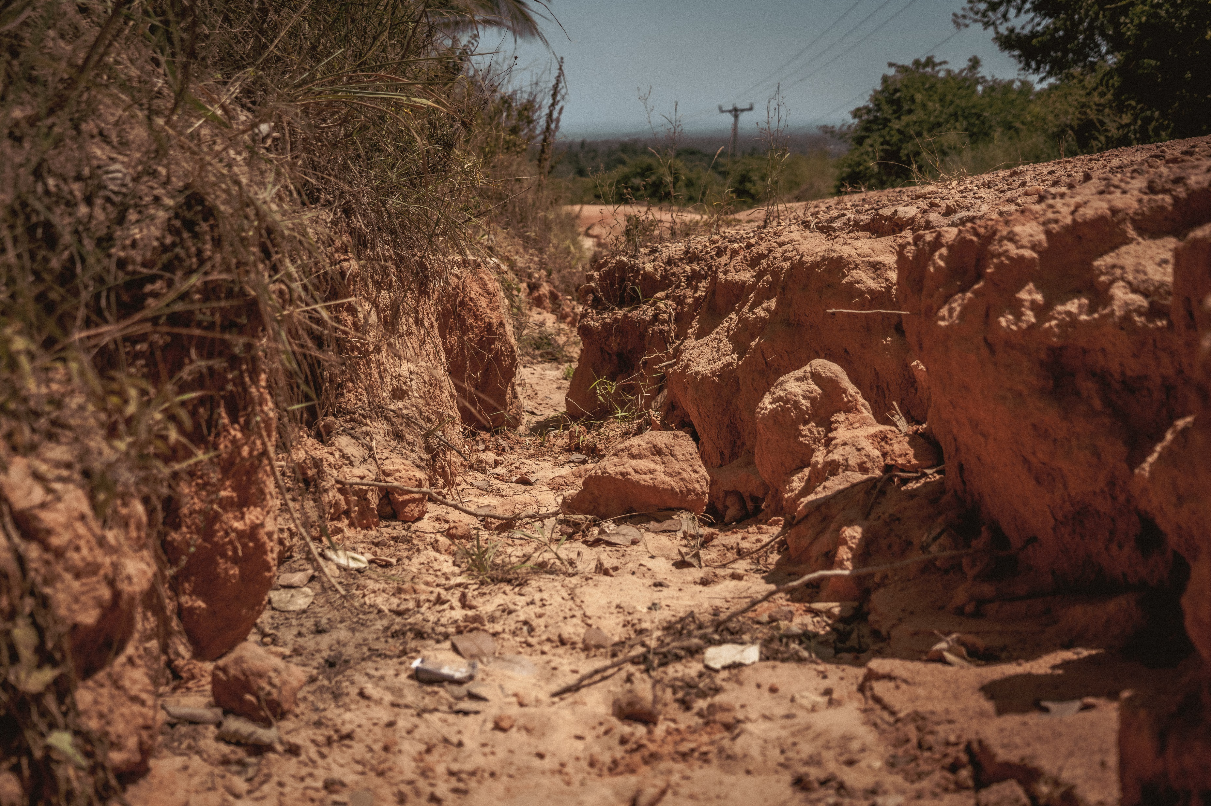
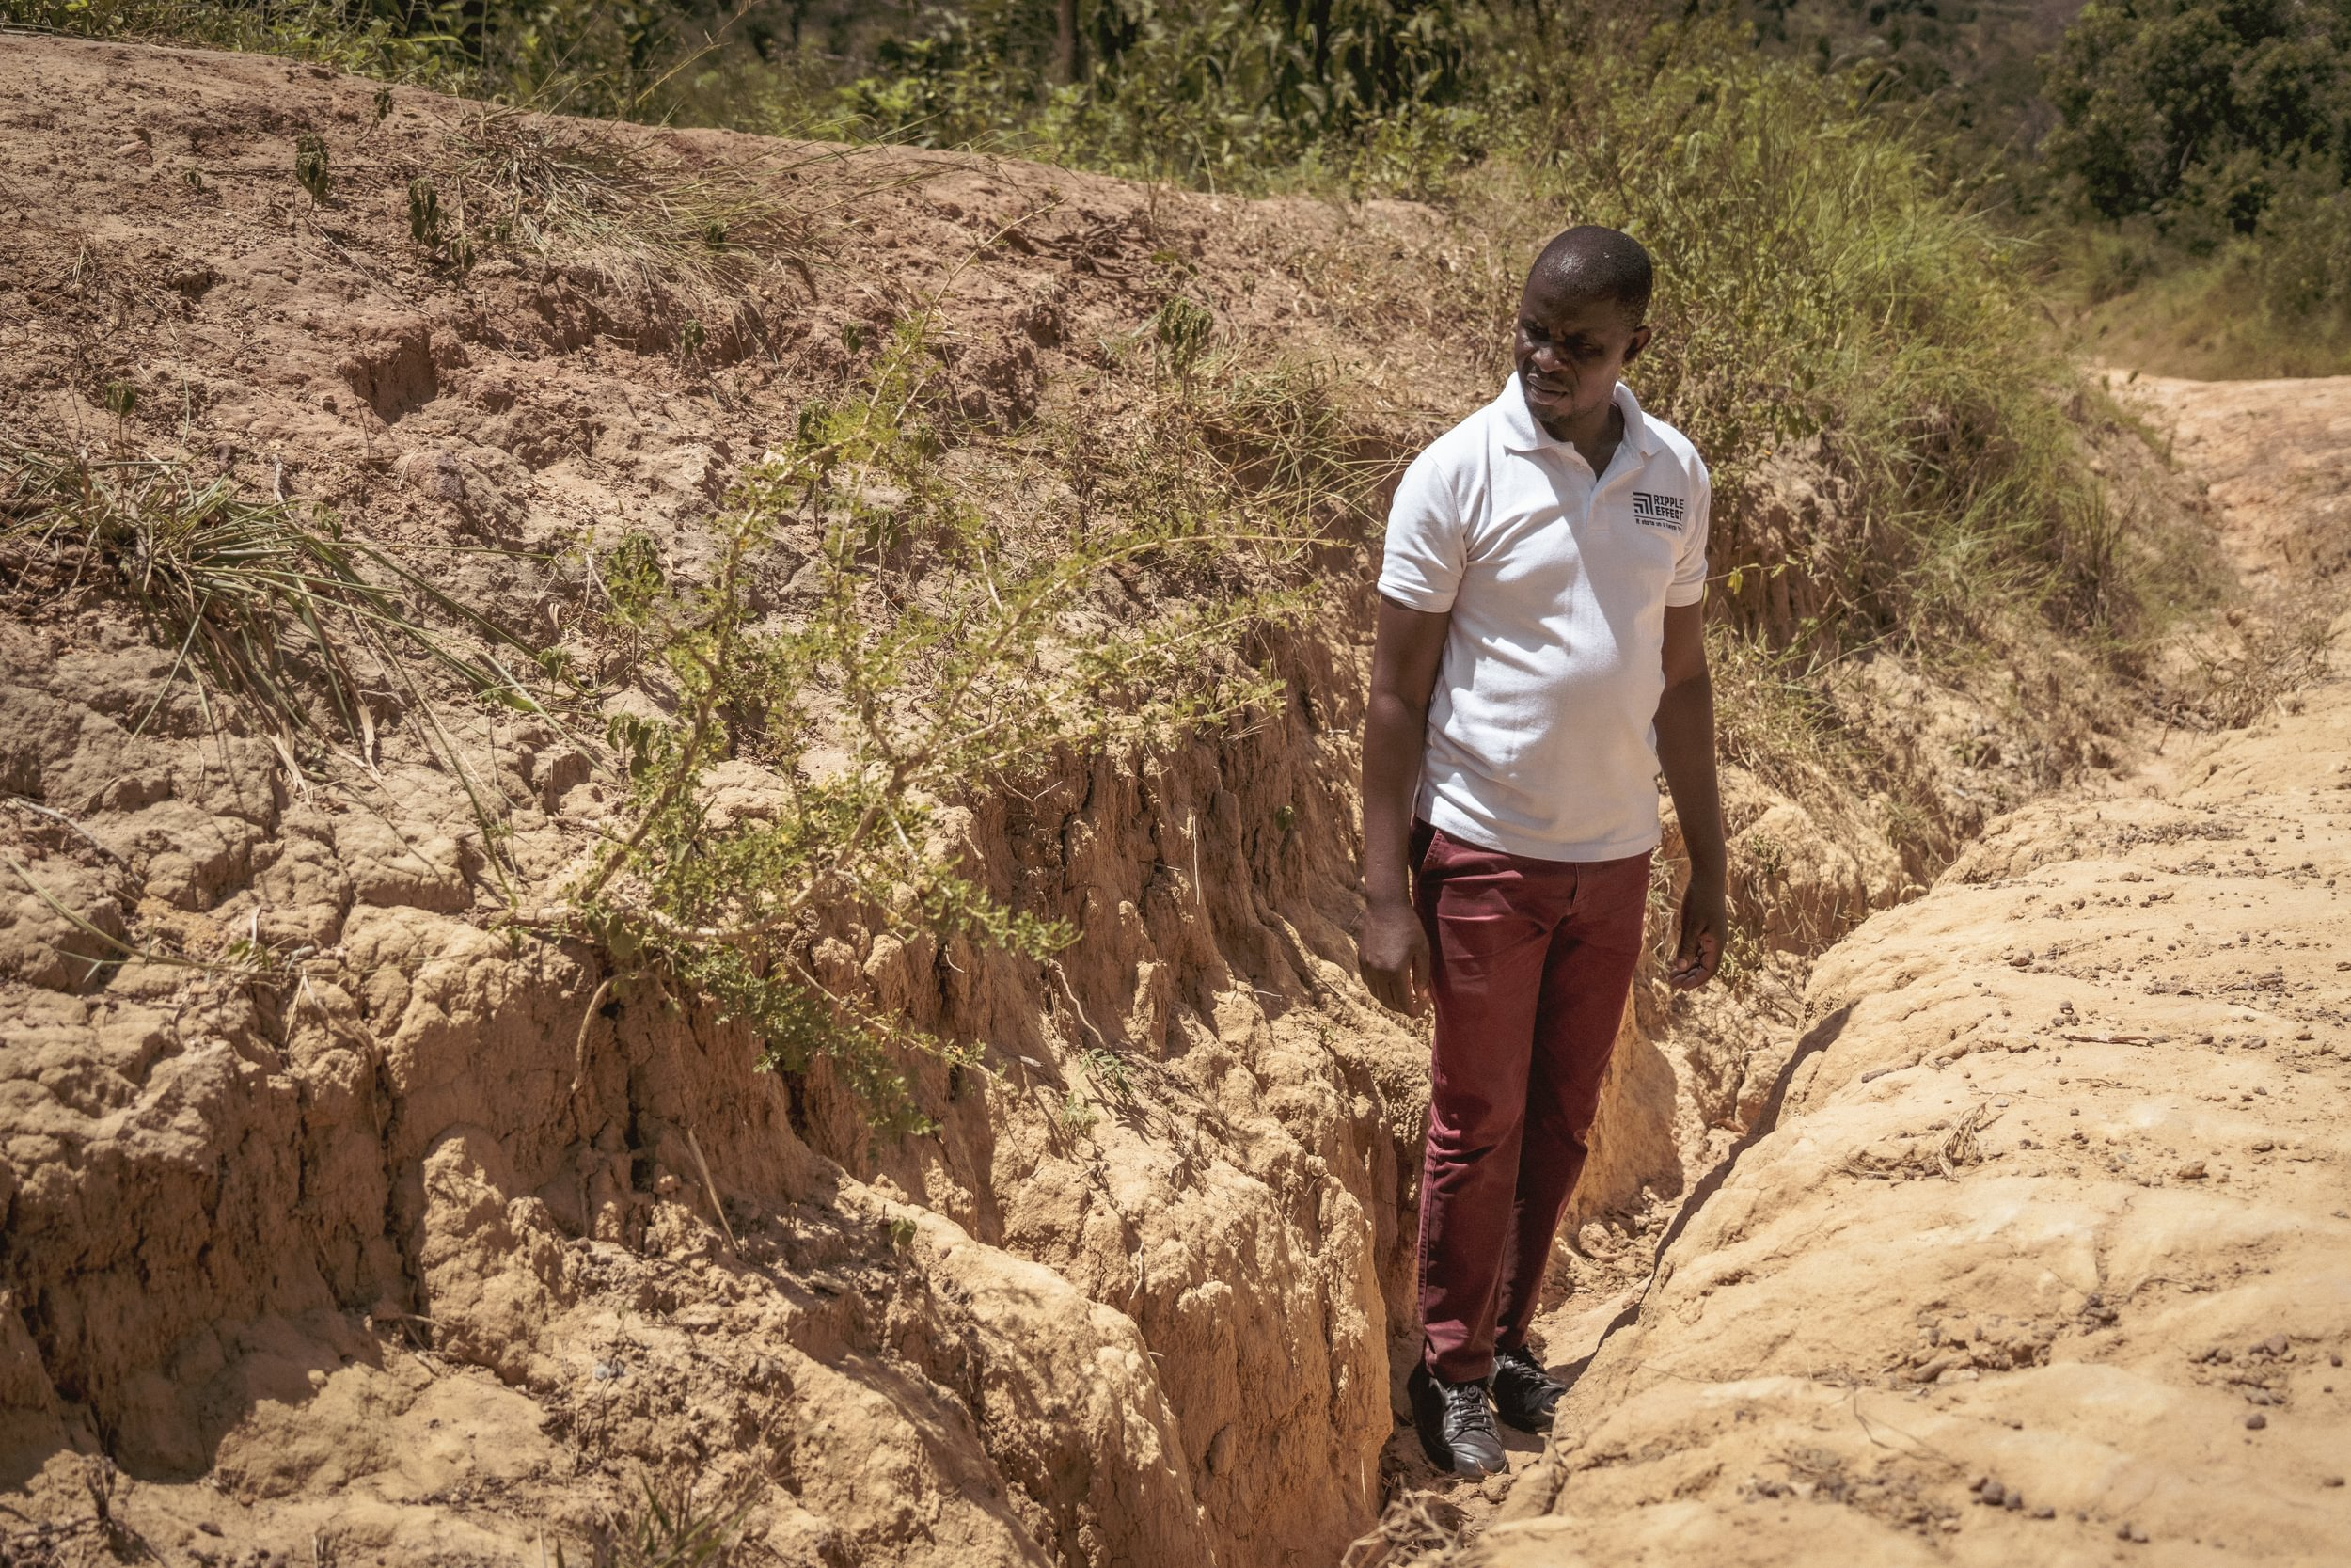
Kenya, Africa
Sandy soil which is poor at holding water and nutrients for plants to grow.
Bare soil washes away in heavy rain
Project facilitator Hassan inspecting a ditch created by cascading rain waters

Slide 8
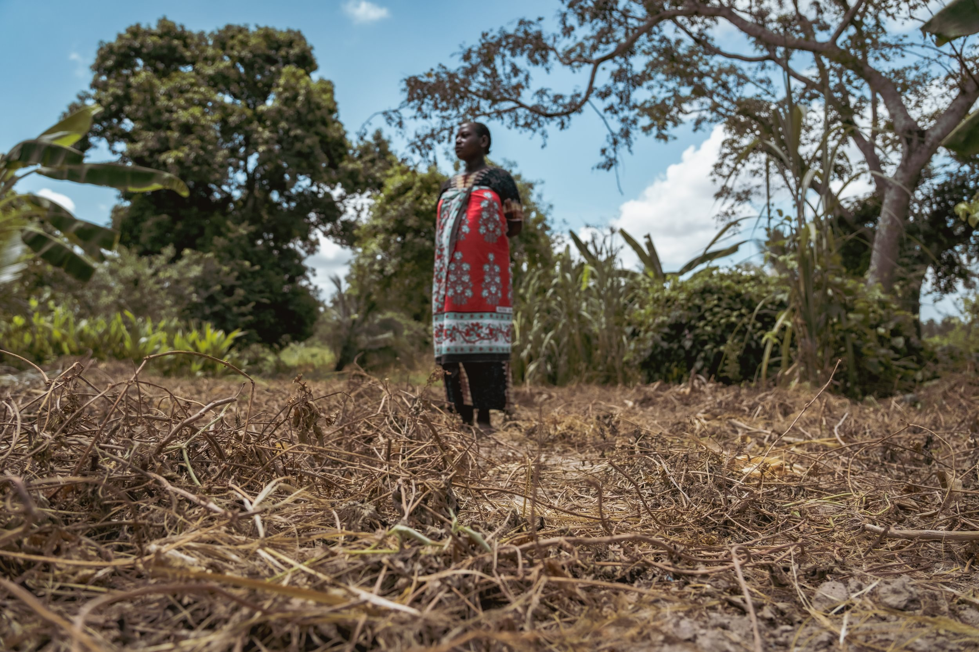
Kenya, Africa
Sandy soil which is poor at holding water and nutrients for plants to grow.
Sikukuu standing in her garden plot that has been scorched by prolonged droughts

Slide 9
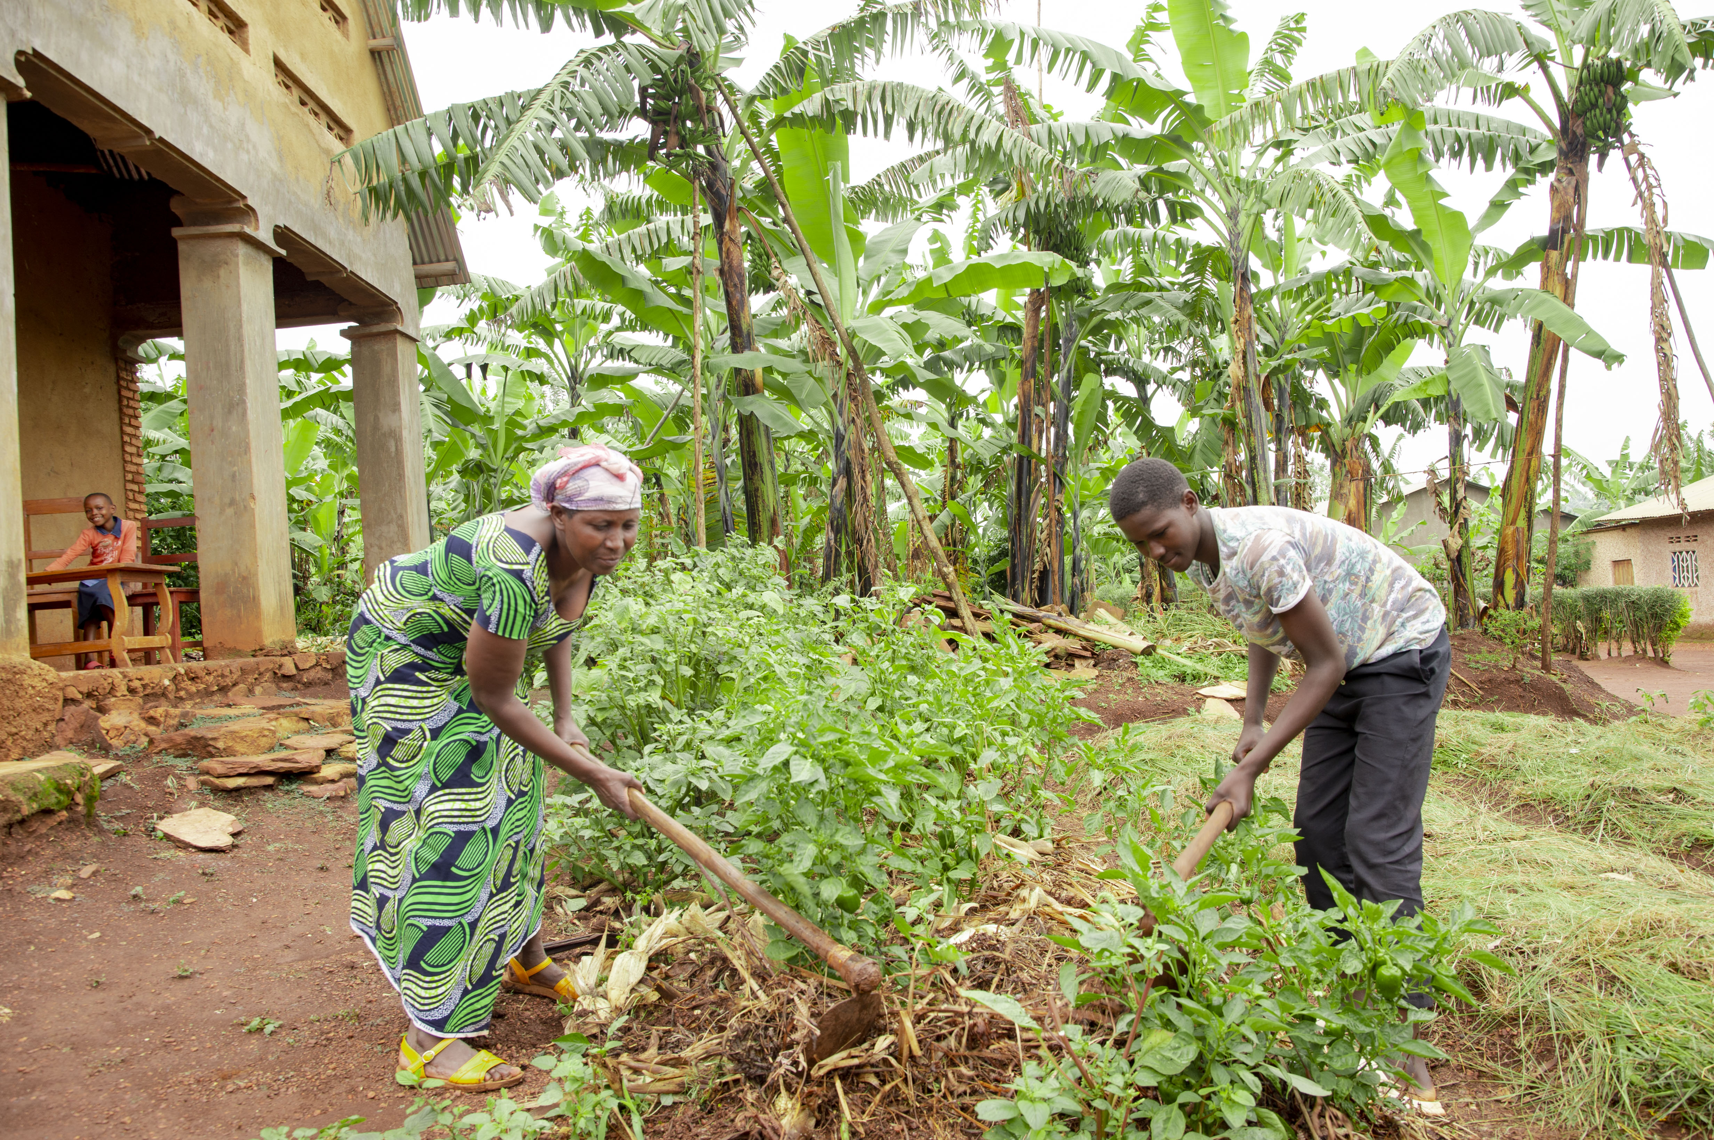
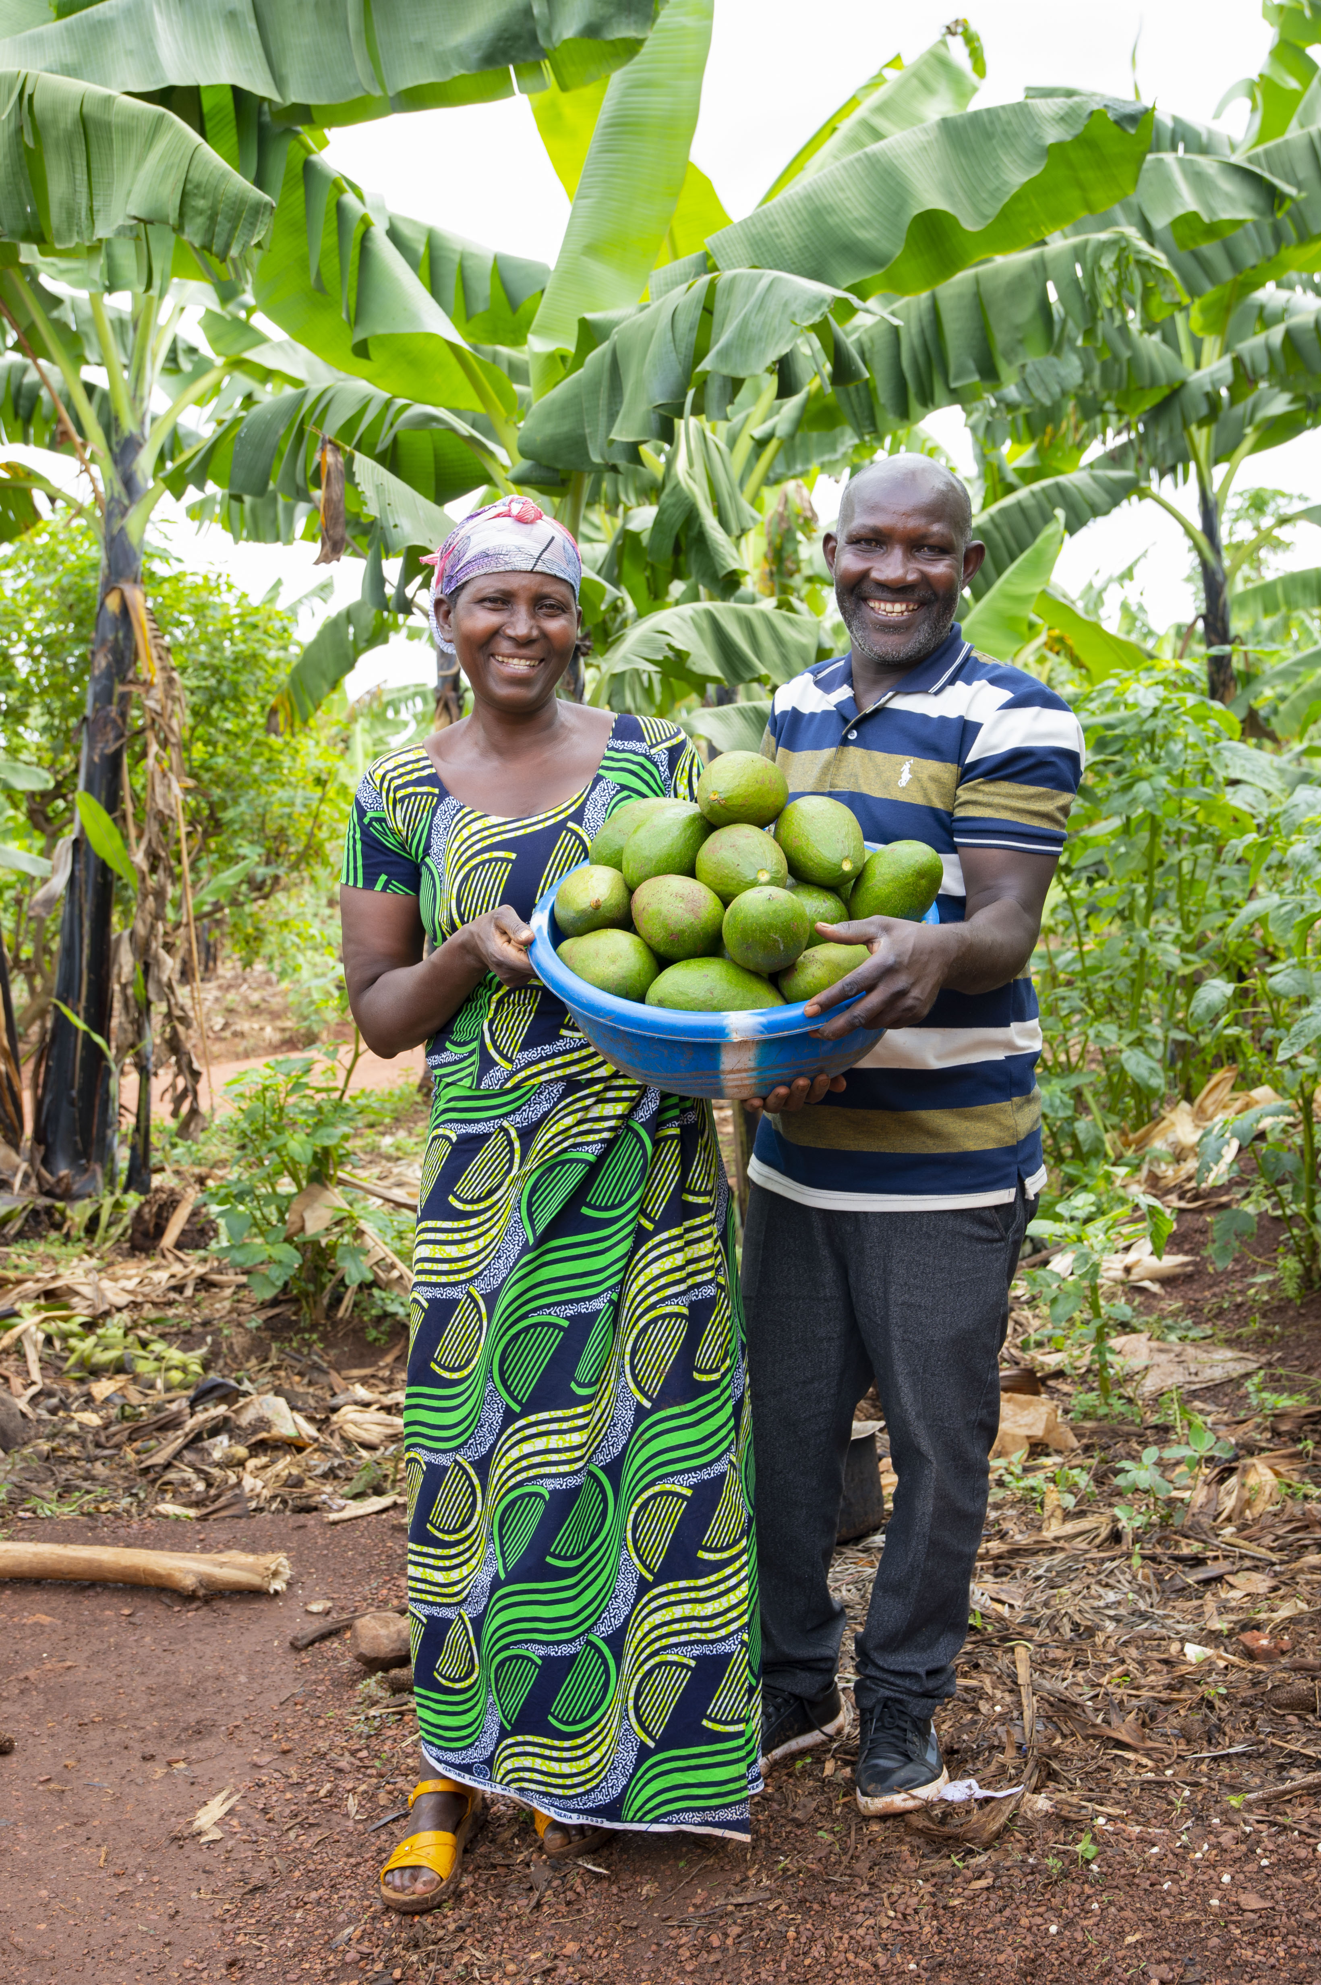
Gardens after Ripple Effect training
Therese and her husband Deogratias with avocadoes they’ve grown on their farm.
Therese and her son Eric tending their vegetable gardens
Siblings Eric and Aline studying with their school books.

Slide 10
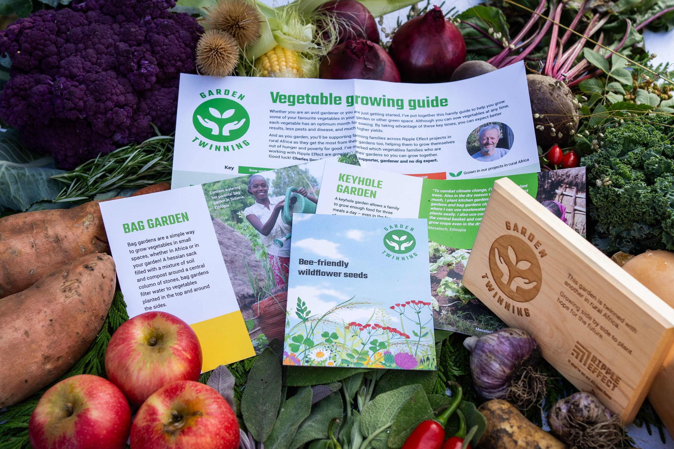
Garden Twinning Pack
Garden Twinning
Raise £120 to twin your school garden!
You'll receive a wooden plaque to display in your garden, some seeds and a vegetable growing guide.

Slide 11


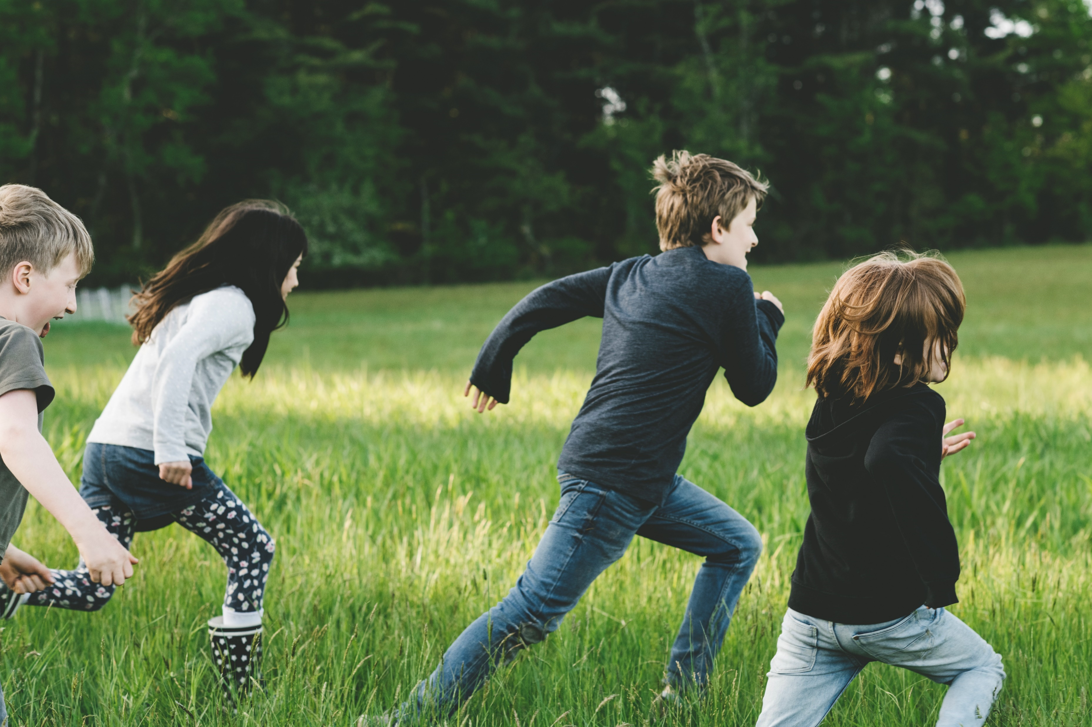
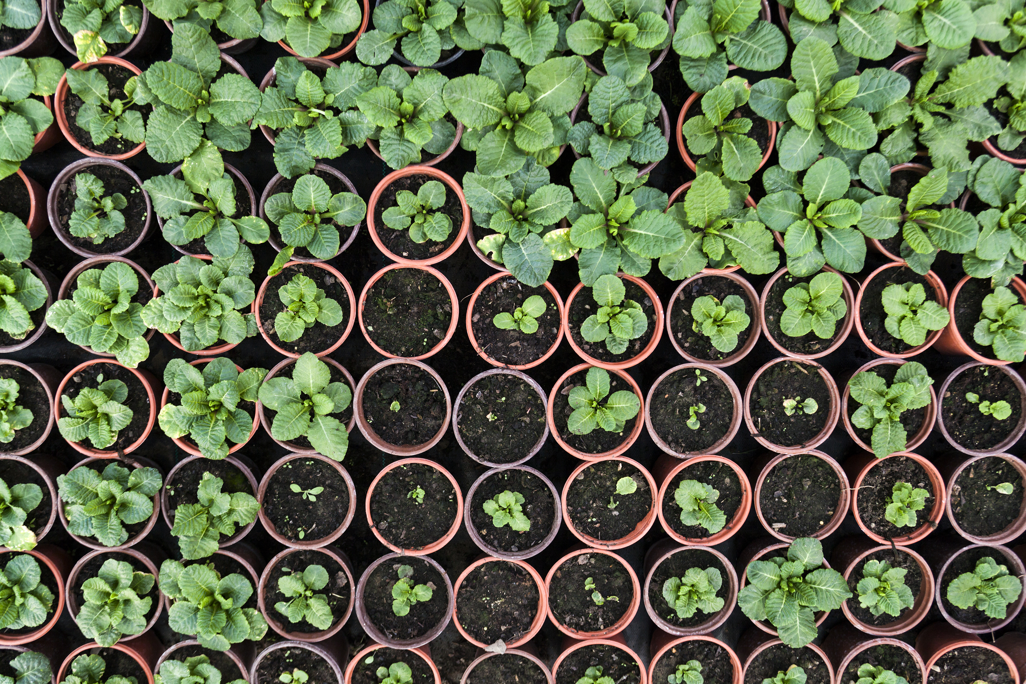
Fundraising Ideas- What can we do?
Concert?
Plant Sale or Bake Sale?
Fun Run?

