Slide 1
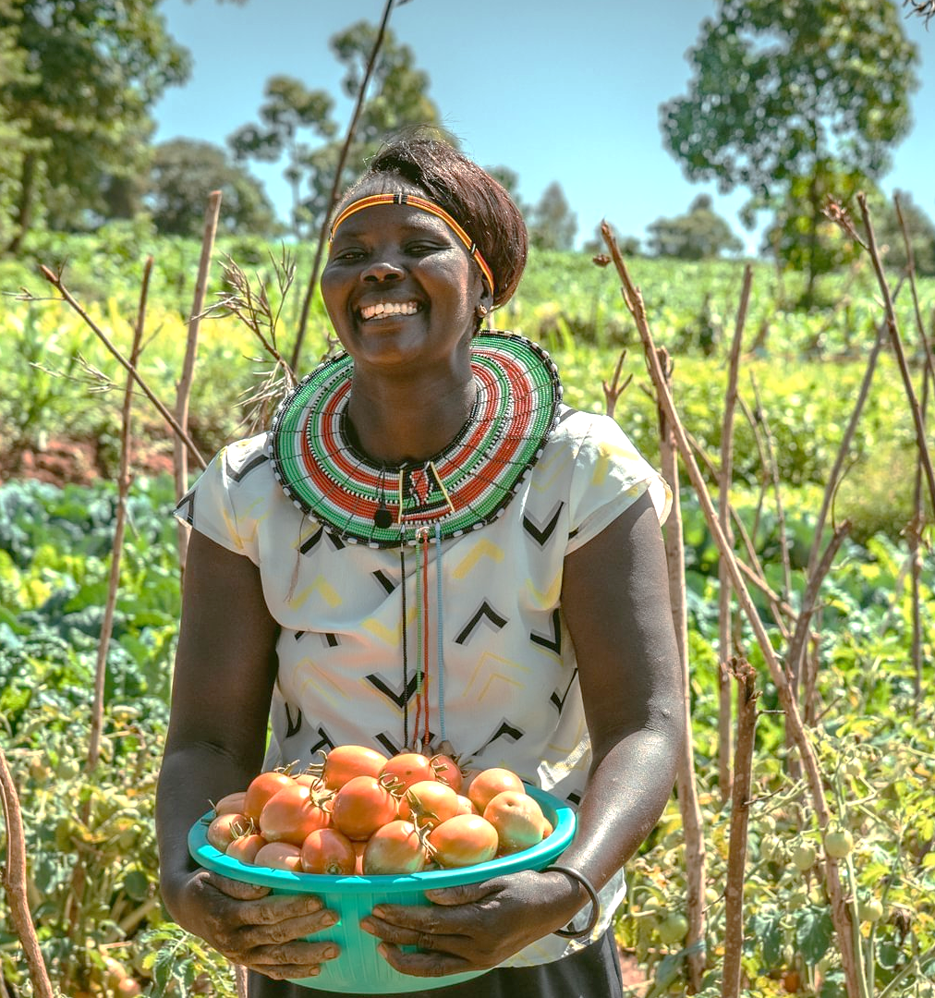
Every meal tells a story:
This Harvest you can be part of a story of growth and resilience, not hunger..
Notes:
Thank you for choosing to support Ripple Effect this Harvest.
In this presentation, you’ll learn about the work of Ripple Effect and find how your church can help equip rural farmers in East Africa with the seeds, skills, and support they need to grow abundant harvests and nourish their children.

Slide 2

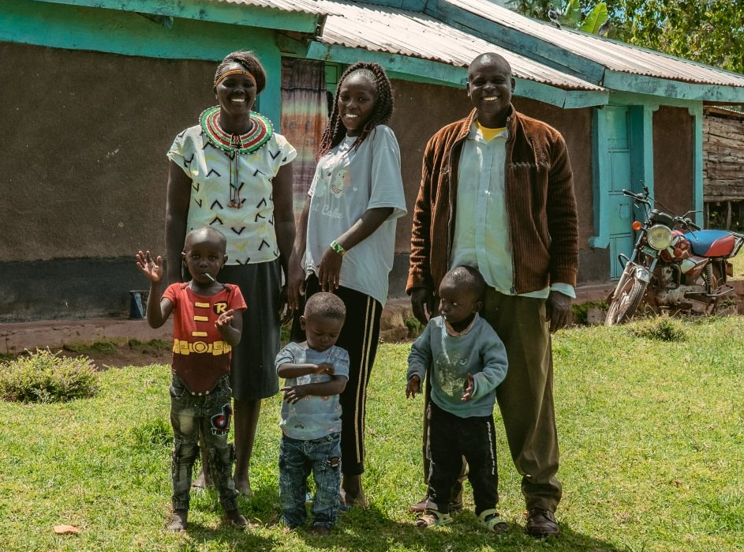
Priscillah’s story
Notes:
Priscillah, her husband and their family
Meet Priscillah…
My Name’s Priscillah, and I live in West Pokot, Kenya with my husband Dixon, five children and two grandchildren.
Not long ago, life was very difficult for us. The challenges we faced were the unreliable climate, and we didn’t know how to cope with it. We didn’t have the knowledge or access to a good variety of seeds. We also didn’t know how to plan our land or where to put what. We didn’t understand that there was potential to get so much income from what we had.
Through Ripple Effect’s training, I learned how to plan my land better, improve my soil, and manage water more effectively. Today, everything has changed.
Now I grow a wide variety of crops, including sweet potatoes, peas, legumes, and avocados. My land is carefully organised so that I can have continuous harvests throughout the year. I like growing nuts as it helps me meet the six food categories.
Growing a variety of crops has improved my soil and strengthened my family’s nutrition. Sweet potatoes are now a daily staple in our home, and I make sure that everything from the harvest is used so nothing goes to waste.
With irrigation from a nearby river and improved composting techniques, I am able to grow vegetables even during the dry season, when food used to be scarce.
This improved harvest has changed our family life. We now eat a wider variety of nutritious foods, and my children are healthier and better nourished.
Our income has also increased through the sale of surplus produce, helping us meet our essential needs. We don’t have any financial constraints these days.
My husband Dixon has also seen the change. He recognises both the improved harvest and my growing confidence and leadership. Together, we are building a more secure future from our land.

Slide 3
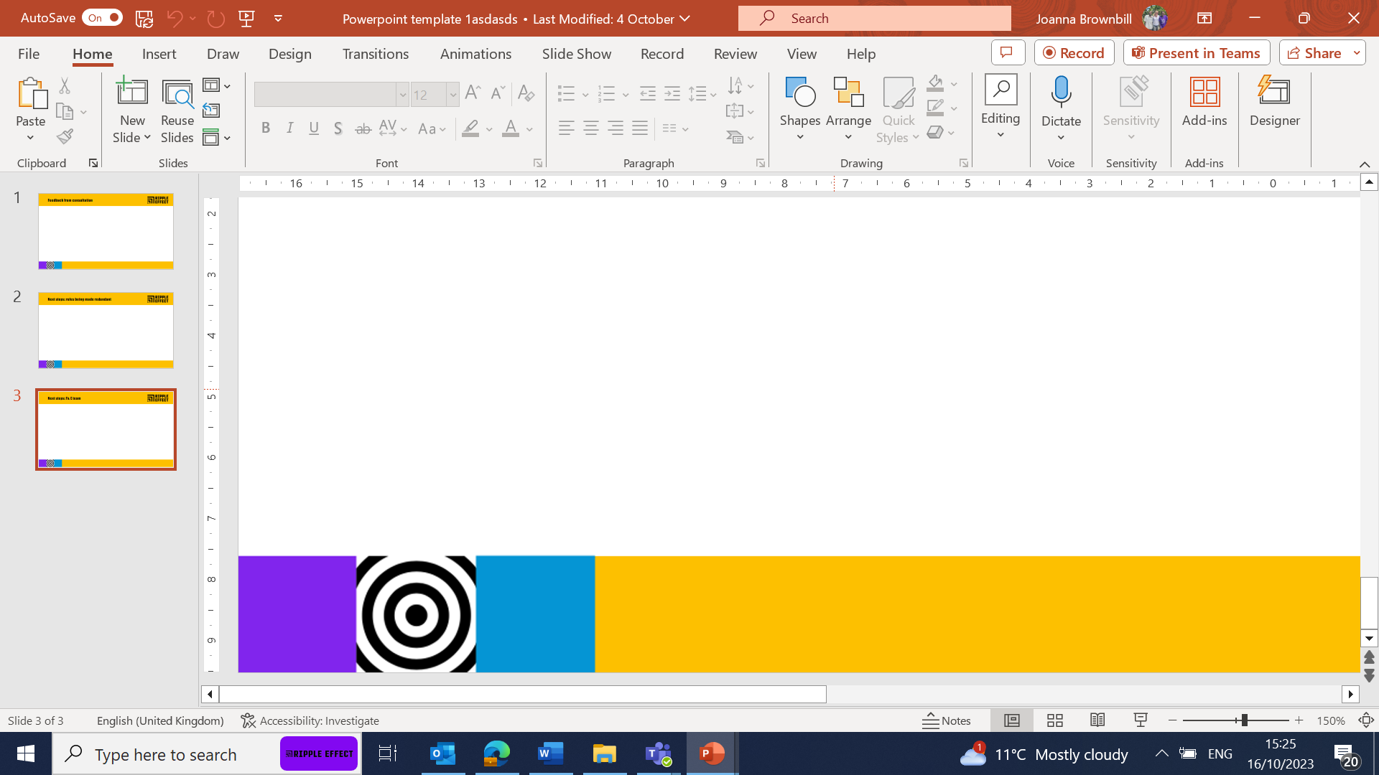
Therese’s story
“Now I can grow all the food my family needs… better nutrition is making my family stronger.”
Priscillah, Ripple Effect farmer, Kenya

Slide 4
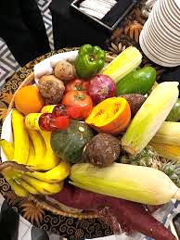
Introduction
Umuganura (National Harvest Festival in Rwanda); is Rwanda's traditional national Harvest festival, celebrated annually on the first Friday of August as a public holiday.
This year it was celebrated on 7th August
This event embodies gratitude, unity, and the power of collective effort. Rooted in centuries-old customs, it brings communities together to honor the land, share food, and reflect on national identity and resilience.

Slide 5
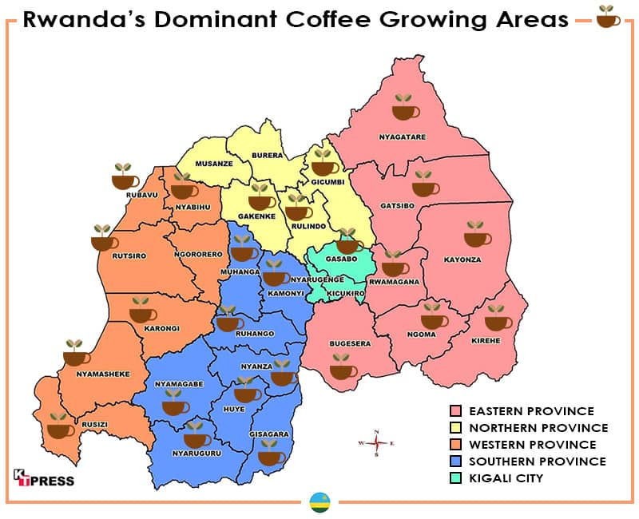
Working with Coffee Growing Communities
Notes:
Name of Project: Empowering Women and Girls in Coffee-growing Communities in Rwanda
Where is coffee grown in Rwanda?
Eastern Province coffee-growing districts such as Gatsibo, Rwamagana are more exposed to climate variability, reinforcing the need for livelihood diversification approaches that strengthen household resilience.
Gatsibo,is part of the Eastern Province coffee belt.

Slide 6
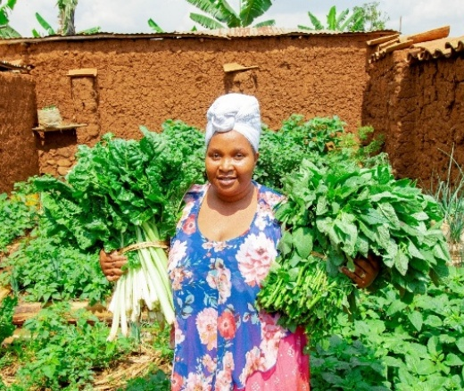
Setting Context
Coffee earnings are concentrated around the annual coffee harvest season
Creates periods of limited cash availability between harvests.
An integrated livelihood approach moves households from being solely coffee producers to becoming more resilient farming enterprises
Able to manage climate risks, improve incomes, and sustain coffee production over the long term.
Solange, Ripple Effect farmer, Rwanda

Slide 7
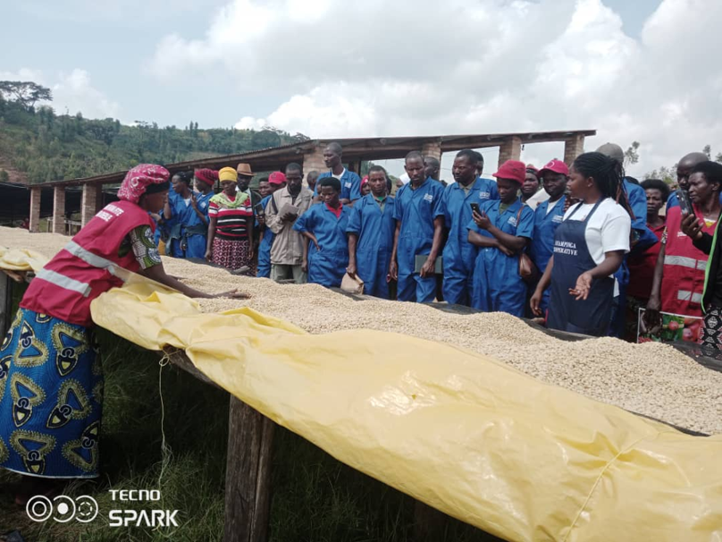
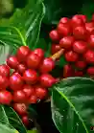

Coffee Communities in Rwanda
Climate related challenges include:
Variable rainfall and drought risk,
Lower altitude conditions,
Soil fertility pressures,
Greater need for complementary livelihood options such as livestock, food crops, agroforestry and off-farm income.

Slide 8
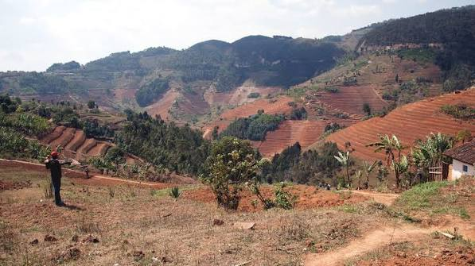
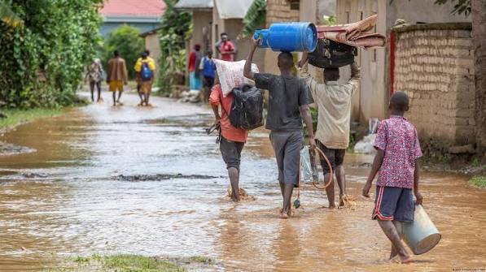
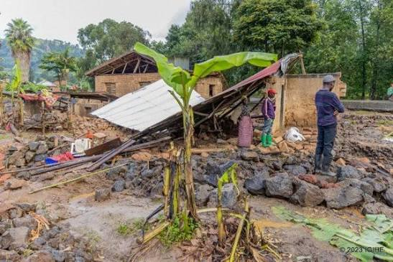
Climate shock examples

Slide 9
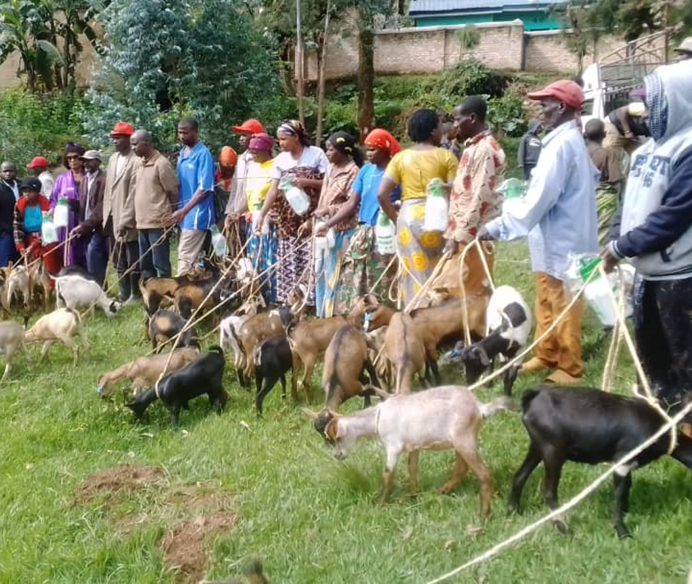
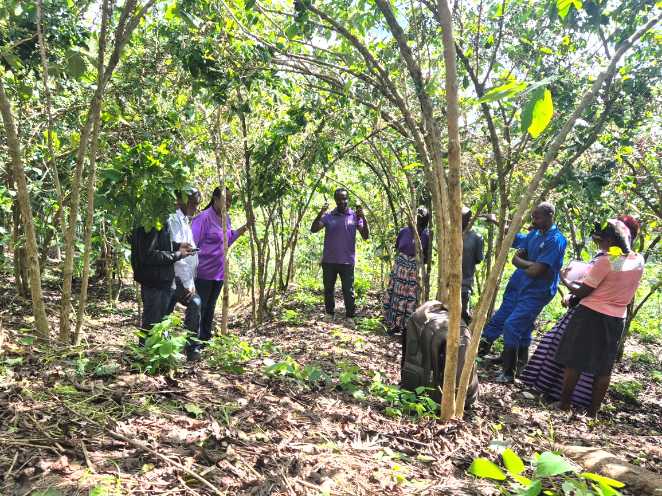
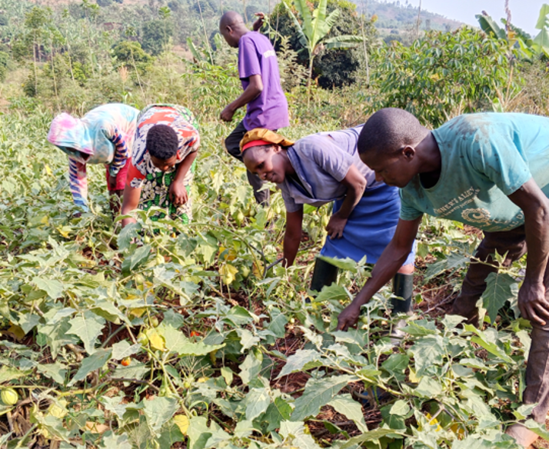
Ripple Effect Interventions
Greater need for complementary livelihood options such as livestock, food crops, agroforestry and off-farm income.

Slide 10
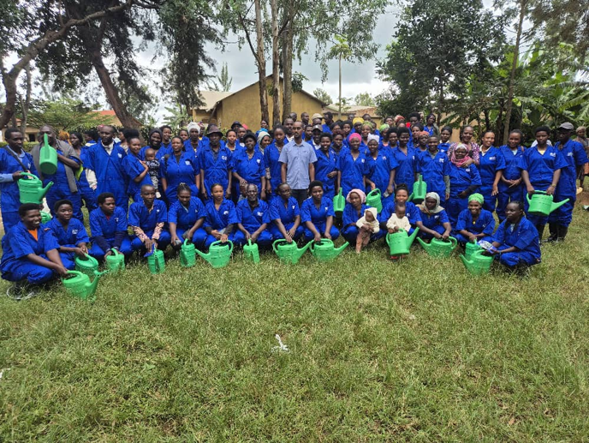
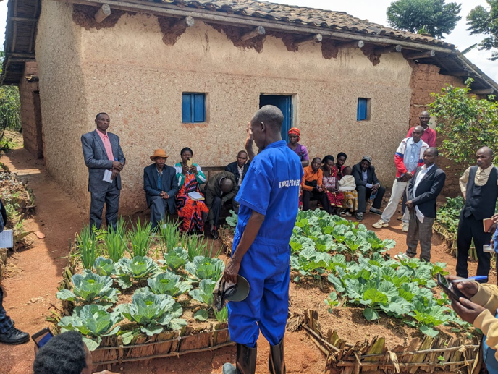
Ripple Effect Interventions

Slide 11
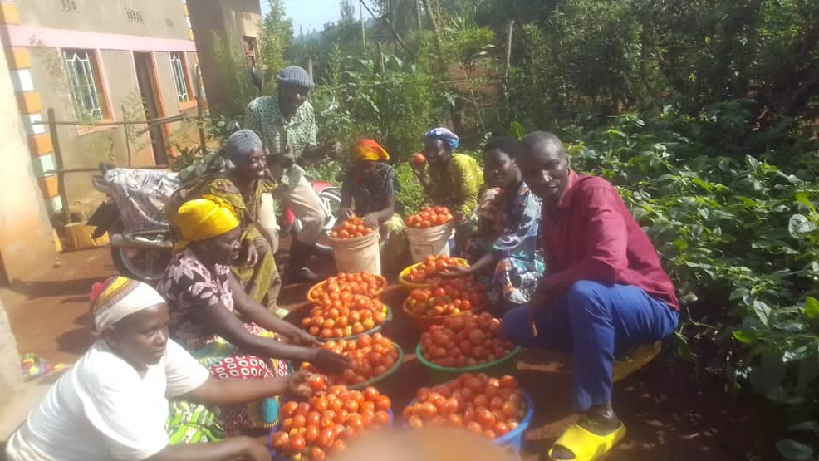
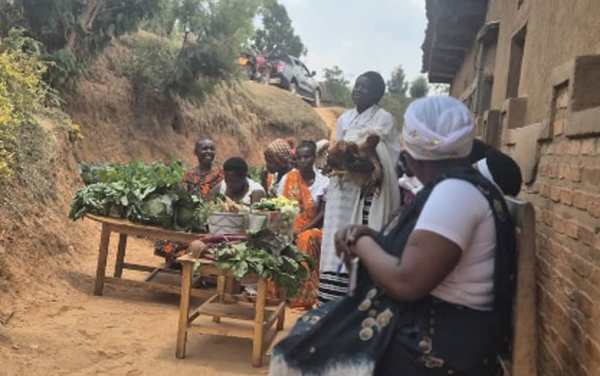
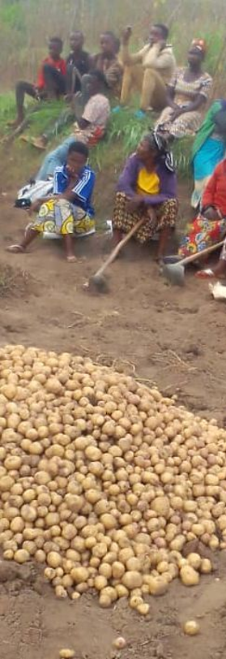
Outcome: Bumper Harvest
Good Harvest of the vegetables produced for the Coffee Growing communities : Tomatoes, Green Vegetables, Potatoes

Slide 12
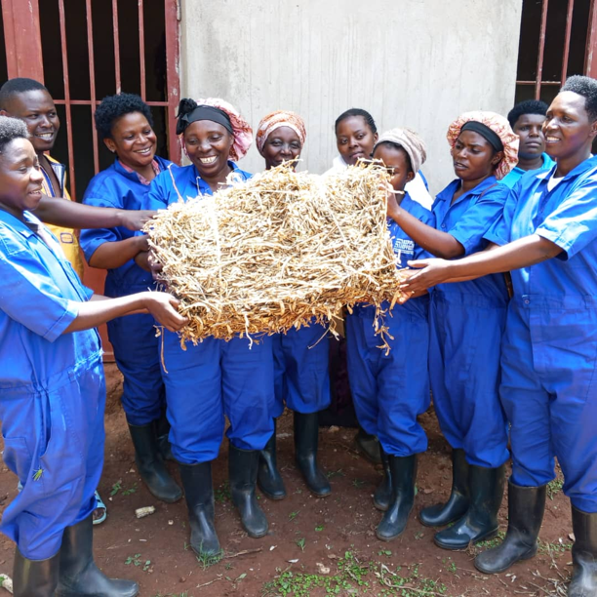
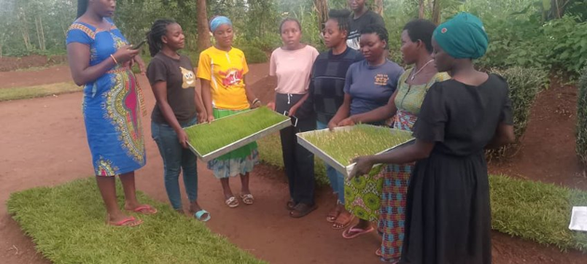
Harvesting Fodder and Feed for livestock

Slide 13
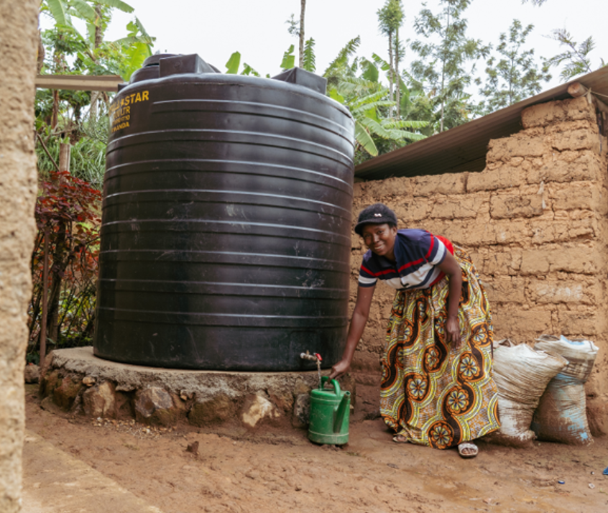
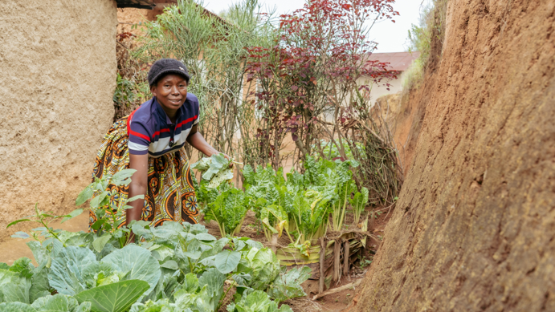
Alphonsine’s story
Alphonsine, 47 years. She lives in Muliza village, Nyagisozi sector, Nyaruguru district, southern Rwanda.
A widow with 5 children
Climate shocks – Lack of water, Low rainfall, run off poor hygiene
Notes:
Family now has access to vegetables every day.
Increased income from vegetable sales.
Able to pay health insurance and school fees.
Rented additional agricultural land using a savings group loan.
Leads a self-help group of 42 members.
Trains farmers beyond her immediate group.
Participates in a network of 96 self-help groups with collective savings exceeding 50 million RWF.

Slide 14
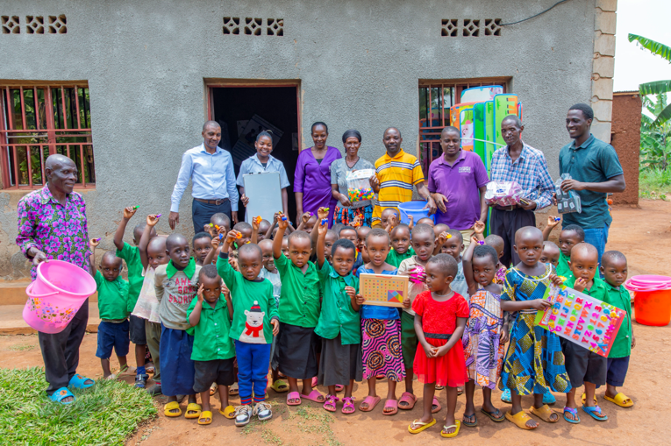
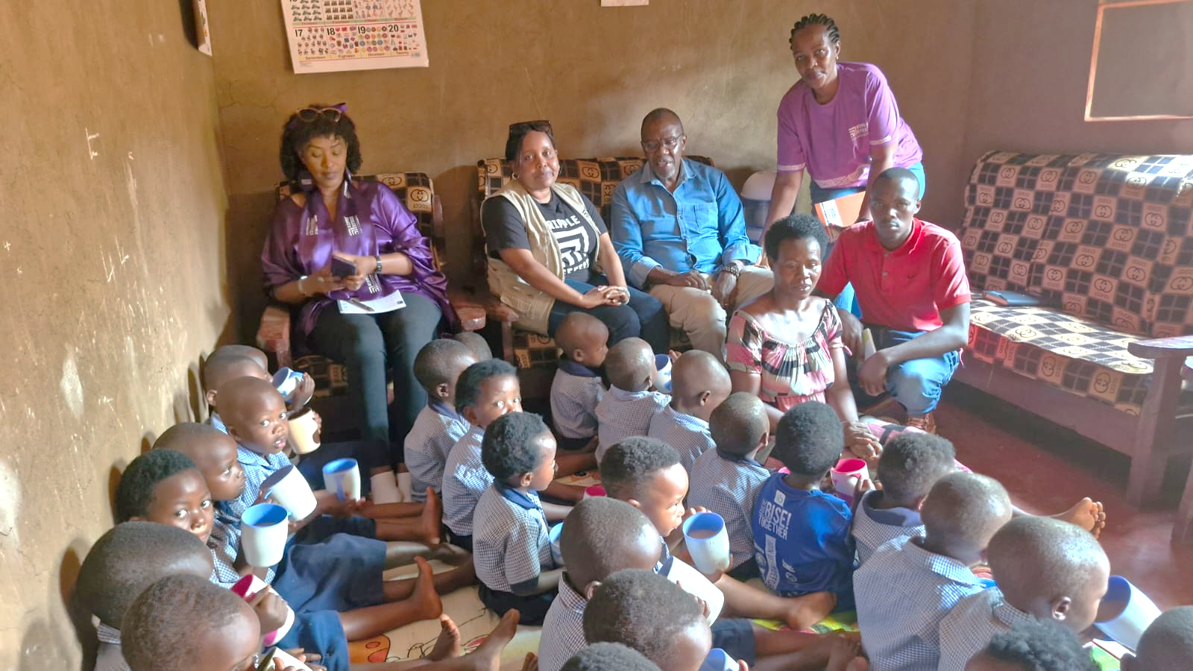
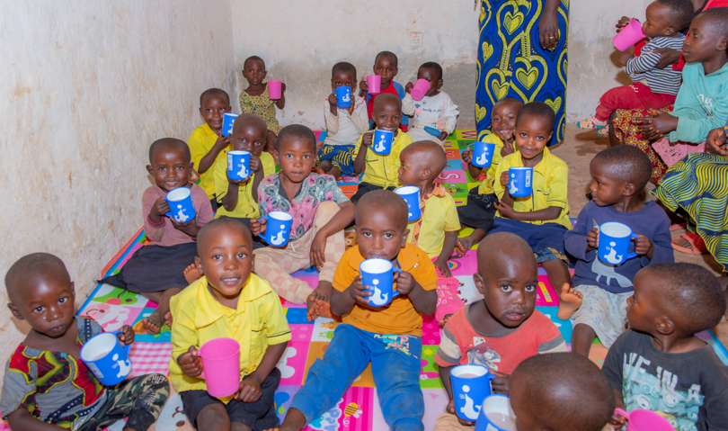
Child development Centres

Slide 15
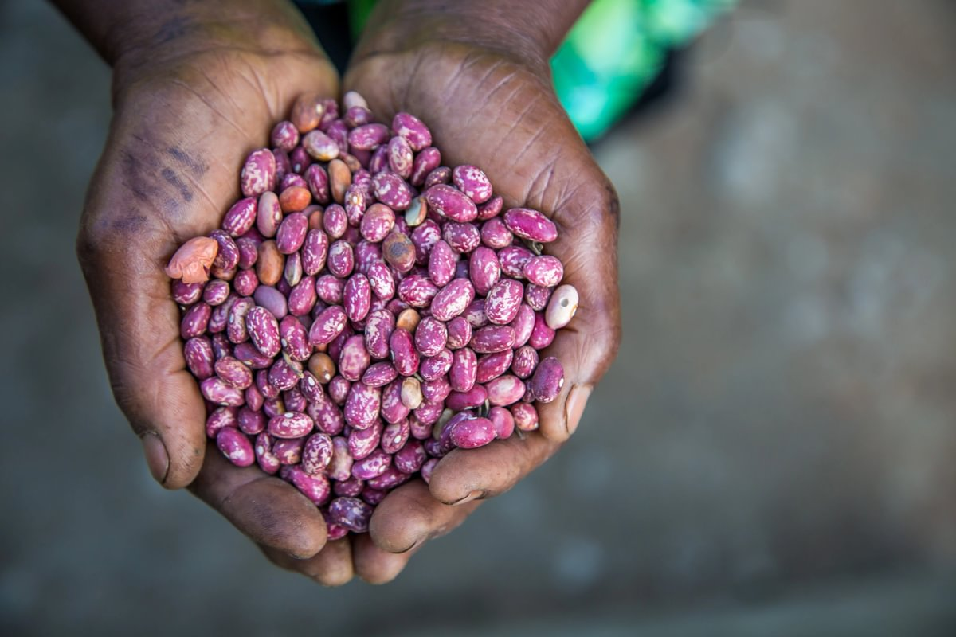
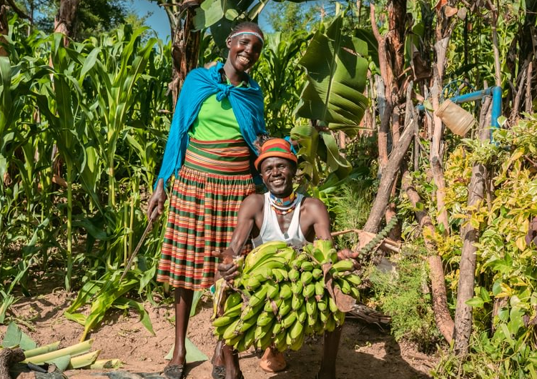
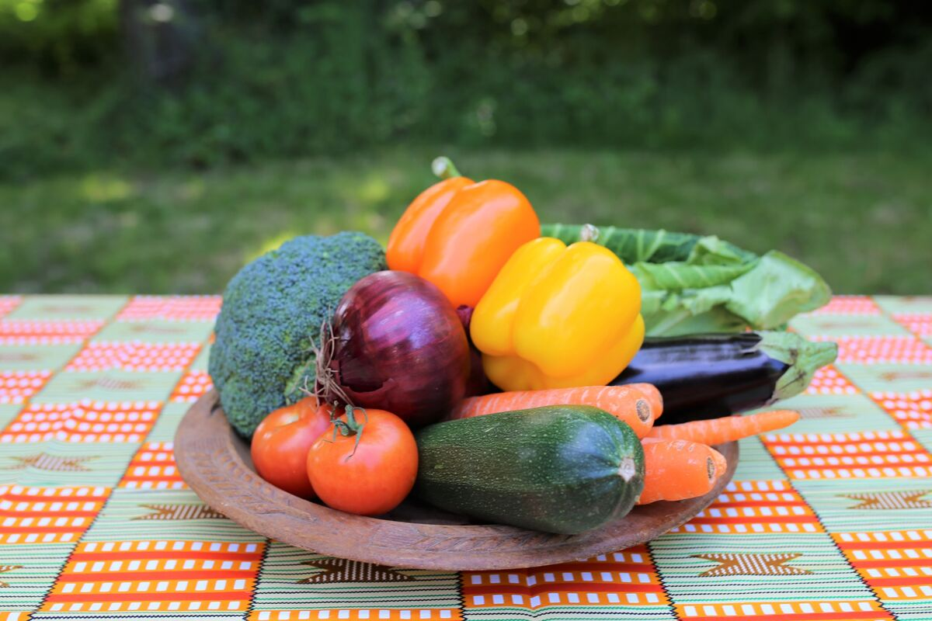

How you or your church can help
£50 could provide super strong seeds that survive extreme droughts and floods
£100 could provide a community of 30 families with banana seedlings
£250 could provide a rainbow plate of fruits and vegetables along with initial training
Whatever you give will make a difference!
Notes:
Whatever you are able to give, your donation is supporting families like Priscillah’s to restore their land for a future free from hunger. Thank you.

Slide 16
Thank you
Thank you for choosing to support Ripple Effect this Harvest.
There will be a time of prayer from 2.00-2.30, everyone is welcome!
For further information visit rippleeffect.org/harvest
or contact ann.hatton@rippleeffect.org

