Slide 1
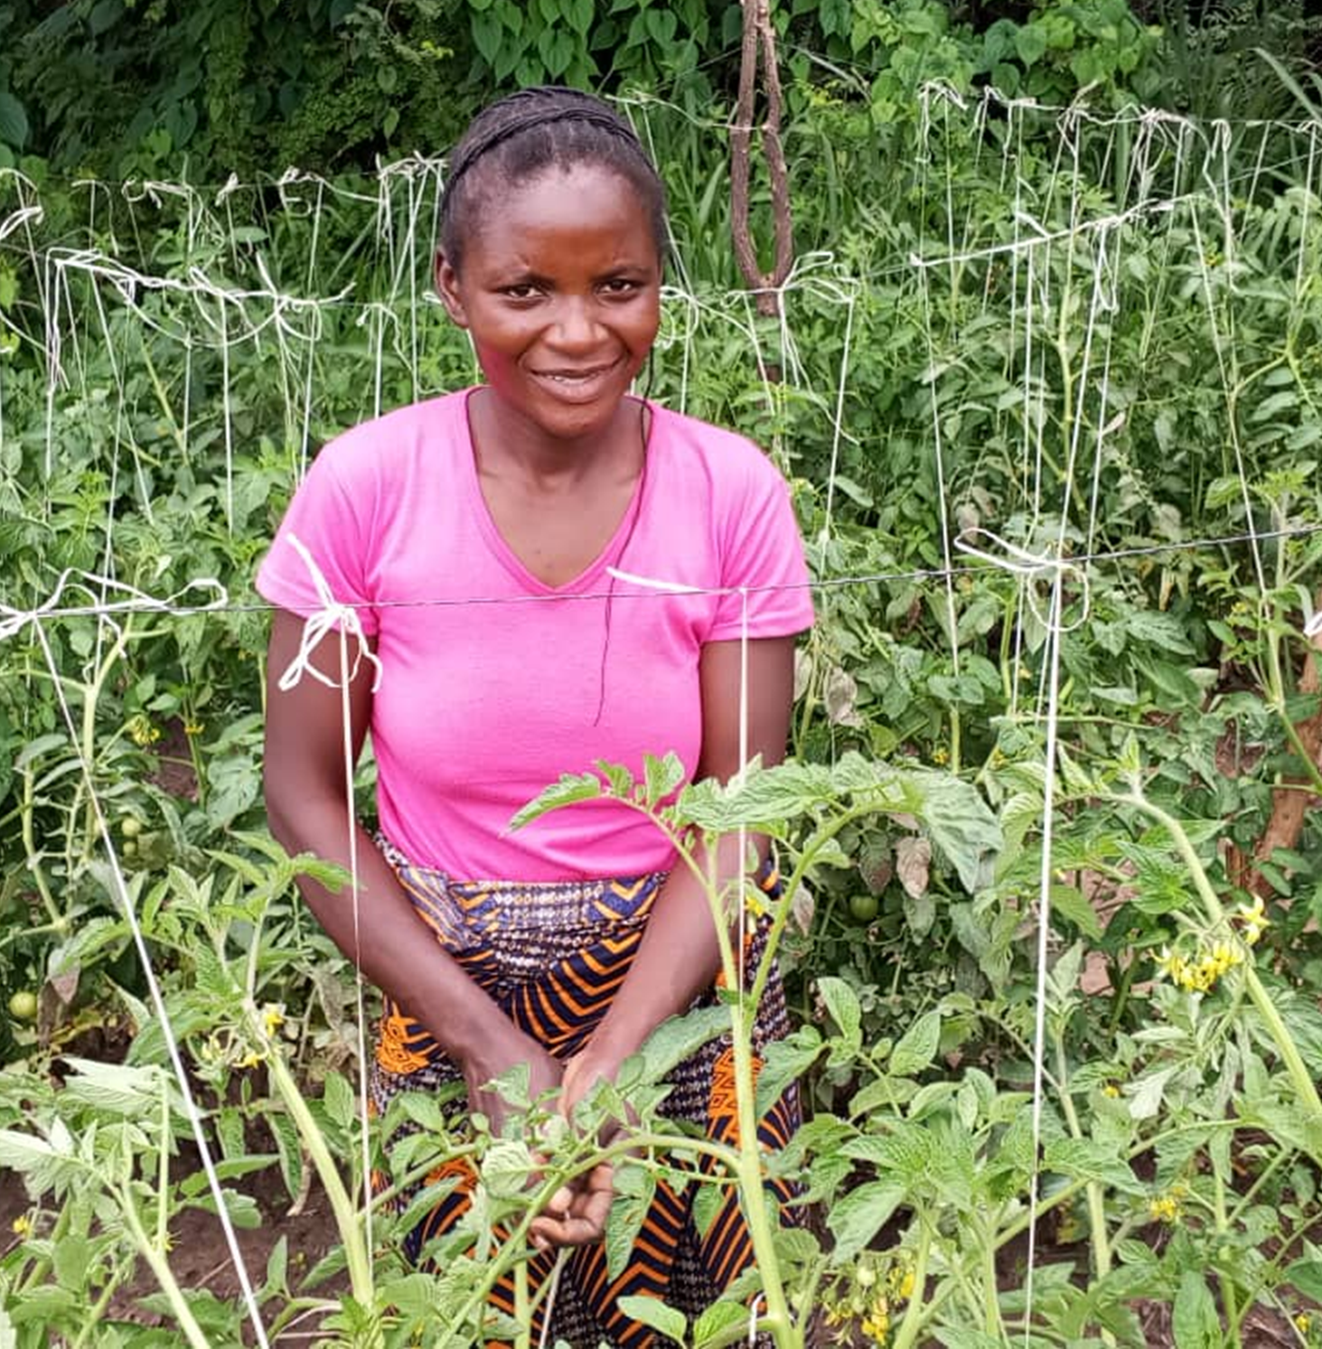
Coffee and Chat
March 26
Ann Hatton
Ripple Effect working alongside ZRDF

Slide 2
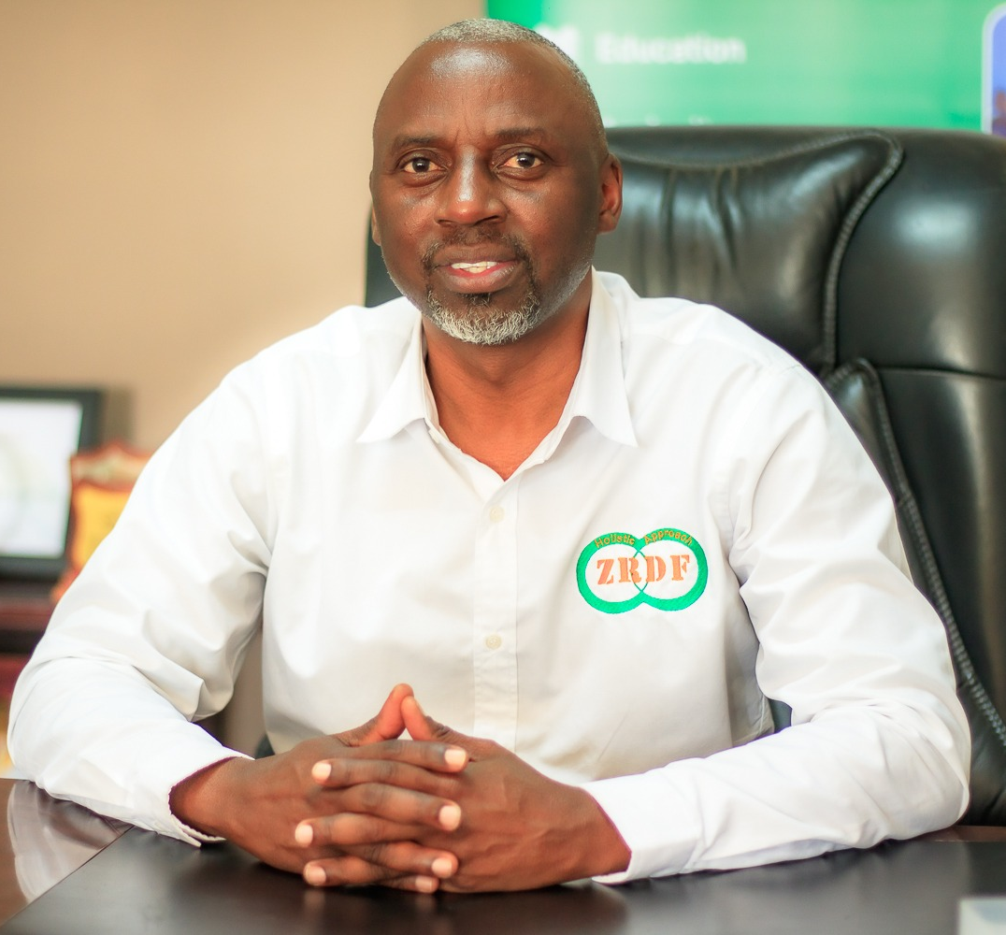
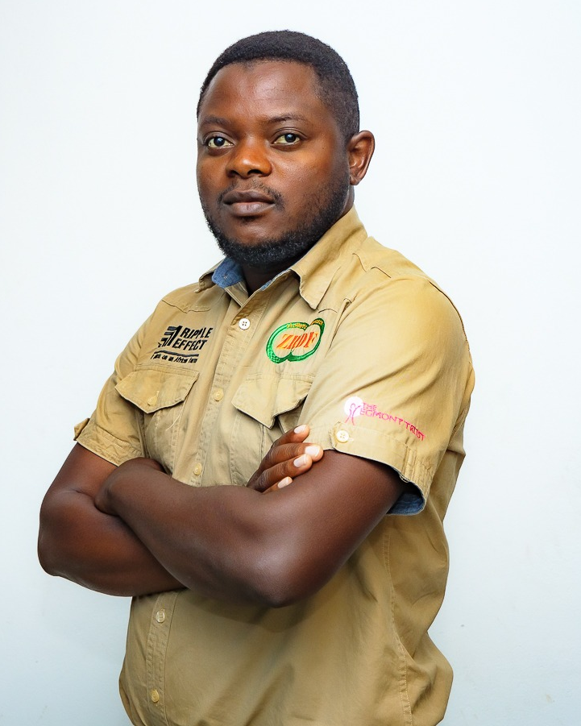
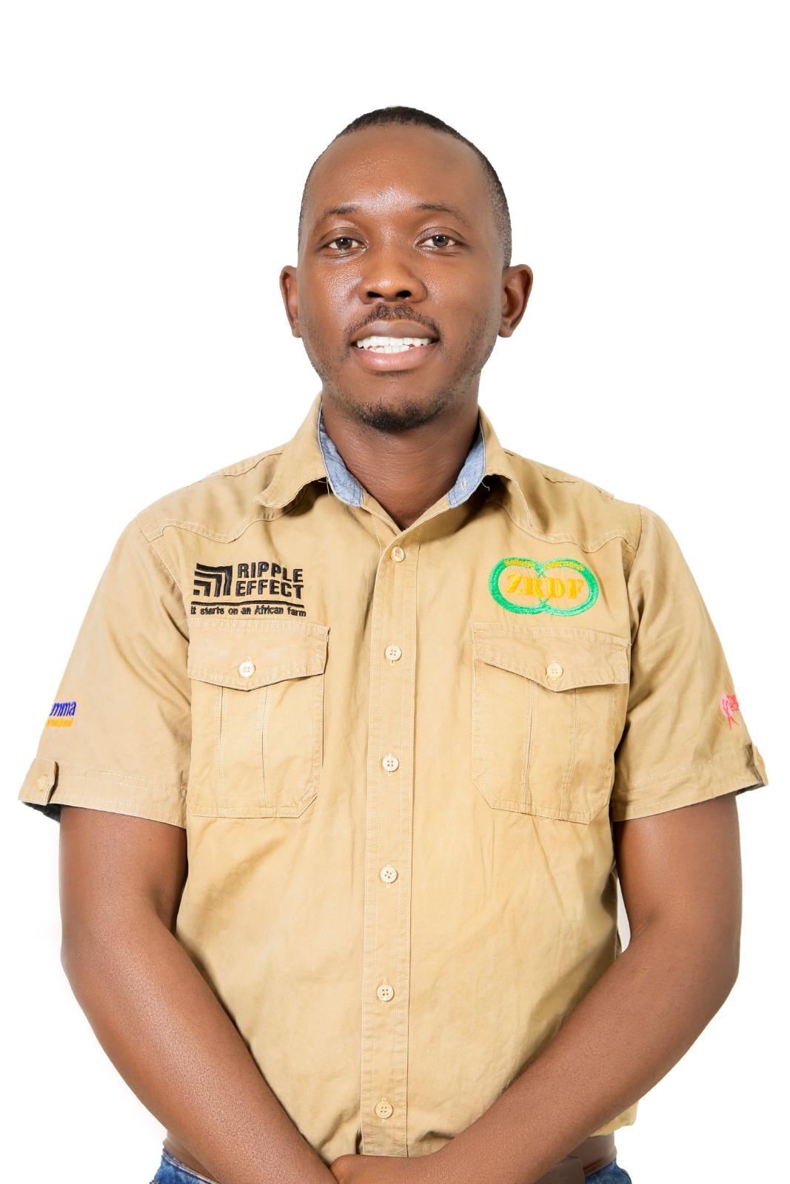
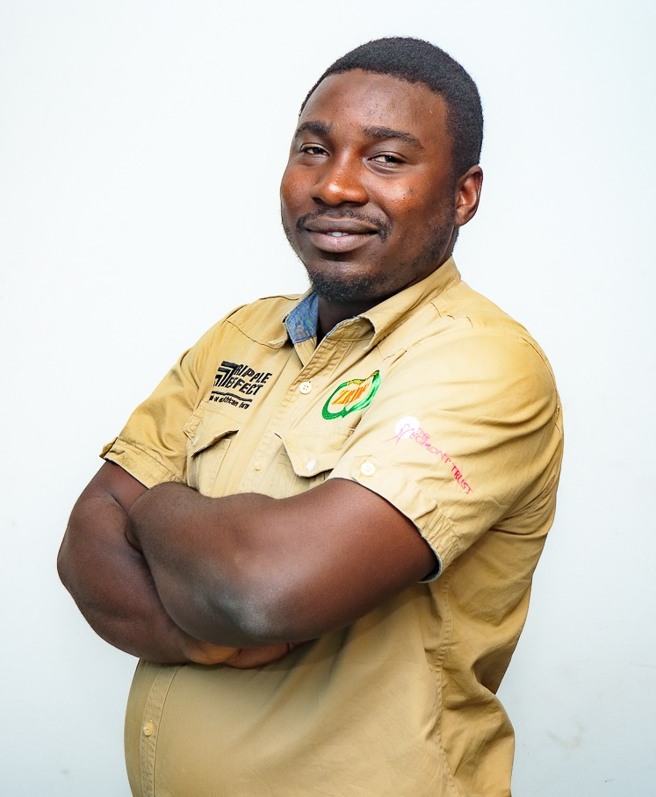


The Zambia Team
Brandy, Eugene, Mitch and Matamola

Slide 3
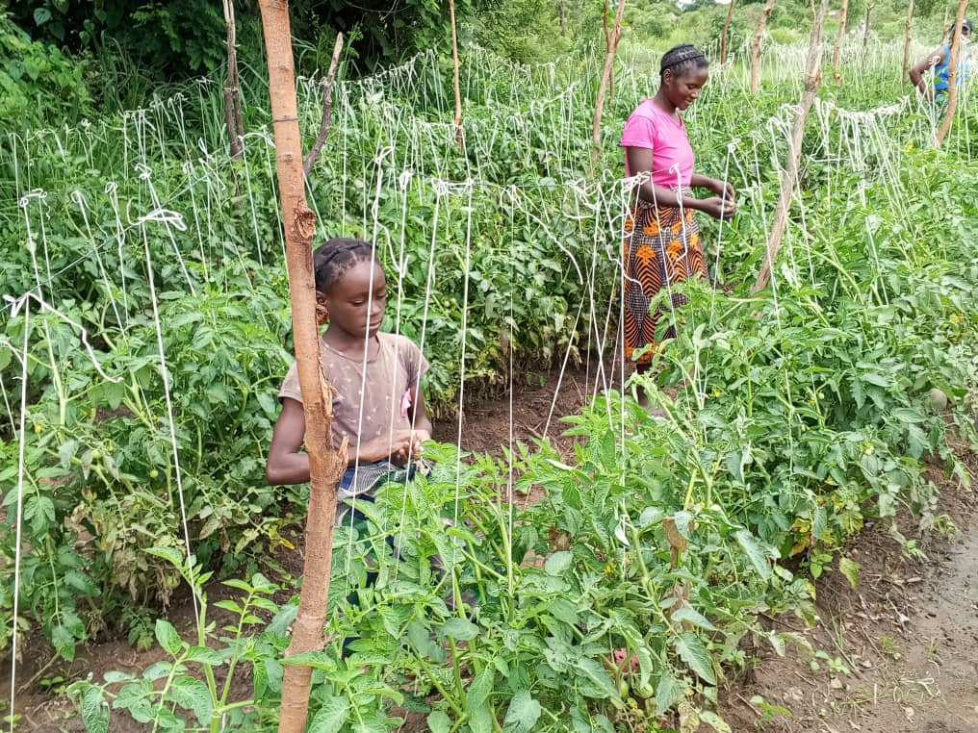
Judith and her daughter with their tomato crop

Slide 4

Judith, Zambian farmer

Slide 5
Thank you!
Find out more at:
Rippleeffect.org

