Slide 1
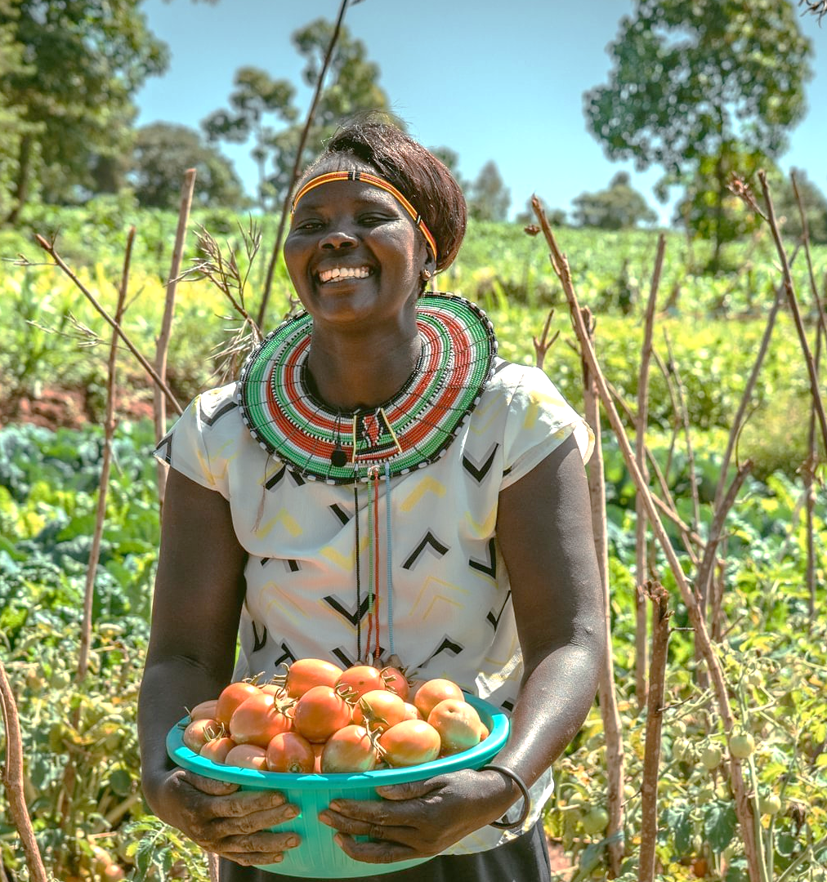
Every meal tells a story:
This Harvest you can be part of a story of growth and resilience, not hunger.
Notes:
Thank you for choosing to support Ripple Effect this Harvest.
In this presentation, you’ll learn about the work of Ripple Effect and find how your church can help equip rural farmers in East Africa with the seeds, skills, and support they need to grow abundant harvests and nourish their children.

Slide 2
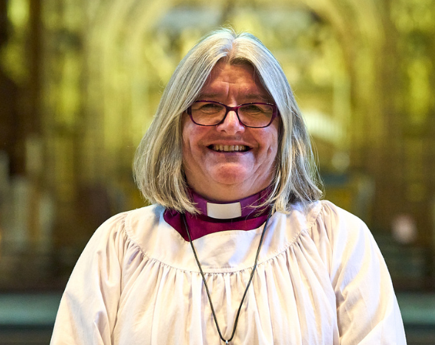
A message from Bishop Ruth Worsley
Hi, I’m Ruth Worsley.
I’m one of the patrons of Ripple Effect. I currently serve in the Diocese of Liverpool as their interim Bishop.
As we celebrate Harvest, we are reminded of our connection to the world God has given us. We see the abundance of his goodness and his gifts to us, and this is an opportunity for us, as part of the Ripple Effect family, to help ensure that our brothers and sisters in rural Africa can also build a sustainable future, where hope can flourish and children, families and communities can thrive.
Thank you for your support and engagement at this special time of year.
As we give thanks to God for his gifts to us, may we also work in partnership with our wider global family, so that they too may know something of the gift of the world God has given them.
Bishop Ruth Worsley, acting Bishop of Liverpool

Slide 3
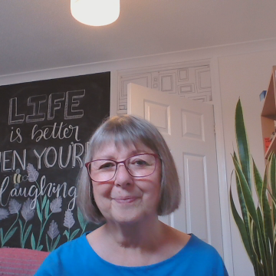
A message from Ripple Effect
If you have any questions, email me:
ann.hatton@rippleeffect.org
ann.hatton@rippleeffect.org

Slide 4
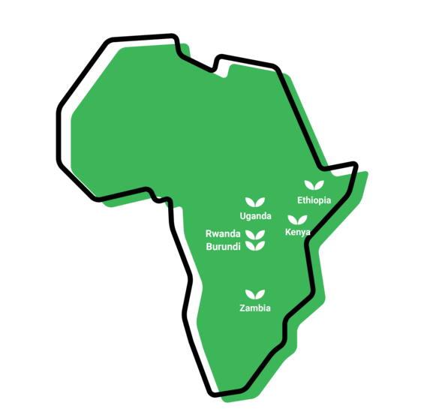

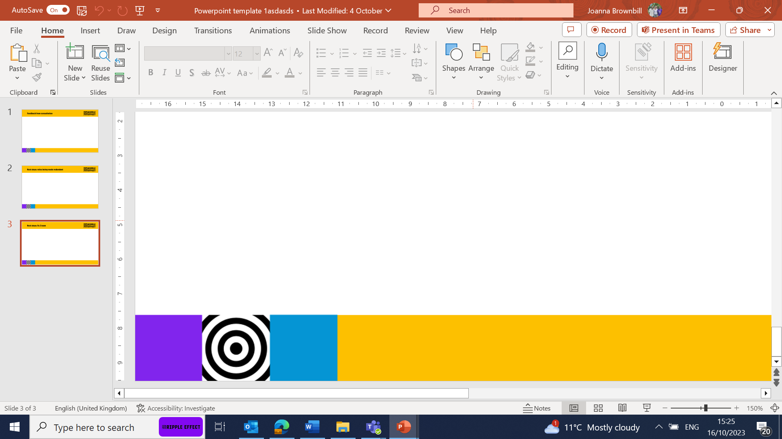
Where we work
Notes:
WHERE
Ripple Effect has established country programmes in Ethiopia, Kenya, Uganda, Rwanda, Burundi and Zambia.
80% of Ripple Effect staff are from these countries – working with and for the communities they live alongside.

Slide 5
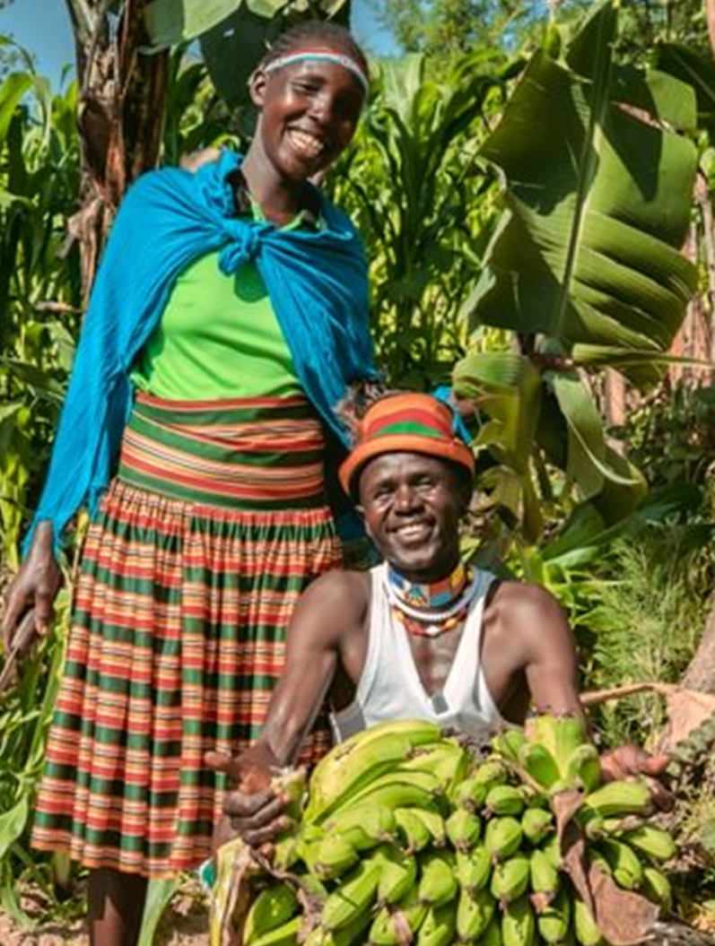
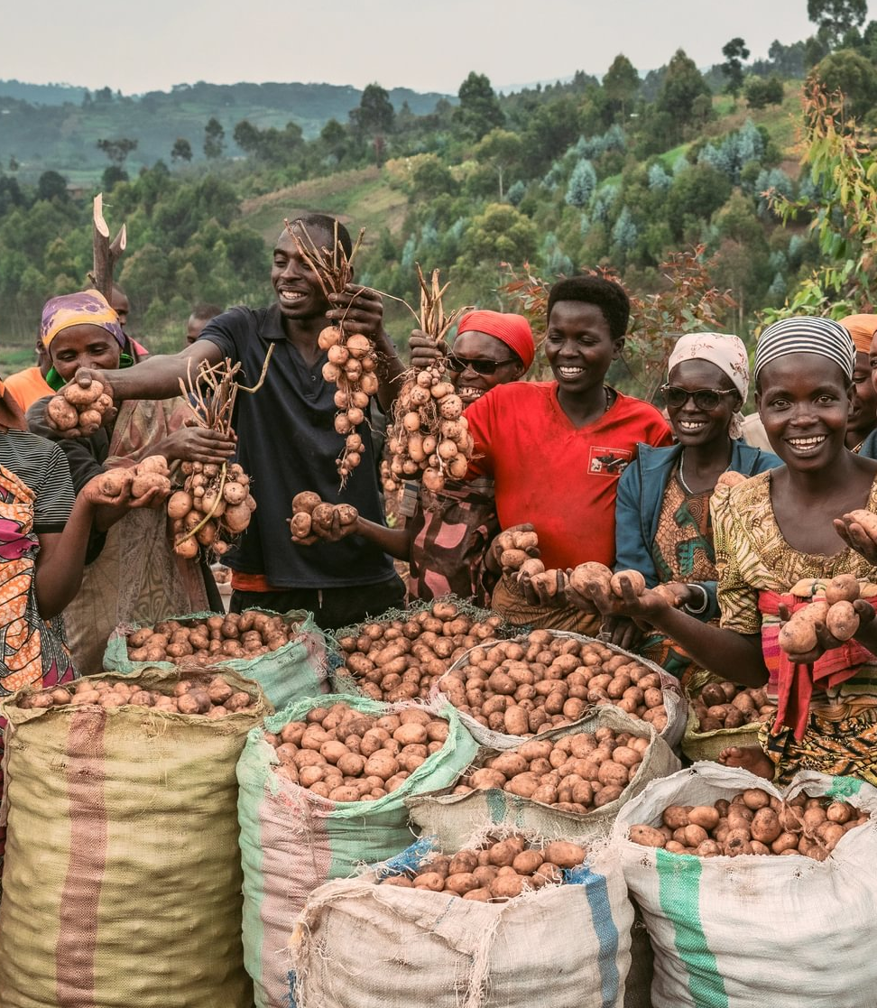
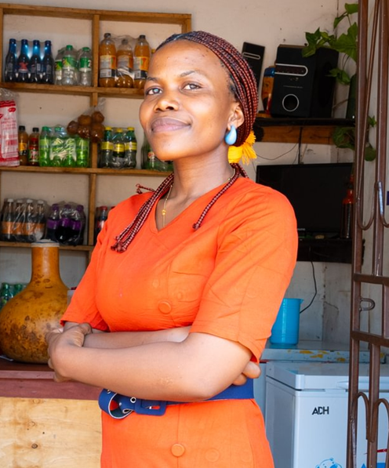
The three strands of our work
Notes:
We have 38 years' experience supporting families in rural Africa to learn more, grow more and sell more. Our projects are typically three years long. Once families have completed their Ripple Effect training, they then share what they know and have with their communities, creating a ripple effect across rural Africa.
There are three core strands to our work (detailed in the following slides)
Farming sustainably
Gender and social inclusion
Business skills

Slide 6
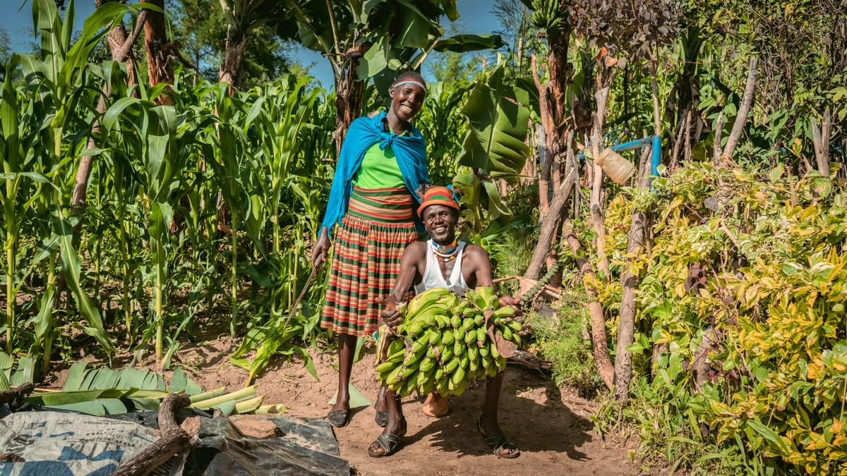
Farming sustainably
Farming sustainably
Meselech, Ripple Effect farmer, Ethiopia
Selena and Thomas, Ripple Effect farmers, Kenya
Notes:
Farming sustainably
Ripple Effect trains families in using up to date and traditional approaches to farming. Families learn to build productive farms and to adapt to the effects of the climate crisis. And ultimately their farms will have a climate-positive impact!
Community trainers and peer farmers share their knowledge with more farmers and communities, so there is a ripple effect of learning.
Ripple Effect helps farmers think about the resources available to them within their community. We then teach the organic agricultural principles and skills they need to integrate these into a sustainable, biodiverse farm – without expensive artificial fertilisers or GM seeds.
Techniques (many that you’ll be familiar with) such as water harvesting, composting, use of manure, vegetable growing, tree planting and animal husbandry are easily adaptable to each farmer’s own land and needs.

Slide 7
Gender & social inclusion
Gender and social inclusion
Ripple Effect farmers, Kenya
Ripple Effect farmers, Burundi, with their potato crop
Notes:
Gender and social inclusion:
Ripple Effect’s local staff in Africa help families develop a shared vision for their home. Through facilitated activities we help the family work out how best to share the workload and decision-making to achieve their vision.
Through this approach, family life becomes more harmonious and prosperous, and children grow up happier, better educated and with wider horizons.
Women in particular are supported to raise their aspirations beyond subsistence farming.
65% of the people we work with are women – research indicates women are more likely to invest income into their family’s future
50% of those women are widows – some of the most vulnerable people

Slide 8

Business skills
Patience, Ripple Effect farmer, Kenya
Notes:
Business skills
More farmers learn to manage their farm as a business, moving away from subsistence farming to control their own futures: developing profitable businesses and co-operatives which can access new markets.
As part of their training farmers learn money management and enterprise skills. They also investigate how best to add value to their produce – for example processing it into another product or storing it so that it can be sold out of season.
Ripple Effect farmers become resilient entrepreneurs, capable of making choices and in charge of their own futures.
In this photo Patience is part of a Ripple Effect project in Kenya. She is a single mother who has started a shop as part of the project, and has huge energy and big plans to match.

Slide 9
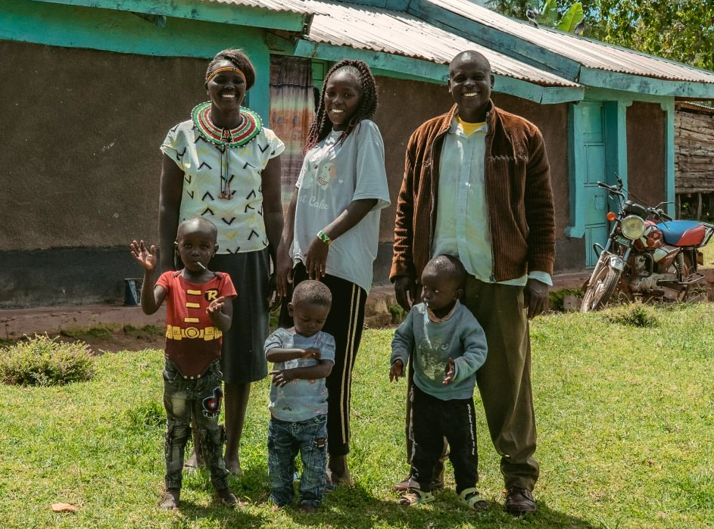
Priscillah’s’s story
Notes:
Priscillah, her husband and their family
Meet Priscillah…
My Name’s Priscillah, and I live in West Pokot, Kenya with my husband Dixon, five children and two grandchildren.
Not long ago, life was very difficult for us. The challenges we faced were the unreliable climate, and we didn’t know how to cope with it. We didn’t have the knowledge or access to a good variety of seeds. We also didn’t know how to plan our land or where to put what. We didn’t understand that there was potential to get so much income from what we had.
Through Ripple Effect’s training, I learned how to plan my land better, improve my soil, and manage water more effectively. Today, everything has changed.
Now I grow a wide variety of crops, including sweet potatoes, peas, legumes, and avocados. My land is carefully organised so that I can have continuous harvests throughout the year. I like growing nuts as it helps me meet the six food categories.
Growing a variety of crops has improved my soil and strengthened my family’s nutrition. Sweet potatoes are now a daily staple in our home, and I make sure that everything from the harvest is used so nothing goes to waste.
With irrigation from a nearby river and improved composting techniques, I am able to grow vegetables even during the dry season, when food used to be scarce.
This improved harvest has changed our family life. We now eat a wider variety of nutritious foods, and my children are healthier and better nourished.
Our income has also increased through the sale of surplus produce, helping us meet our essential needs. We don’t have any financial constraints these days.
My husband Dixon has also seen the change. He recognises both the improved harvest and my growing confidence and leadership. Together, we are building a more secure future from our land.

Slide 10
Therese’s story
“Now I can grow all the food my family needs… better nutrition is making my family stronger.”
Priscillah, Ripple Effect farmer, Kenya

Slide 11

How your church can help
You could:
Donate your Harvest collection
Host a cake sale with a pineapple theme
Host a Songs of Praise evening
Host a Harvest supper
Find out more at rippleeffect.org/harvest
Notes:
The Restore project is vital not just for families, but for the region’s wider environmental health. Lake Cyohoha is a crucial water source, and restoring soil prevents runoff that pollutes the lake and damages biodiversity. With healthy land, healthy crops, and resilient ecosystems, this region can have a fighting chance against the climate crisis.
£250 could train mothers, like Jeanne, in climate-smart technologies helping families regenerate their land, grow enough to eat and sell, and build a future filled with hope.
This Harvest, will your church donate your Harvest collection, host a Harvest supper, or organise a Songs of Praise event to support mothers like Jeanne?
With help from your church, mothers like Jeanne can transform their lives—feeding their children well, restoring their soil, and sending their children to school.
Whatever you are able to give, your donation is supporting families like Jeanne’s to restore their land for a future free from hunger. Thank you.

Slide 12
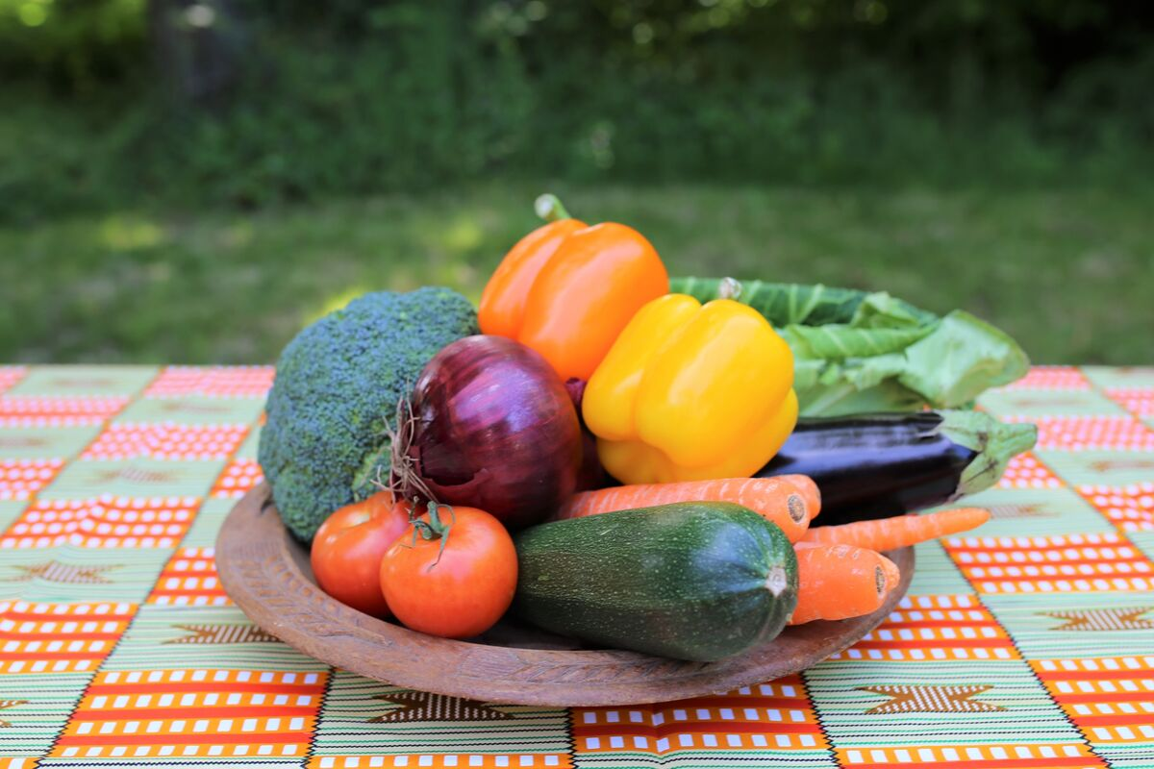
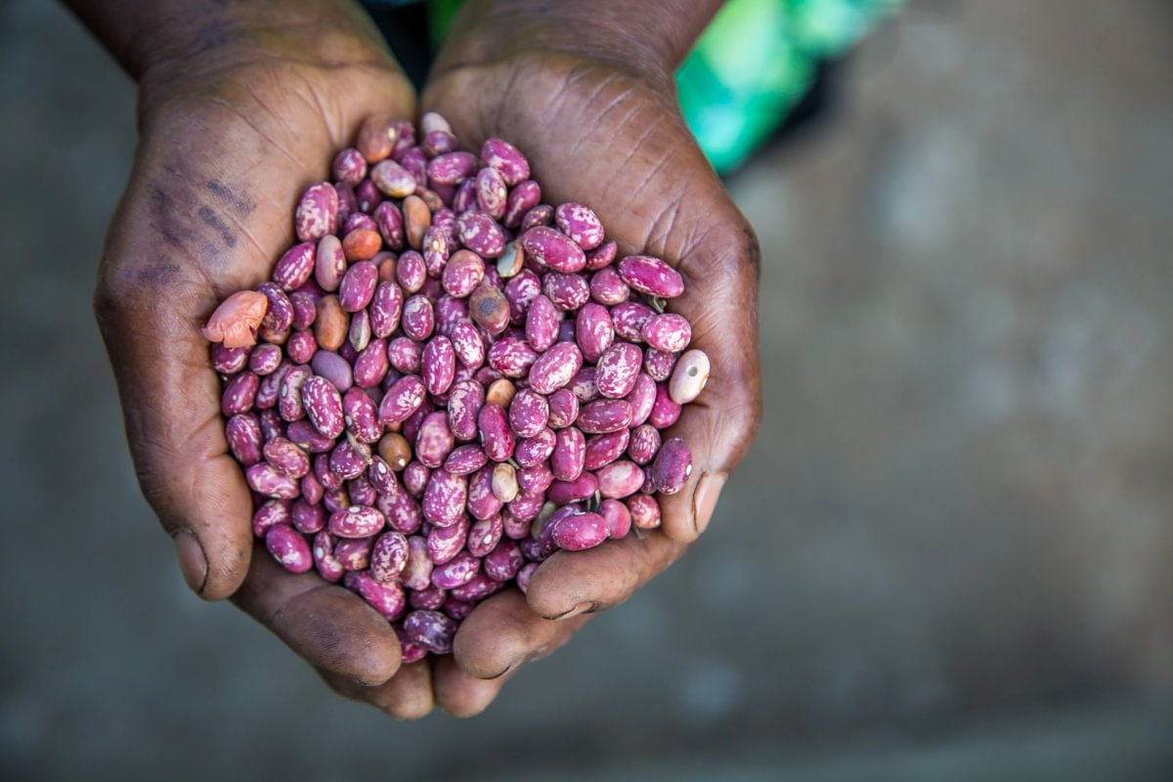
How your church can help
£100 could provide a community of 30 families with banana seedlings
£250 could provide a rainbow plate of fruits and vegetables along with initial training
£500 could provide super strong seeds that survive extreme droughts and floods
Find out more at rippleeffect.org/harvest

Slide 13
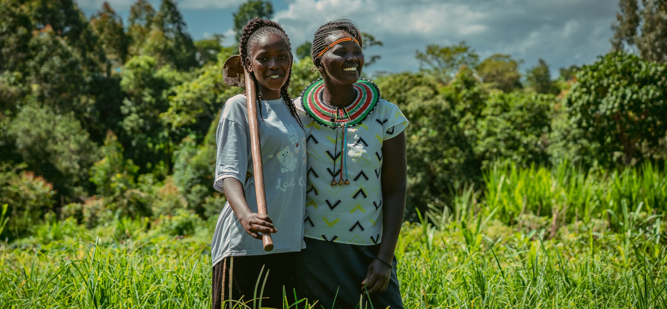
Thank you for choosing to support Ripple Effect this Harvest!
Find out more at rippleeffect.org/harvest

