Slide 1
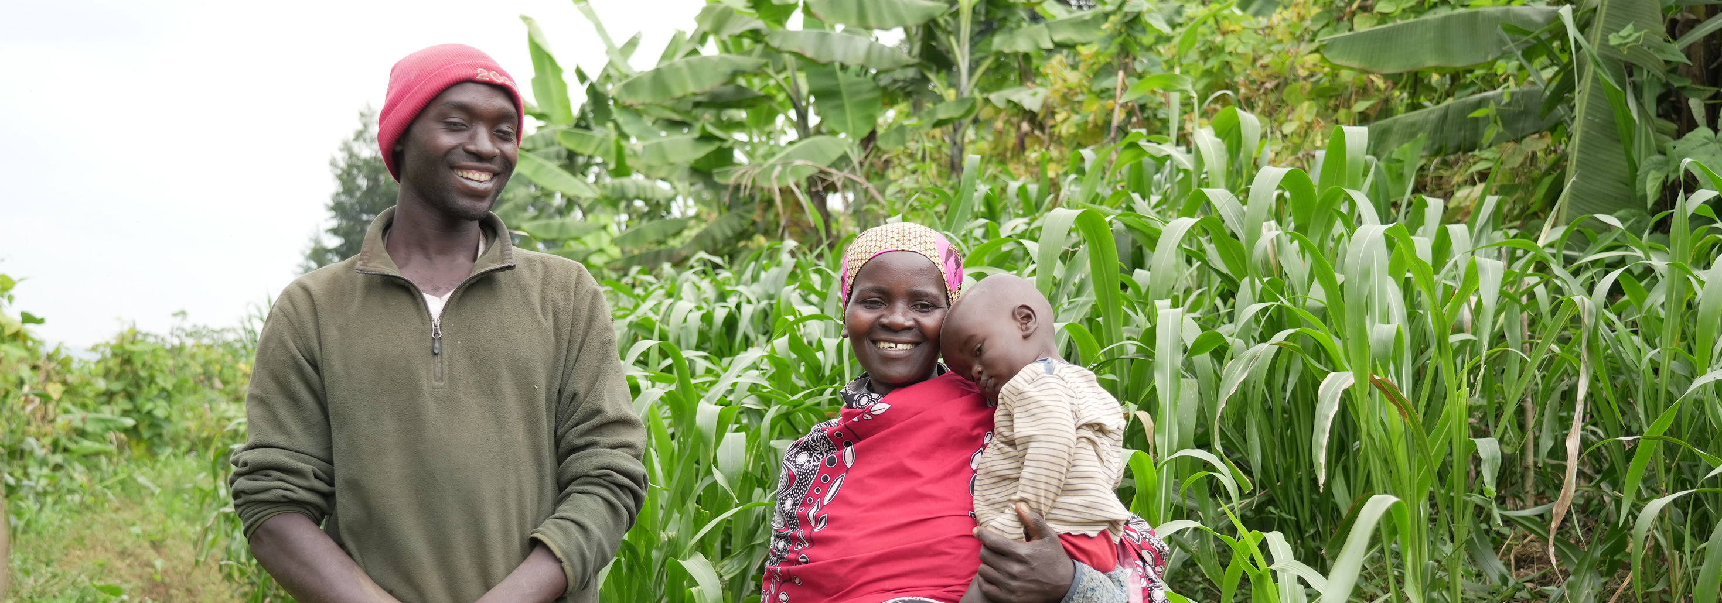




Join Ripple Effect in Bath Abbey for our
Christmas Celebration
Tuesday 2 December at 7.00pm
Doors open from 6.30 for festive refreshments
This is a free ticketed event, so book your tickets today:
rippleeffect.org/christmas-celebration

