Slide 1


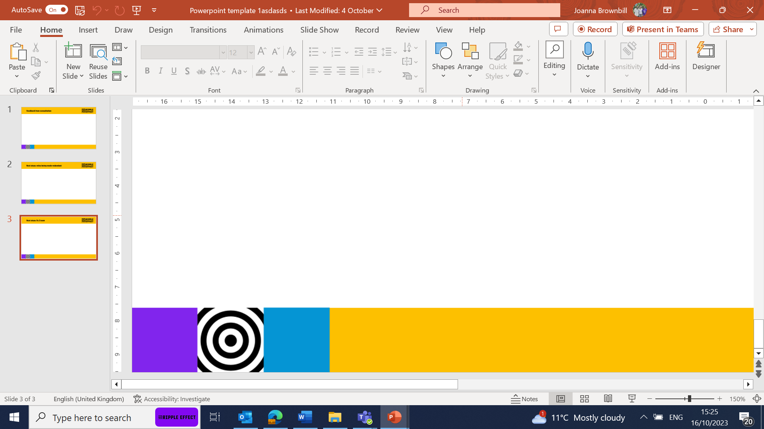
Bulking up your presentation
Suggestions:
10-15 minutes - the Harvest/Christmas or Lent PPT will be a good length.
30 minutes – add a bit of the history of Ripple Effect (see slide 2) and a personal story
45 – 60 minutes – also add a video, time for discussion. Ask them questions too.

Slide 2
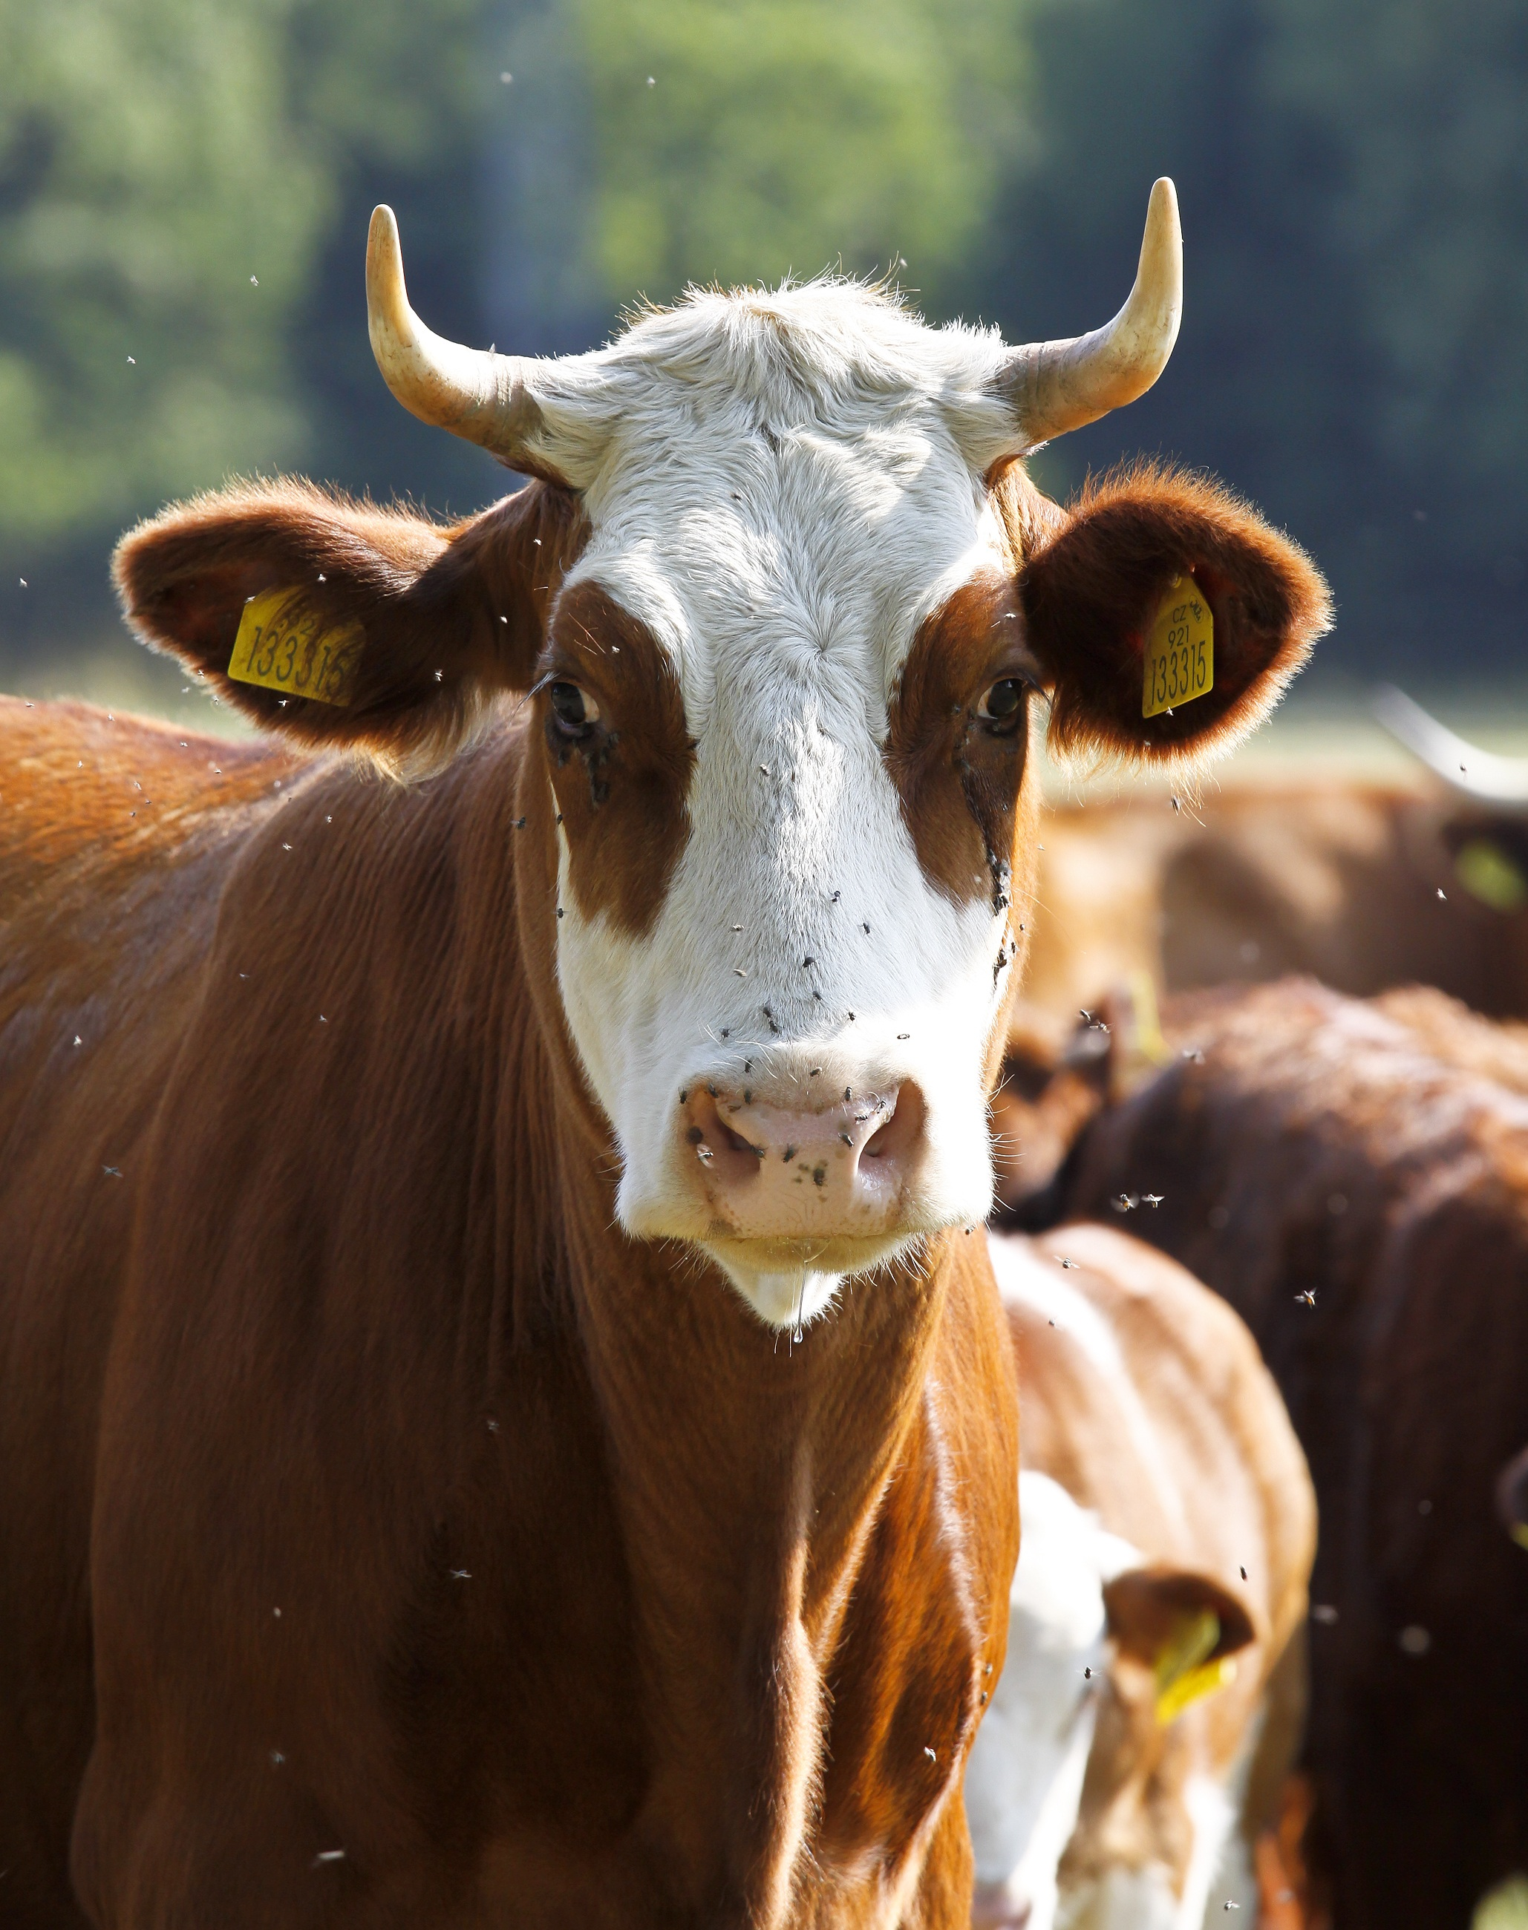
History of Ripple Effect
Ripple Effect was set up by a group of Christian dairy farmers from the UK in 1988.
Outraged at EU milk quotas, which were forcing them to slaughter healthy dairy cows, and in response to an appeal from Uganda for milk, they embarked on a project, which was set to become an innovative and practical charity.
Uganda was just emerging from a long civil war, communities and their farmland had been destroyed and much of the country's livestock wiped out. Several of the UK farmers flew to Africa to investigate how they could help.
Meeting with Ugandan farmers, the Bishop of Mukono, and a livestock expert, they saw how smallholder dairy farming in Africa could work. People there were unable to feed themselves and milk would provide an instant source of nutrition. They returned to the UK determined to help, and sent cows from their own herds to Uganda. Ripple Effect was born.
We've changed a lot since then.
We no longer send cows from the UK, we source them locally. In fact, livestock is just a tiny part of what we do today.
Over time, our work has expanded to include much wider training on nutrition, gender equality and business skills. We are proud to have worked with over 2 million people as they have learned to grow and sell more, and share their new-found knowledge with their neighbours, who then do the same.
Watch our video below to see how far we’ve come, with the help of our global family.

Slide 3

Make it personal
If you’ve been on a trip, please use your photos and tell them how you felt seeing the projects - make it personal!
If you’ve not been on a trip, then get to know one of the stories and talk about it with passion.

Slide 4
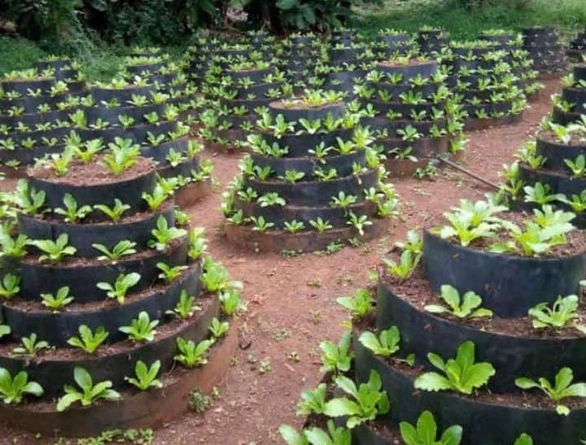
Add in a video or some extra photos
Add in extra photos. You can use photos from Winnie’s talk, or from Dash ( here’s the link)
Talking about some of the different technologies is helpful (cone gardens get some conversations going!)
The videos we have on the Ambassador talk section can all be downloaded and watched offline.

Slide 5

Useful questions to ask
What do you know about the climate crisis? How does it affect you?
What do think families will buy with the income they start to make? (soap, school equipment, tools to repair their home, they’ll start to diversify their income streams)

