Slide 1
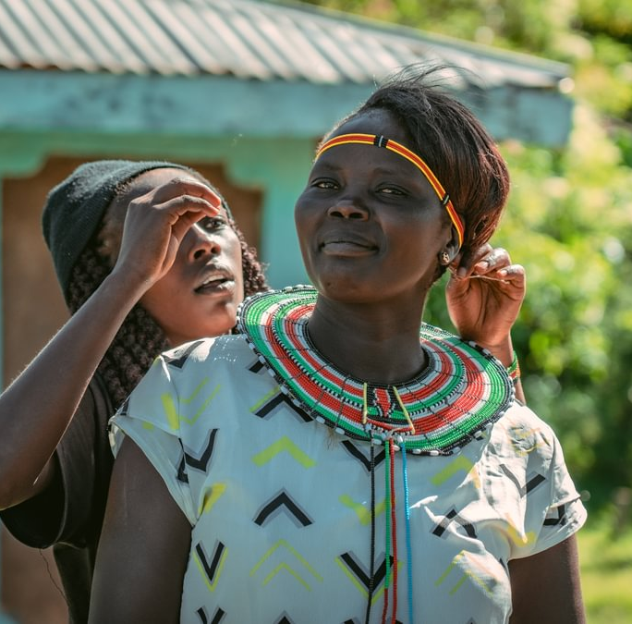
Welcome to our
Ambassador workshop
April 2026!

Slide 2
Please remind me to record this meeting!

Slide 3
10.00 -10.10 | Ann - Welcome & Housekeeping
10.10 -10.25 | Paul: Vision & Direction
10.25 - 10. 40 | Ann - Who's who - who you are and how long you've been an ambassador
10.40 - 11.10 | Laura: an introduction and some updates
11.10-12.10 | Ambassador Kenya Trip Update
12.10 - 12.55 | Lunch
12.55 -1.25 | An introduction to the MCSE team
1.25 - 1.40 | Ann -Tools & Practical Guidance
1.40 - 2. 40 | The ideal Ambassador toolkit - interactive activity
2.40 - 2.50 | Refreshments
2.50 - 3.10 | Q&A
3.10 - 3.20 | Final Reflection : One thing you are inspired to do, next steps & thank you
3.20 - 3.30 | Thank you and end
3.30 - 4.00 | Collect leaflets and pop ups etc and see the office!

Slide 4
Paul

Slide 6
Laura

Slide 7
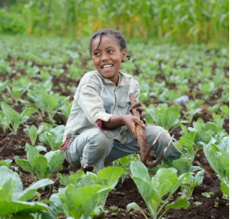
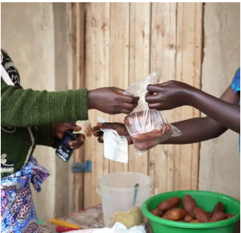
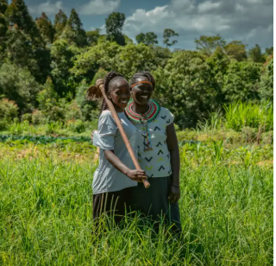
Thematic Funds
Farming for the Future
(Spring appeal)
Supports families to adapt to unpredictable seasons, restore their land, and grow diverse, nutritious crops. By 2030, more families will be food secure, resilient to hunger, and using farming methods that protect the environment.
Seed & Scale
(Christmas appeal)
Helps farmers turn their crops into sustainable businesses, access savings and finance, and connect to reliable markets.
Equal Roots
(Summer/ Autumn appeal)
Works to ensure women, young people, and people with disabilities can access opportunities, influence decisions, and live free from discrimination and violence.

Slide 8
Ambassador strategy
Ambassadors are vital to Ripple Effect with raising awareness, inspiring new support and increasing reach - an important lifeline creating collective impact and increasing social giving.
We need to adapt and evolve to the developing environment we operate in to continue running a successful Ambassador programme.
We need to grow the number of people choosing to become an Ambassador for Ripple Effect.
    develop and launch our Ambassador Journey – a framework that makes sure we give our Ambassadors high-quality inductions, receive the appropriate levels of support and protection throughout their time with us and, crucially, are recognised and appreciated for what they do.
    Increase awareness and recruitment marketing- digital, events, supporter comms
More details and plans to be shared in the September workshop.

Slide 9
General updates
Schools- we will be looking to develop a school's programme later this year focusing on raising awareness, fundraising and long-term relationship building with younger generations. More details and plans to be shared at the September workshop.
Updated leaflets- we have been updating our leaflets to ensure brand and messaging consistency and reducing the number of materials we produce so we have a more streamlined engagement approach with supporters. You will be able to pick up some of them today/ others will be mailed out to you.
Using images from trips- we are happy for you to use images taken on trips to our programmes however, please ensure you also use up to date branded, images with consent to ensure we meet our image consent regulations.

Slide 10
General updates
4. Purchasing screens/ projectors- we are happy to cover the costs of purchasing screens/ projectors to support you with your talks/ events. If this is something you need, please speak to Ann.
If you have already purchased items, please let Ann know and we will reimburse the costs.
5. Using branded templates- please use the branded templates provided when presenting talks. Our brand provides our identity and helps people to remember who we are. We need to use our branding correctly and consistently across all our engagements with the public and supporters. Thank you.

Slide 11
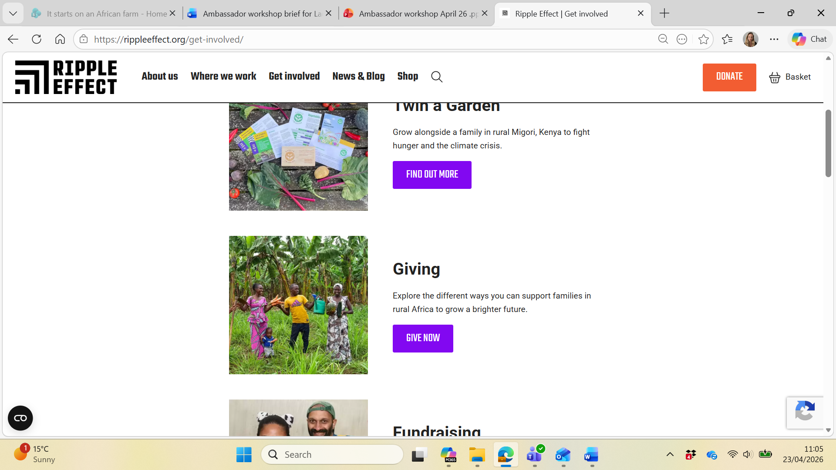
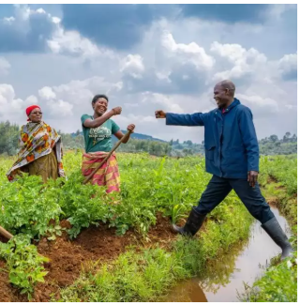
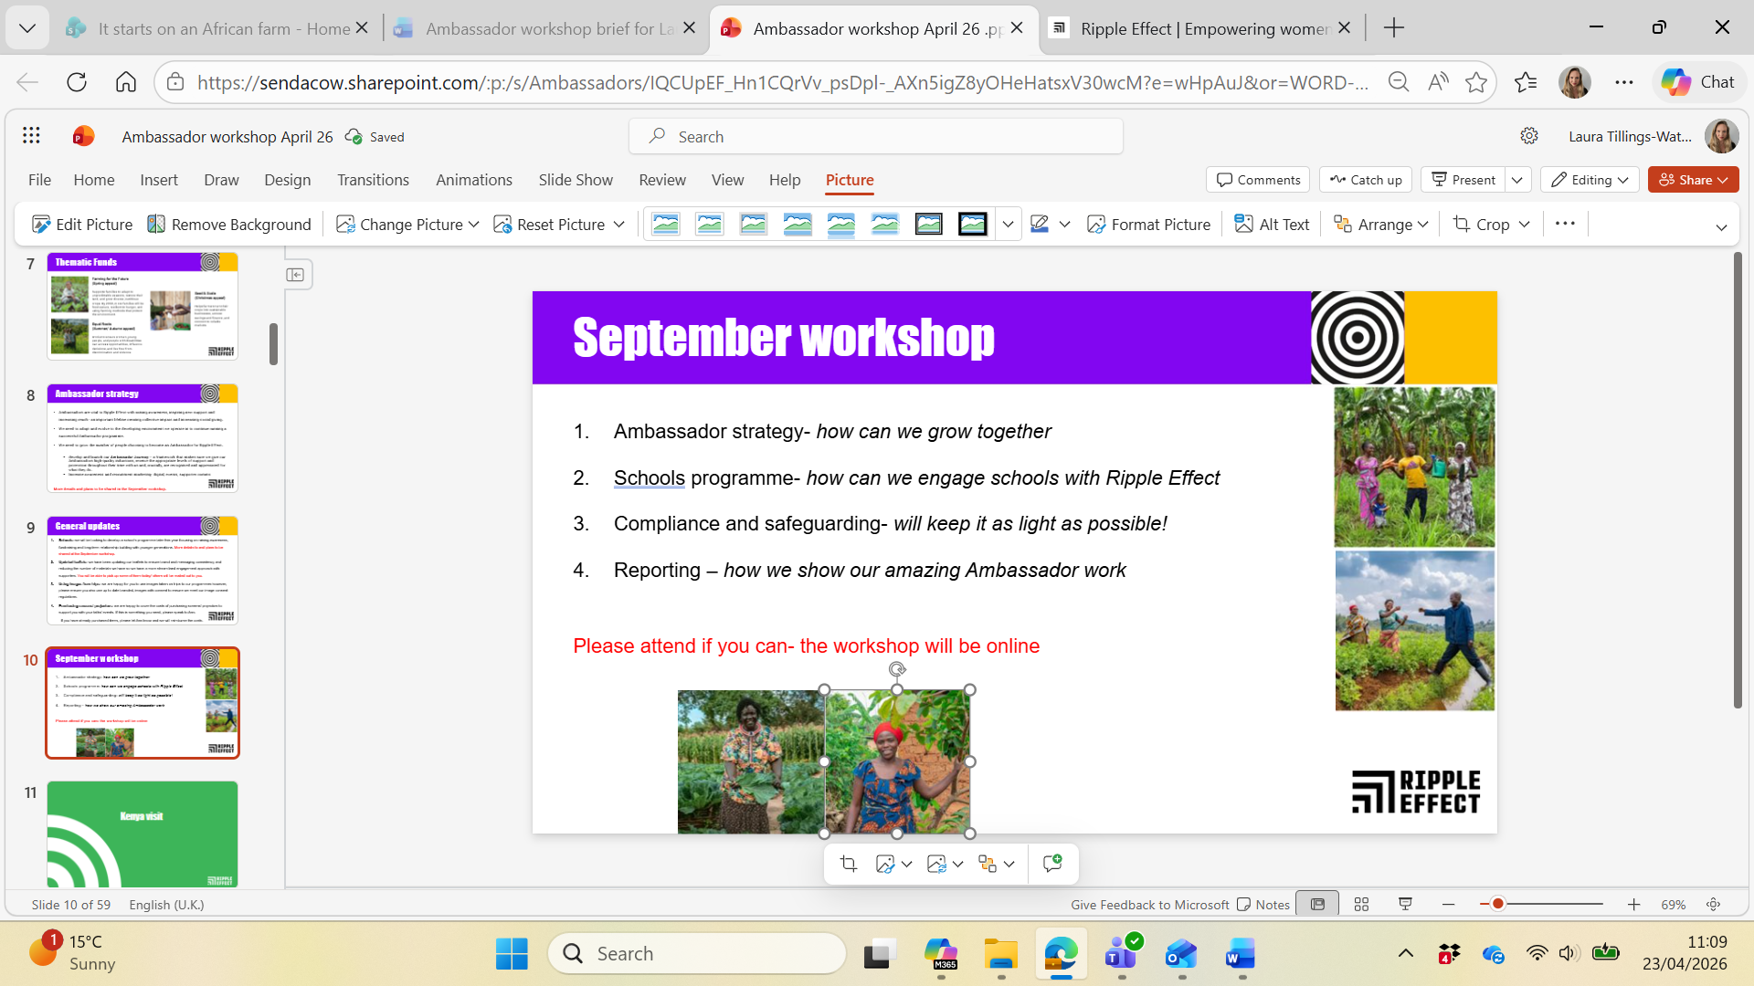
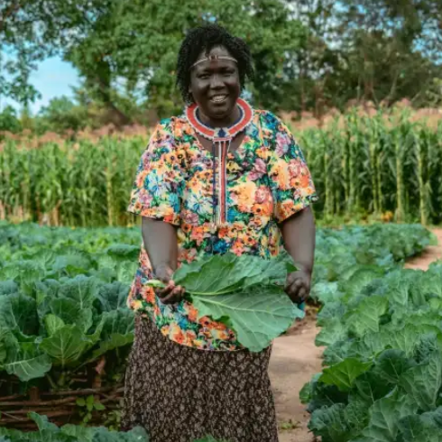
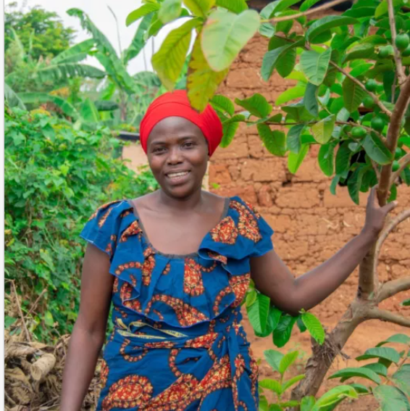
September workshop
Ambassador strategy- how can we grow together
Schools programme- how can we engage schools with Ripple Effect
Compliance and safeguarding- will keep it as light as possible!
Reporting – how we show our amazing Ambassador work
Please attend the workshop if you can- the workshop will be online
Massive thank you for your continued support

Slide 12
Kenya visit

Slide 13
David and Sandra

Slide 15
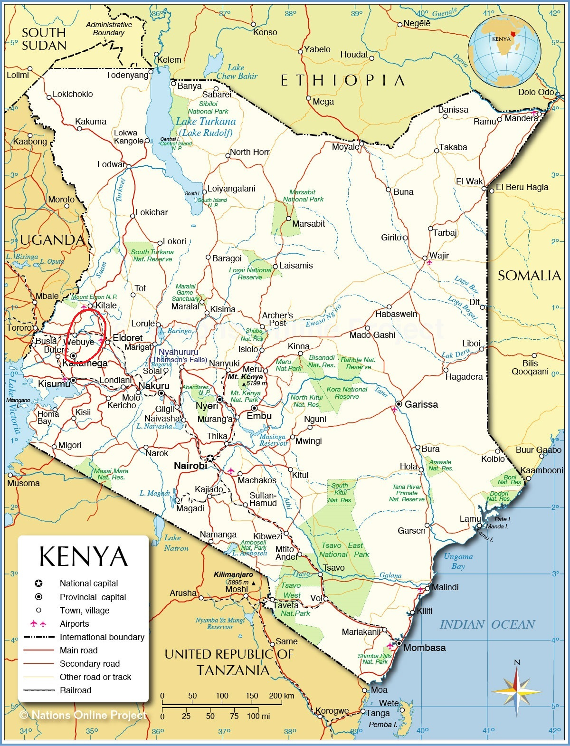

Slide 16
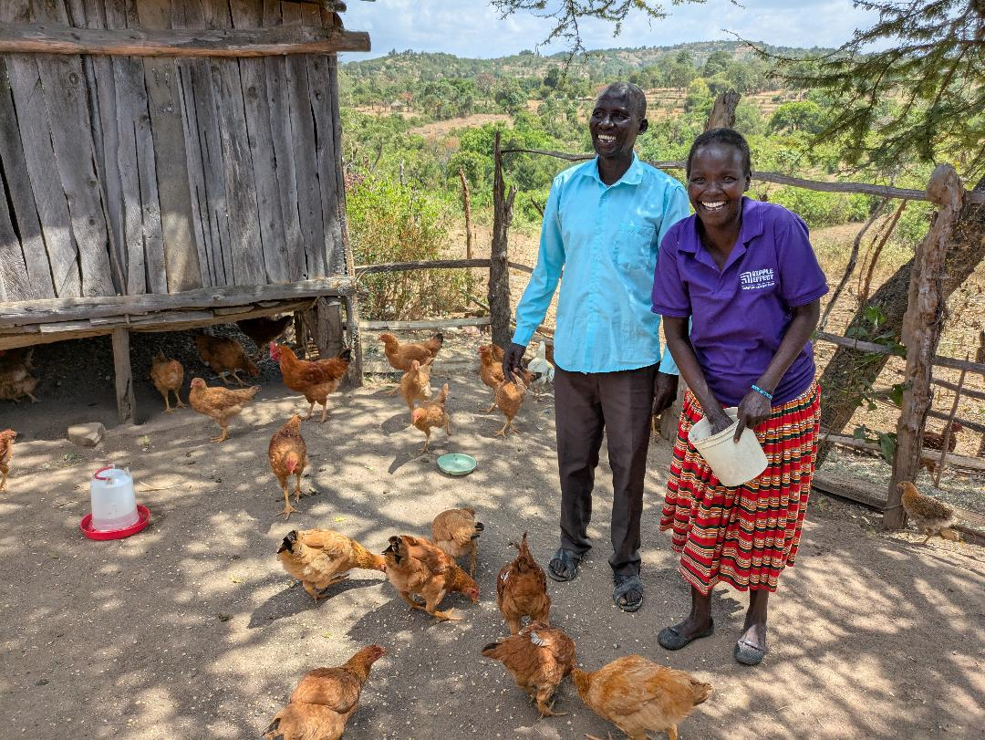
Boresha Mazingira Project
David and Margaret

Slide 17
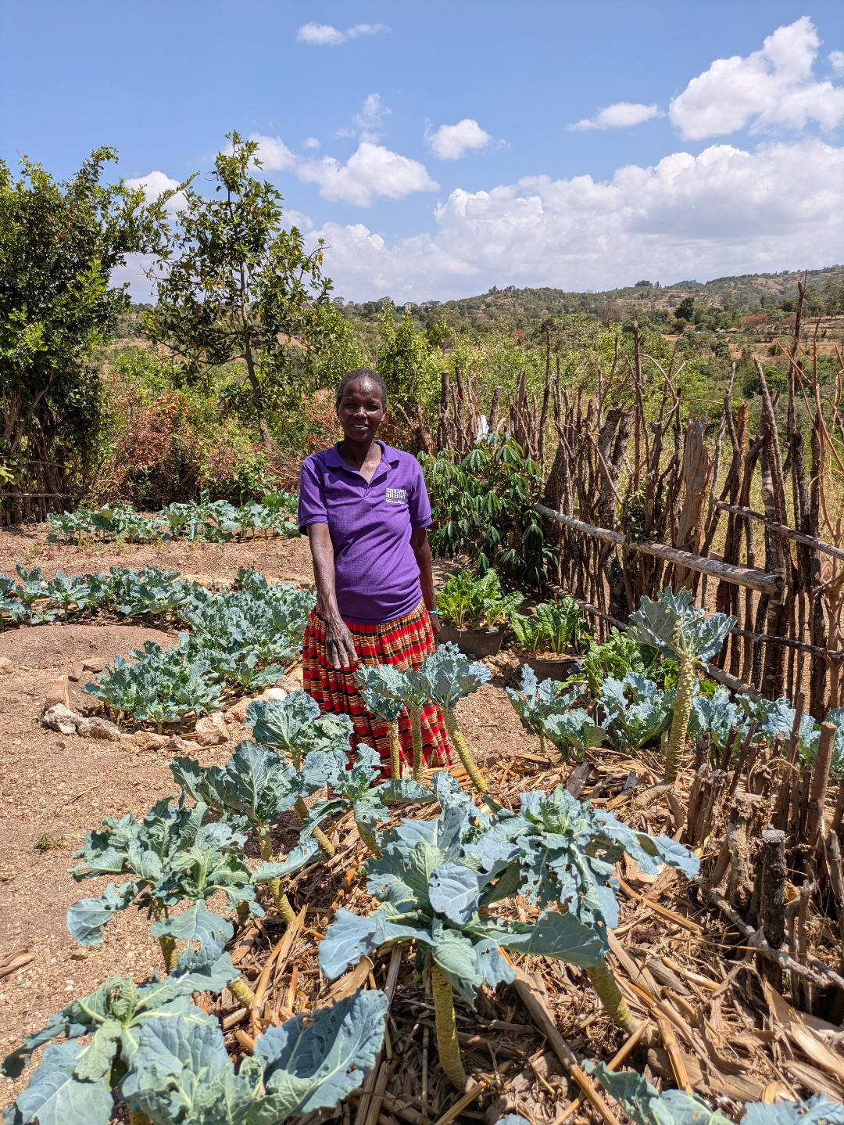
Margaret

Slide 18
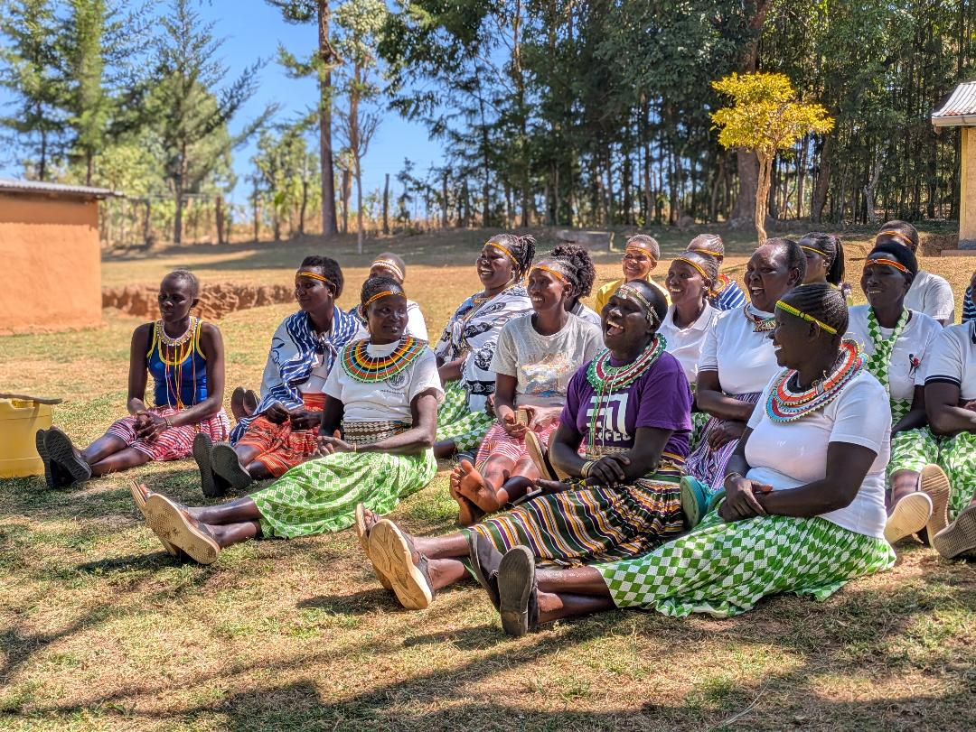
Working Together - Boresha Mazingira Project

Slide 19
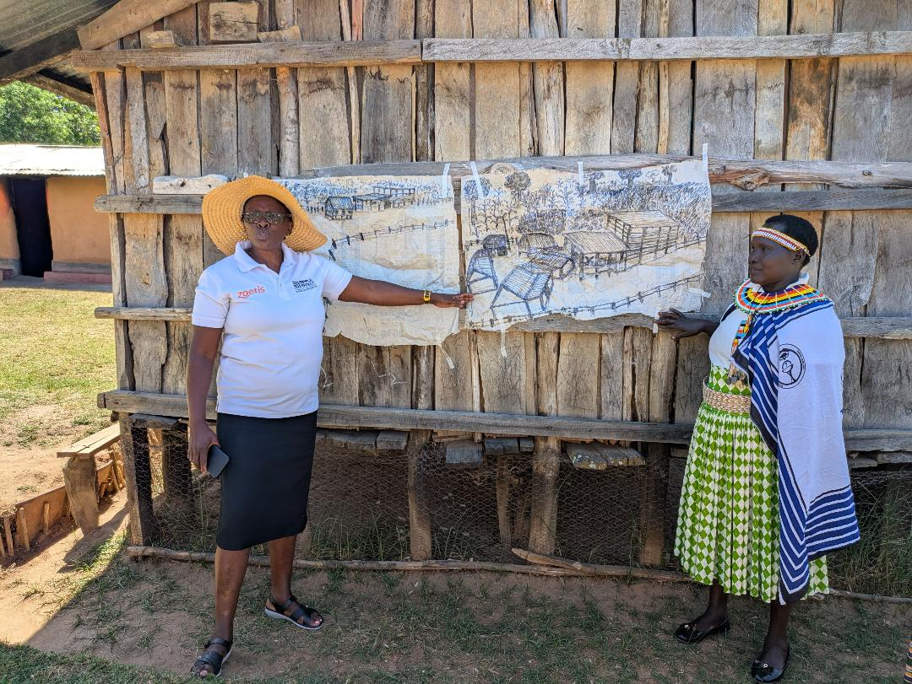
Rachel's Vision - Boresha Mazingira Project
Rachel with

Slide 20
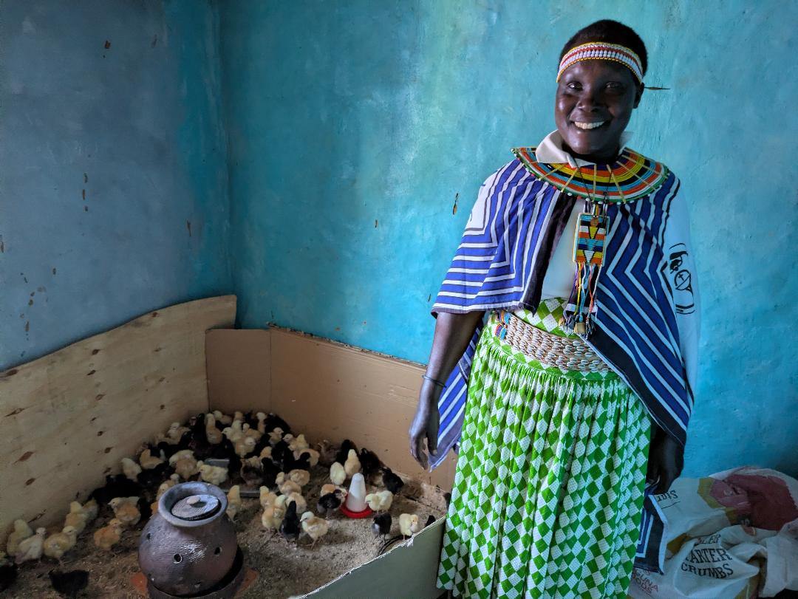
Rachel

Slide 21
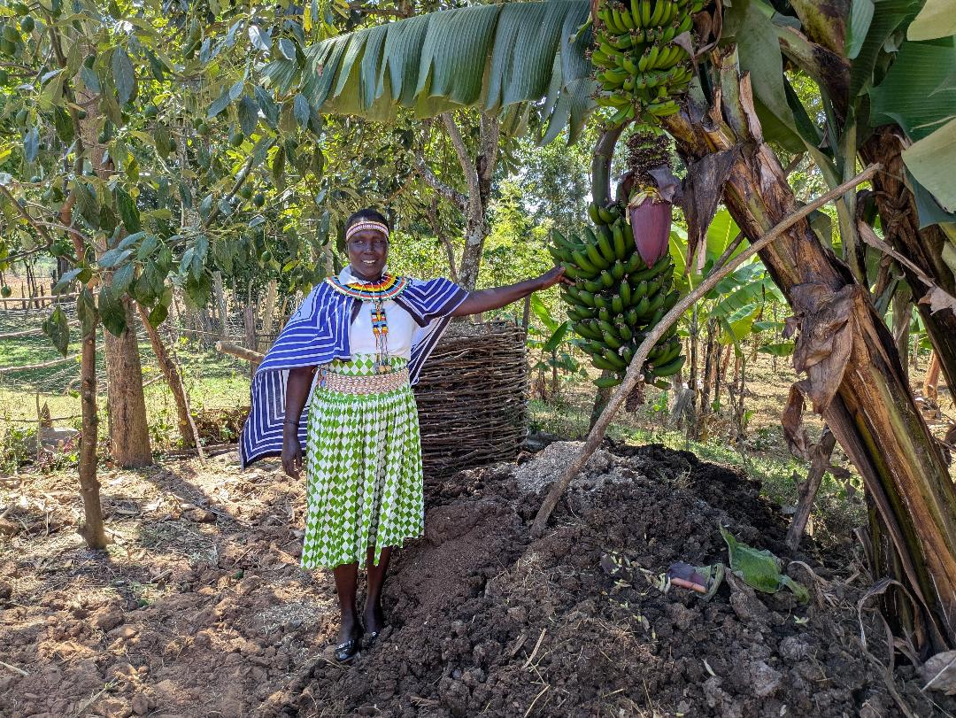
Rachel

Slide 22
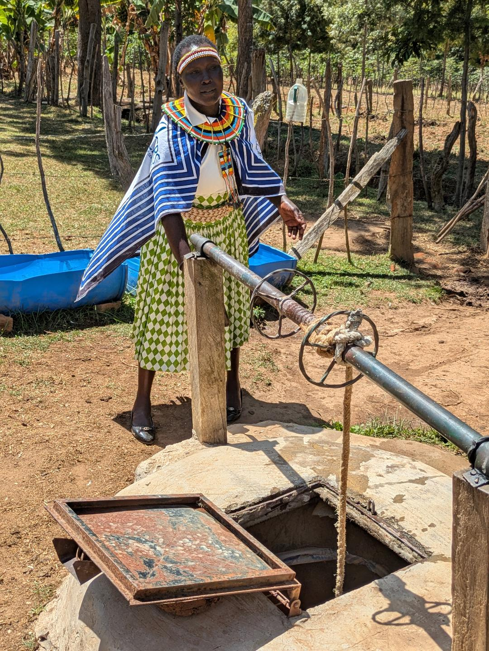
Rachel

Slide 23
Bella

Slide 24
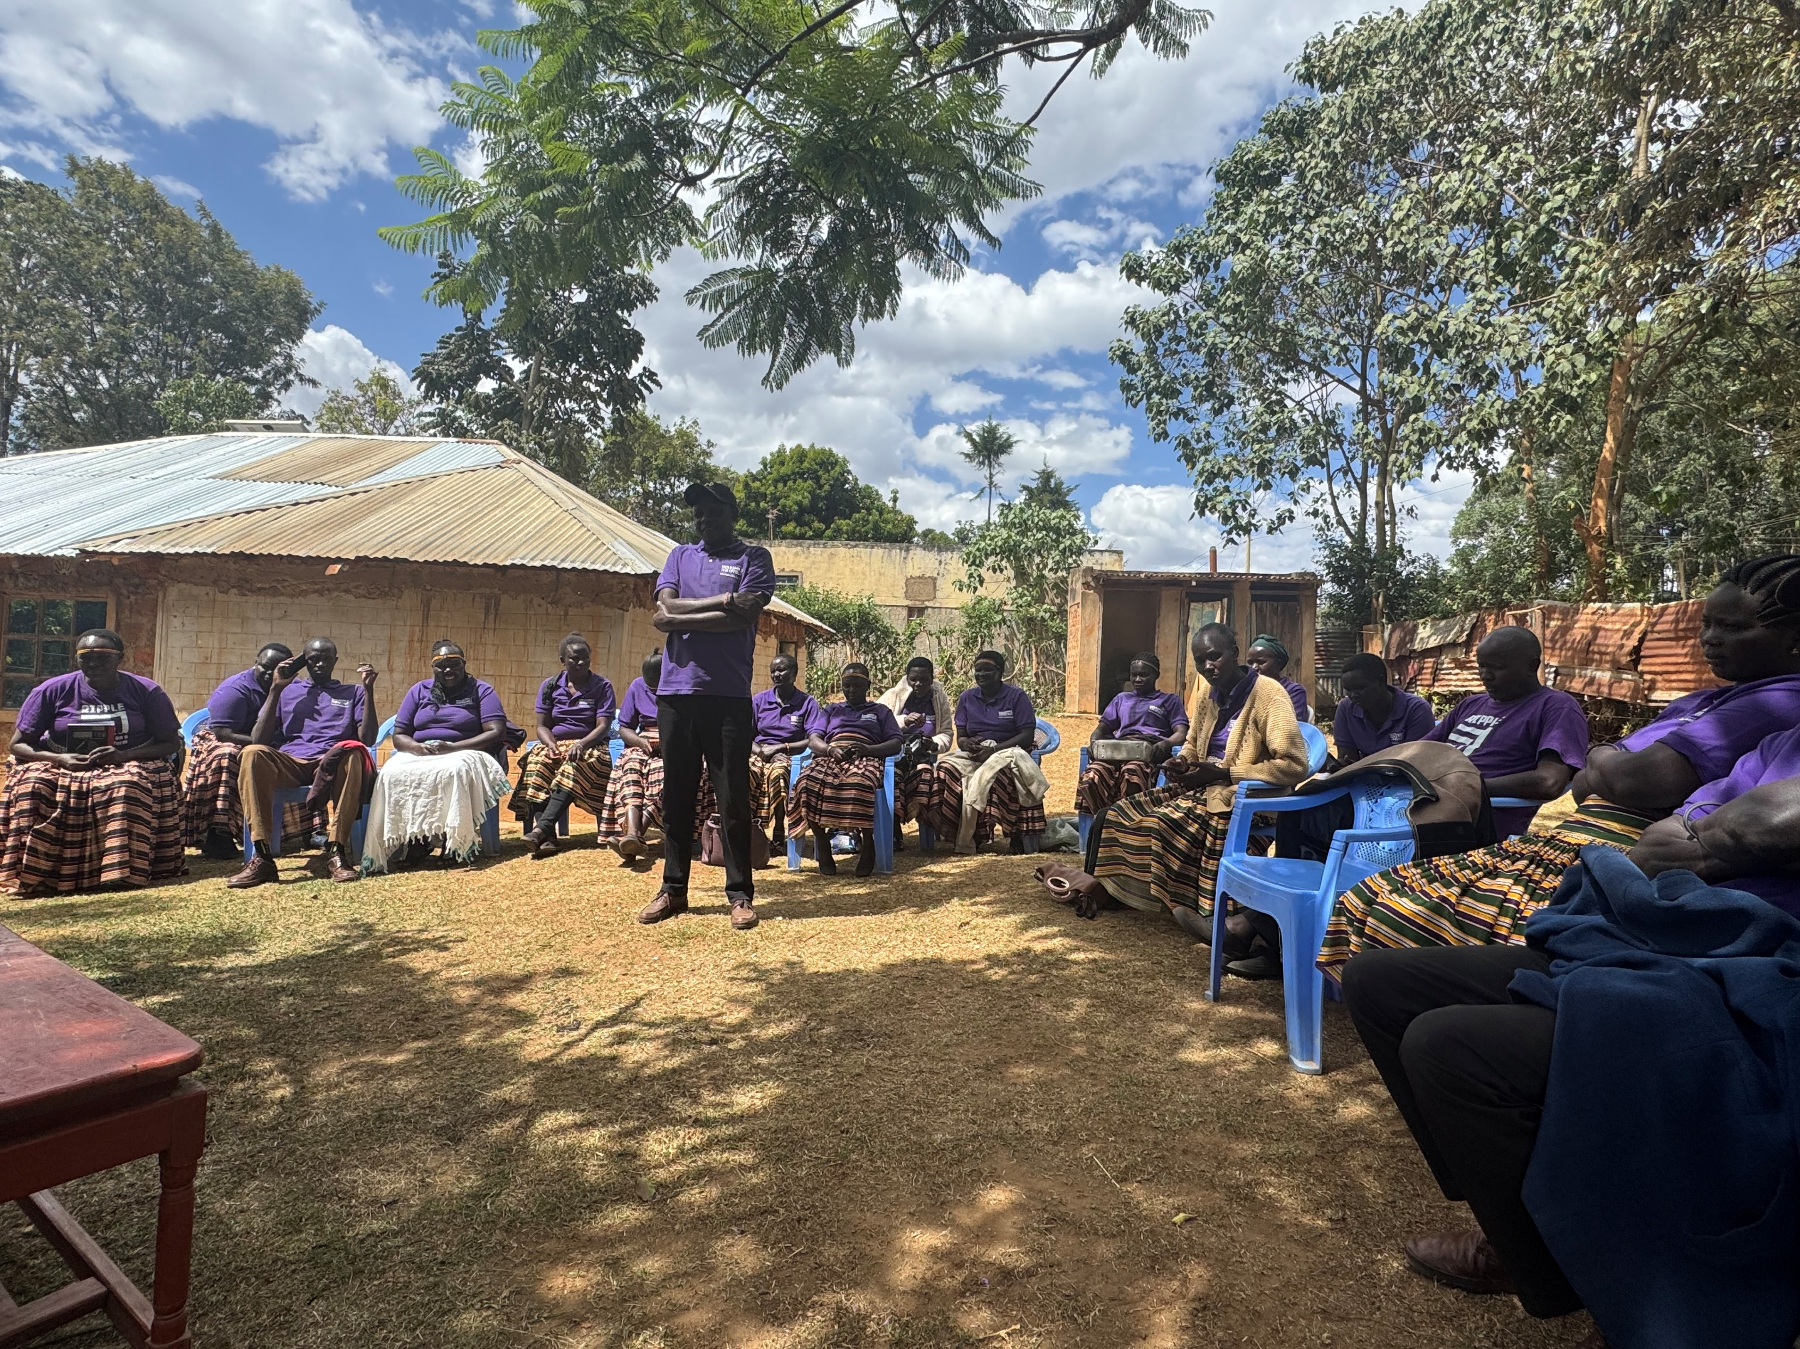
Peer farmer trainers
Bella - Peer farmers (Flora). Spreading the ripples

Slide 25
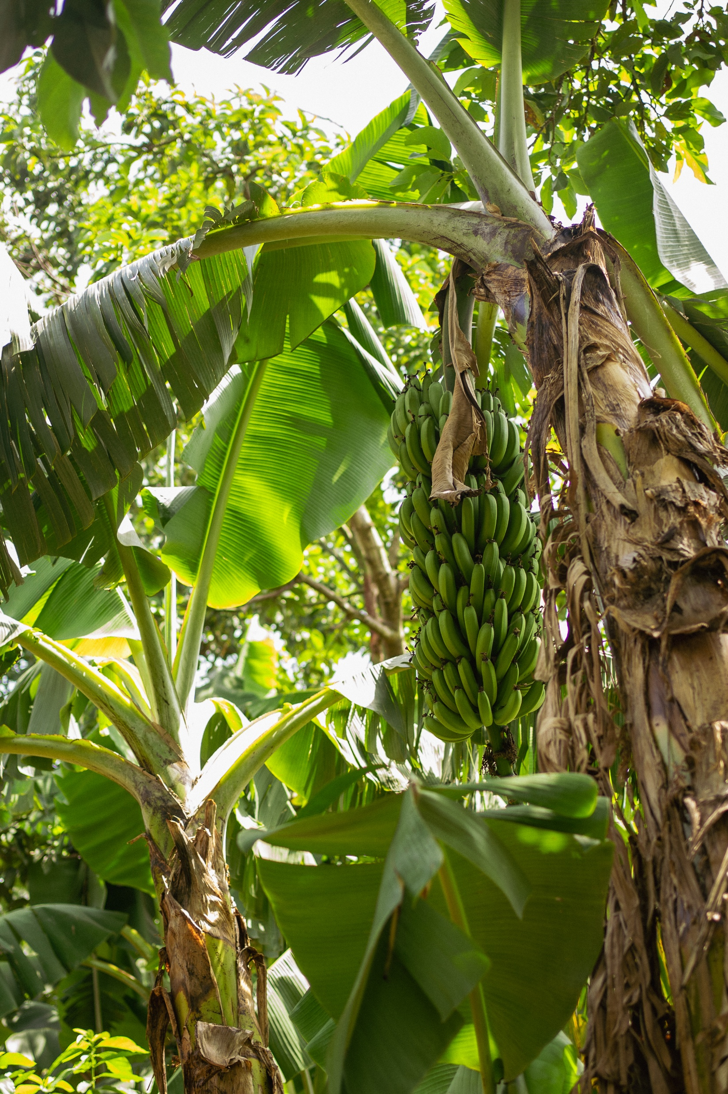
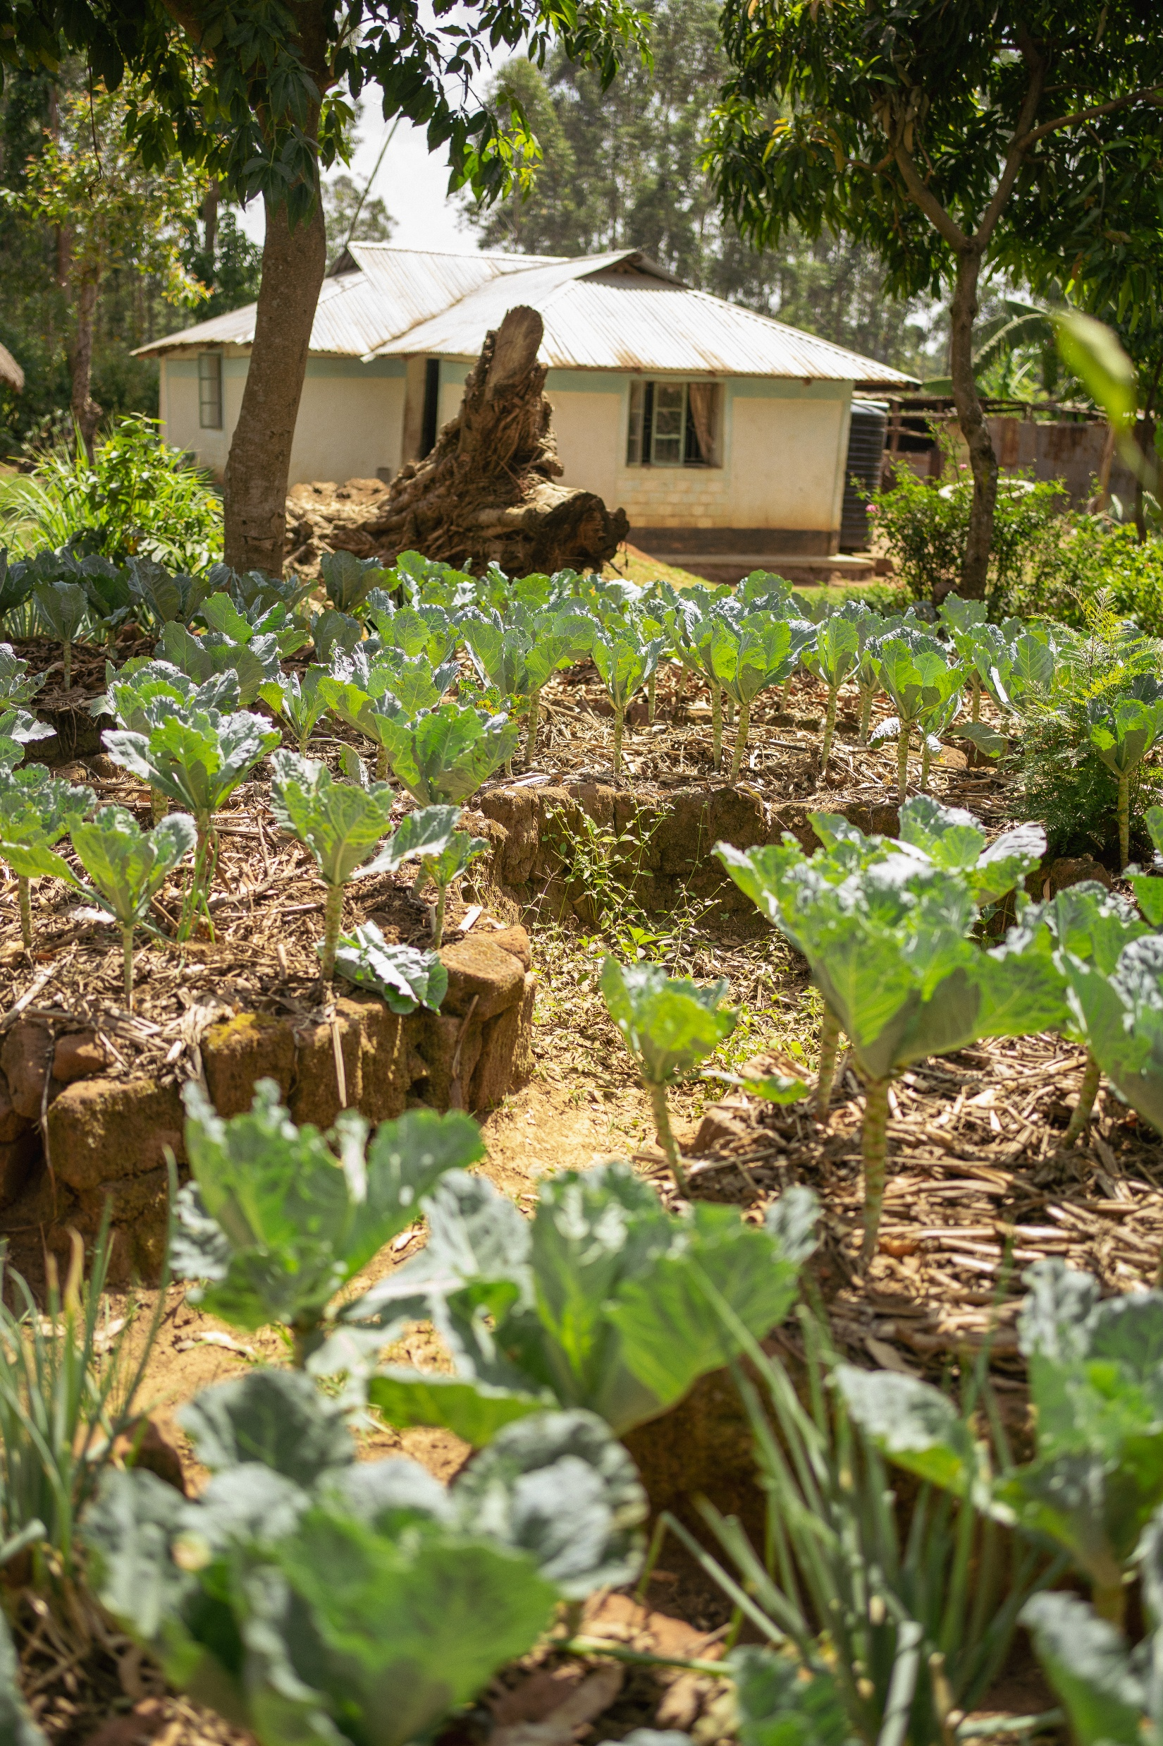
Florah – started in 2015

Slide 26
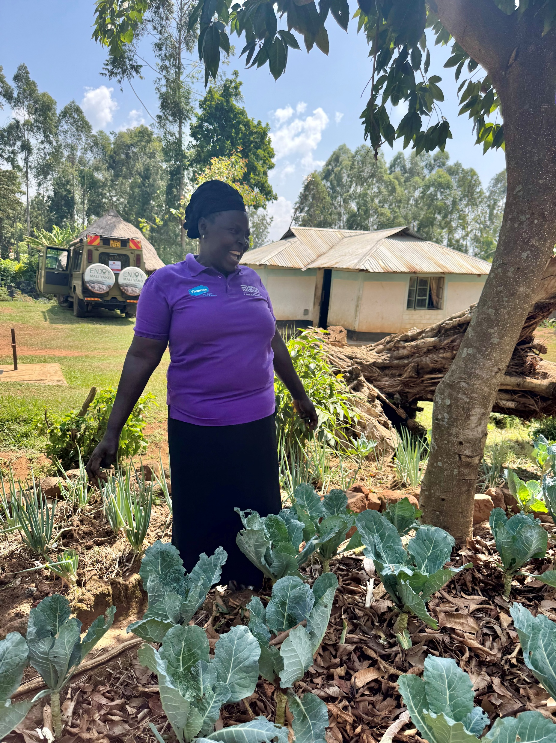
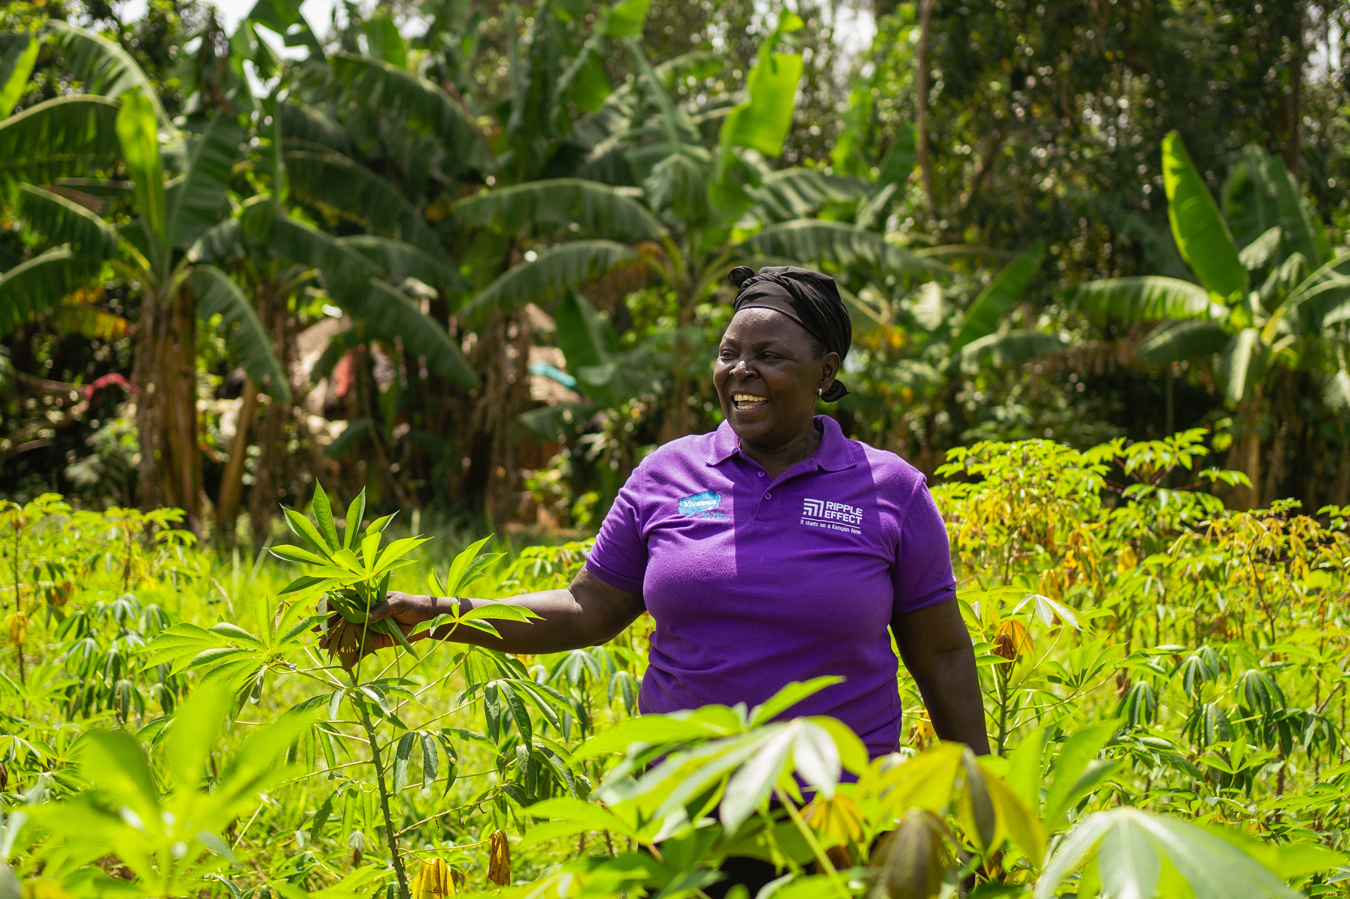
Florah – started in 2015

Slide 27
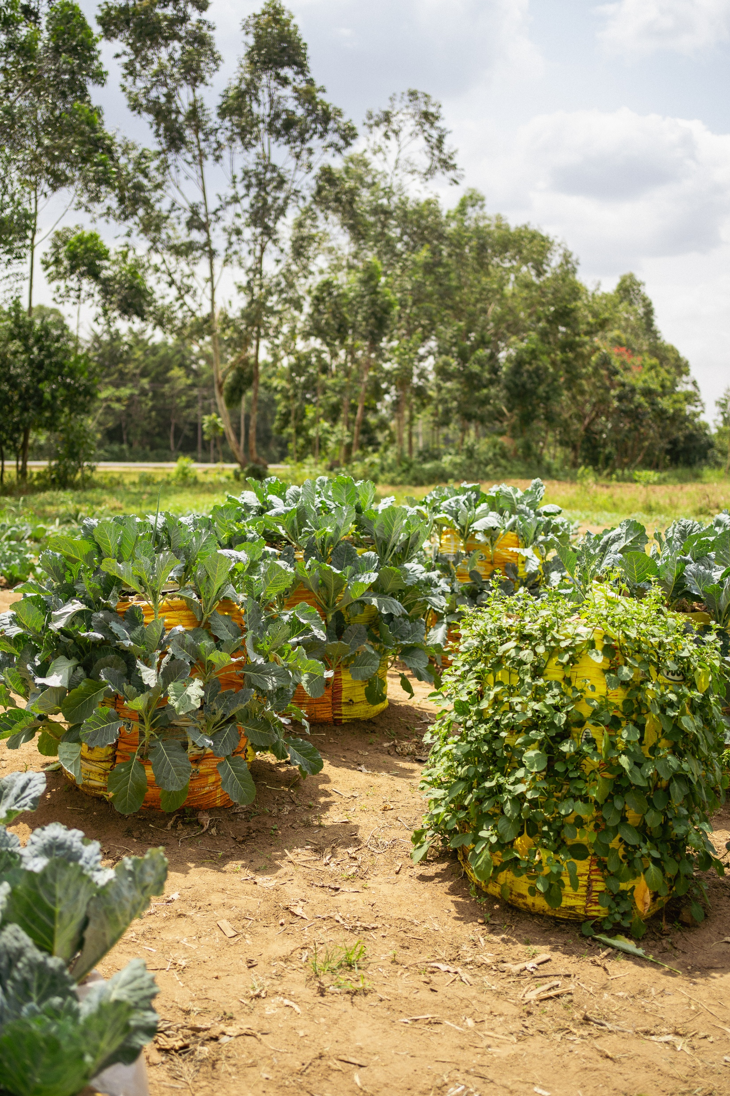
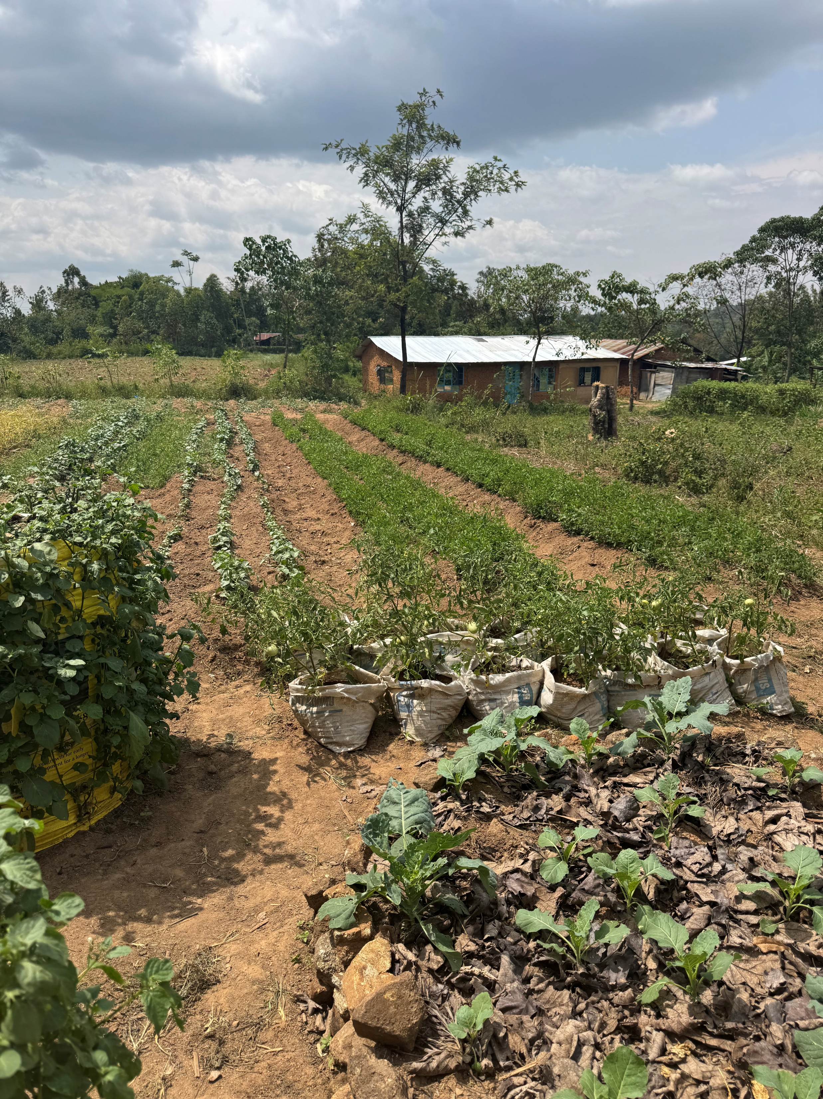
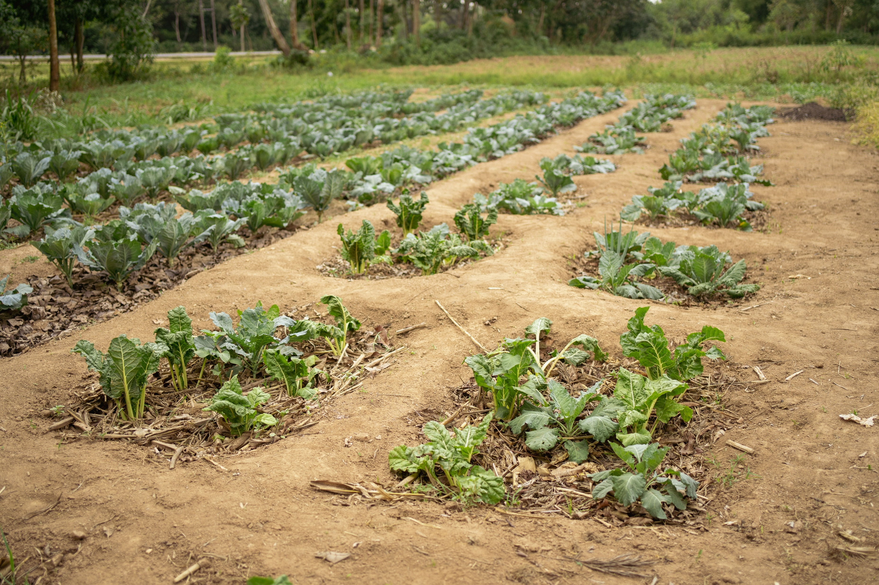
Saida and Ali – started 3 months ago

Slide 28
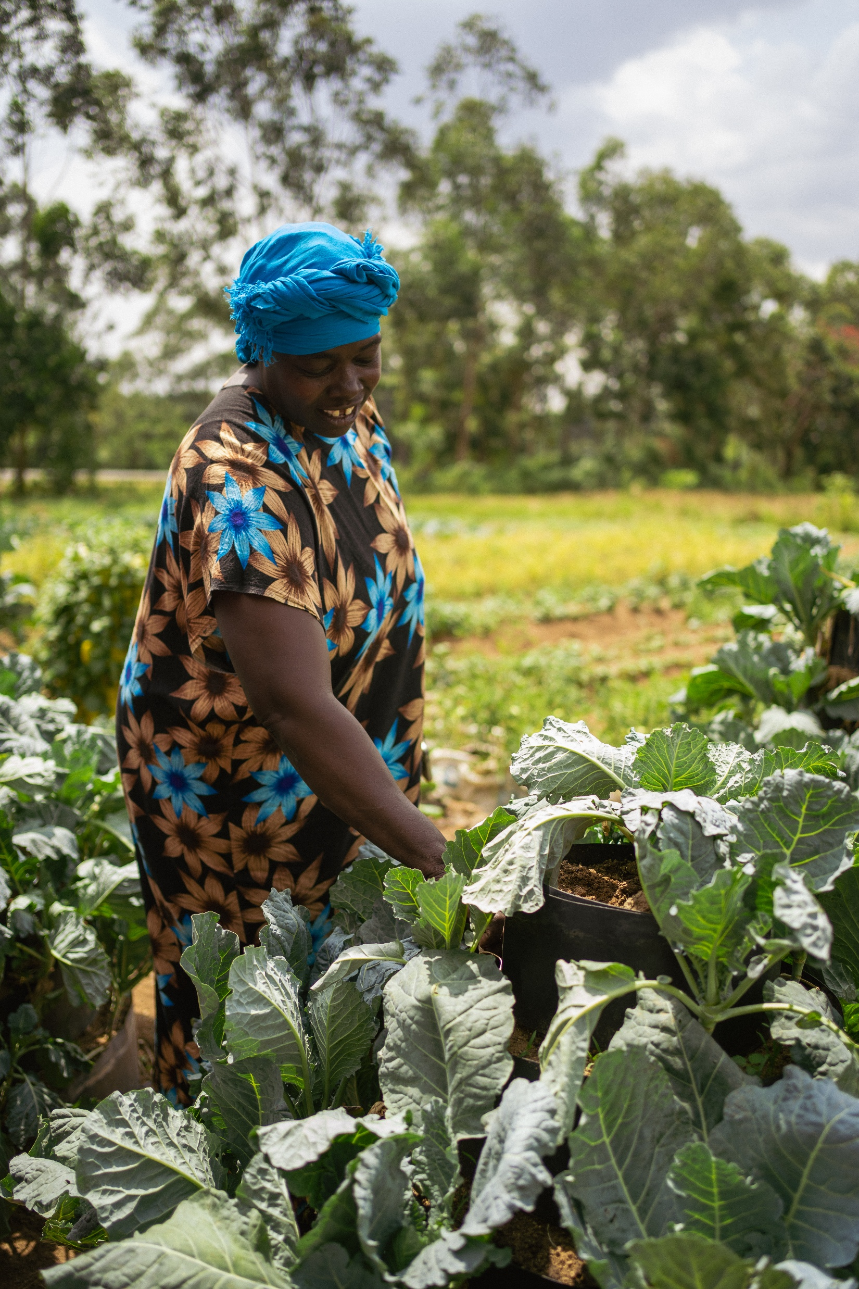
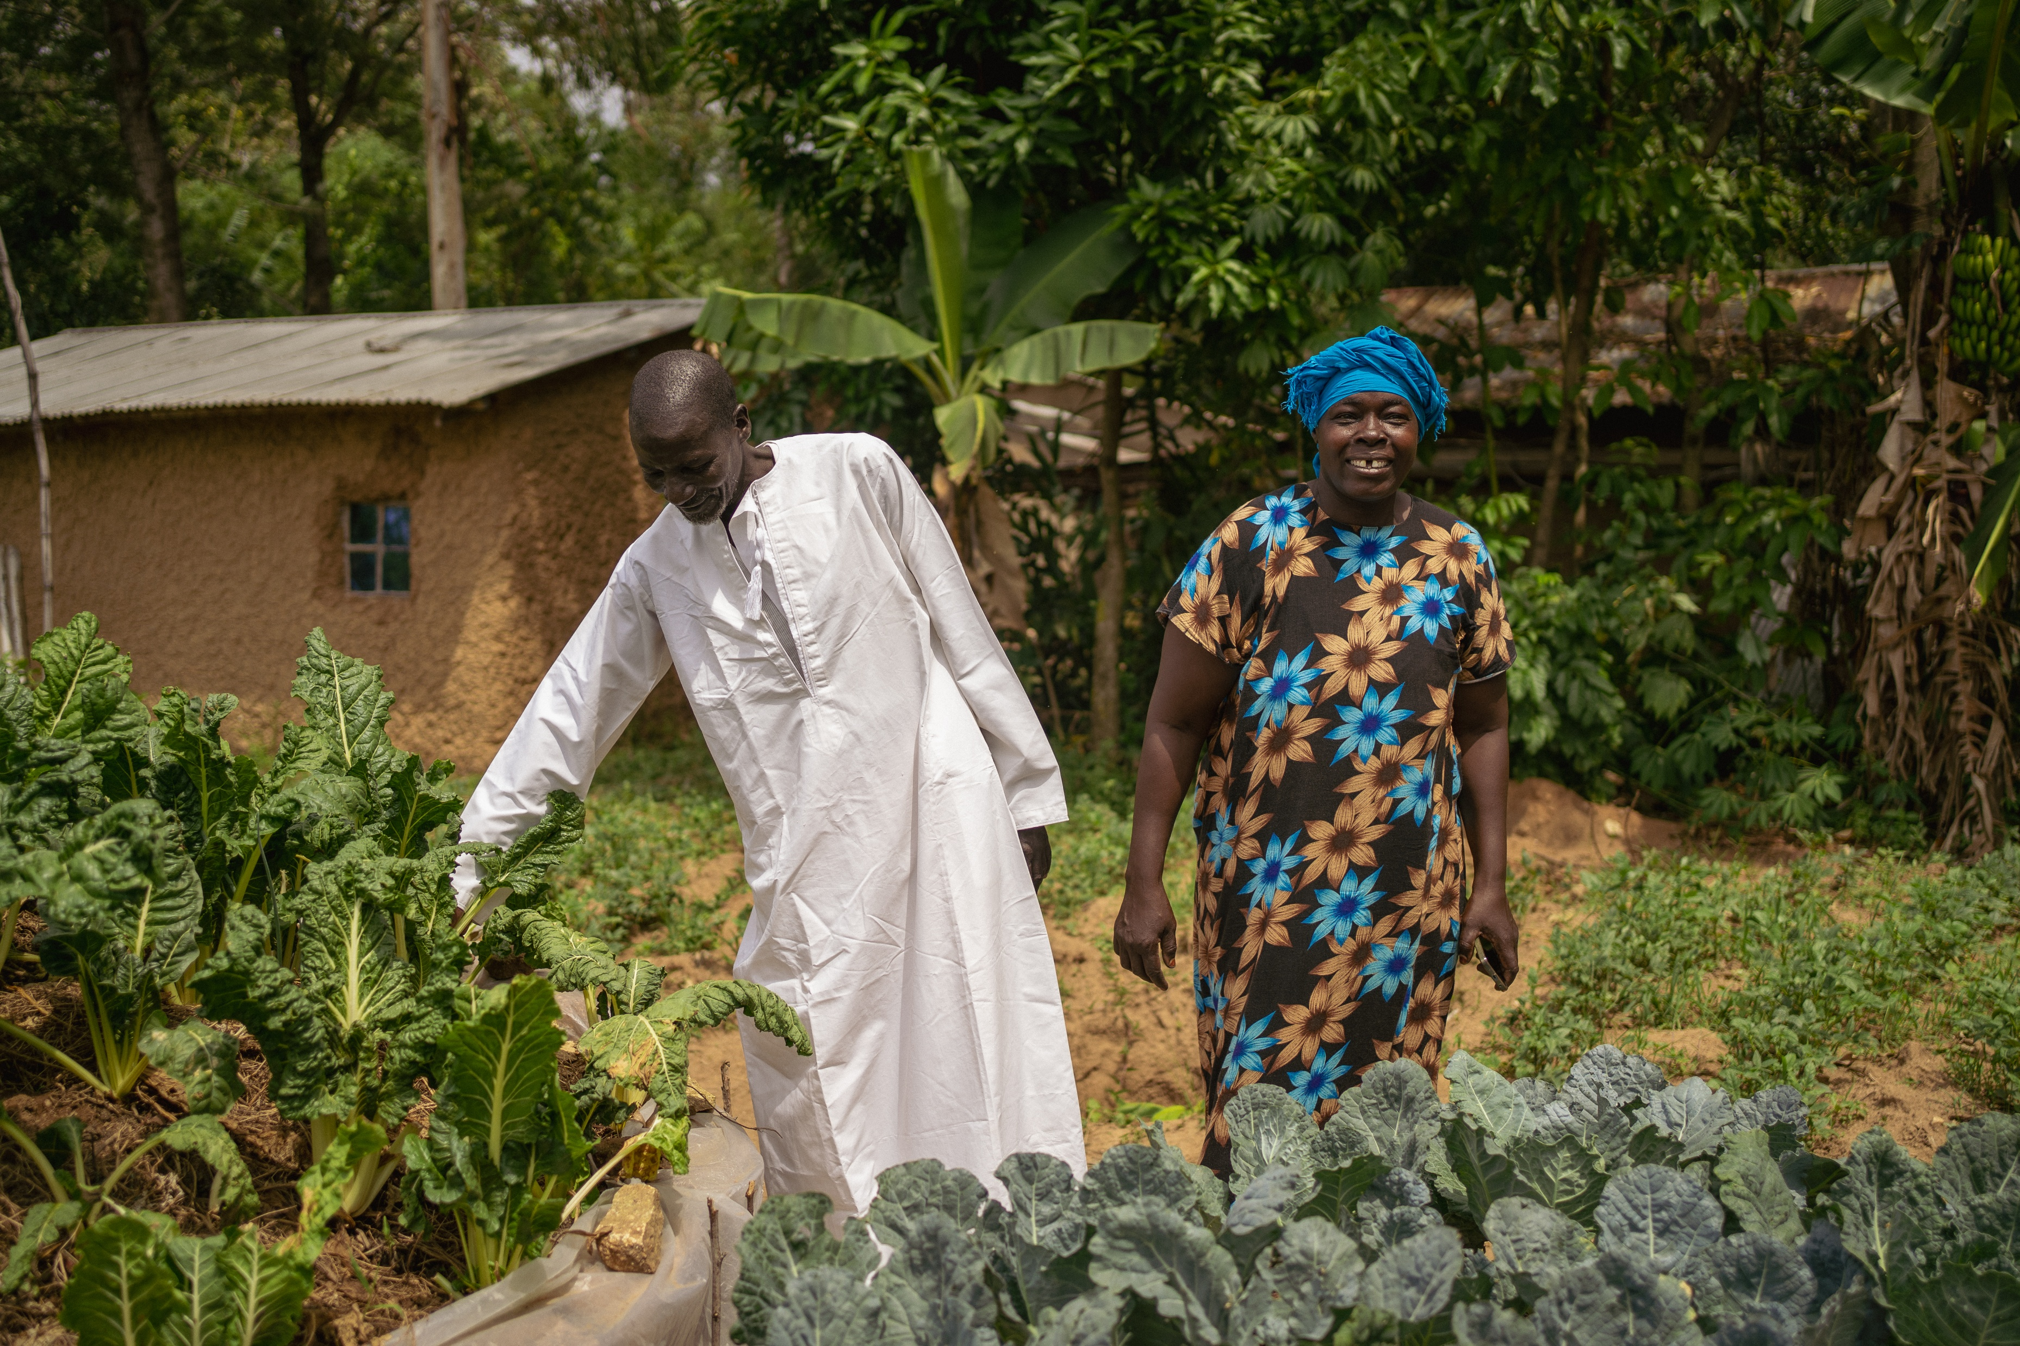
Saida and Ali – started 3 months ago

Slide 29
Jackie

Slide 30

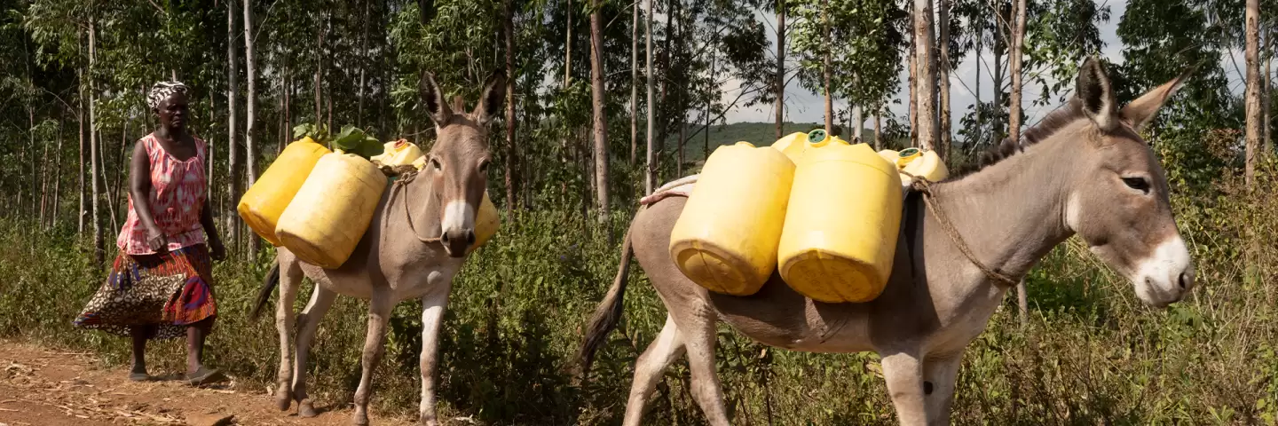
Thriving with Donkeys Partnership with The Brooke
"To the world it is just a donkey,
but to the donkey owner a donkey can be the whole world.”
"Titus Sagala Kenya Country Director”
Mary Owuor

Slide 31
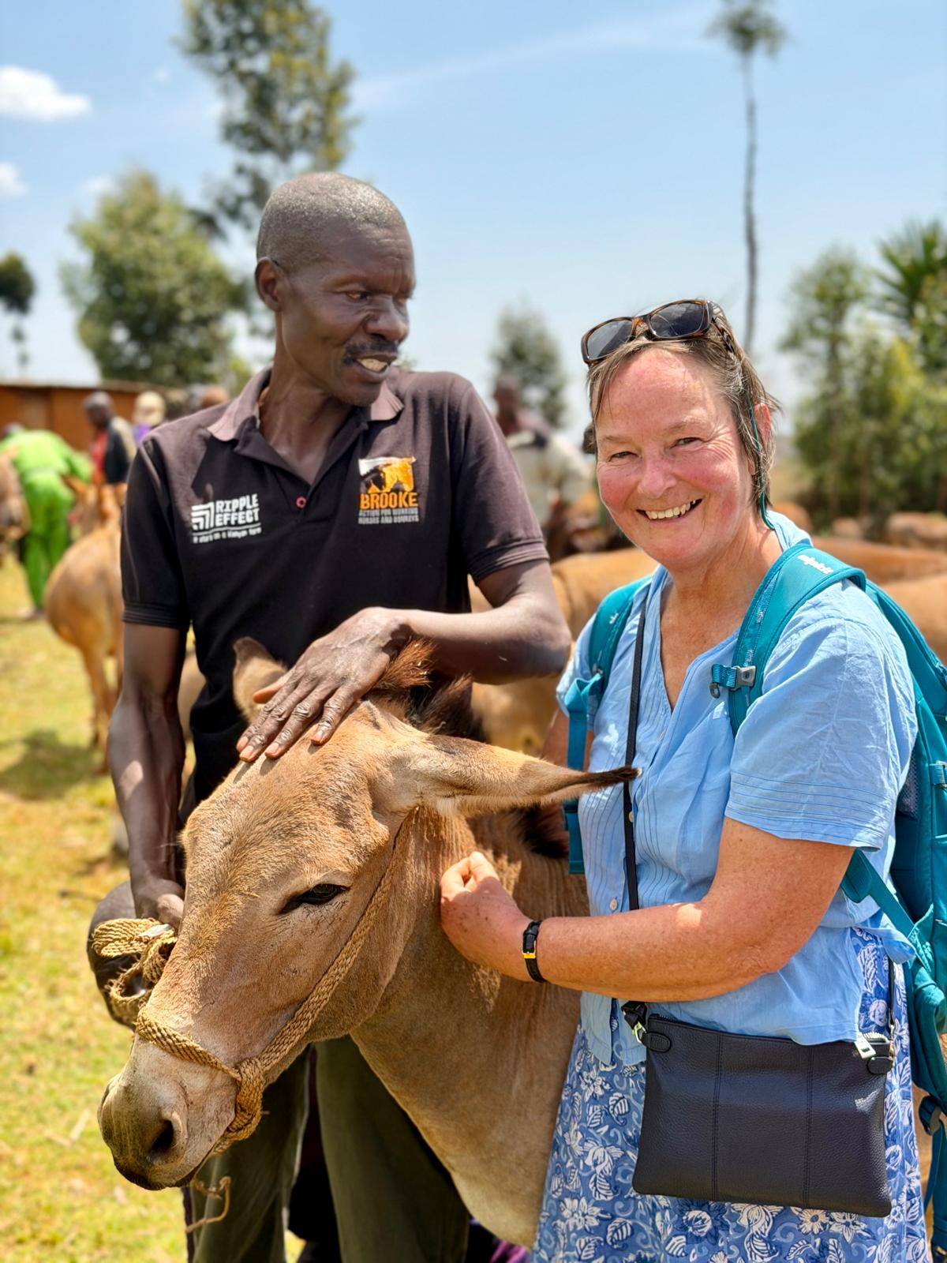
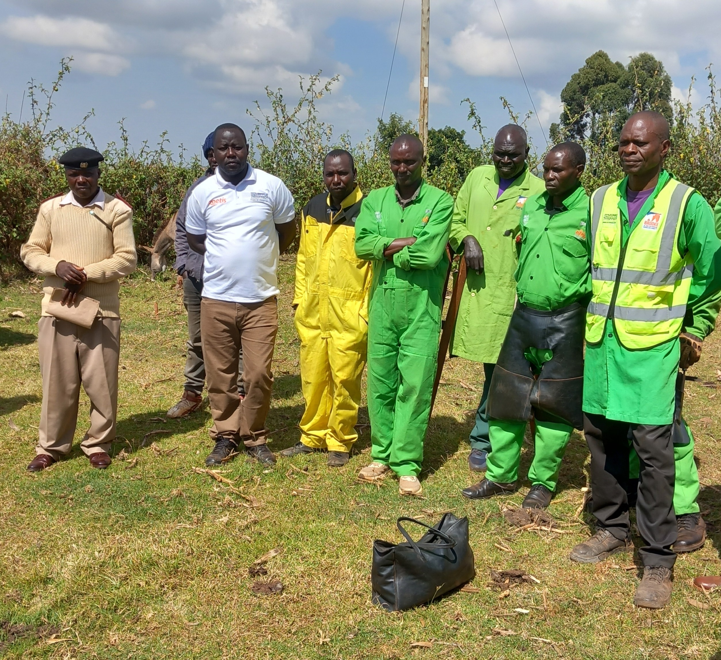
Paravet, Jackie and Abraham
Donkey Clinic
Left to right
Govt. official
George[RE]
Farriers[note disabled included]

Slide 32
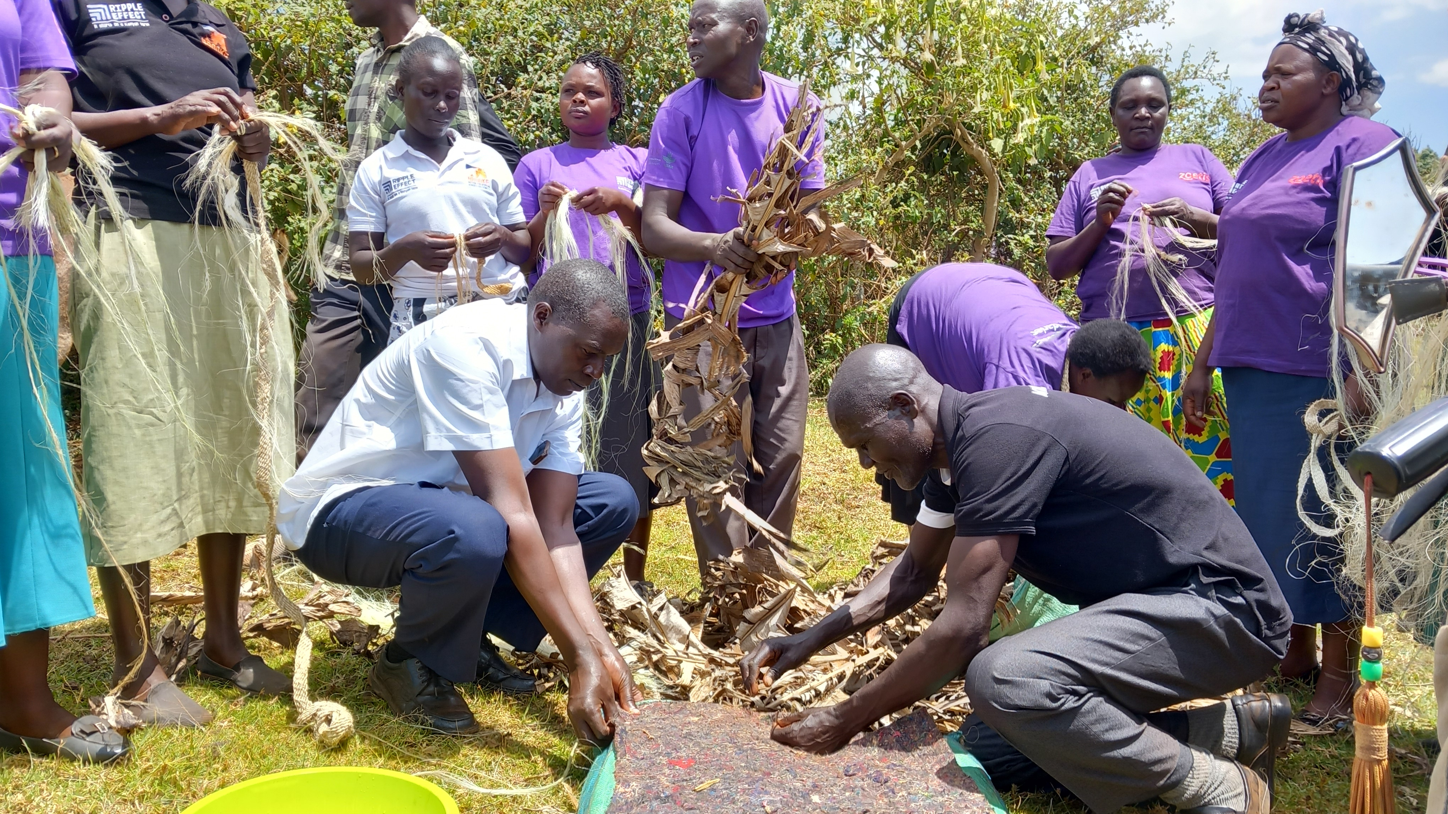
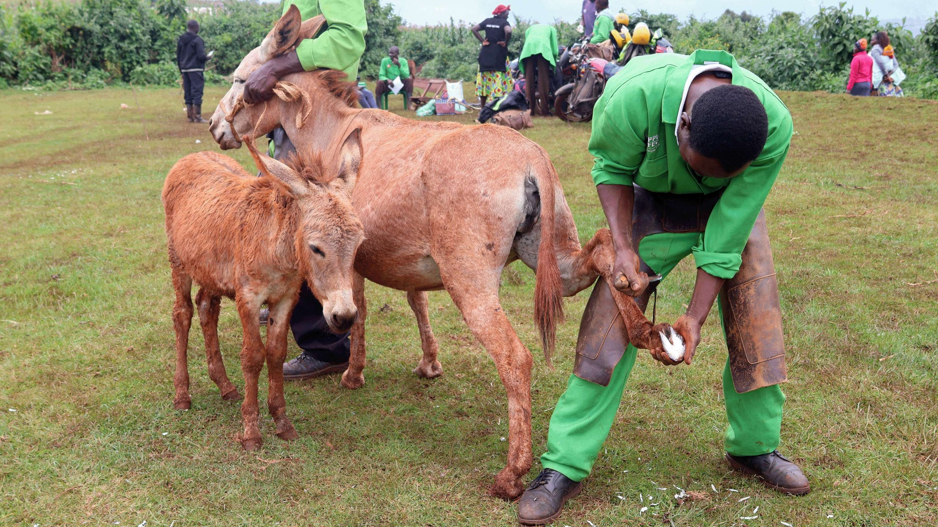
Sisal Halters Soft banana leaf back packs
Income generating activities
Farrier

Slide 33
Add your photos here
Theft of Donkeys
Donkey population in Kenya
2016 1.9 m, census 2019 1.1m
2025 ?
Ejiao
A cosmetic ingredient and traditional Chinese medicine
made from donkey skins.
“The Chinese demand for donkey has perpetuated this wanton killing, which worsens the living standards, particularly women and girls, who depend on their donkeys”
Isaac Ogutu Farm Systems manager

Slide 34
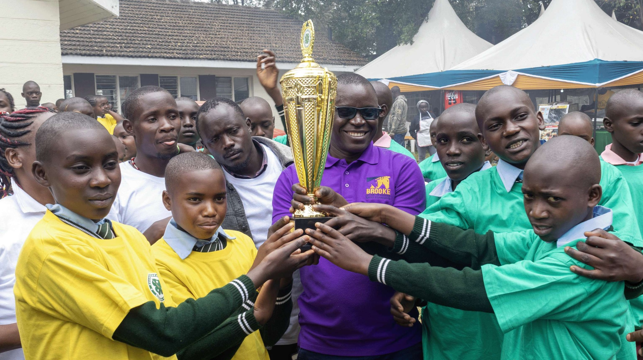
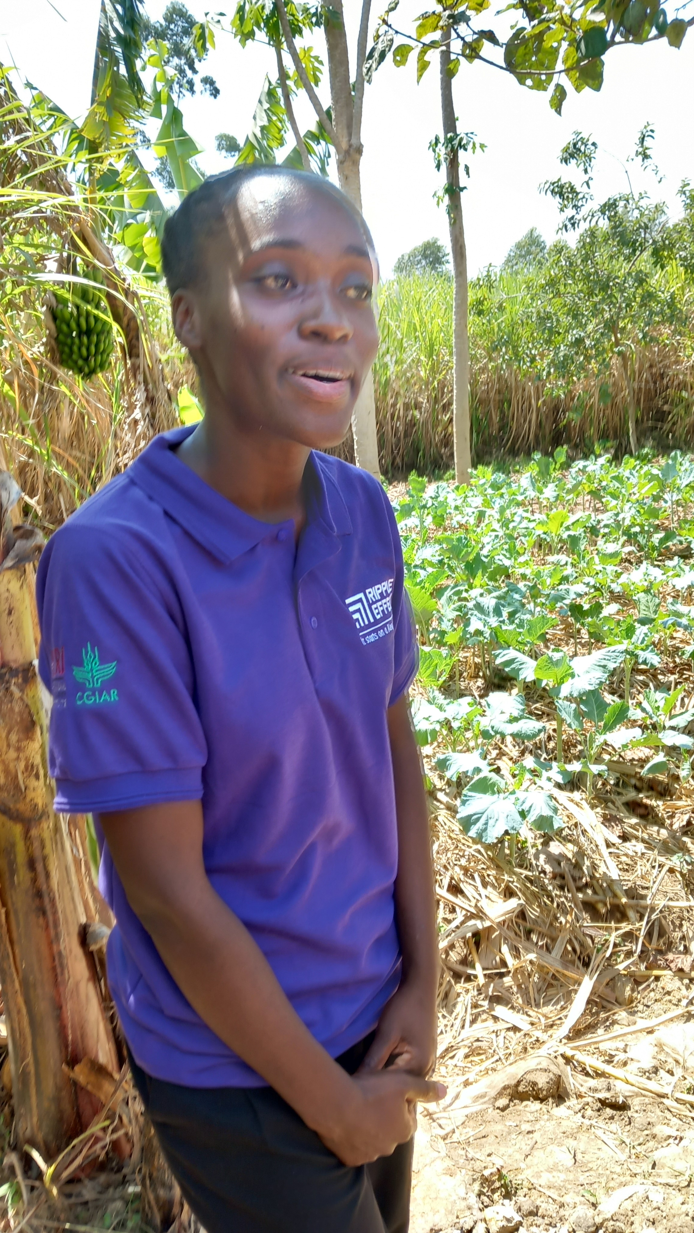
Add your photos here
The Future
Mercy- Vet Intern
Kopsiro Primary school

Slide 35
Sarah

Slide 36
Informal finance schemes
One of Ripple Effect’s project objectives is for people to become financially secure and engaging in the local economy.
With little or no access to formal banking, we saw 2 types of informal schemes being used.
Boresha Mazingira to date – total saved £37k, loans £29k
Savings and loans schemes – regular savings by members create a pot of funds available for loans when needed – eg in times of need, to start or grow a small enterprise.
Merry Go Round – gives members a regular cashflow boost

Slide 37
Key features = SUCCESS
Managed by the members themselves
Insist on a commitment to regular saving
Inclusive – identification of neediest in community
Saving with a purpose

Slide 38
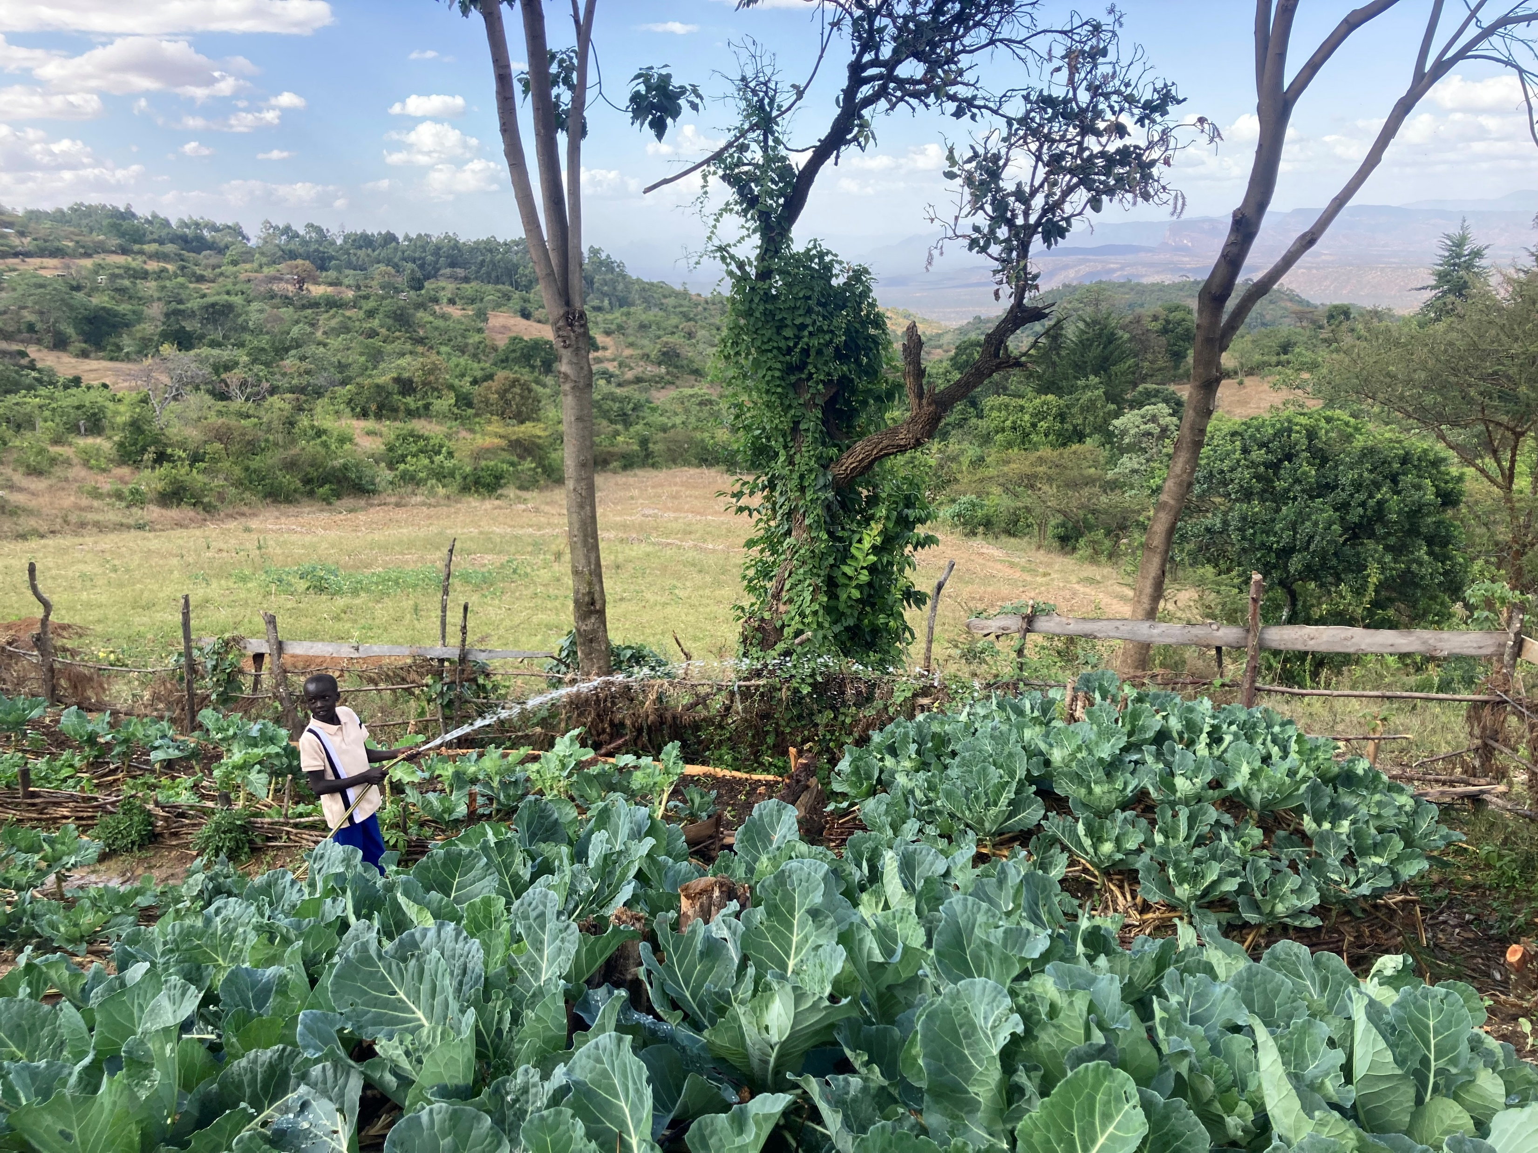
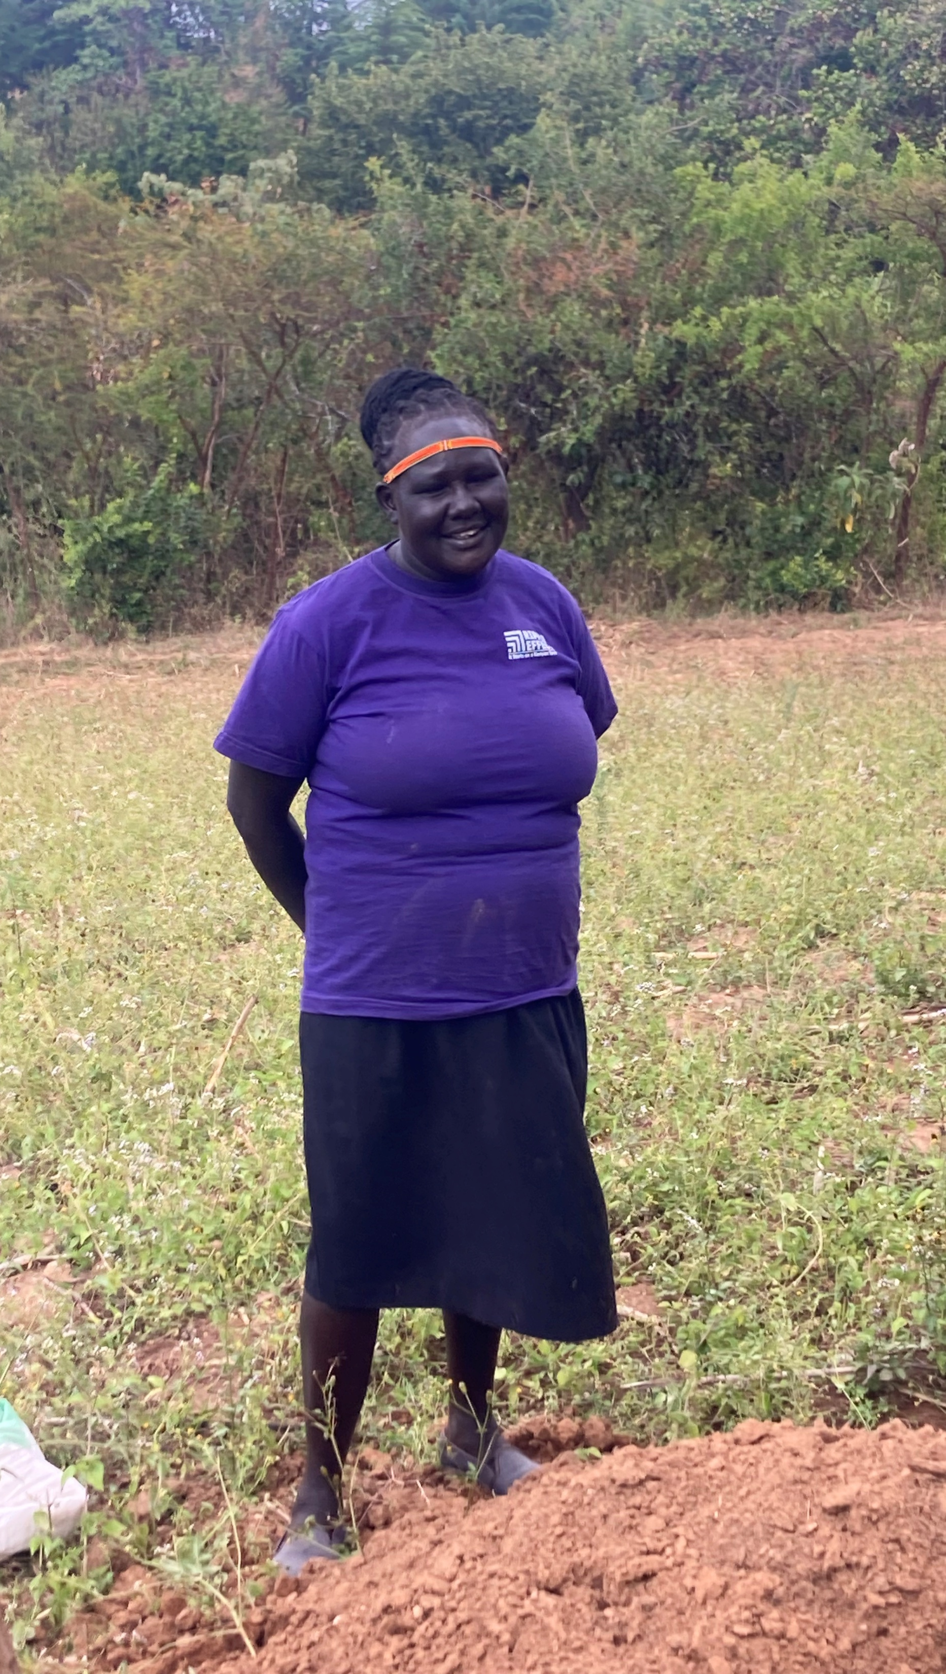
Evelyne now has irrigation

Slide 39
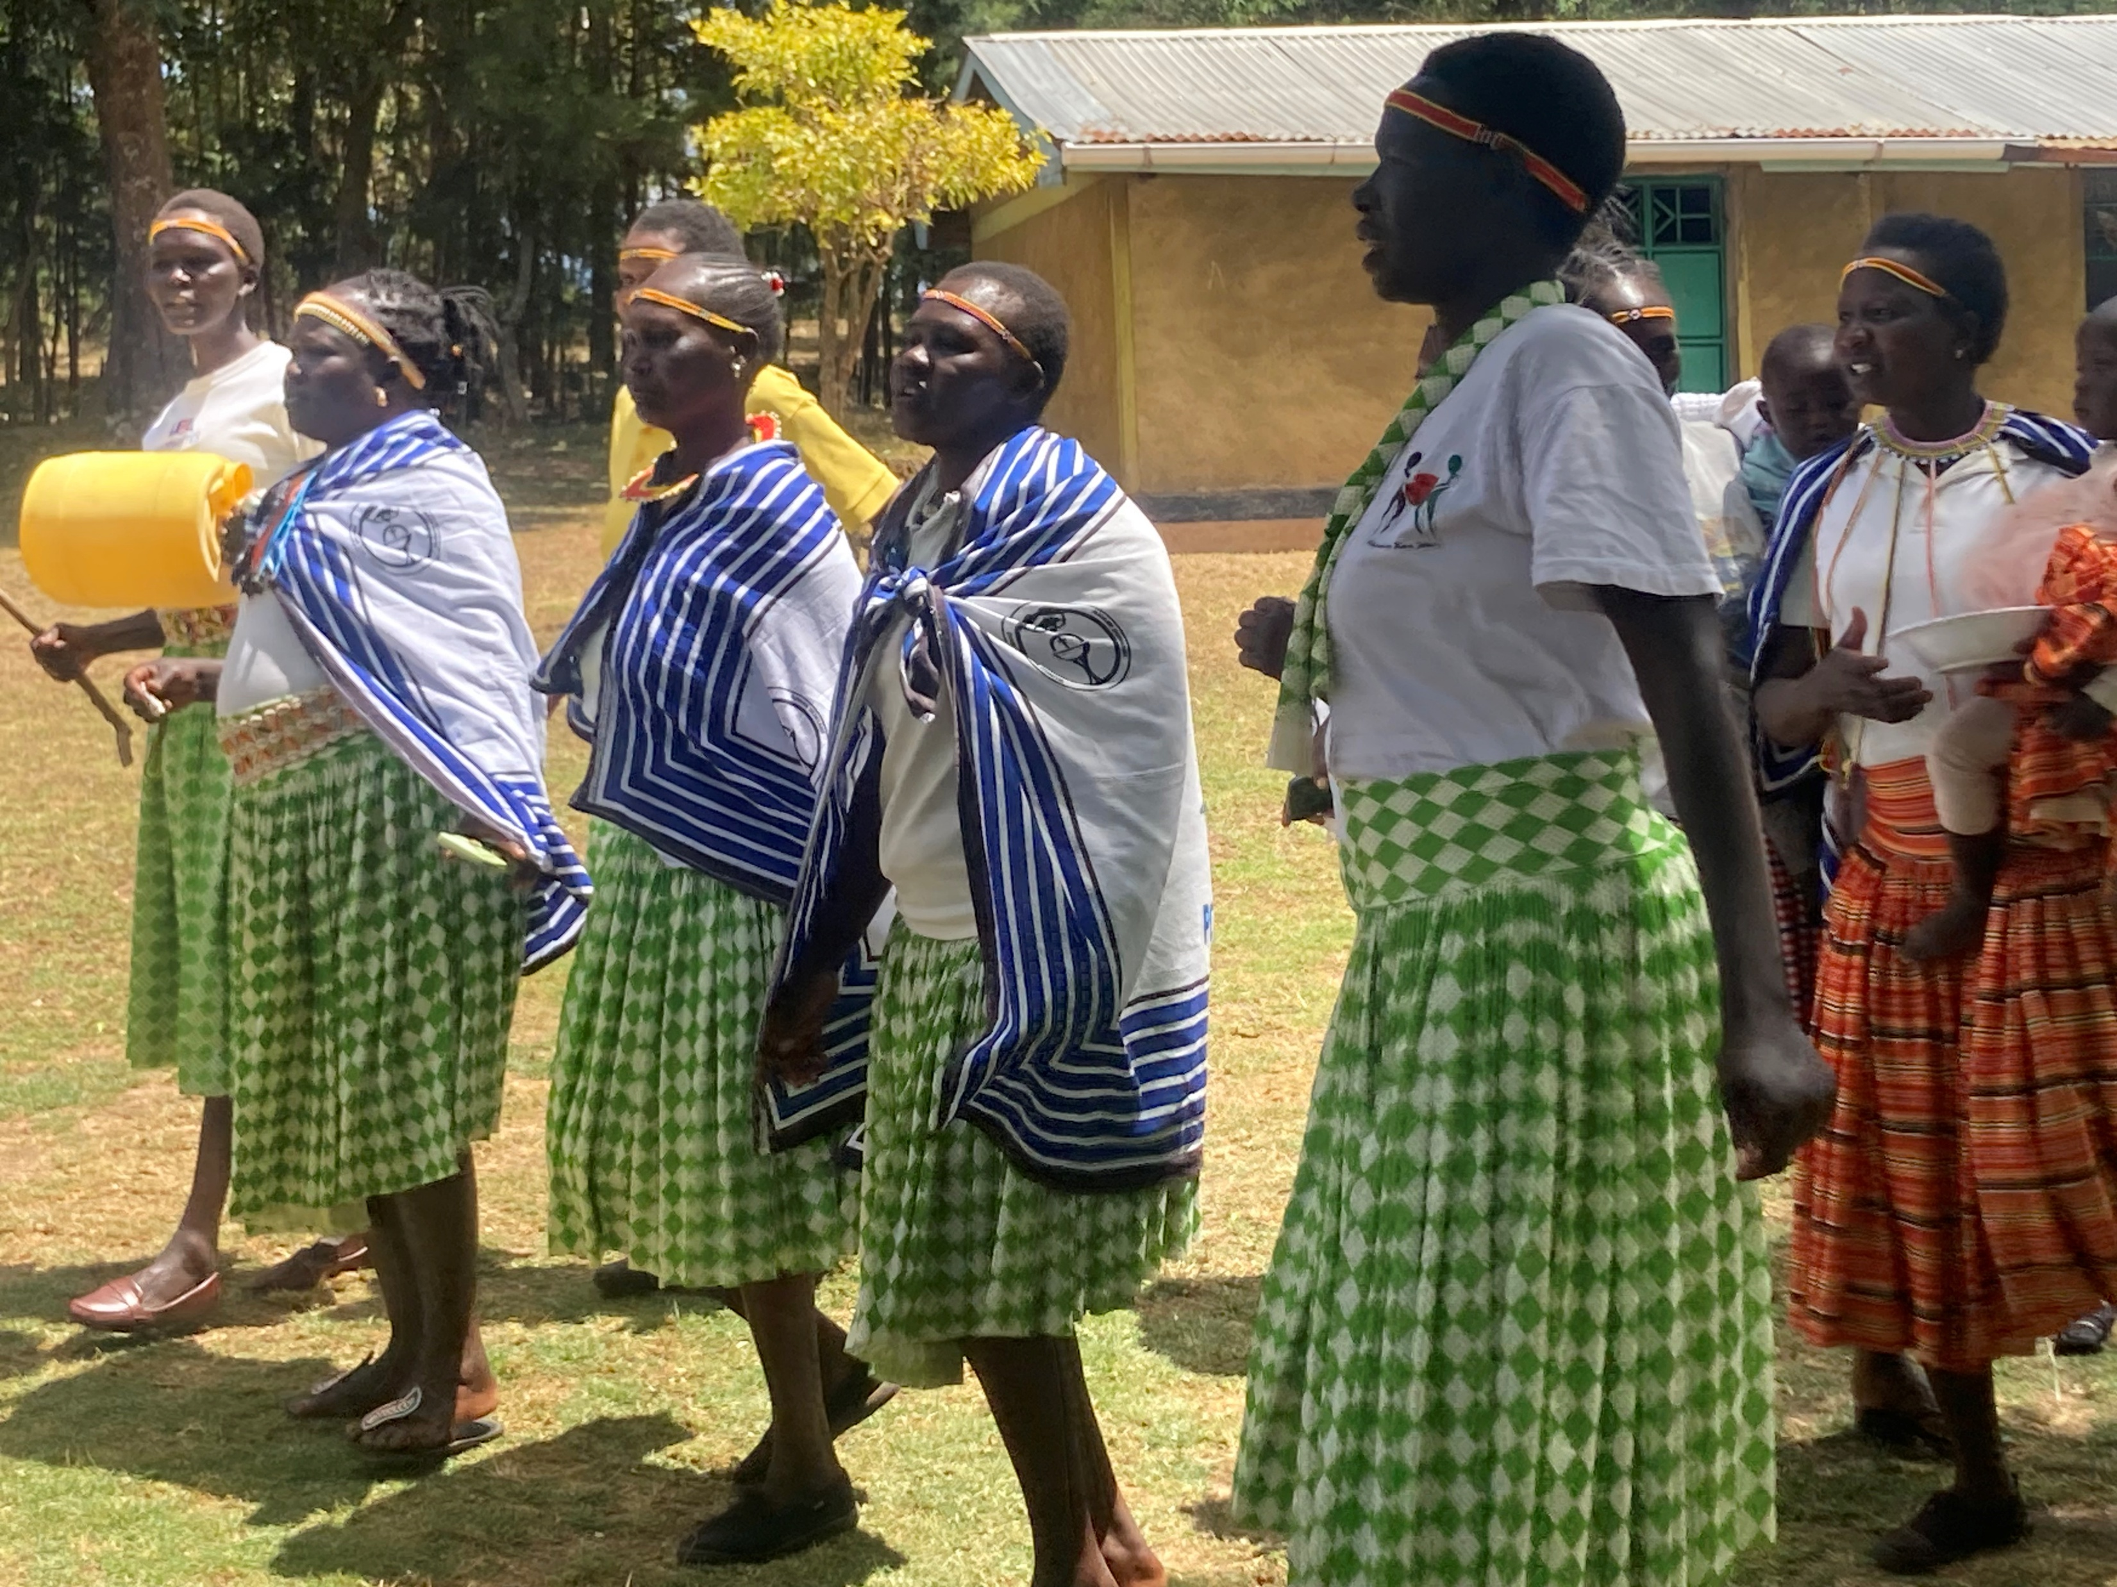
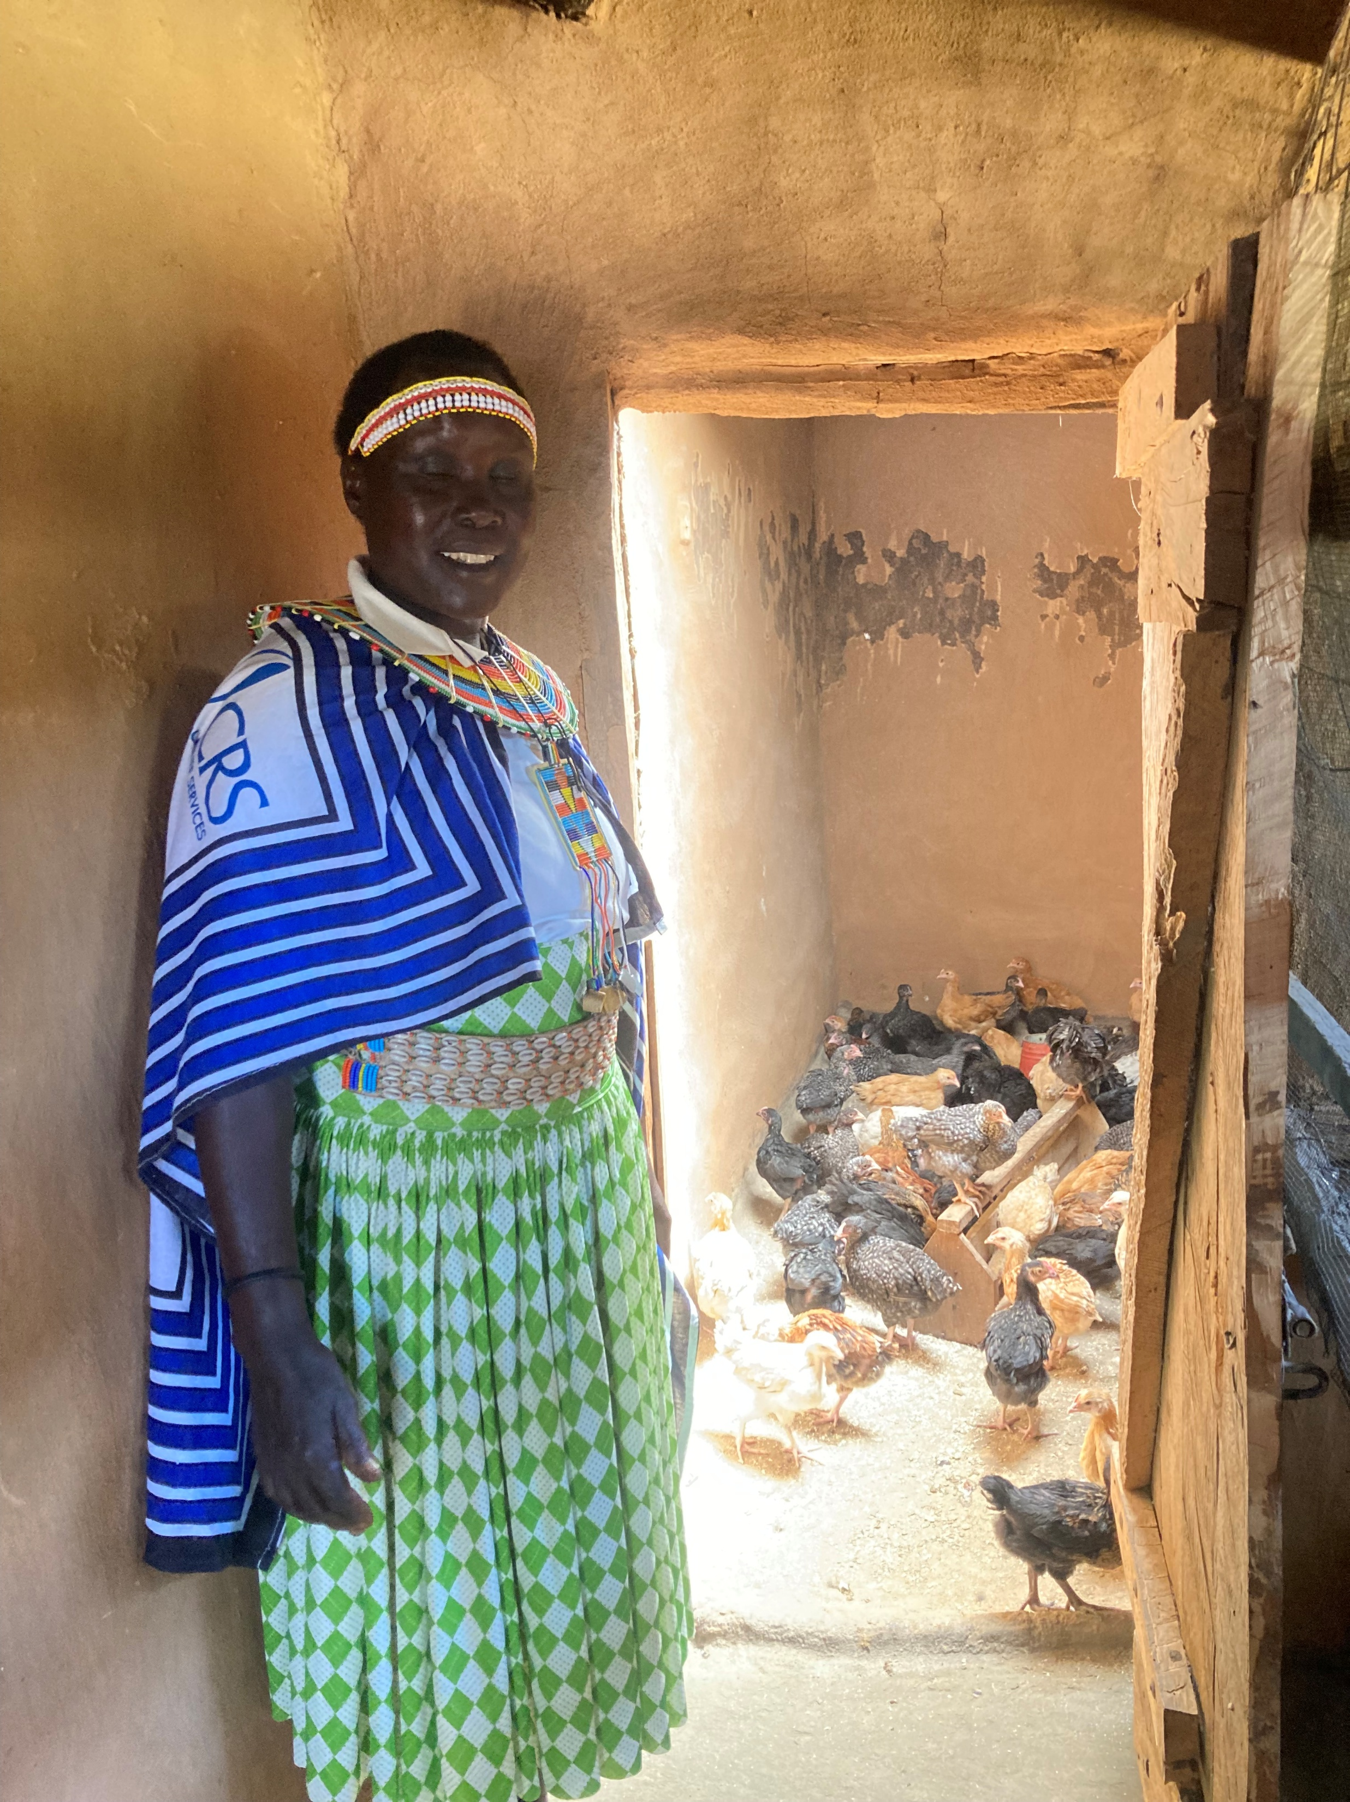
Gloria’s group increased savings

Slide 40
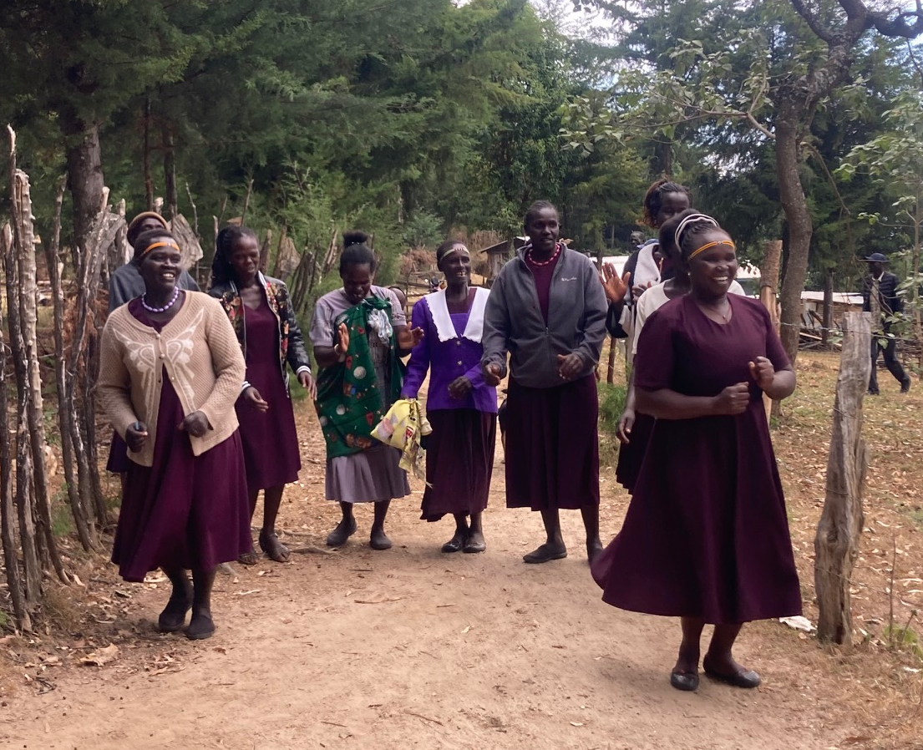
Theresa – used Merry Go Round

Slide 41
OTHER OUTCOMES
Women become financially independent
Community support – especially for the neediest
Empowerment
Confidence
Leadership skills
Mutual trust and stronger communities

Slide 42


Slide 43
Please remind me to stop recording this meeting!

Slide 44
Lunch

Slide 45
Please remind me to recording this meeting!

Slide 46
12.55 -1.25 | An introduction to the MCSE team
1.25 - 1.40 | Ann -Tools & Practical Guidance
1.40 - 2. 40 | The ideal Ambassador toolkit - interactive activity
2.40 - 2.50 | Refreshments
2.50 - 3.10 | Q&A
3.10 - 3.20 | Final Reflection : One thing you are inspired to do, next steps & thank you
3.20 - 3.30 | Thank you and end
3.30 - 4.00 | Collect leaflets and pop ups etc and see the office!

Slide 47
Marcomms Supporter Engagement team

Slide 48
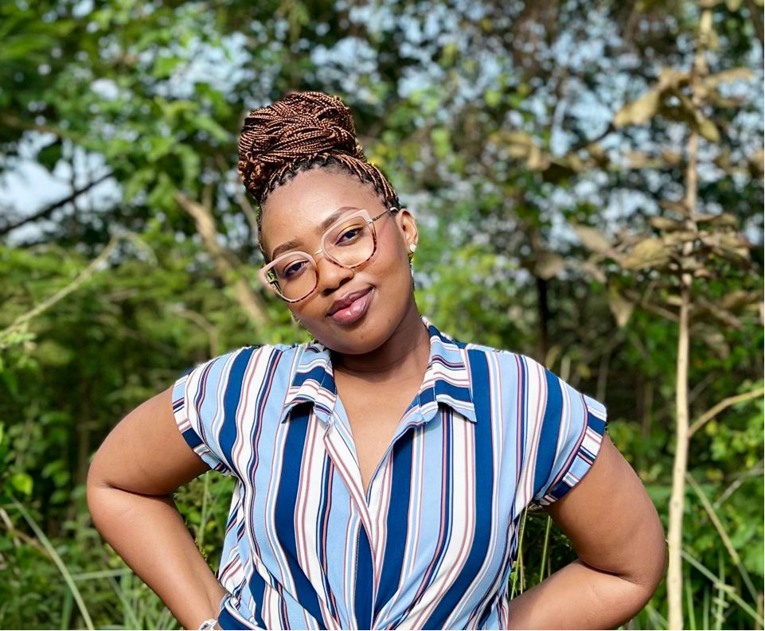
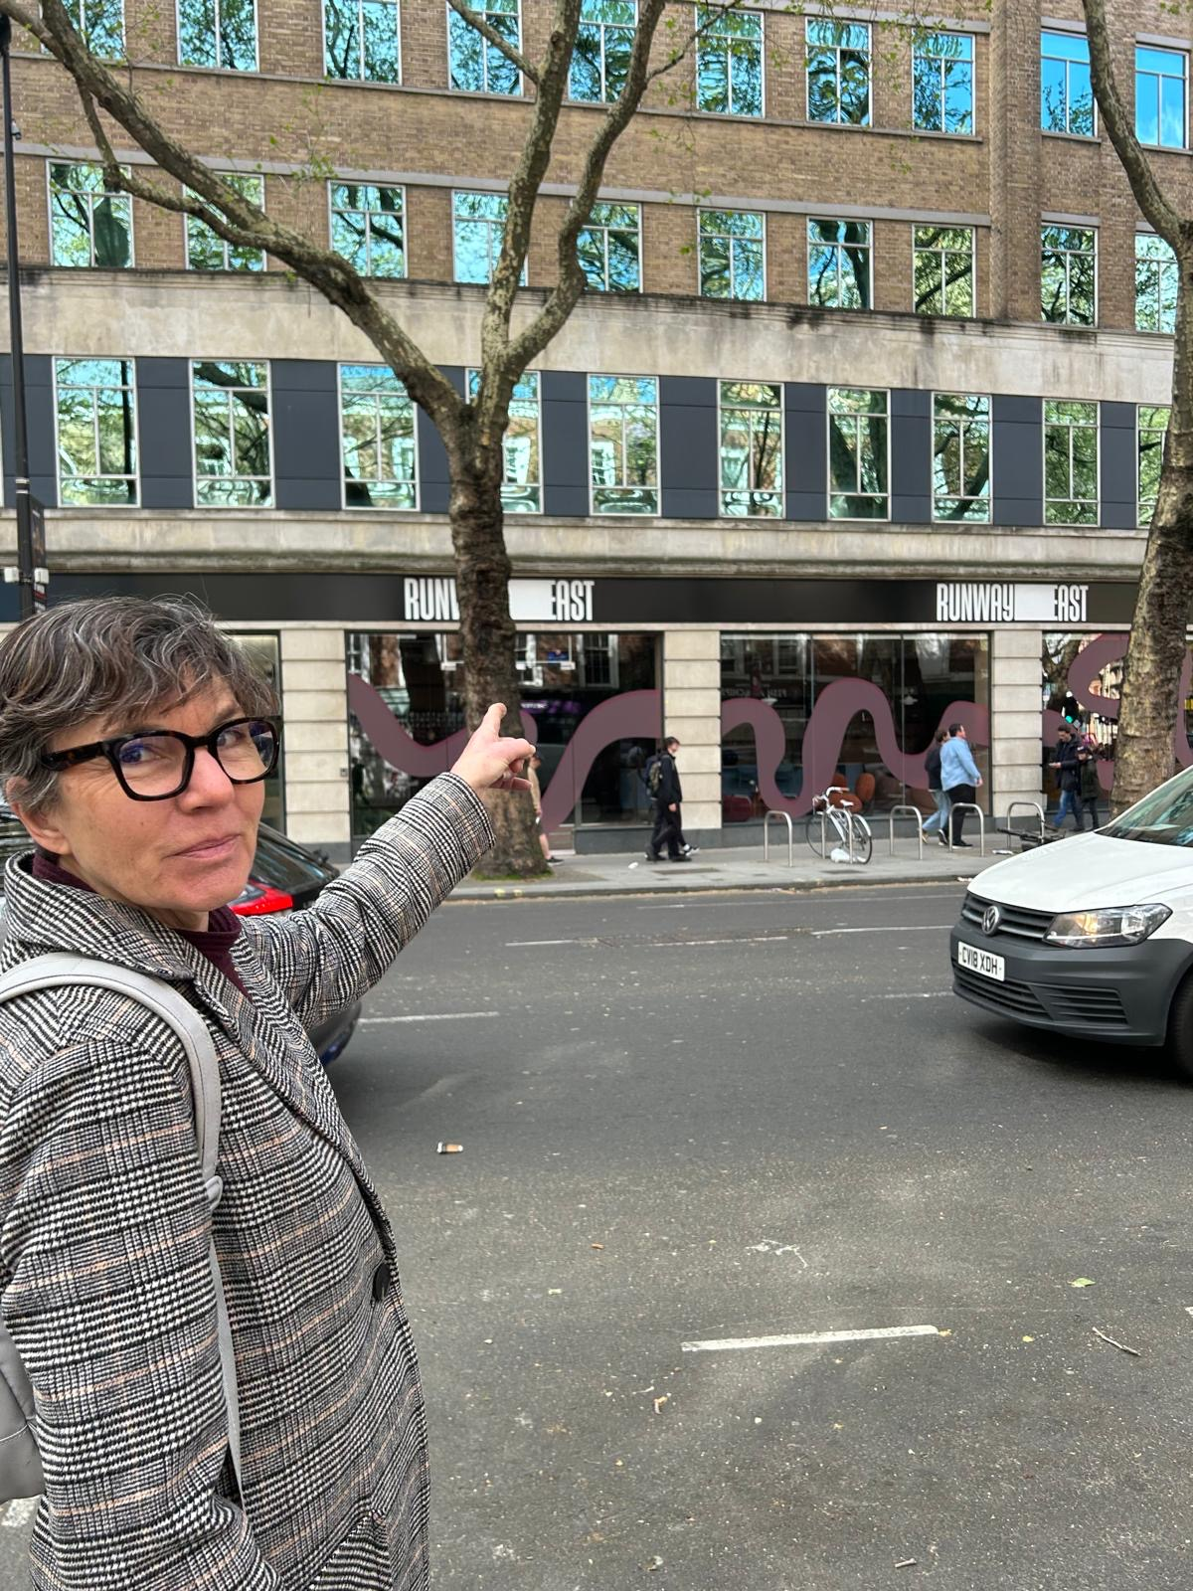
Marcomms & Supporter Engagement team
Laura Tillings Watson – Head of Marcomms & Supporter Engagement
Bella Cook, Lisa Hawkins and Verity Abbot – Supporter Care
Hollie Brooks – Individual Giving Manager
Ann Hatton – Community Manager
Antony Kahaya – Visual Communications Manager (Uganda)
Anna Borsboom – Digital Marcomms Manager (UK)
Merci Umutoniwase – Communications Exec (Rwanda)
Betel Gezahegn - Content Exec (Ethiopia)

Slide 49
News from Ann

Slide 50
News from Ann
Carol Goram
2. What we now say:
  For every family we work with many more will benefit too. As they share what they know, and what they have, the benefits are passed on to their families, their neighbours and communities creating a ripple effect of lasting change.
3. Appeals - you will receive these as an FYI
PPT template 2026
Thank you for using the small donations part of the donations form

Slide 51





Resources update
GT leaflet

Slide 52
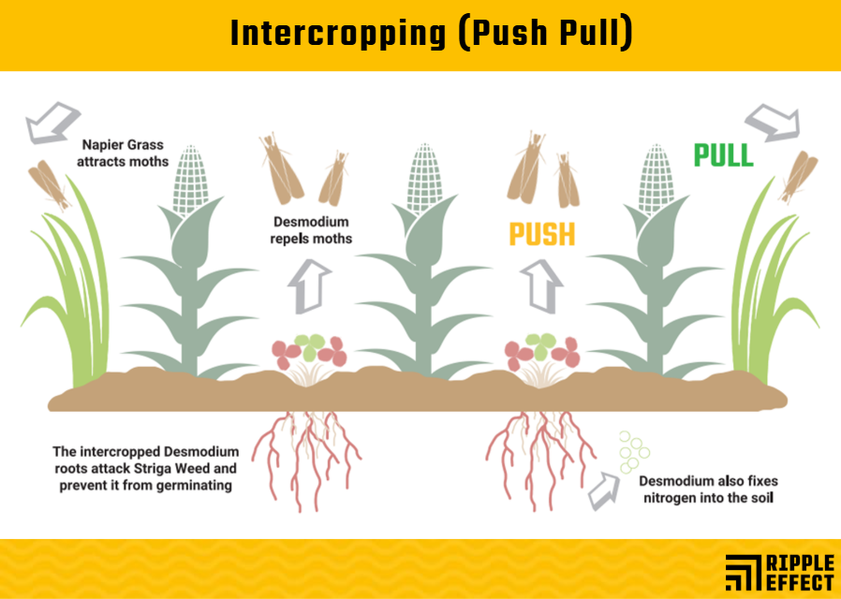
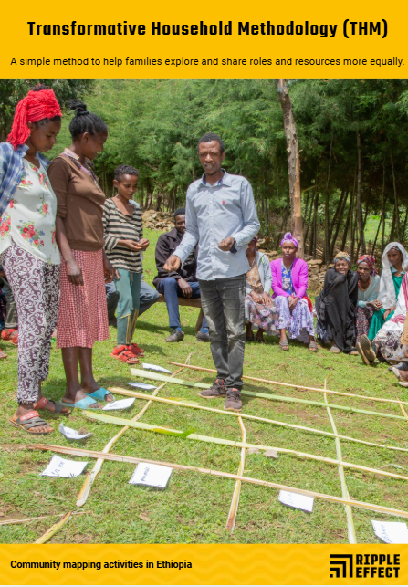

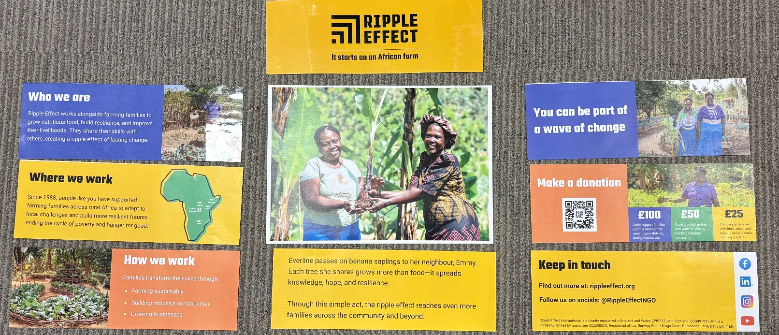
Printable resources

Slide 53
Important
Recycle all out-of-date leaflets and banners
Read the emails please
Take a look at the website // useful links section of my emails:
  Forms and policies:
  Donations form
  Expenses form and expenses policy
  Speaker booking guidelines to make things clearer if you’re unsure.
  Useful information:
  TOR for our Coffee and Chat (in the forms and policies section)
  Update on staff list
Updating lots of forms which we will go through in the September – especially GDP
AI…

Slide 54
Dates for your dairy
Next Coffee and Chat: Friday 5 June, 9.15-10.15am
  Let me know if there’s ever anything you’d like to cover in these sessions
  We will be inviting Joseph to speak to us soon
Ambassador workshop part 2 (online only): Monday 14 September 9.30 –11.30
Christmas Celebration: Wednesday 2 December, 7.00pm

Slide 55
The ideal Ambassador toolkit

Slide 56
The ideal Ambassador toolkit
Scenarios:
Church –10-20 minute talk
Organisation (I.E. WI/MU/ Soroptimist/Rotary) 30 – 60-minute talk
Events – anywhere you might have a stand (country fair, garden event, festival)
Hosting your own event (a meal, carols, sale, garden event)
You have 15 minutes to discuss in your groups what do we need in your toolkit:
• What resources/information do you need?
• What’s your top tip—something you know works and that’s excited you?
• What’s your opening “hook” to draw people in?
• What is your call to action/what are you asking them to do?
• What questions might your audience ask? We can add these to our FAQs we’re developing
Online group will look at : Organisation (I.E. WI/MU/ Soroptimist/Rotary) 30 – 60-minute talk

Slide 57
Please remind me to stop recording this meeting!

Slide 58
Refreshments

Slide 59
Please remind me to recording this meeting!

Slide 60
Q&A

Slide 61
Questions you asked
Anything that shows the impact of our work – I hope you found some answers in the Ambassador feedback session from their trip to Kenya
Tried and tested ways to successfully introduce Ripple Effect's work to the public – this was today’s activity - I’ll be writing up the notes
An 'all year' rather than just a specific Christmas catalogue - we will have one!
Resources for schools - Laura gave an update on this
Information about the countries we work in – Anna gave an update on this
Gardening techniques – this is currently being updated with a link to the website for further information
GDPR - we will do an update on this in our September meeting

Slide 62
Q&A
The Ambassador WhatsApp group: 07817 891590

Slide 63
Final reflection:
What one thing will you take awa from the workshop?

Slide 64
Thank you and safe journey home!

